Slide 1
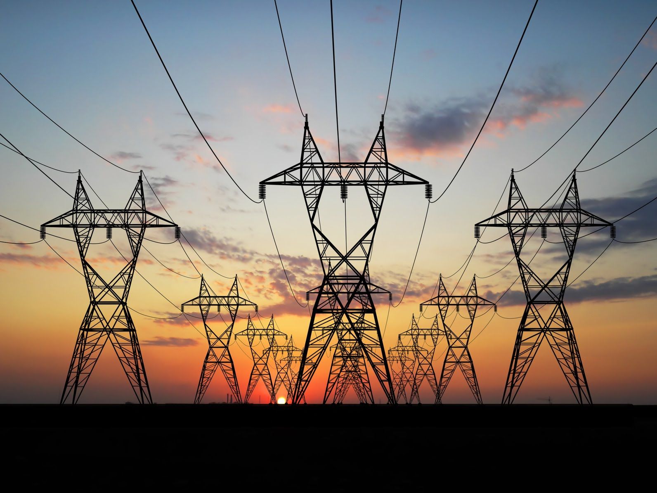

LADWP Transmission and Preferred Resources
May 8, 2018

Slide 2
Ten Year Transmission Plan Assessment
Purpose
Ensure present and future reliability of LADWP’s System
Meet customer demand and needs
Promote efficient utilization of LADWP’s System
Facilitate timely and coordinated transmission development
Key Drivers
Public policy initiatives (RPS Goals)
Load growth rate
Wholesale and generator interconnection requests
Regulatory and environmental considerations

Slide 3
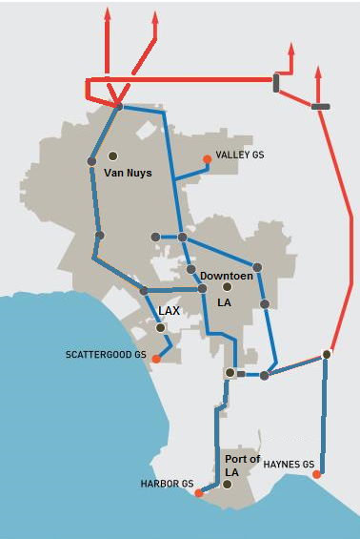
LADWP Transmission System Overview
Major Transmission Arteries (Out-of-Basin)
C
D
Vic-LA Path: Collectively Segments A & B
Pacific DC Intertie: Segment C
Owens Valley System: Segment D
A
B
Local Transmission System (In-Basin)
Local Transmission: Blue Lines
Generating Stations Supporting Local Transmission:
  Scattergood Generating Station
  Haynes Generation Station
  Harbor Generating Station
  Valley Generating Station
Scattergood, Haynes, and Harbor Generating Stations Are All Once-Through Cooling (OTC) Thermal Plants.

Slide 4
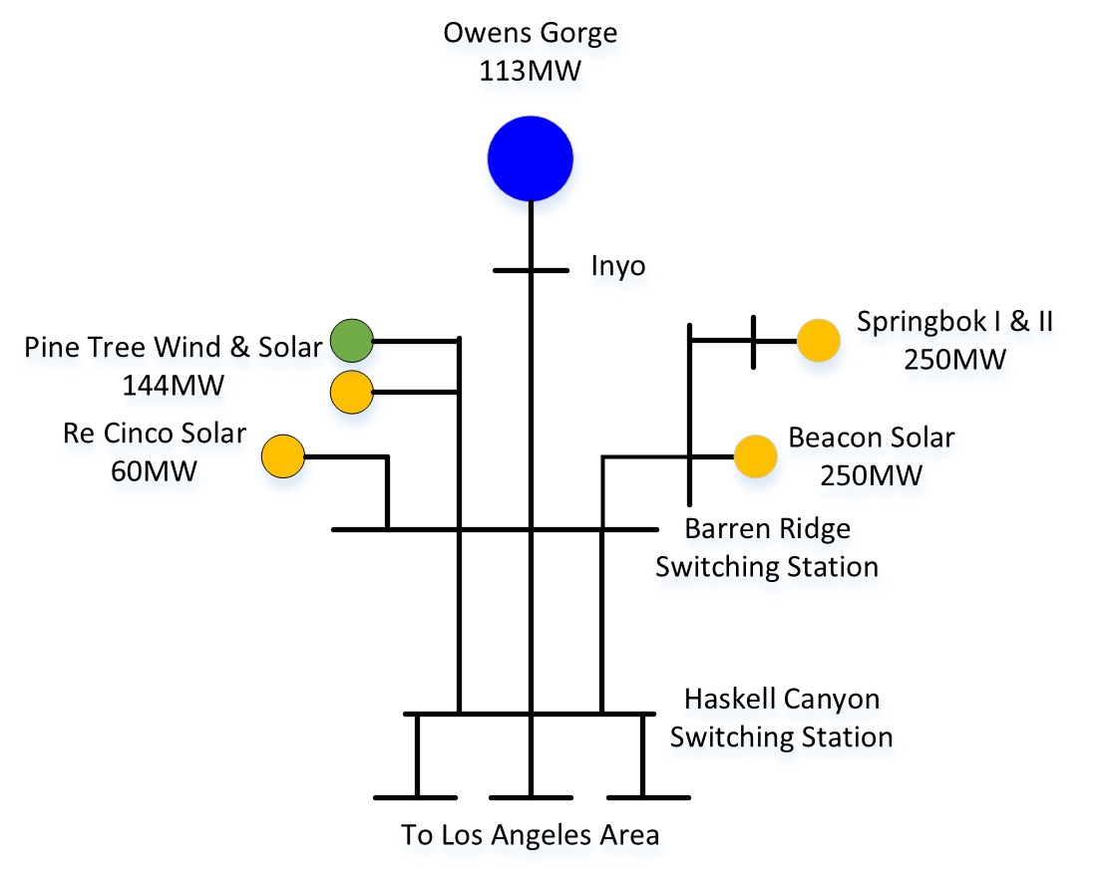
Completed Transmission Projects
D
Barren Ridge Transmission Project Completed in 2016 to Deliver over 1,000 MW of Renewable Energy to Los Angeles.

Slide 5
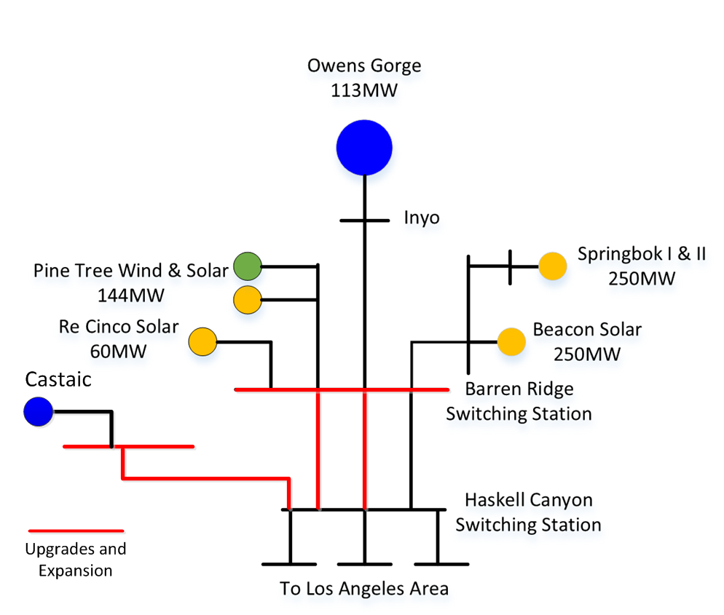
Near-Term Transmission Upgrades
D
Barren Ridge Transmission System Expansion when completed in 2022 will deliver up to 1,700 MW of renewable energy to Los Angeles.

Slide 6

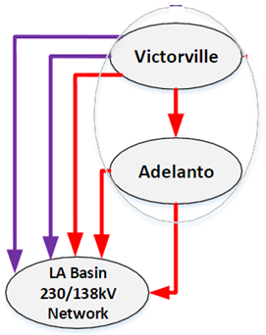

Near-Term Transmission Upgrades
Vic-LA Path (A & B)
Increase import capacity of about 450 MW
Maximize renewable energy import
In-service date of 2022
A
B
A
B
Vic-LA Path Upgrades Completion Will Reduce LADWP Reliance on Natural Gas While Improving System Reliability.

Slide 7
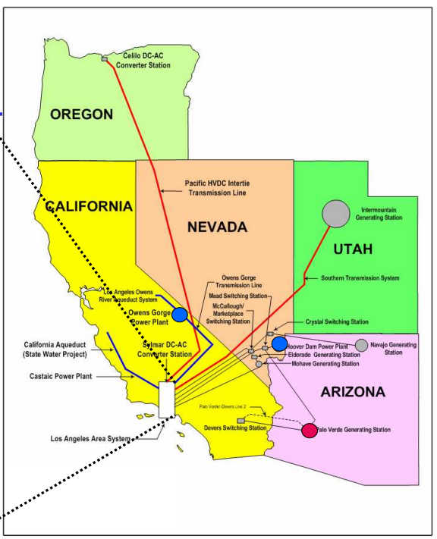
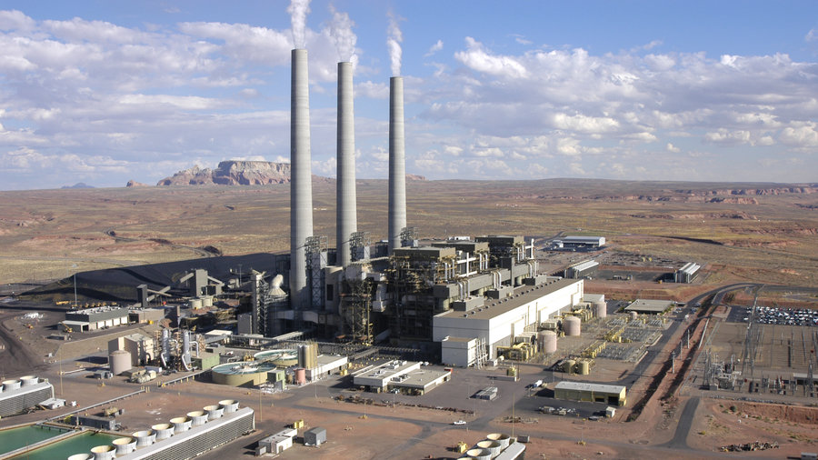
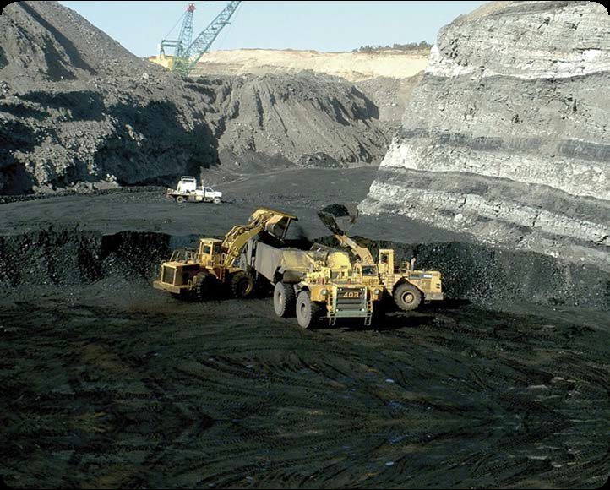
Leveraging Existing Assets to Increase Renewable Energy
Navajo Generating Station
LADWP’s transmission capacity ownership of 48.9% (628 MW)

Slide 8
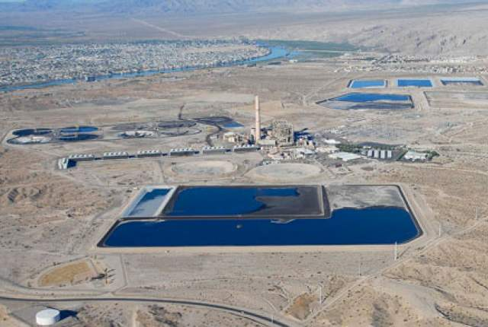
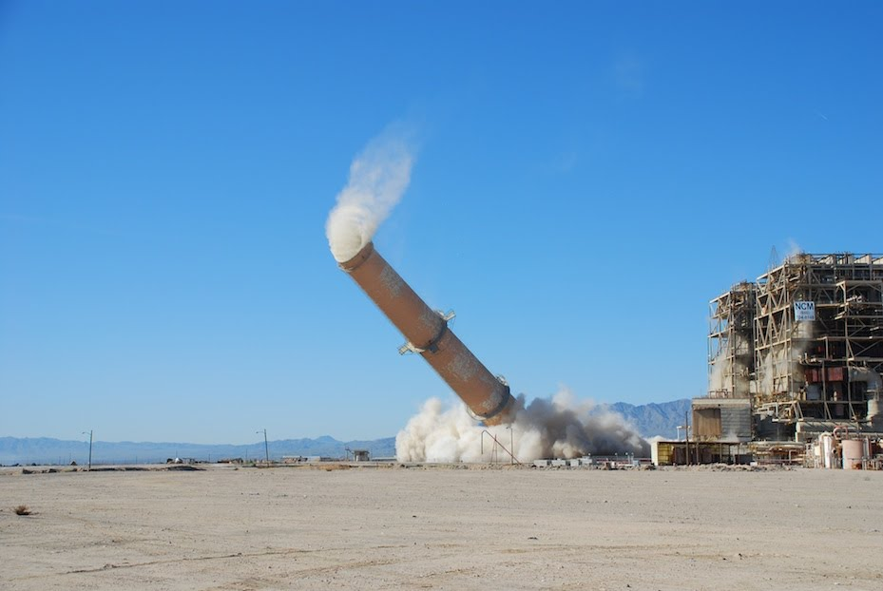
Leveraging Existing Assets to Increase Renewable Energy
Mohave Generating Station
LADWP’s transmission capacity ownership of 30% (716 MW)

Slide 9
Long-Term Transmission Expansion Plans for More Renewable Energy Access
Vic-LA Path (A & B) Major Upgrade Feasibility Studies
Increase transmission capacity of 500 kV Lines (Segment A)
Convert 287kV Century Lines 1 and 2 (Segment B) into High Voltage DC or AC
Southern Transmission System (STS)
Perform STS DC system life extension upgrade
Up to 600MW of additional renewable energy from coal retirement
A
B

Slide 10
Long-Term Transmission Strategies
Key Objectives:
Increase renewable energy level
Maintain high level of system reliability
Cost-effective and responsible transition
Factors for Consideration:
OTC Study (Completion date Fall 2018)
RPS Mandates: achieved 31% in 2017, with 55% target by 2030
100% Renewable Energy Portfolio Study (Completion date Summer 2020)
Joint BPA, CAISO, and LADWP PDCI Upgrade Study (Completion Fall 2018)
Environmental Process
Costs

Slide 11
Preferred Resources
  Mitigation Measure Summary – Distributed Energy Resources
    Accelerated & launched new energy storage projects
    Accelerated existing EE programs
    Accelerated DR program and launched SummerShift
    Maximized the use of renewable energy resources:
      Continued Solar Incentive Program (SIP)
      Launched Solar Rooftops Program (SRP)
      Re-launched Feed in Tariff (FiT) Program
      Utility-Scale Solar and Wind

Slide 12
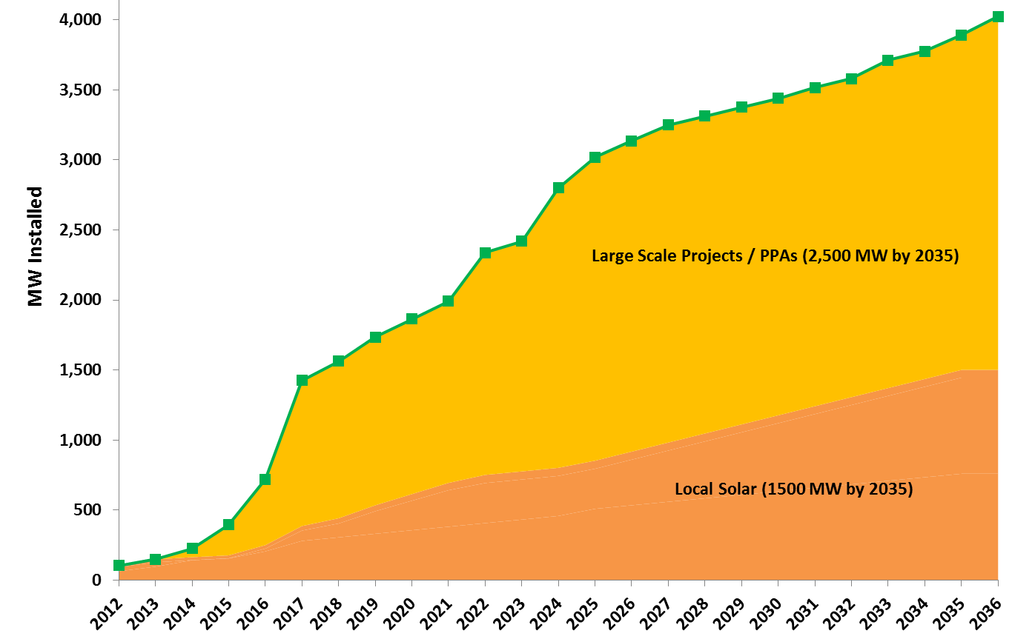
Local Solar Programs
Solar Incentive Program/Net Metering
240 MW installed
Goal: 760 MW
Feed-in Tariff
47 MW in-service
Goal: 700 MW
Community Solar Programs
Solar Rooftops Pilot
Launched 2017
Utility Built Solar
7 MW in-service
Goal 40 MW
Shared Solar Pilot
Prop. Jan 1, 2019

Slide 13
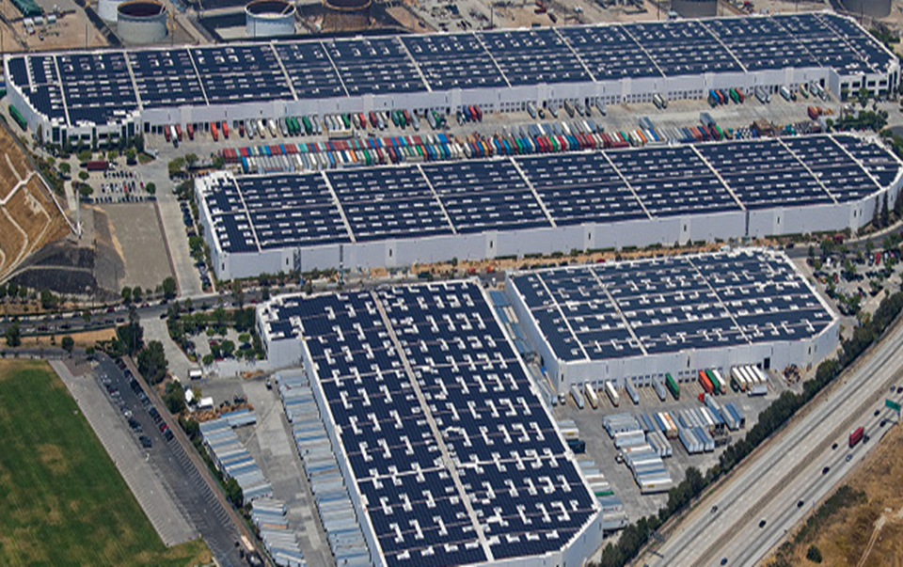
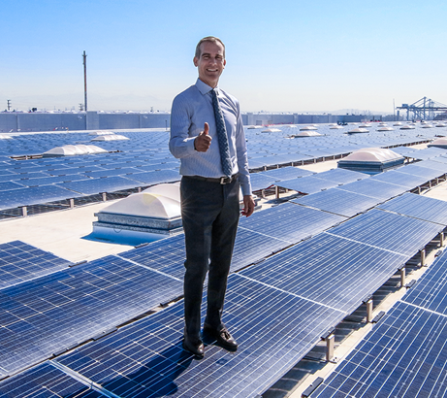
Westmont Solar Project – 15 MW

Slide 14
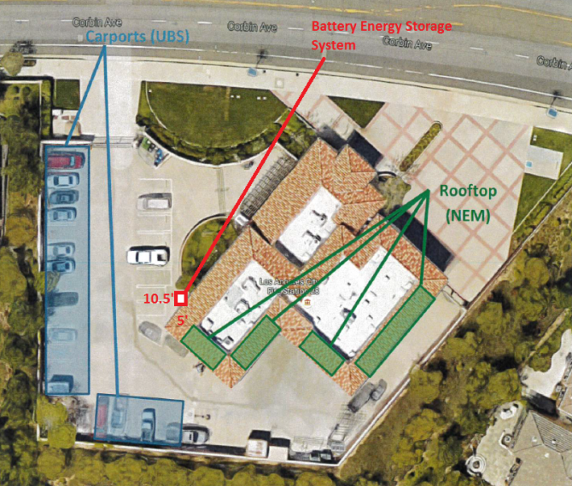
Energy Storage
Achieved
  Upgraded Castaic Power Plant, 21 MW - Completed 2013
  Fire Station 28, 12 kW - Completed 2/2018
  La Kretz Innovation Center, 60 kW - Completed 7/2016
  Beacon Battery Energy Storage System, 20 MW - target 6/2018 in service
In Progress
  LADWP HQ : 200 kW BESS – Evaluating Proposals
  Over 500 Interconnection applications totaling ~3.6 MW’s
  Grid-connected installations at LAPD, Rec & Parks, Distributing Stations, LA Zoo and others

Slide 15
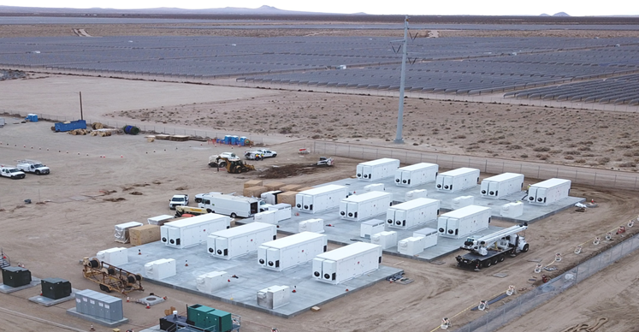
Beacon Battery Storage – 20 MW

Slide 16
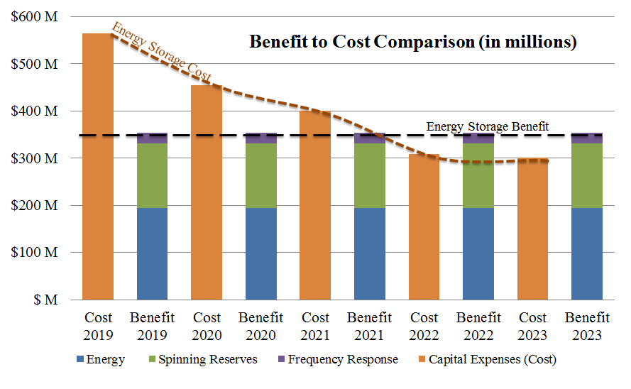
LADWP’s SB 801 Initiative
  100 MW 4-hr battery + 200 MW solar: LADWP engaged Electrical Power Research Institute (EPRI) to perform an in-depth cost-effectiveness study

Slide 17
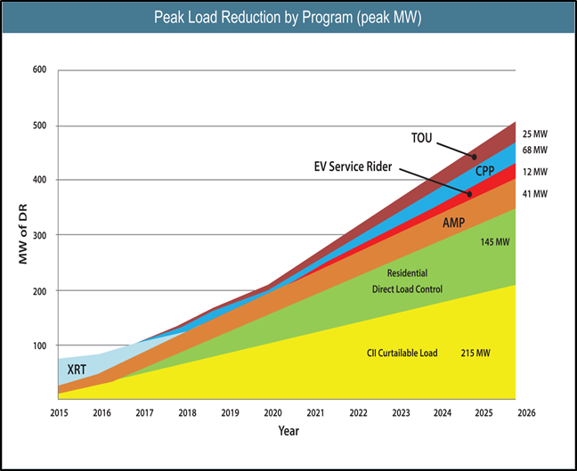
Demand Response
500 MW by 2026
June 2015 launched C&I
Launched “SummerShift” program in 2016 with 100 MW
Created “DER Planning” organization to conduct pilot and deploy DERMS
Next:
Residential Thermostat Program
& Smart Charging Pilot
Update DR targets with consideration for OTC results

Slide 18
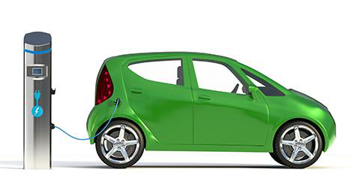
LADWP’s Draft 5 Year EV Plan
5 Year Goal:
The equivalent of 145,000 Electric Vehicles in LA
10,000 commercial chargers by 2021 (4000 on City Property)
Governor Brown’s Zero-Emission Vehicle Executive Order of 250,000 chargers by 2025
Strategy:
Increase EV adoption to 15% of vehicle purchases
Count Public and Workplace Chargers as EV equivalent.
Consider non-light duty as EV equivalent (i.e. Medium & Heavy Duty).

Slide 19
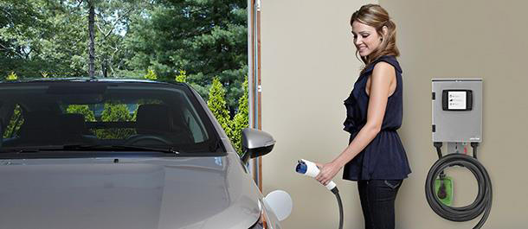
Residential & Commercial EV Charging
Residential
Used Car Rebate – $450
EV Charger Rebates – up to $500,
with +$250 for dedicated service
Developing Residential Smart EV charging pilot
blueLA – New City of LA car sharing program
Commercial
Up to $4,000 per charger – workplace, public & multi-unit
Depot Charging: off-peak “industrial rate” with no monthly demand charge – 2.5 cents/kWh discount for off-peak
“Anytime Rate”: Need to develop a rate for charging anytime during the day.

Slide 20
Energy Efficiency: 15% by 2020
Annual EE Investment and Goals: 2010 – 2020
Fiscal Year | 2010-11 | 2011-12 | 2012-13 | 2013-14 | 2014-15 | 2015-16 | 2016-17 | 2017-18 | 2018-19 | 2019-20
Budget (millions) | $49.5 | $37.3 | $50.0 | $78.0 | $79.0 | $73.0 | $133.0 | $178.0 | $180.0 | $163.0
GWh Savings | 265 | 228 | 319 | 337 | 343 | 412 | 480 | 412 | 396 | 359
Portfolio Savings Cum’l | 1.1% | 2.1% | 3.4% | 5% | 6.5% | 8.2% | 10.4% | 12% | 13.7% | 15.1%
Actuals
Current Year Plan
Future Planned

Slide 21
Energy Efficiency: 15% by 2020
Residential LED Distribution
  2.6M bulbs to all 1.3M LADWP residential customers, SF and MF
AC Optimization Program
Energy Savings Assistance Program
  Partnership with SoCalGas, available to CPUC-eligible low-income residents in multi-family buildings in LA.
EE lighting measures for LAUSD
Electrification Targets: February 2018, LA City Council requests LADWP to adopt aggressive Building Electrification targets aimed at GHG reduction; LADWP partnering with SCE & SMUD on study

Slide 22
Thank You
Jason Rondou
Manager of Strategic Development & Programs
Power Planning & Development Division
jason.rondou@ladwp.com

