Slide 1

SDG&E – Carlsbad Energy Center and Preferred Resources Update

Slide 2
Carlsbad Energy Center Update
Carlsbad Energy Center
500 MW (5 GE LMS 100’s) approved by the CPUC in May 2015
First unit expected to be on-line in May 2018 with completion in Q4

Slide 3
Preferred Resource Update
2016 Preferred Resources LCR RFO
A.17-04-017 – Seeking approval of three third-party energy storage resources, two utility-owned energy storage resources, and one demand response resource. The CPUC issued a proposed decision April 25 approving all contracts.
Notes:
Fallbrook BESS: Project developed by AES Corporation (AES). 40 MW of capacity utilizing lithium ion technology with a discharge duration of four hours. Build-own-transfer (BOT) contract.
Miramar BESS: Project developed by RES Americas Construction (RES). 30 MW of capacity utilizing lithium ion technology with a discharge duration of four hours. EPC.
Enel Green Power North America: 15-year PPTA for 3 MW of capacity.
Advanced Microgrid Solutions: 20-year contract for 4 MW of capacity.
Powin Energy: 10-year contract for 6.5 MW of capacity.
EXTRA: Wildan EE Q4 2021 18.5 Energy Efficiency
EXTRA: EC and ES BES systems totaling 37.5 MW

Slide 4
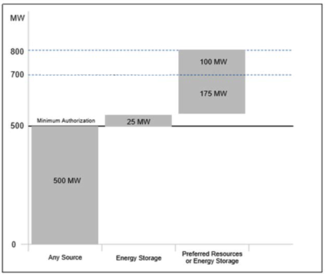
Track IV Procurement
CPUC Direction
LCR Procurement Status
The CPUC’s 2012 Long-term Procurement Plan Track IV decision authorized SDG&E to procure between 500-800 MW of capacity by the end of 2021 to meet in-basin generation needs attributed to the SONGS retirement.
SDG&E sought to replace capacity from SONGS with cost-effective resources to meet its Local Capacity Requirement (LCR) and to further California’s energy goals of reducing greenhouse gas emissions. SDG&E currently expects 500 MW to be delivered from the Carlsbad Energy Center and 144 MW from in-basin preferred resources, all counting towards Track IV procurement.

Slide 5
Questions?
David H. Thai, P.E.
Origination Analytics Manager
SDG&E - Electric and Fuel Procurement
Ph: (w) 858-654-1174, (c) 619-819-5007
dathai@semprautilities.com

