Slide 1
Economic Early Retirement of Gas Fired Generation – Managing the Risk
Neil Millar
Executive Director, Infrastructure Development
CEC IEPR Workshop
April 24, 2017

Slide 2
What is the risk of retirement of gas units?
Growth of Renewables
Increased downward pressure of market revenues for gas resources
Long Term Contract Competition
Existing generation competing for compensation
Not under long term contracts
Gas Fleet “Shake Out”
Once-through-cooling generation retirement and other pressures
No central coordination of which units should retire and when
What level of retirement provides comprehensive reliable service, and are the “right” sources leaving?

Slide 3
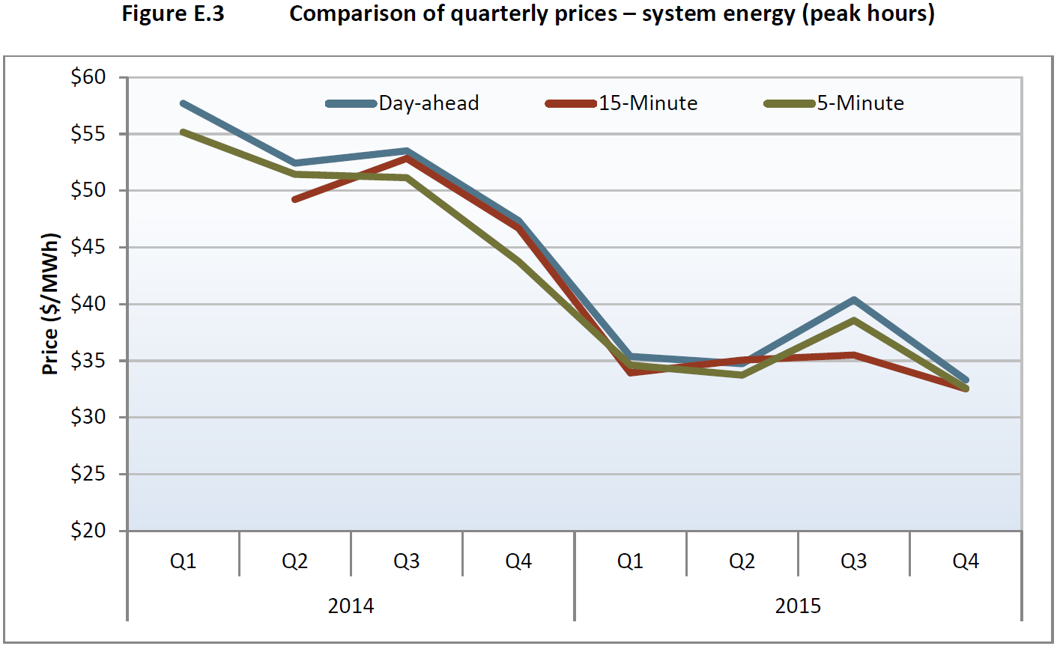
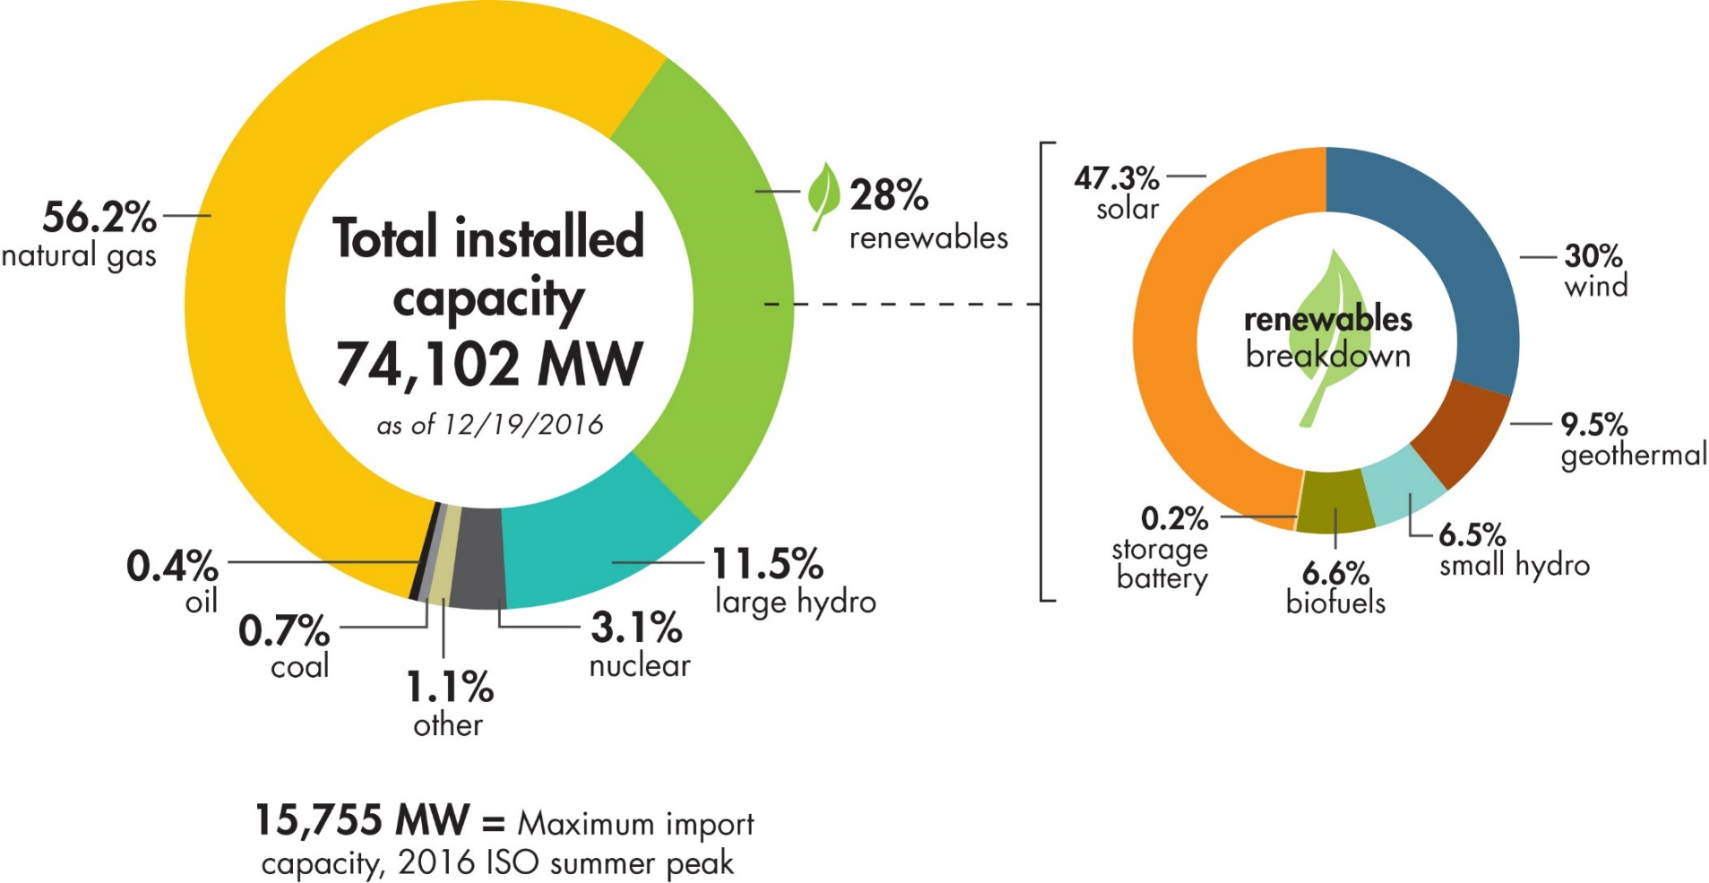
Increases renewable resource mix putting downward pressure on energy prices
December 2016

Slide 4
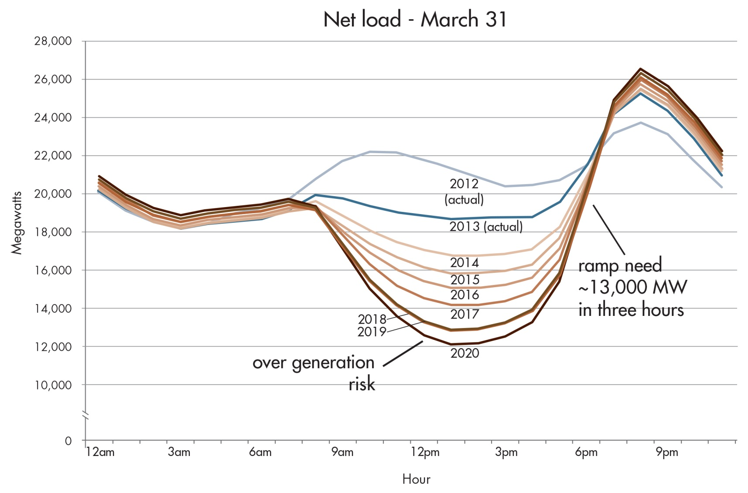
Non-summer months – net load pattern changes significantly starting in 2014, creating new challenges

Slide 5
Managing the consequences of gas-fired generation retiring before expected end of physical life
System Resources
Loss of ramping capability
Maintaining sufficient capacity for the post solar peak
Transmission Grid
Maintain local capacity area needs
Loss of peaking capacity
Possibly new reliability requirement areas
Impact on remedial action schemes and path ratings

Slide 6
The ISO conducted a preliminary study in conjunction with the 2016-2017 transmission plan process:
Examined system-wide resource needs as well as transmission grid needs - outside of existing local capacity areas - considering a single 50% RPS scenario
In exploring new transmission grid impacts, beyond known local capacity requirements, we looked for pockets of somewhat similarly-situation generators that could be at risk of early retirement
Details and assumptions are available under the 2016-2017 Transmission Plan page on the ISO website

Slide 7
Study Scope
Identify the incremental path flow impacts (congestion from production cost modeling) of the retirement scenarios on California transfer paths.
Identify high level potential path flow impacts on the California transfer paths and the associated Remedial Action Schemes using power flow analysis.
Identify potential system level impacts on ancillary services and flexibility requirements.

Slide 8
Transmission grid analysis - two scenarios and a Midway-area sensitivity were studied
Total Estimated Retirement
Scenario 1 = 8265 MW
Scenario 2 = 9658 MW
Midway area sensitivity = 2600 MW

Slide 9
Summary of Transmission Grid Analysis Findings
Lower Path 26 (PG&E – SCE) flows due to potential generation retirement north of Path 26 and in the Midway area and potential loss of generators participating in remedial action schemes that support north to south flows
Manageable potential thermal loading concerns for a 230 kV line under overlapping P6 contingency condition in the LA Basin:
  Can be mitigated by existing “fast” (i.e., 20-minute) demand response, or small transmission upgrades (i.e., line series reactors)
Potential thermal loading concerns on a previously identified 500 kV line connecting LADWP and the ISO under contingency conditions – the Victorville-Lugo line:
  Can be mitigated by previously identified transmission upgrades for LADWP and SCE-owned facilities
Grid impacts manageable overall as long as local capacity needs are respected

Slide 10
The system-wide resource study simulated six retirement cases:
Retirement by Technology (MW) | Case 1 | Case 2 | Case 3 | Case 4 | Case 5 | Case 6
CCGT | -3,739 | -4,325 | -4,325 | -5,107 | -5,107 | -5,107
CHP | -219 | -286 | -751 | -751 | -840 | -1,138
GT | 0 | -200 | -250 | -250 | -939 | -1,632
ST | 0 | 0 | 0 | 0 | -10 | -10
Total | -3,958 | -4,811 | -5,325 | -6,107 | -6,895 | -7,886
The candidates for retirement assessment
  Were selected through a screening using the transmission model
  Met local capacity requirements and transmission constraints

Slide 11
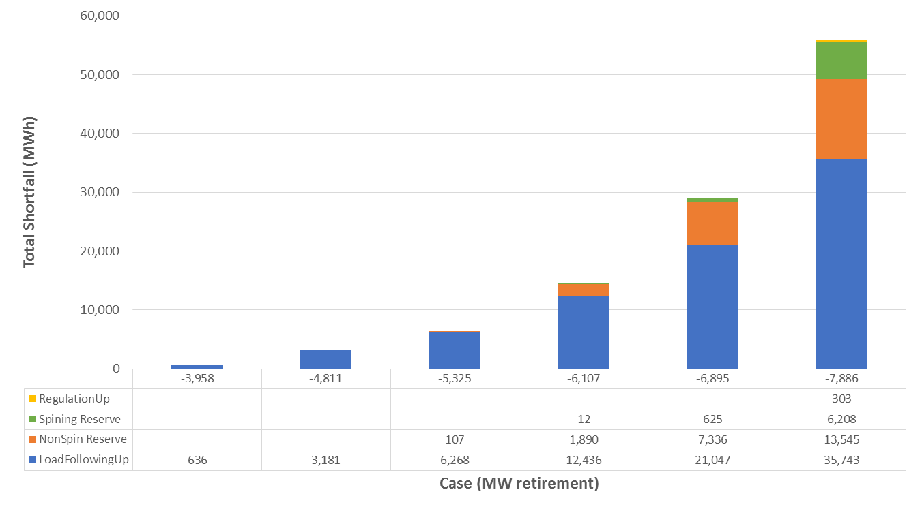
Total load-following and reserve shortfalls by case

Slide 12
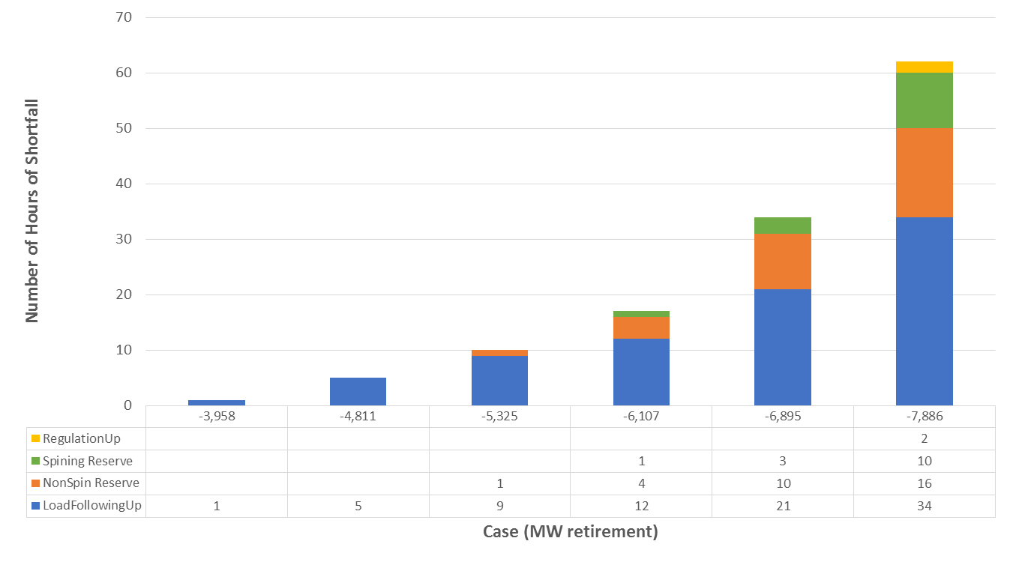
Total number of hours with load-following and reserve shortfalls by case

Slide 13
Summary of System Resource Findings
Unlimited renewable curtailment masks the need for flexible capacity during downward ramping in the morning and upward ramping in the afternoon
The shortfalls in load-following and reserves reflect capacity insufficiencies
Capacity insufficiencies occur in early evening after sunset, which is the new peak (net) load time
Capacity sufficiency issues start to emerge between 4,000 to 6,000 MW of retirement, considering some uncertainties in forecasts.

Slide 14
Questions?

