Slide 1



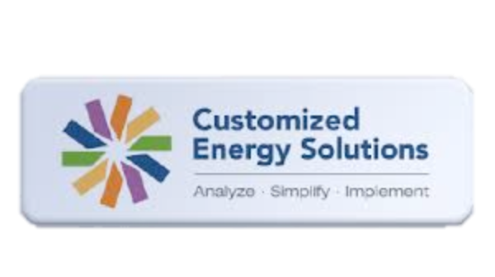

Empowering Prosumers to Access Wholesale Energy Market Products
Save energy. Get paid.

Slide 2

Empowering Prosumers to Access Wholesale Energy Market Products
Goals
1) Gauge and analyze consumer interest in participating in DR
2) Methods to improve customer adoption of devices and participation in events
3) Lowering the barriers for telemetry using residential aggregations

Slide 3
Project Successes
Strong user growth (Task 2)
  Primarily in low-income areas
  Exceeded expectations of the initially scoped set of 12,500
  Users are separated from other contracts on a resource-based level
Leaning into #OhmHours – drives increased engagement
  Users cite #OhmHours as a way to unplug, recharge, and spend time with family
Large data set of #OhmHours (Task 3)
  Dispatched 405k #OhmHour events across 11,580 users
  Utility data available for 251k events across 10,960 users
Initial discussions with CAISO have been positive (Task 4)

Slide 4
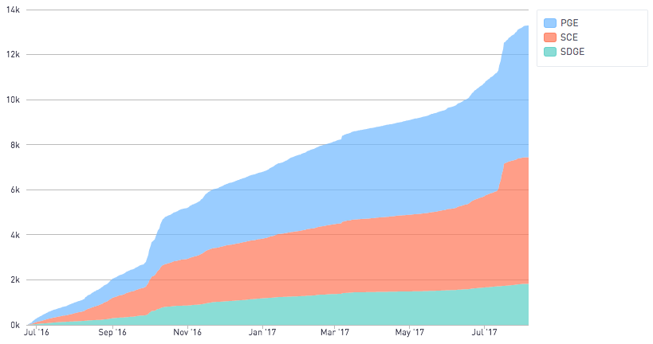
>13k users have received points for this program

Slide 5
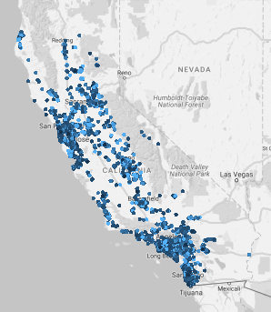
Benefits to California
Lowering costs to load management
Unlocking an untapped resource
Permitting high penetration of renewables
Connecting consumers with the grid
Involving low income consumers
Creating the cleanest of energy sources

