Slide 1

CLEAN ENERGY EQUITY INDICATORS
SB 350 LOW-INCOME BARRIERS STUDY,
PART A
Akua McLeod
Stanford Fellow
California Energy Commission
August 9, 2017

Slide 2

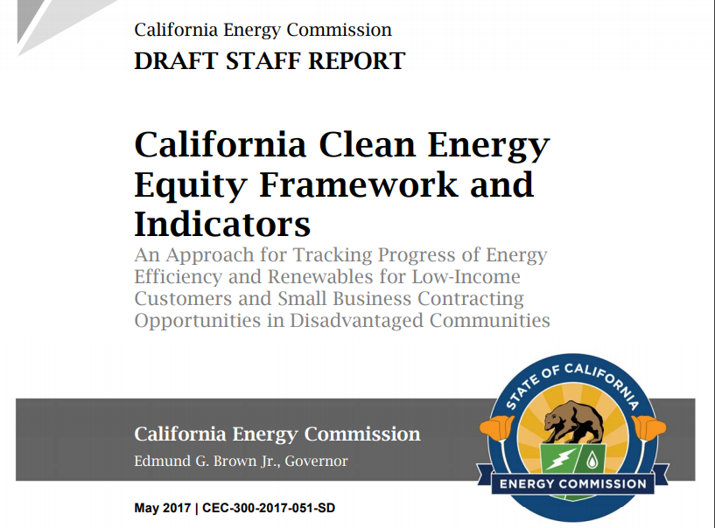

Slide 3

Energy Equity Framework and Draft Indicators
For more information, please see California Clean Energy Equity Framework and Indicators , draft staff report
http://docketpublic.energy.ca.gov/PublicDocuments/17-IEPR-08/TN217611_20170515T154916_California_Clean_Energy_Equity_Framework_and_Indicators.pdf

Slide 4
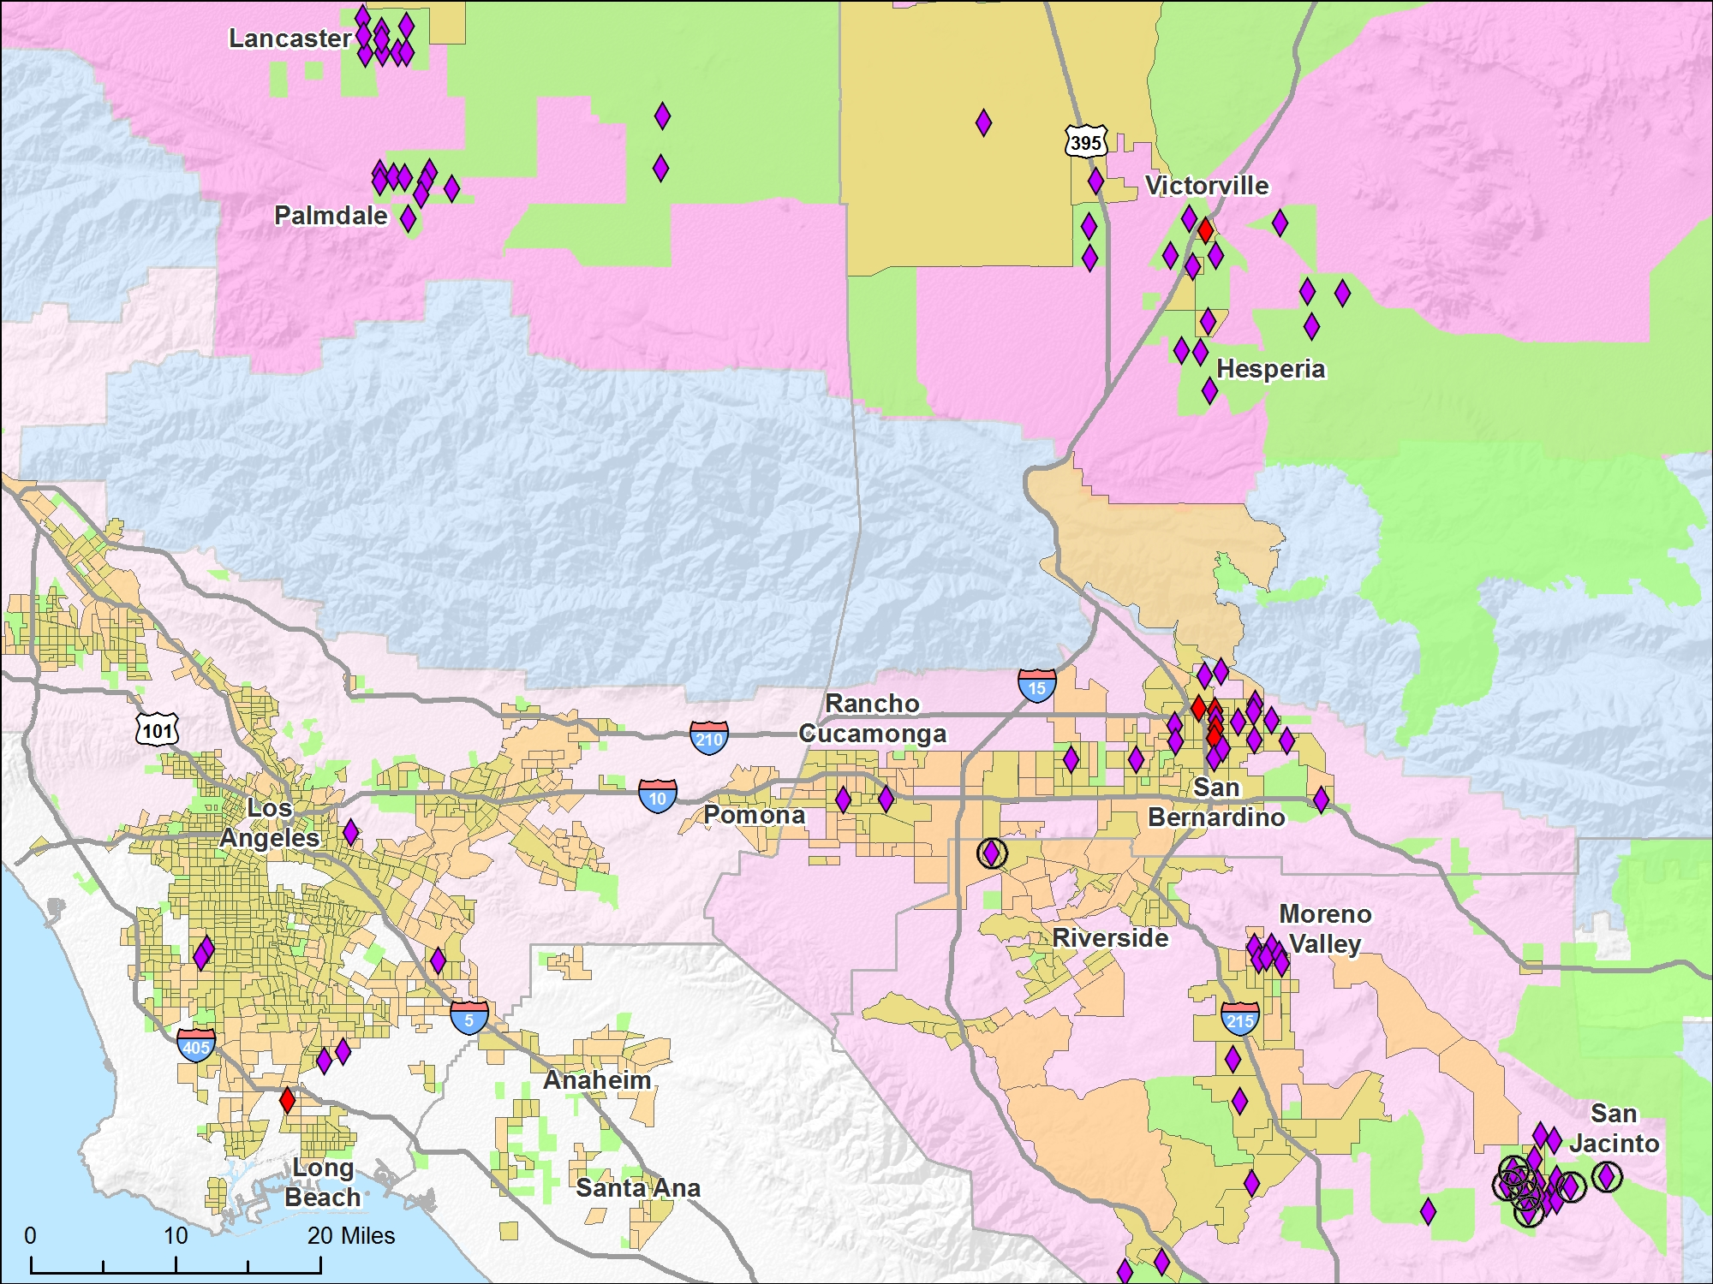
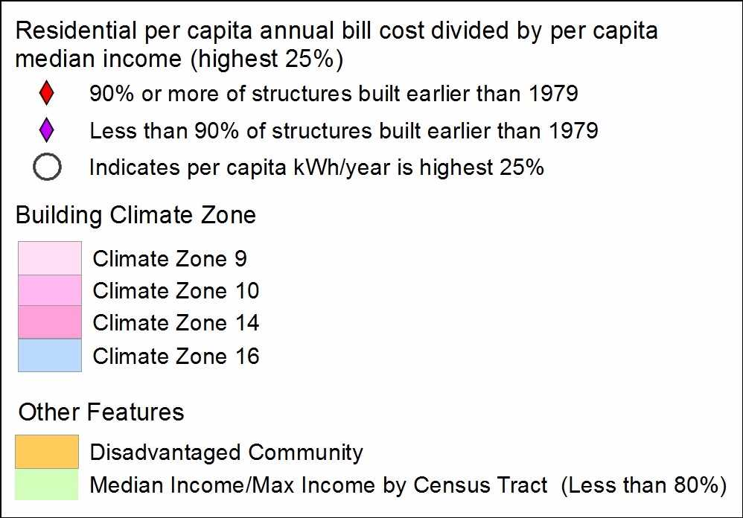
Areas with Greatest Energy Burden
(IOUs 2014)
This data will be used for the following indicator:
P10 Energy Burden
Data source: California Public Utilities Commission

Slide 5
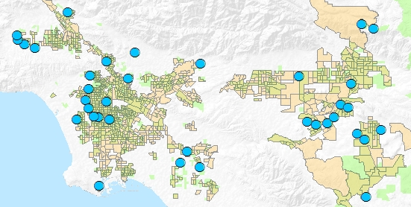

Areas with Least Energy Savings (IOUs 2016)
Rancho Cucamonga
San Bernardino
Los
Angeles
Riverside
Santa Ana
This data will be used for the following indicator:
P1 Energy Savings
Data Source: California Energy Efficiency Statistics - http://eestats.cpuc.ca.gov/Views/EEDataShelf.aspx

Slide 6

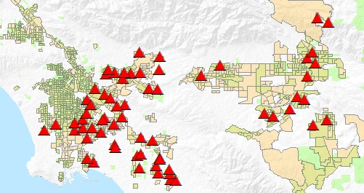
Areas with Fewest Rooftop PV Installations (IOUs 2016)
Rancho Cucamonga
San Bernardino
Los
Angeles
Riverside
Santa Ana
This data will be used for the following indicator:
P3 Renewable Energy
Data Source: California Solar Statistics, Currently Interconnected Data Set - https://www.californiasolarstatistics.ca.gov/data_downloads/

Slide 7
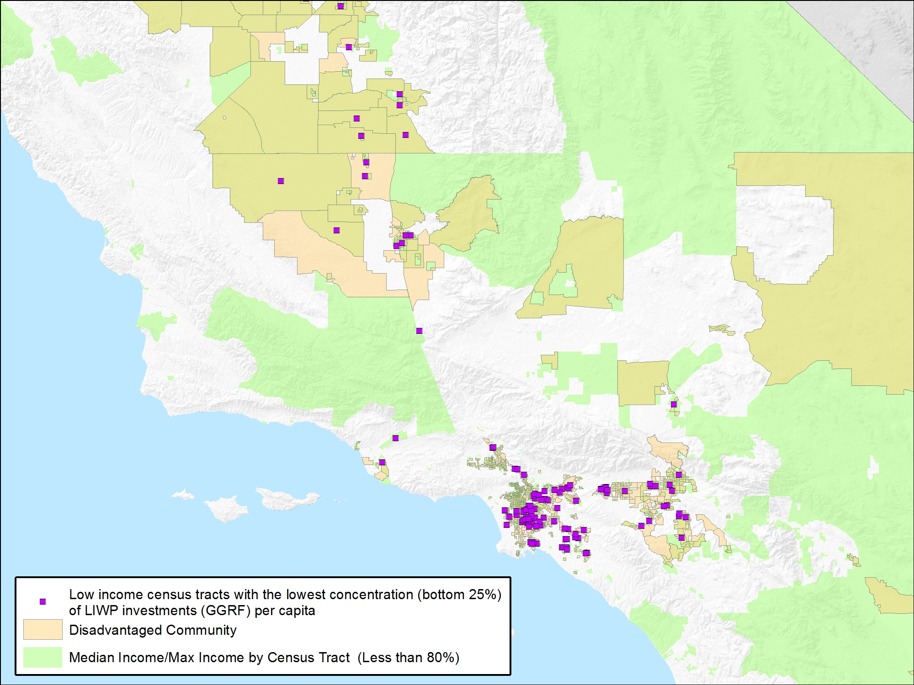
Areas with Least Low Income Weatherization Program Investment (2016)
San Bernardino
Rancho Cucamonga
Los
Angeles
Riverside
Santa Ana
This data will be used for the following indicator:
P5 Amount Invested
Data Source: Low Income Weatherization Program: Single-Family and Small Multi-Family Weatherization Projects By Census Tract, California Greenhouse Gas Reduction Fund Project Map - https://www.arb.ca.gov/cc/capandtrade/auctionproceeds/auctionproceedsmap.htm#

Slide 8
References
American Community Survey
https://www.census.gov/programs-surveys/acs/#https://www.census.gov/data.html
CalEnviroScreen 3.0 https://oehha.ca.gov/calenviroscreen/report/calenviroscreen-30
California Building Climate Zone Areas
http://www.energy.ca.gov/maps/renewable/building_climate_zones.html
California Energy Efficiency Statistics http://eestats.cpuc.ca.gov/Views/EEDataShelf.aspx
California Greenhouse Gas Reduction Fund Project Map https://www.arb.ca.gov/cc/capandtrade/auctionproceeds/auctionproceedsmap.htm#
California Solar Statistics, Currently Interconnected Data Set https://www.californiasolarstatistics.ca.gov/data_downloads/
Clean Energy Equity Framework and Indicators, Draft Staff Report http://docketpublic.energy.ca.gov/PublicDocuments/17-IEPR-08/TN217611_20170515T154916_California_Clean_Energy_Equity_Framework_and_Indicators.pdf

Slide 9
Thank You!

