Slide 1


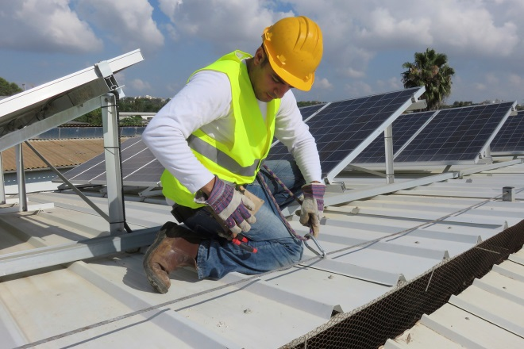
California Low-Income Barriers Study Overview
Barriers Study Implementation IEPR Workshop
May 16, 2017
Michael Sokol
California Energy Commission

Slide 2
Senate Bill 350 – The Clean Energy and Pollution Reduction Act of 2015
50% renewable energy by 2030
Doubling of energy efficiency by 2030
Encourages widespread transportation electrification
Shift toward integrated resource planning to reduce GHG emissions
Low-Income / Disadvantaged Communities focus

Slide 3
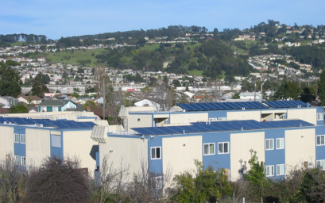

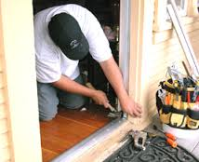
BARRIERS STUDY REQUIREMENTS
  Photovoltaics and renewable energy
  Energy efficiency and weatherization investments
  Contracting opportunities for small businesses
  Clean transportation access

Slide 4
SB 350 BARRIERS STUDY PROCESS
  Literature Review
  100+ articles
  Community Meetings
      7 meetings, 150+ participants
  Technical Public Workshops
    Agencies, Industry, Advocates
  Extensive Outreach
    Fact Sheets, social media, translation

Slide 5
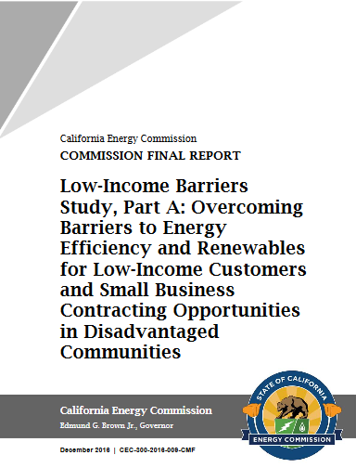
BARRIERS STUDY FINAL REPORT
“Low-Income Barriers Study, Part A:
Overcoming Barriers to Energy Efficiency and Renewables for Low-Income Customers and Small Business Contracting Opportunities in Disadvantaged Communities”.
Adopted on December 14, 2016
http://www.energy.ca.gov/sb350/barriers_report/

Slide 6
BARRIER CATEGORIES:
  Structural Barriers
  Policy and Program Barriers
  Small Business Barriers

Slide 7
STRUCTURAL BARRIERS:
  • Low home ownership rates
  • Complex needs, ownership, and financial arrangements for low-income multifamily housing
  • Insufficient access to capital
  • Building age
  • Remote or underserved communities

Slide 8
PROGRAM/POLICY BARRIERS:
  Market delivery
  • Program integration
  • Data limitations
  • Unrecognized non-energy benefits

Slide 9
SMALL BUSINESS BARRIERS:
  Lack of access to information
  Technical assistance and workforce development needs
  Lack of access to financial resources
  Lack of access to support, opportunity

Slide 10
PRINCIPAL RECOMMENDATIONS:
Establish a coordinating task force
Enable the economic advantages for community solar
Strategize on effective green workforce and education goals in disadvantaged communities
Continue developing a series of energy upgrade financing pilot programs
Collaboration to establish common metrics and collect and use data systematically across programs

Slide 11
ADDITIONAL RECOMMENDATIONS:
Expand opportunities for renewable energy
Enhance affordable housing tax credits/credit enhancements supporting clean energy upgrades
Establish a pilot program for multiple regional one-stop shops
Heightened consumer protection
Collaboration with qualified CBOs
Research, development, demonstration, and market facilitation programs include targeted benefits
In-depth study to increase contracting opportunities

Slide 12
JOINT AGENCY TASK FORCE
Kickoff meeting held Tuesday, May 9
Includes key agencies involved in Barriers Studies
Objectives:
    Drive forward implementation of recommendations
    Facilitate coordination across programs
    Align eligibility requirements & encourage standardization
    Leverage resources across agencies
    Prioritize key topics

Slide 13
NEXT STEPS
Participate in future task force meetings
2nd Implementation workshop: August 1, 2017
Possible additional community outreach meetings
Tracking Progress on SB 350 Goals

Slide 14
QUESTIONS/CONTACTS
Michael Sokol Alana Mathews
SB 350/802 Coordinator Public Adviser michael.sokol@energy.ca.gov Alana.mathews@energy.ca.gov
916-654-4516 916-653-5898

