Slide 1
Integrated Resource Planning:
Addressing Grid Operational Issues
Edward Randolph, Director, CPUC Energy Division
2017 IEPR Joint Agency Workshop on the Increasing Need for Flexibility in the Electricity System
05/12/2017

Slide 2
Presentation Outline
Current Approach to Meeting Grid Operational Needs
Shift to Integrated Resource Planning
Statutory Basis and Goals of IRP
IRP Scenarios Development
2017-18 IRP Schedule Overview
5/15 IRP Staff Proposal Highlights
Specific Highlights: GHG Planning Targets, and Interagency Coordination
From Operational Conditions Today to a 2030 Preferred System Plan

Slide 3
Current Approach to Meeting Grid Needs
Need | Existing Regulatory Responses
System Capacity | Production Reserve Margin (PRM) sets system need Long-Term Procurement Plan (LTPP) identified need for new system capacity over 10-year horizon; transitioning to Integrated Resource Plan Resource Adequacy (RA) program to ensure short-term sufficiency
Local Capacity | RA Requirements (short-term demonstrations) LTPP / Integrated Resource Planning (IRP) (long-term resource availability)
Flexibility | Existing market products available for flexible RA in near-term CAISO’s FRACMOO 2 can further define flexibility attributes to inform procurement in CPUC’s RA and IRP proceedings
Resource Adequacy Observations
Multi-year RA contracts are occurring where need justifies them (observed in CPUC data collection and reporting)
More specific definitions of grid integration needs (i.e. flexibility) can lead to additional market-driven contracting activities and, potentially, compliance demonstrations.

Slide 4
Shift to Integrated Resource Planning
IRP is a strategy to identify an optimal mix of supply and demand-side resources over the long-term (20-years)
Electric sector GHG emission targets and grid reliability needs are constraints
Modeling can identify portfolios of resources to meet policy and grid operating constraints
Key inputs define baseline grid operating conditions, including:
  Electricity demand and load shapes based on CEC’s IEPR demand forecast
  Existing fleet of resources and planned retirements (e.g. OTC retirements)
  Existing resource mandates (e.g. 50% RPS by 2030)
Resources can be optimized in modeling to meet GHG and grid operational constraints
Renewables (e.g. PV, wind, geothermal, biomass)
Storage (both short and long duration)
Advanced demand response (e.g. shift and new load shed measures)
Thermal generation
Sensitivities can provide insights into optimal amounts of other resources: EE, conventional DR, behind-the-meter PV, electric vehicles, building electrification.
Procurement can be informed by modeling

Slide 5
Statutory Basis for IRP at CPUC
The commission shall...
454.51.
Identify a diverse and balanced portfolio of resources...
454.52.
...adopt a process for each load-serving entity...to file an integrated resource plan...to ensure that load-serving do the following...

Slide 6
IRP Goals in 454.52(a)(1)
Meet GHG emissions reduction targets established by CARB
Achieve 50% RPS
Enable electric corporations to serve their customers at just and reasonable rates
Minimize impact on ratepayer bills
Ensure system and local reliability
Strengthen the diversity, sustainability, and resilience of bulk transmission system and distribution system, and local communities
Enhance distribution systems and demand-side energy management
Minimize localized air pollution and other GHG emissions, with early priority on disadvantaged communities

Slide 7
2017 IRP Schedule Overview
June 2016
May 2017
June 2017
September 2017
Q1/Q2 2018
Q2/Q3 2018
CPUC Reviews/Certifies IRPs for Consistency with Optimal Portfolio
Load Serving Entities (LSEs) File IRPs
CPUC Issues Proposed Decision on IRP Process and Optimal Portfolio to Reach Emissions Planning Target
Energy Division Releases Modeling Results for Electric Sector to Reach GHG Emissions Targets
Energy Division Releases Staff Proposal on IRP Process
Energy Division Launches IRP

Slide 8
Highlights – Mid-May Staff Proposal
Proposes overall IRP process responsive to CA’s unique circumstances
IRP process will include:
  GHG planning target based on ARB’s Climate Change Scoping Plan
  Reference System Plan – a CPUC-modeled optimized portfolio to meet the GHG planning target and reliability at lowest ratepayer cost
    Will evaluate opportunities and impacts in disadvantaged communities
    Will output a marginal GHG abatement cost to use in resource valuation
  LSEs develop responsive portfolios using knowledge of their needs and resources
  CPUC compares LSE IRPs to the Reference System Plan
  CPUC aggregates LSE IRPs into a Preferred System Plan – the basis for decision-making about system-wide investments, procurement, or other programs

Slide 9
Highlight: GHG Planning Targets for IRP
SB 350 requires the CARB to establish GHG reduction targets for the electricity sector and for individual LSEs to meet in the IRP process.
Jan. 2017: CPUC, CEC, and CARB initiated a joint agency process in to facilitate coordination in establishing these targets
Feb. 2017: Joint agency (CPUC and CEC) staff discussion paper and workshop
Steps for setting and monitoring IRP GHG planning target:
  #1: Work with CEC and ARB to establish electric sector target
  #2: Work with CEC and ARB to apportion sector target between POUs and LSEs
  #3: Define CAISO-wide GHG constraint for IRP modeling purposes
  #4: Establish LSE-specific targets
  #5: Work with CEC and ARB to track LSE emissions

Slide 10
Highlight: IRP and Interagency Coordination
Integrated Resource Planning has potential to affect, and be affected by, multiple processes at other related agencies
  CEC: POU Integrated Resource Planning, Integrated Energy Policy Report Demand Forecast
  CARB: Climate Change Scoping Plan Update, LSE Cap-and-Trade Compliance Obligations
  CAISO: Transmission Planning Process, Resource Adequacy, and reliability studies.
IRP coordination work is already occurring; CPUC, CEC, and ARB are working on alignment to realize the full benefits of IRP
  Nature and timing of data inputs and outputs from each process

Slide 11
From Operational Conditions Today to the Preferred System Plan
IRP is a first-ever opportunity to provide Californians a potential path from today’s operational conditions to a resource mix that achieves SB 350
Reliability and GHG emissions reductions must be optimized together to achieve least cost solutions
We already know that:
  Any scenario in which SB 350 is realized requires 100% achievement of ambitious mandates: EE, RPS, DR, ZEVs, and energy storage
  The IRP process needs a chance to work; in the meantime, California should avoid new carve-outs for specific resources
  IRP will help CA understand change in natural gas fleet over time, including impacts on GHG emissions and grid flexibility
  SB 350 goals and electric system optimization are easier to achieve with highly-regulated LSEs than numerous locally controlled entities.

Slide 12
Backup slides

Slide 13
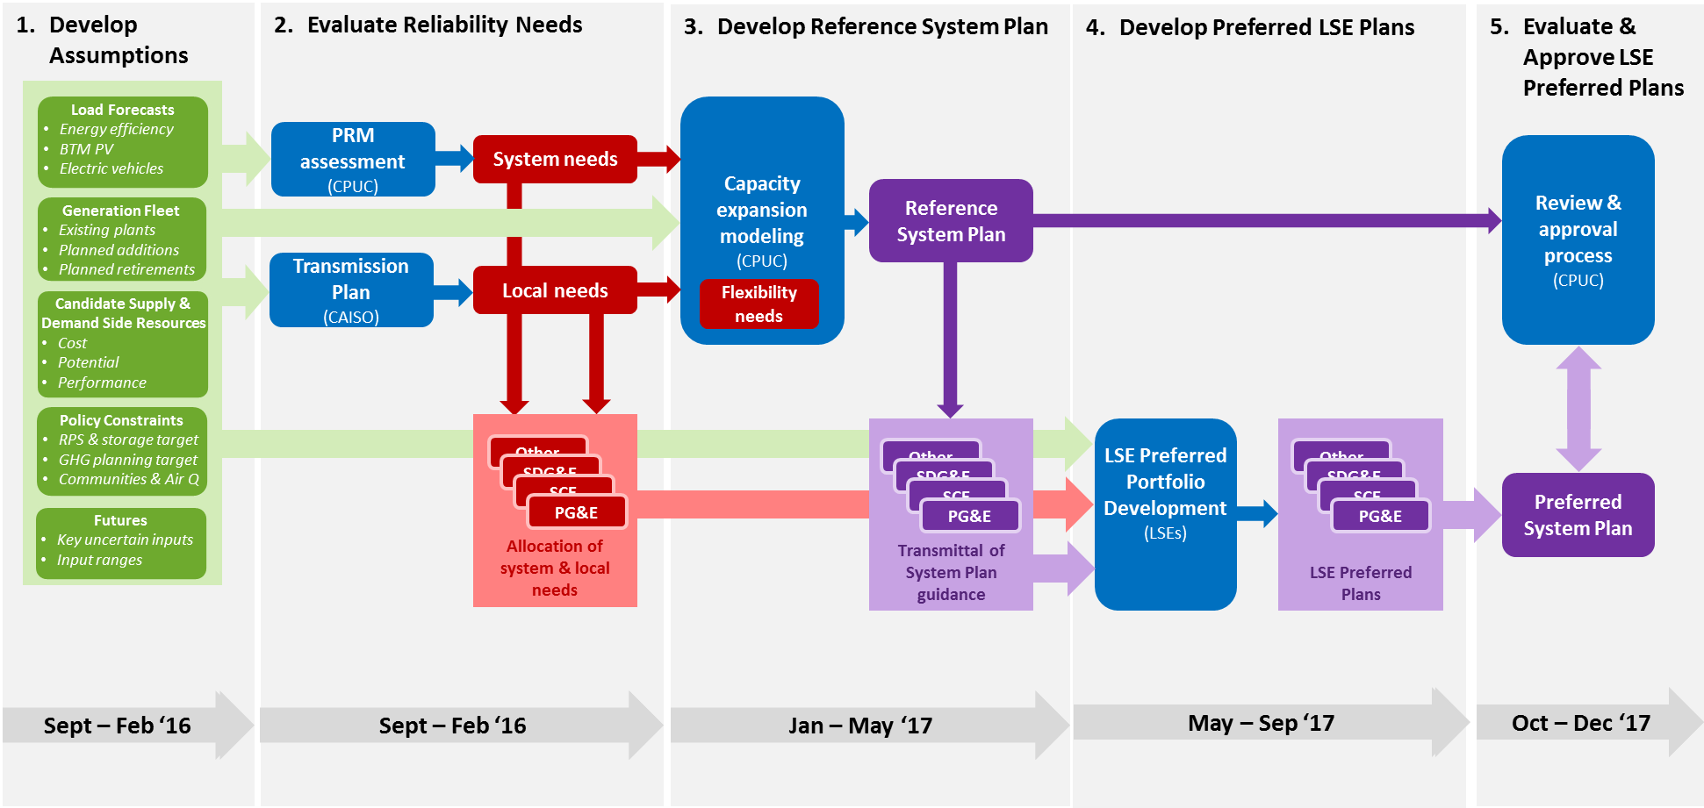
Proposed IRP Analytical Framework

