Slide 1
Regional integration
Peter Miller
Director of Western Energy
May 12, 2017

Slide 2
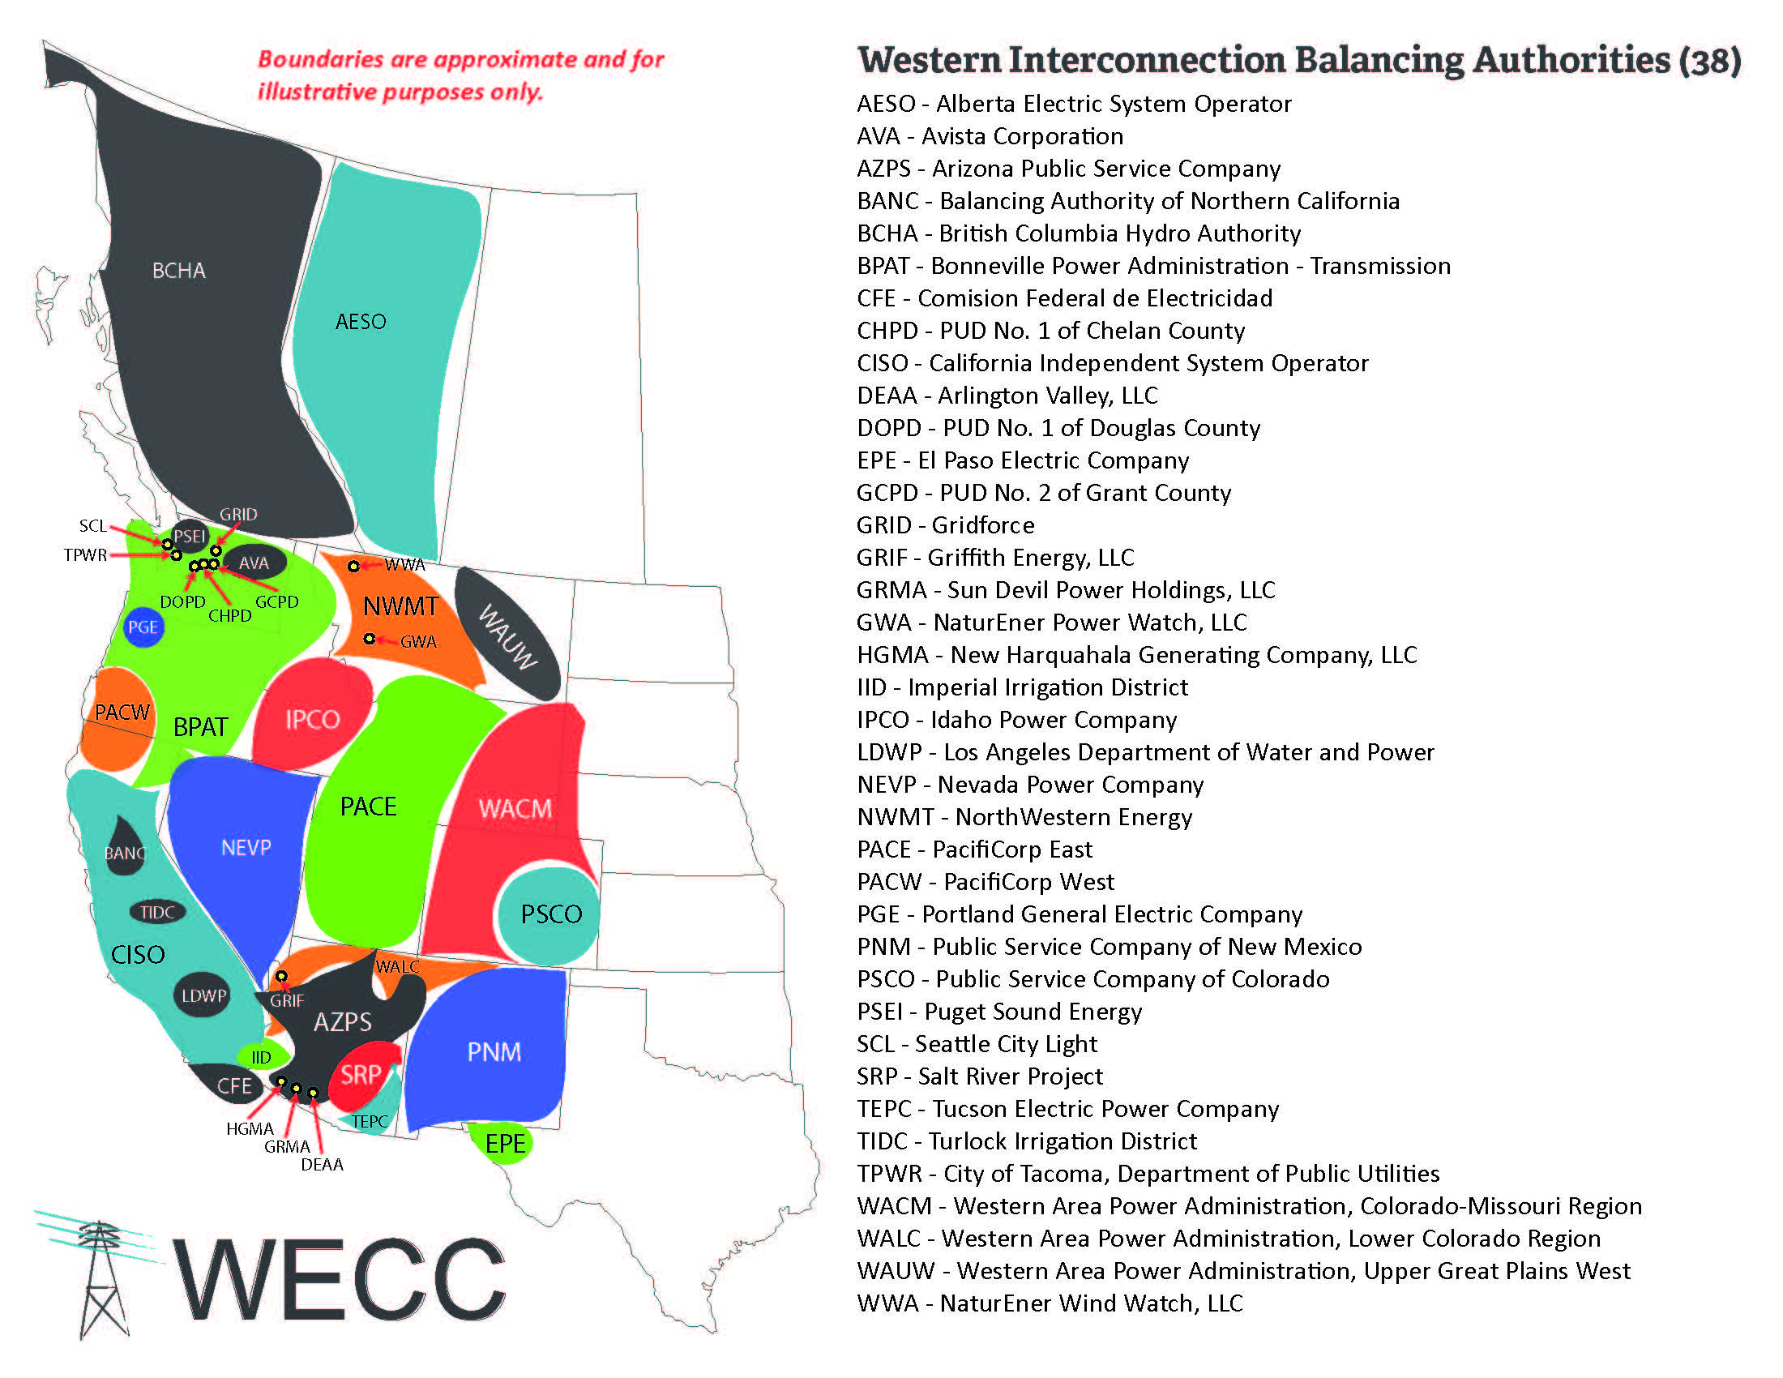

Slide 3
Advantages of Regional Integration
Operational and Management Practices
  Scheduling, control consolidation, technology, sharing reserves
Efficient Markets for energy and grid services
Geographic Diversity and Uncorrelated Variability
Access to lower cost generation to all parts of the footprint
SB 350 studies quantify benefits to approximately $1.5 billion annually by 2030

Slide 4
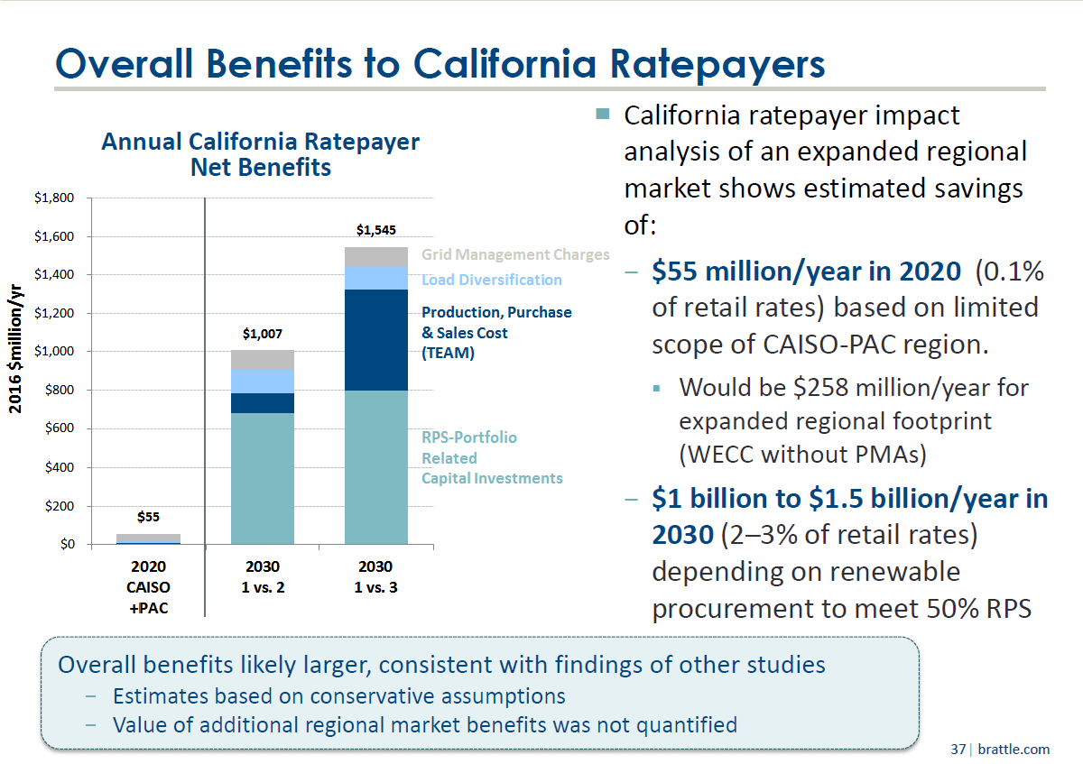

Slide 5


Slide 6


