Slide 1
Demonstration of Advanced Reliability Services from a Utility-Scale
Solar PV Plant
California Energy Commission
IEPR Workshop
May 12, 2017
Clyde Loutan: Principal Engineer, Renewable Energy Integration

Slide 2
The ISO, First Solar and NREL demonstrated how a 300 MW solar PV plant can provide essential reliability services
 | Test | Performance
Ramping | Ramp its real-power output at a specified ramp-rate | ⬄
 | Provide regulation up/down service
Voltage | Provide reactive power support in various modes Control a specified voltage schedule Operate at a constant power factor Produce a constant level of MVAR Provide controllable reactive support (droop setting) - Capability to provide reactive support at night | ⬄
Frequency | Provide frequency response for low frequency and high frequency events Control the speed of frequency response Provide fast frequency response to arrest frequency decline | ⬄

Slide 3
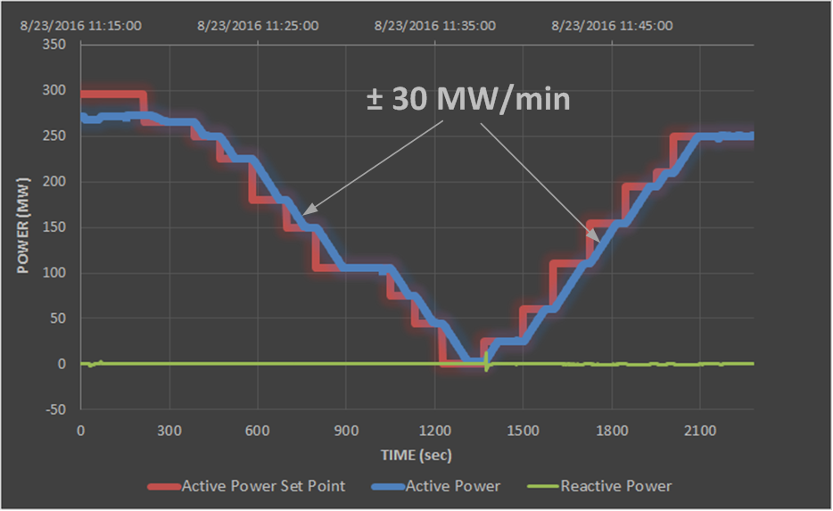
Active Power Ramp Control Test

Slide 4
Demonstrated that the solar plant was able to accurately follow the 4-second regulation signals

Slide 5
Regulation accuracy of the solar plant demonstration exceeded accuracy of conventional resources
Blue bars taken from the ISO’s informational submittal to FERC on the performance of resources providing regulation services between January 1, 2015 and March 31, 2016

Slide 6
Voltage Control: Test demonstrated the plant’s capability to control system voltage at night
By changing the reactive output of the plant from +100 MVAR to -100 MVAR, the voltage at the POI changed from 242 kV to 227 kV (Green curve)

Slide 7
High frequency event in the WECC

Slide 8
Solar response similar to a hydro plant using 5% governor-like droop setting for high frequency event

Slide 9
Under frequency event in the WECC

Slide 10
Ability of solar plant to respond and arrest frequency decline similar to a combined cycle plant for a low frequency event

Slide 11
Next steps towards using renewable resources to balance the grid
Continue to share test results
Evaluate the existing solar fleet to determine the amount of capacity able to provide essential reliability services
Further explore additional opportunities for renewable resources to participate in the various markets for energy and ancillary services
Final Report: http://www.caiso.com/Documents/UsingRenewablesToOperateLow-CarbonGrid.pdf

Slide 12

Questions!

