Slide 1
Bonneville Power Administration: CEC/CPUC Integrated Energy Policy Report
May 12, 2017

Slide 2
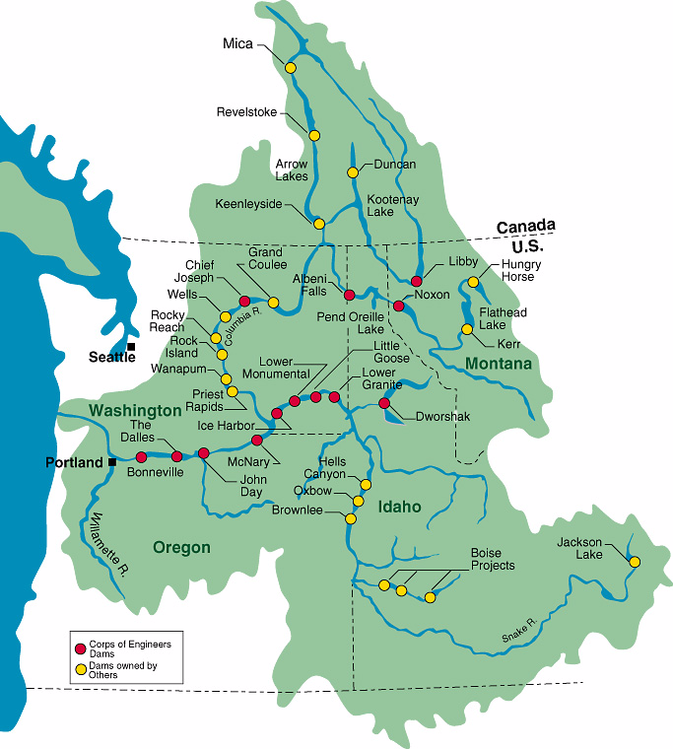
Federal Columbia River Power System
FCRPS is a partnership
  US Army Corps of Engineers (Corps)
  US Bureau of Reclamation (Reclamation)
  Bonneville Power Administration (BPA)
FCRPS 31 hydro plants
  21 Corps (14,651 MWs)
  10 Reclamation (7,807 MWs)
  209 Generating Units ranging from 1 MW (Boise Diversion) to 805 MW (Grand Coulee)
Canadian and Non-Federal entities also operate significant hydro facilities on these rivers

Slide 3
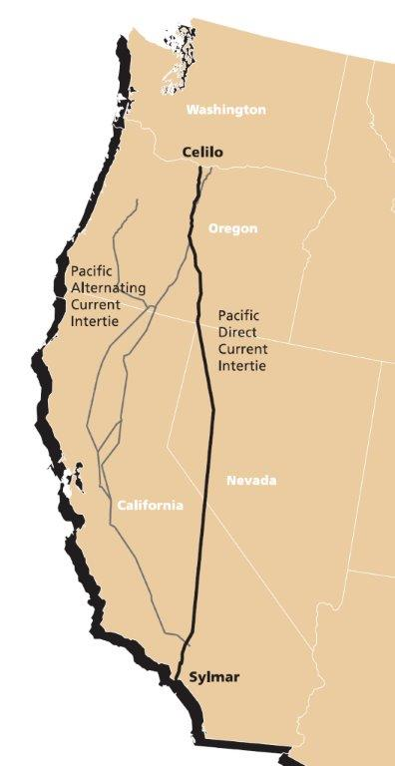
Northwest & California Intertie Transmission
Flexibility increases as commitments move earlier and longer
California-Oregon Intertie (COI) has 400 MW of dynamic transfer capability for 5 minute dispatch
The entire COI capacity totals 4800 MW that can be used in 15 minute or longer increments
The Pacific DC intertie has 3100 MW of transfer capability and can be scheduled hourly or longer

Slide 4
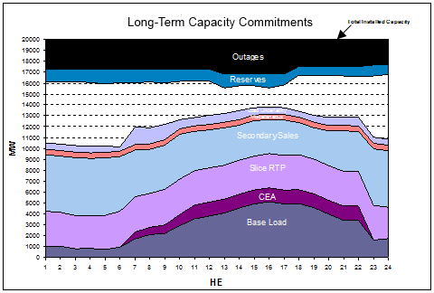
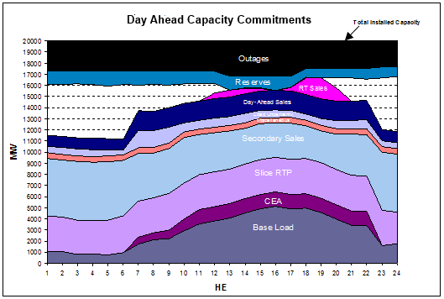
Example Hydro Resource Commitment
Flexibility increases as commitments move earlier and longer
Fuel supply is committed over time to meet water requirements & load
Managed across connected projects to meet needs now and in the future
Major capacity commitments day ahead (see navy blue)
Forecastable vs. Non-forecast flexibility have different impacts
Flexibility decreases as real time approaches (see pink)

Slide 5
Current CA Block Product vs. Future CA Flexible Product
Provides carbon benefit to California
Facilitates hydro management
Compensation reflects Northwest opportunity cost – including avoided carbon value in California
Highly utilizes existing transmission interties bought and paid for by ratepayers in Northwest and California
If a more flexible, shaped product is desired, then we must work together to address:
  Commitment in a day-ahead market
  Qualifying external resources
  Changes in compensation
  Changes in streamflow
  Changes in carbon
  Changes in
  transmission
  availability
MW
MW
Hours in a Day
Hours in a Day

