Slide 1
Renewable Integration
Mark Rothleder
Vice President, Market Quality and Renewable Integration
California Energy Commission
IEPR Workshop
May 12, 2017

Slide 2
Status

Slide 3

Industry in the midst of unprecedented change
- Driven by fast-growing mix of interrelated issues
Federal Election Impacts
Existing 50% goal
Gas Storage Challenges
NEW
100% goal
Community Choice
Grid Modernization
Regional Collaboration
Consumer-owned Power
Fossil Plant Retirements
Transmission & Distribution Systems Interface

Slide 4
Power industry transformation
Wind
Unpredictable Output
4,773 MW Peak – April 24, 2016
Solar Thermal / Photo Voltaic
Semi – Predictable Output
9,868 MW Peak – April 21, 2017
Roof Top Solar
Semi – Predictable Output
Behind the meter – Residential
≈ 10,000 MW Installed Capacity
5,000+ MW Estimated Capacity
6,087 MW Installed Capacity
Main Drivers:
California RPS
GHG reduction
Once-through-Cooled plants retirement
Goals:
Higher expectation of reliability
Higher expectation of security
Smart Grid
Situational awareness through Visualization
* Simultaneous wind and solar has exceeded 13,000MW on April 23, 2017
Notes:
This year, peak solar production of over 6,200MW exceeded the peak wind production of 4768MW. In addition to the grid connected renewables, we are also have about 2500MW of roof-top solar capacity which is growing by 300-500MW and increasing in pace due to the low cost of solar panels relative to retail rates that are as high as $0.34 / kwh.

Slide 5
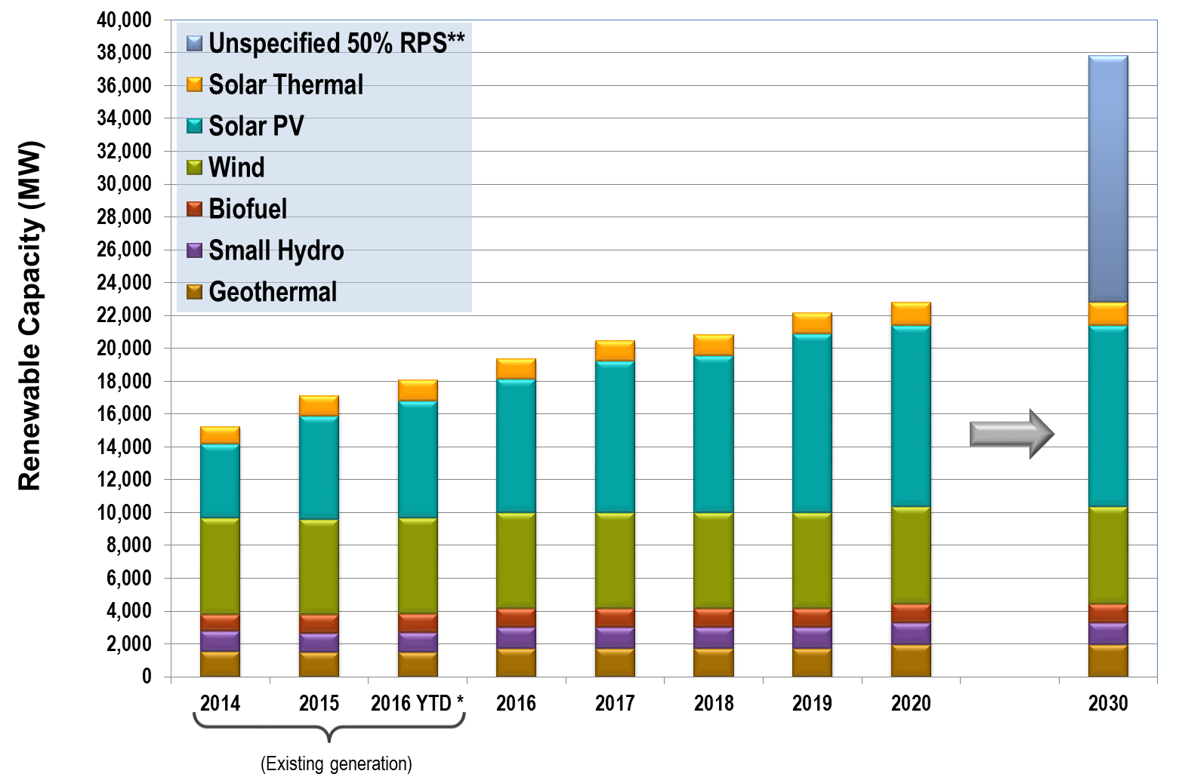
Approximately 4,000 MW of additional transmission-connected renewables by 2020 and an additional 10,000 to 15,000 MW by 2030
*All online resources that are not in test mode are included in the 2016 YTD amounts, including those yet to achieve full commercial operation.
**Approximate
(IOU data through 2017 and RPS Calculator data 2018-2020)

Slide 6
Behind the meter solar PV build-out through 2020

Slide 7
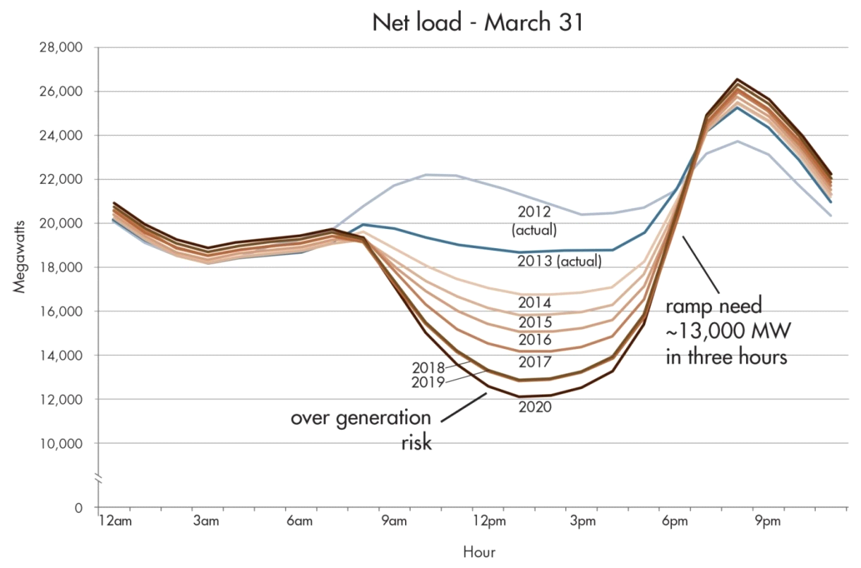
Actual net-load and 3-hour ramps are approximately four years ahead of ISO’s original estimate
Typical Spring Day
Steeper Ramps
Actual 3-hour ramp
of 12,960 MW on December 18, 2016
Deeper
belly
Net Load of 9,187 MW on April 23, 2017

Slide 8
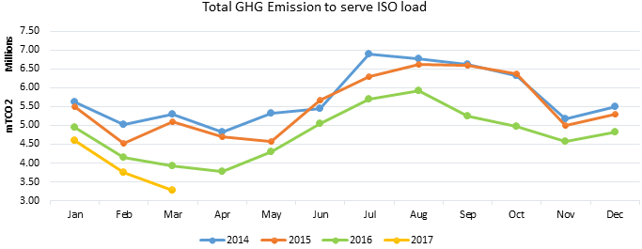
Greenhouse gas reductions are occurring as renewables increase

Slide 9
Opportunities

Slide 10
The success of integrating renewables leads to new grid opportunities
Maximum % of Load Served
58% by wind and solar
65% by renewable resources
83% by carbon free resources

Slide 11
Opportunity 1: Manage oversupply and minimize curtailment

Slide 12
Opportunity 2: New price patterns incentivize innovation in responsive demand and storage
Increasing real-time negative energy price frequency indicates over-generation risk in the middle of the day

Slide 13
Opportunity 3: Enhance operational performance during periods of increased supply variability
CPS1 is NERC Control Performance Standard which is evaluated on a rolling 12-month average. Over the past few years, the rolling average has been declining as a result of some poor daily performances.
Thus, the CAISO need to take measures to enhance daily performance on days with higher variability.

Slide 14
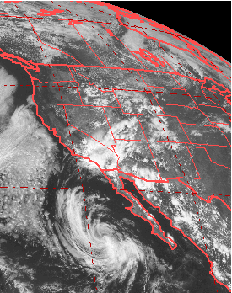
Opportunity 4: Enhance forecasting to manage supply uncertainty
CAISO – Solar Forecast & Actual
July 18, 2015
Example day with monsoonal conditions
2,000 MW difference between expected and actual delivery

Slide 15
Opportunity 5: Evolve fault resiliency capability
Issue
Between the months of August and November 2016 there have been seven transmission system faults that occurred in the ISO system, that resulted in the unanticipated loss of inverter based generation
All transmission line faults cleared in normal tripping time.
The cause of the inverter based generation loss is under review and remediation measures developed
Action Item
ISO is collaborating with other reliability organizations resources and inverter manufactures to develop and implementing short, medium and long term plan to address this issue

Slide 16
solutions

Slide 17
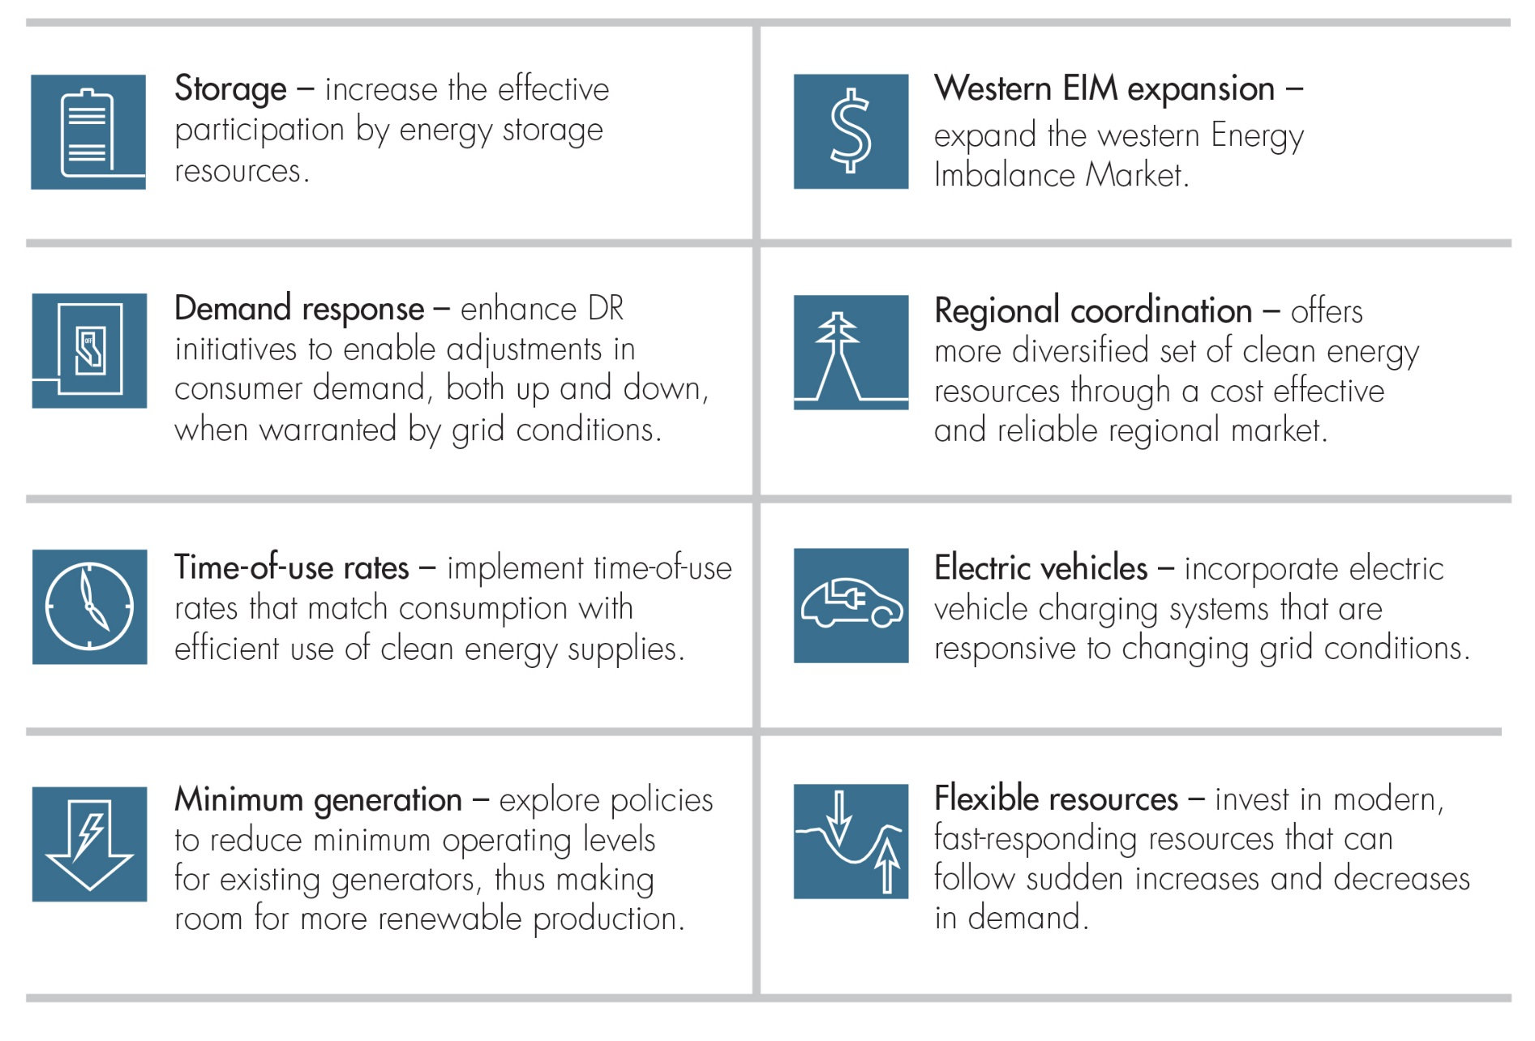
A suite of solutions will be necessary

Slide 18
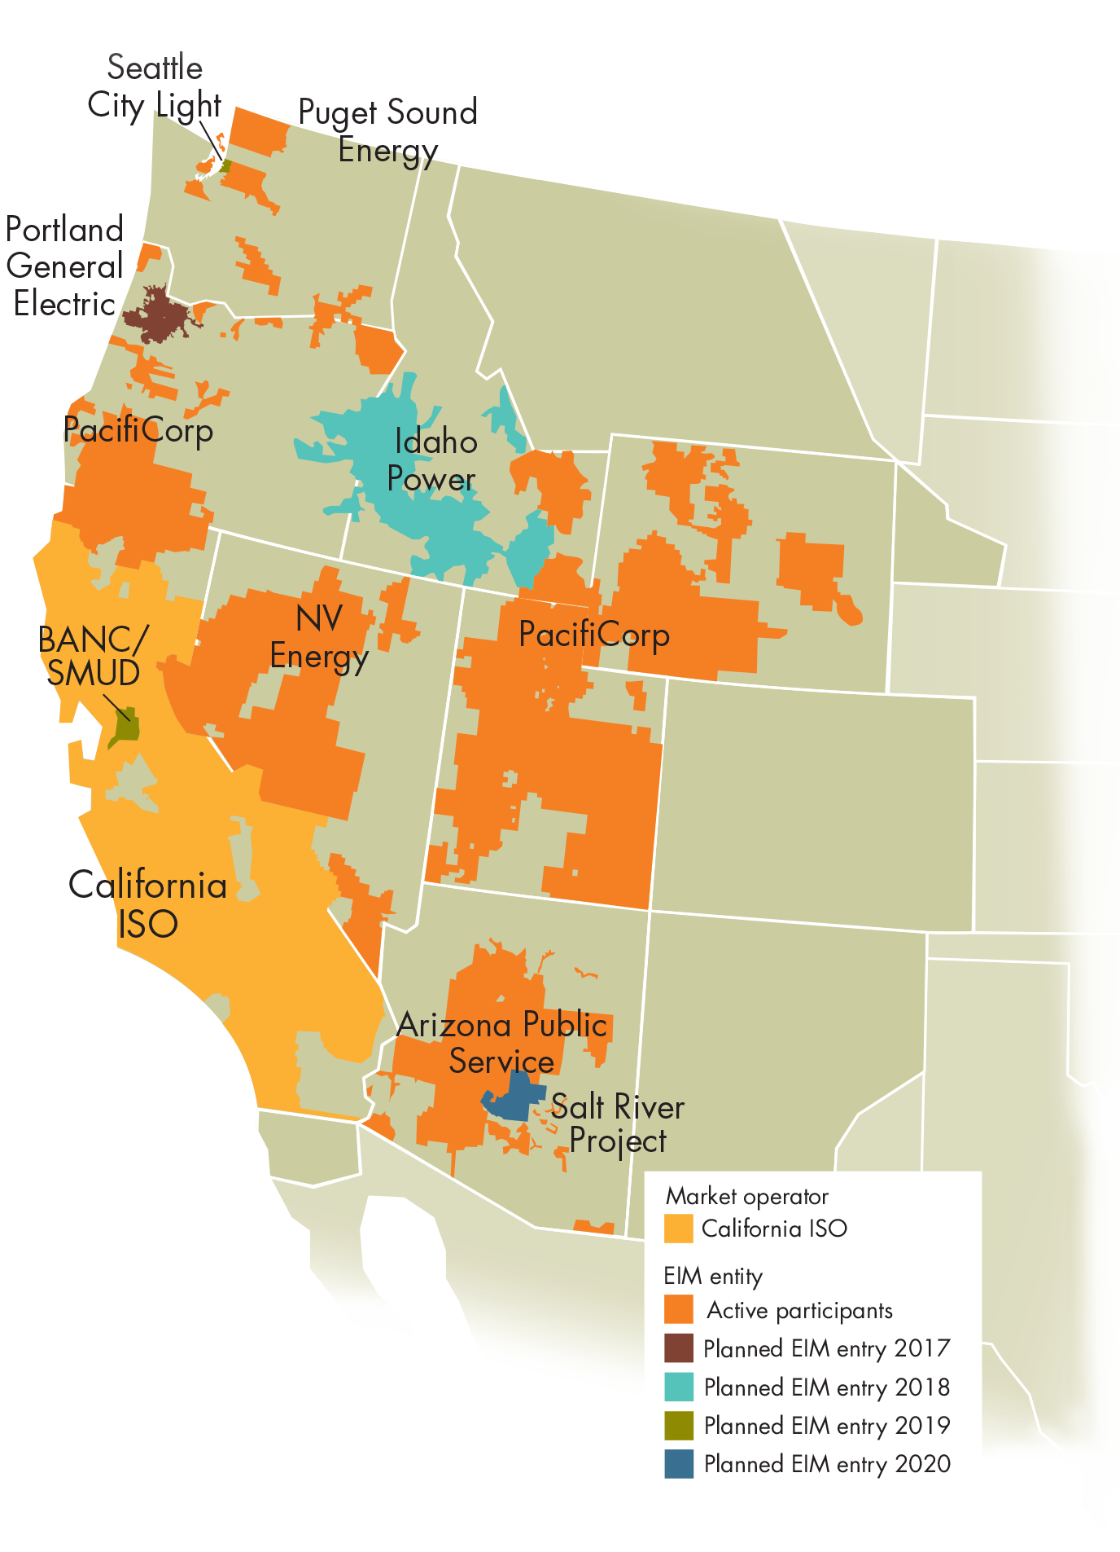
Western Energy Imbalance benefits: $173 million
Entities now in the implementation phase
  Portland General – Fall 2017
  Idaho Power – Spring 2018
  BANC/SMUD & Seattle City Light – Spring 2019
  Salt River Project – Spring 2020
Entities exploring future entry
  CENACE, Baja California, Mexico
  Los Angeles Department of Water & Power (LADWP)
  Northwestern Energy

Slide 19
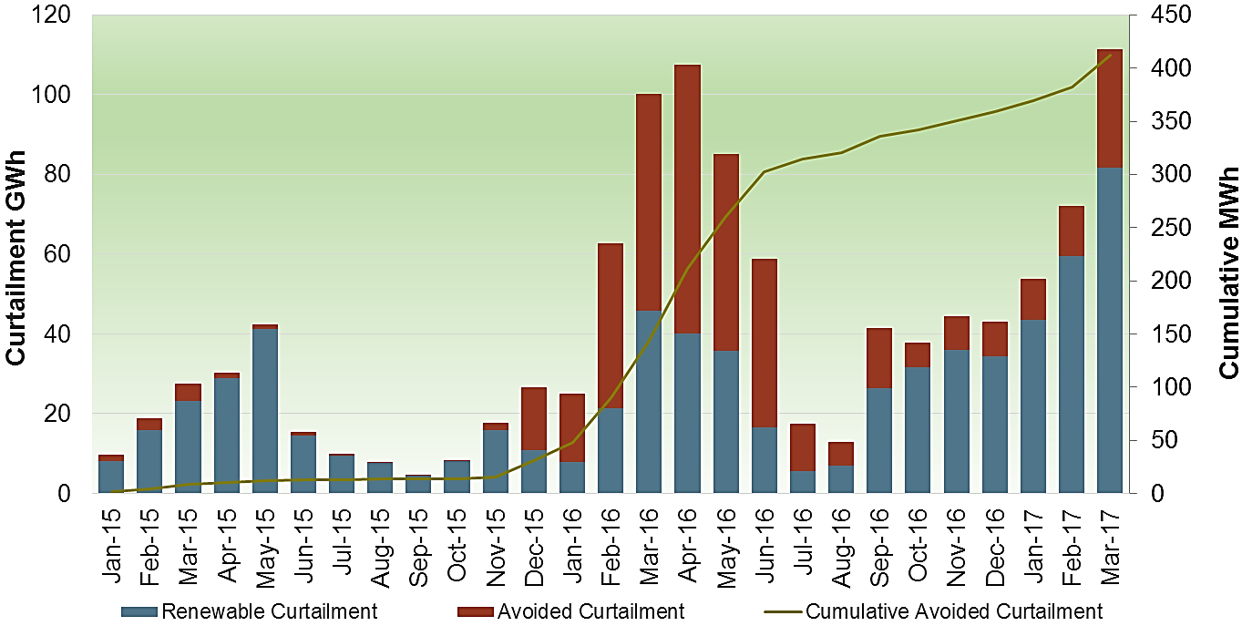
Energy imbalance market helps avoid curtailment
Year-to-date estimated metric tons of CO2 displaced = 176,241
Notes:
Avoided curtailments in 2016 likely due to EIM.

Slide 20
What can we learn from the April 23, 2017: Lowest net load = 9,187MW
Ramping
(12,500 MW from
HE16-HE21)
Intertie: 47%
Gas: 37%
Hydro: 16%

Slide 21
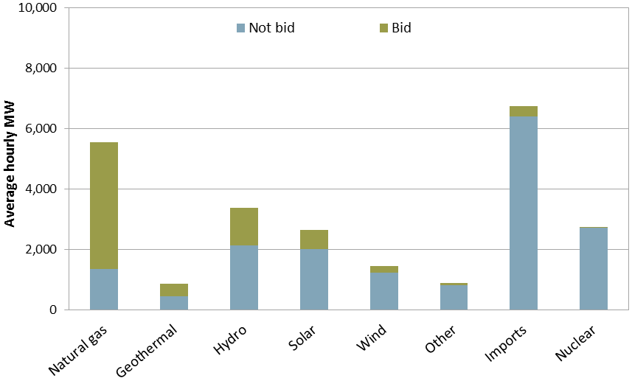
Opportunity for renewables and imports to provide more real-time flexibility via bids
Source: DMM 2016 Annual Report

Slide 22
Time-of-Use Rates can align retail signals with system conditions
Off-Peak
Peak
Net Load
Super Off-Peak
Super Peak

Slide 23
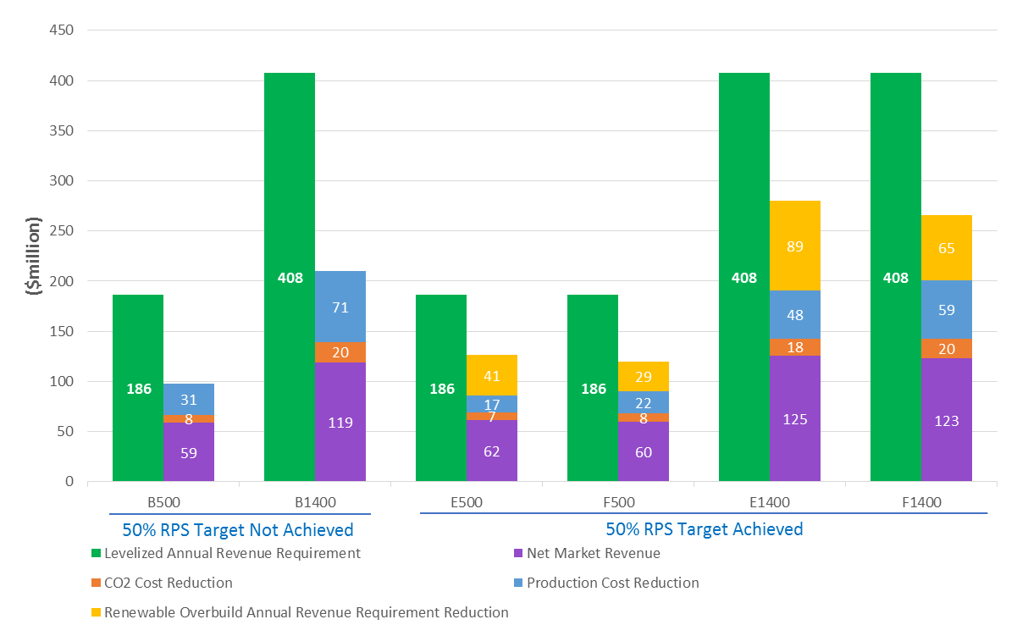
Energy storage could provide multiple benefits
Comparison of levelized annual revenue requirement and benefit streams
(Based on preliminary update to 2016-2017 TPP Special Study on Bulk Storage in 2026)
Net Market Revenue is revenue from energy, reserves and load following minus cost of energy and operation.
System benefits includes reduction of CO2 emission cost, WECC production cost and renewable overbuild cost

Slide 24
Distributed energy resources (DERs) can contribute to meeting operational challenges
Energy Storage can help mitigate over-generation
Load shifting can help mitigate conventional resource needs
DERs may also benefit the system by reducing peak demand and thereby avoiding the need for transmission upgrades
Controlled load dropping can provide spinning reserve and frequency response
Demand Response can reduce the need for conventional resources
Distributed Generation can off-set transmission upgrades
Electric Vehicles can provide regulation service or balancing needs
Micro grids allows participation in ancillary services markets

Slide 25
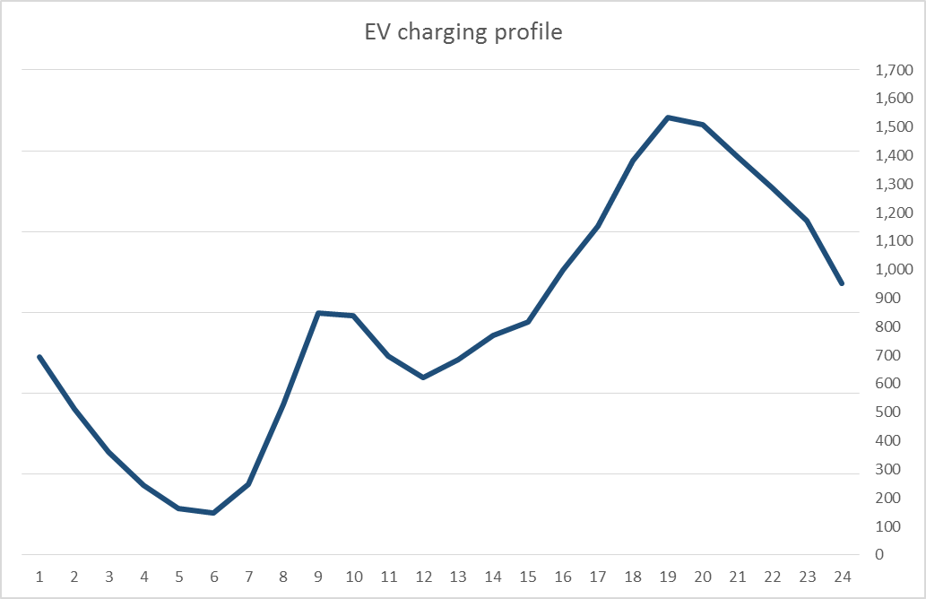
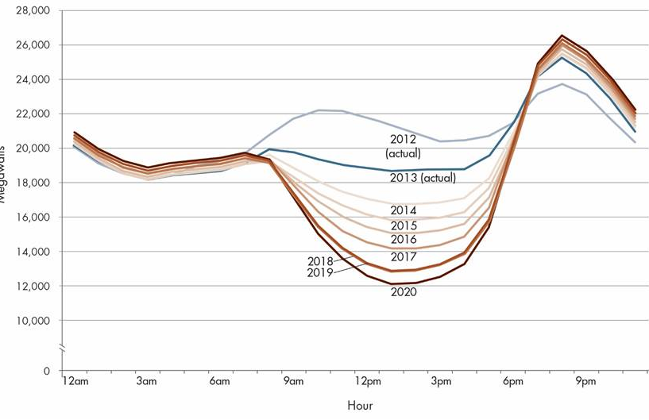
EV charging helps “Duck” depending on alignment
EV Home and Workplace charging

Slide 26

The Long Game: Unlocking the “Dividend” from California’s investment in renewables
California has invested $billions in renewables
A new “dividend:” Clean, plentiful energy that can electrify a low-carbon economy
New consumption opportunities for consumers:
  Electric vehicle charging
  Industrial processes
  Cooking and heating
  Bulk and local energy storage
Then…incent these sectors to provide grid balancing services

Slide 27
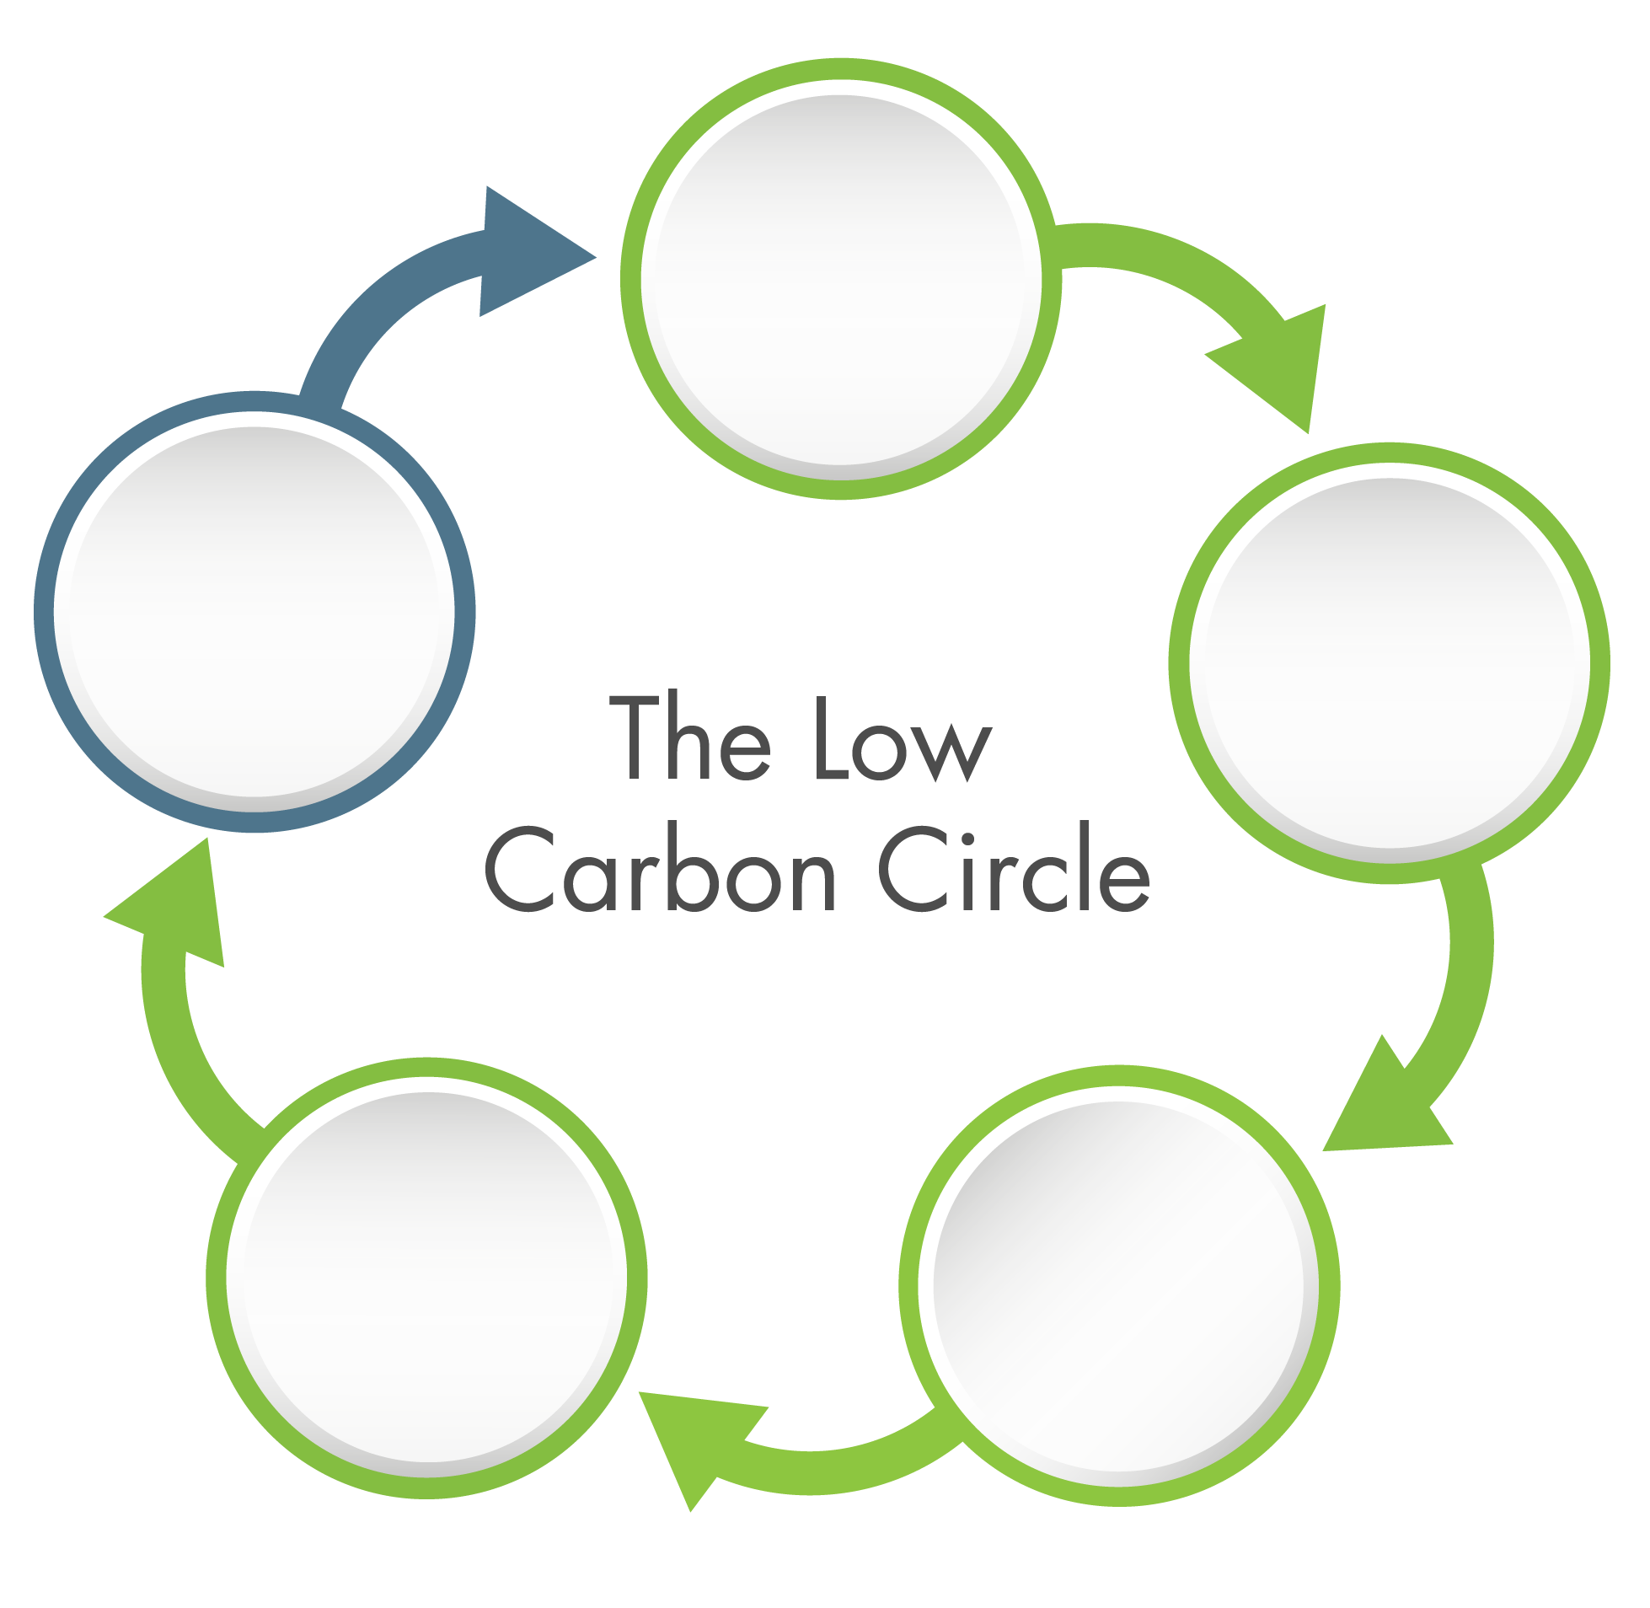
Bringing it all together…
Decarbonize
Bulk Grid
Regionalize
for Visibility & Control
Decentralize
Supply
Enable Sectors to Provide Grid Services
Electrify/
Decarbonize
other Economic Sectors

Slide 28
appendix

Slide 29
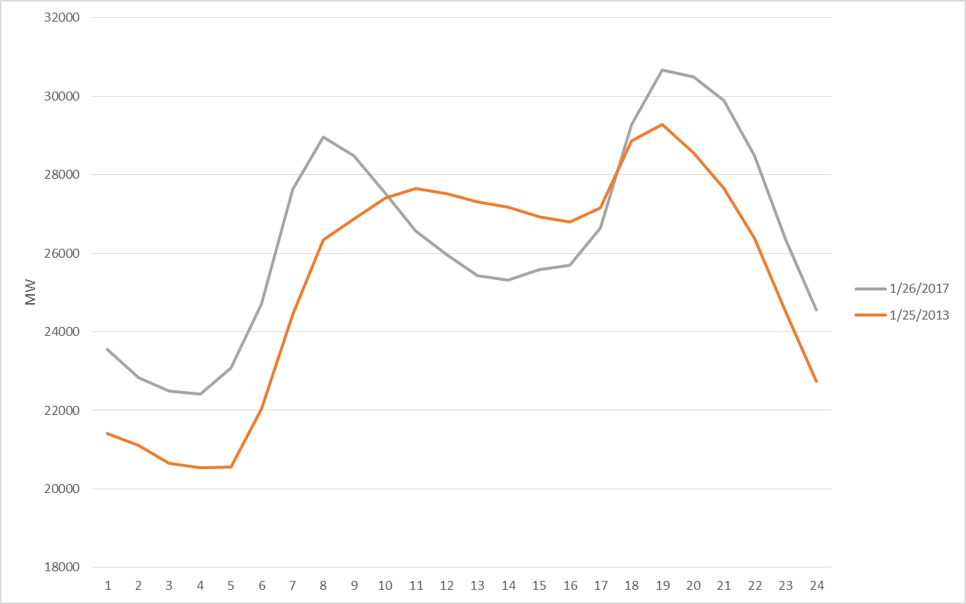
Distributed generation by itself is having significant impact on the actual load curve

Slide 30
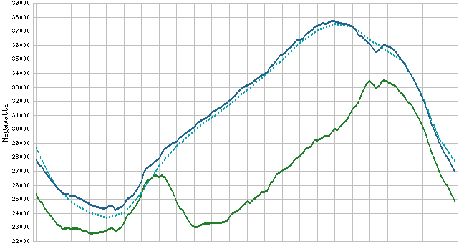
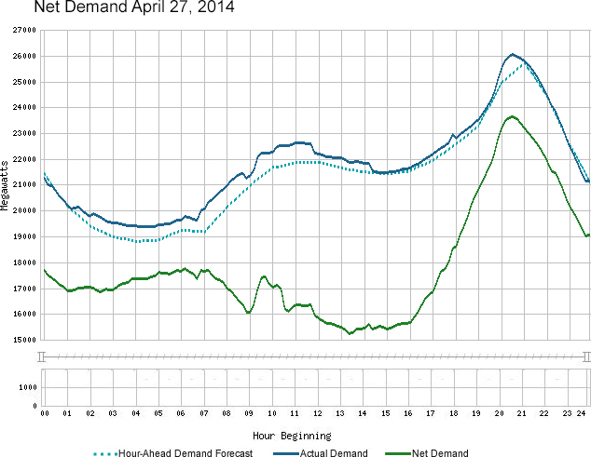
Solar and wind production is shifting the use pattern of conventional resources on peak demand days
Net Demand
The net demand curve depicts the variability in demand and wind and solar supply that the ISO must meet to maintain grid reliability. Net demand is calculated by taking the actual demand and subtracting the electricity produced by wind and solar resources that are directly connected to the ISO grid.
September 1, 2016

Slide 31
Energy transfers in 1st quarter, 2017
PSEI
$15.5
Avg – 80MW
Max – 300MW
Avg – 0MW
Max – 0MW
Avg – 118MW
Max – 300MW
PACW
$17.6
PACE
$17.7
Avg – 108MW
Max – 300MW
Avg – 165MW
Max – 909MW
Avg – 141MW
Max – 330MW
Avg – 144MW
Max – 857MW
Avg – 136MW
Max – 360MW
Avg – 173MW
Max – 506MW
PG&E
$24.7
NEVP
$21.8
Avg – 222MW
Max – 791MW
CAISO
Avg – 231MW
Max – 871MW
Avg – 0MW
Max – 0MW
SCE
$22.7
Avg – 84MW
Max – 150MW
Avg – 184MW
Max – 945MW
Avg – 259MW
Max – 1196MW
AZPS
$17.4
CAISO
SDGE
$24.5
Avg – 186MW
Max – 739MW
Notes:
For the first two days the transfer for the new APS and PSE areas were increased. We observe bi-directional transfers that reflect the economic opportunities.

Slide 32
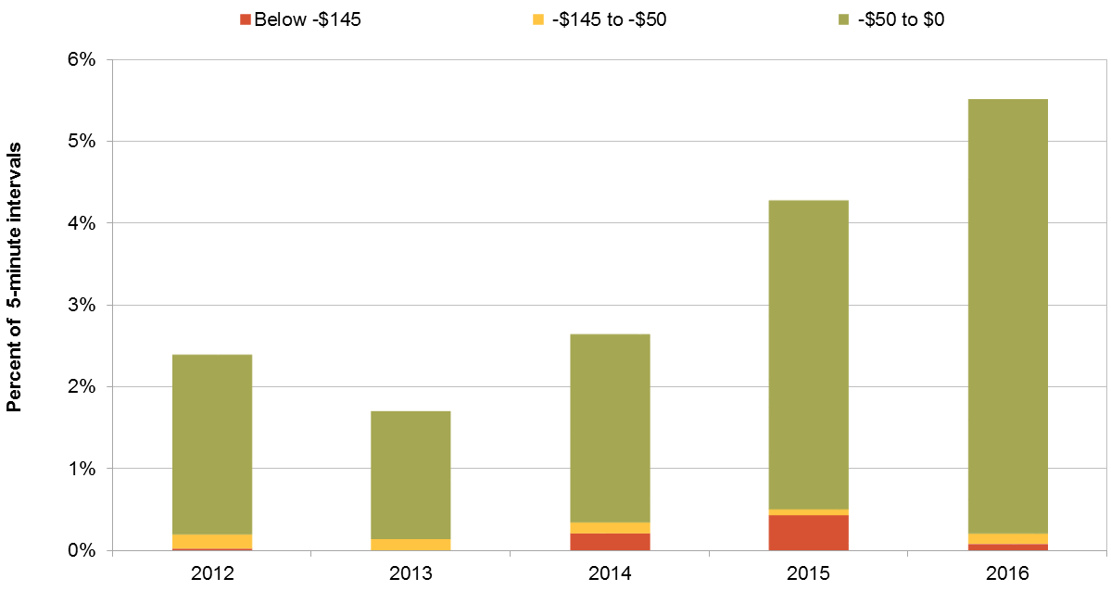
Increase frequency market clearing at negative

Slide 33
Example of how solar ramp affects real-time imbalance
∆1,500 MW

Slide 34
Time-of-Use Rates can align retail signals with system conditions

Slide 35
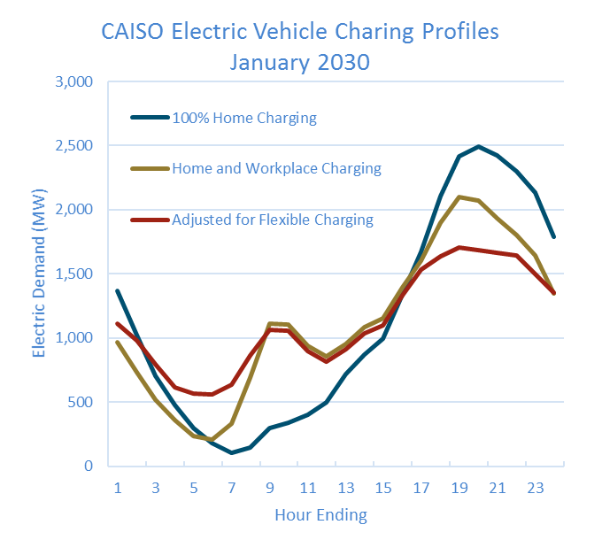
EV charging is not well aligned to help the “Duck”

