Slide 1

Joint Agency Workshop on the Increasing Need for Flexibility in the Electricity System
May 12, 2017

Slide 2
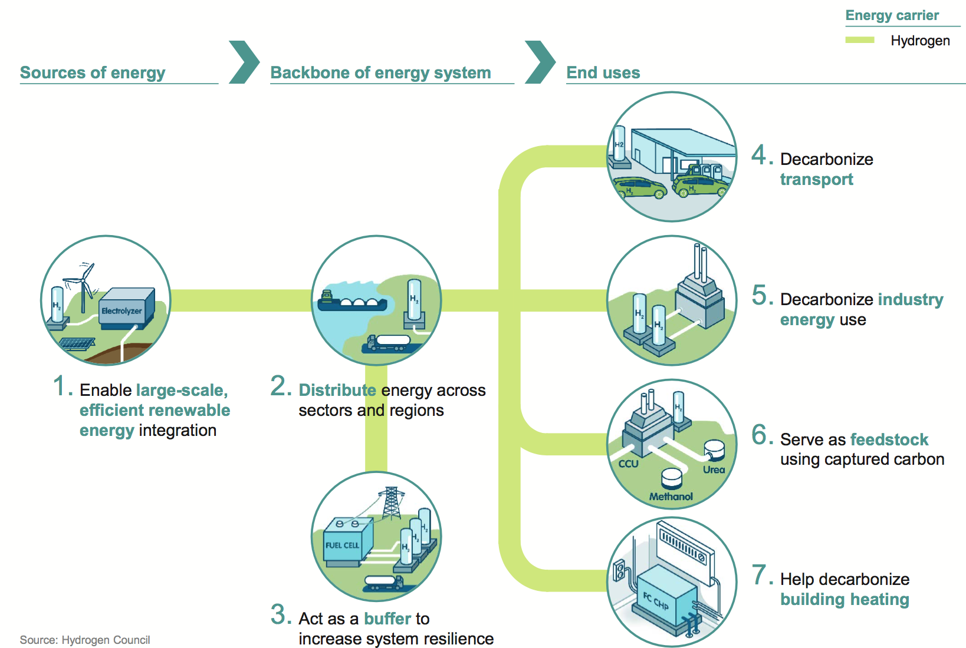
Hydrogen is the Pathway to Greater Electrification & Decarbonization

Slide 3
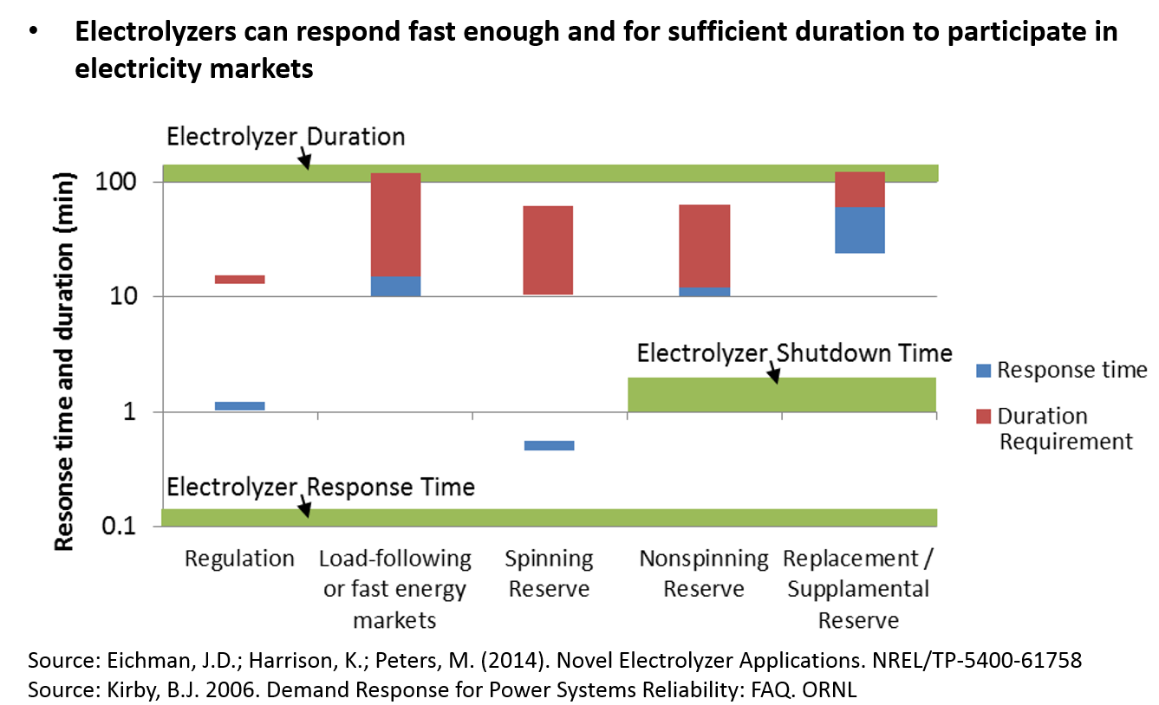
Hydrogen for Renewables Integration

Slide 4
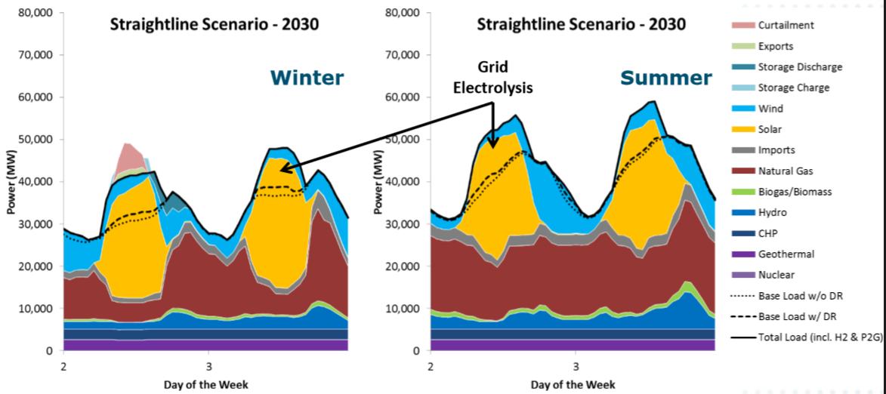
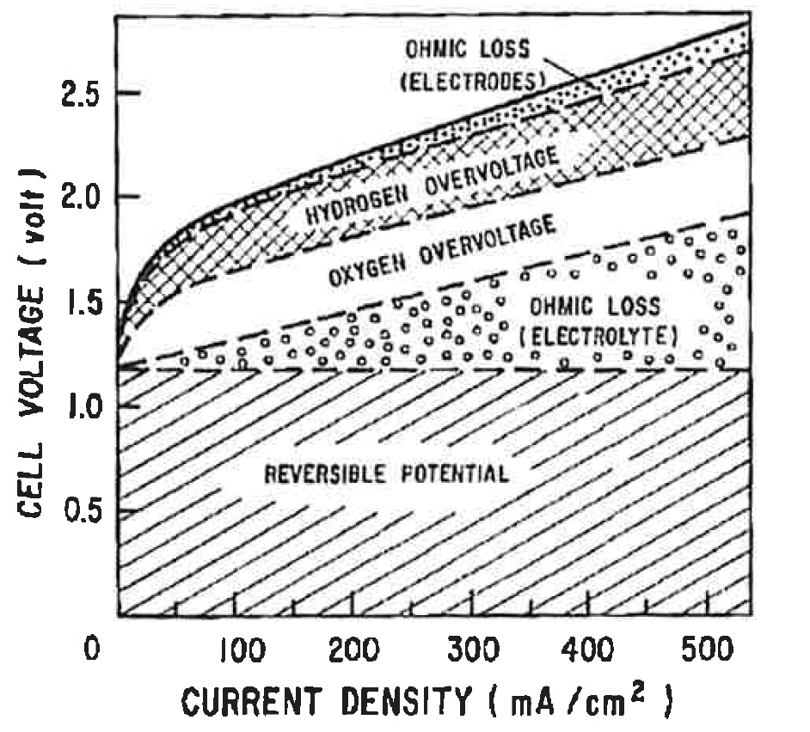
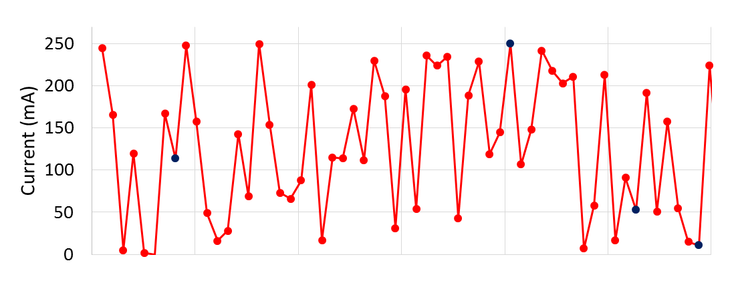
Hydrogen for Renewables Integration
Has the ability to capture real-time, diurnal, and seasonal variations
Example of California in 2030, Source E3
FLEX
2 Minute Renewable Variation

Slide 5
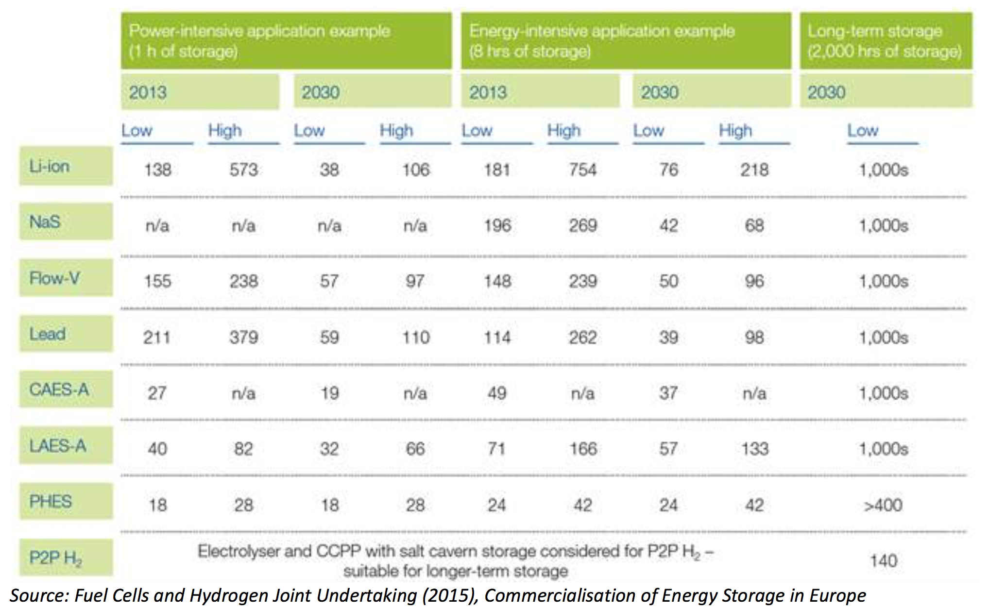
Hydrogen as Storage ($/kWh)
EU Commission: ’Energy Storage' means, in the electricity system, deferring an
amount of the electricity that was generated to the moment of use, either as
final energy or converted into another energy carrier.“

Slide 6
Thank you
Ivo Steklac, CEO
AquaHydrex
i.steklac@aquahydrex.com
(303) 246-4361

