Slide 1
ERCOT
Resmi Surendran
Sr. Mgr. Wholesale Market Ops and Analysis
May 12, 2017

Slide 2
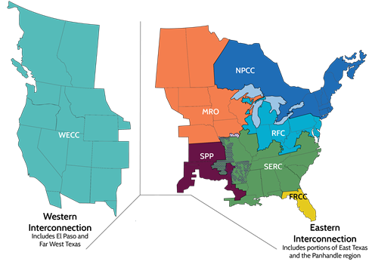


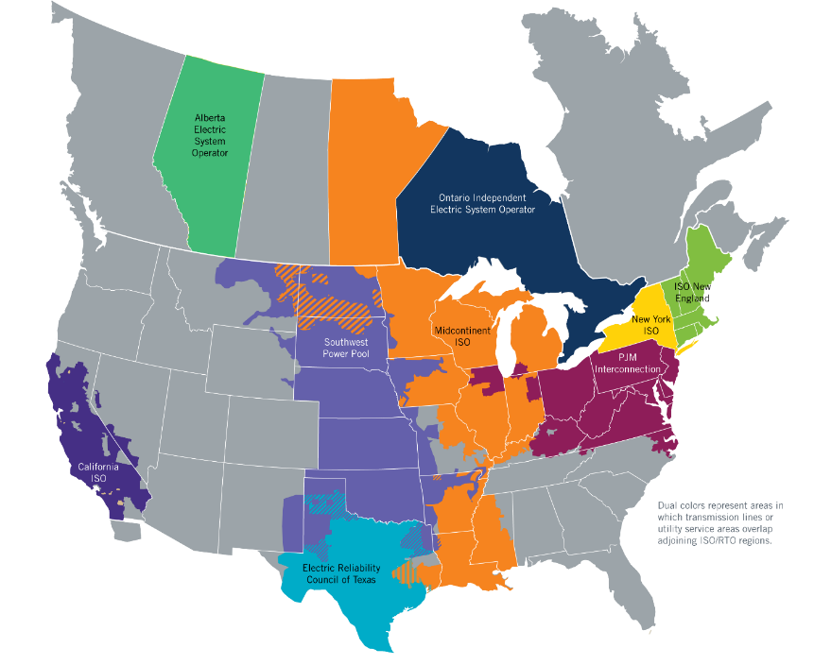
ERCOT Region
~91% of Texas load ~75% land
  24 million consumers
46,500 circuit miles of HV transmission
~78,000 megawatts (MW) capacity for peak
  570 generation resources
  ~18 GW Wind with ~14 - 58% capacity included
  ~550 MW solar ~77% capacity included
71,110 MW peak demand (Aug.11, 2016)
  Peak Wind: 16,141 MW (March 31, 2017)
  Wind penetration record: 50 percent (March 23, 2017)
~$35 billion market
220 MW with SPP
600 MW with SPP
30 MW with CFE
at Eagle Pass
100 MW with CFE
at Laredo
300 MW with CFE at McAllen

Slide 3
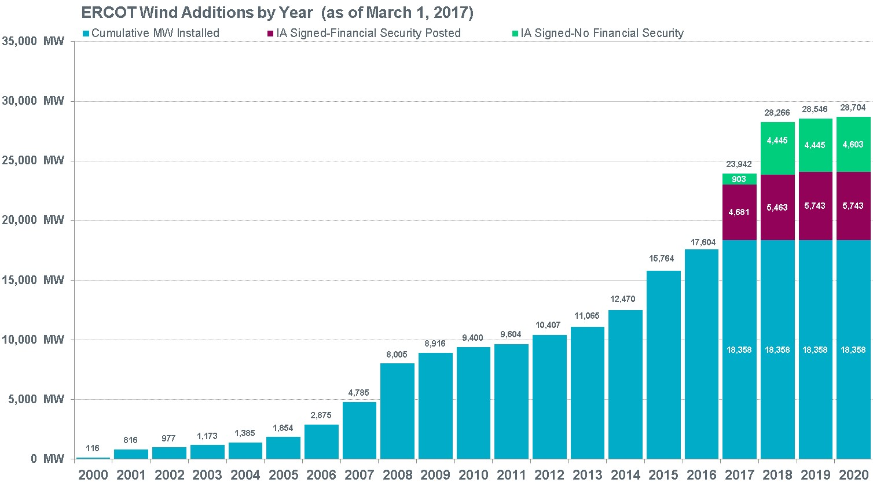
Wind Generation Capacity
Steady growth continues, with some spikes.
Largest annual increase: 3,294 MW in 2015
(A close second: 3,220 MW in 2008)
Incentives, uncertainty and other factors affect construction decisions and schedules.
Historically, not all planned projects are completed.
Texas continues to lead U.S. in wind capacity.
The data presented here is based upon the latest registration data provided to ERCOT by the resource owners and can change without notice. Any capacity changes will be reflected in current and subsequent years' totals. Scheduling delays will also be reflected in the planned projects as that information is received. This chart reflects planned units in the calendar year of submission rather than installations by peak of year shown.
Financial security posted for funding interconnection facilities does not include CREZ security deposits, which are refunded to the Interconnecting Entity when an IA is signed.

Slide 4
Challenges & Rules/Design Changes
Operational Challenges
Inadequate transmission for the wind growth
Large frequency deviations
Constraint management under high and low wind
Increased variability of net load forecast error and net load ramps
Voltage issue
Reduced inertial response
Special Rules and Design Changes
Running RT market every 5 minutes based on current wind
Economic curtailment of wind (proxy offers at -$250)
Phase Shifter optimization in DAM/RUC for wind management
Ramp limitations
Frequency response requirement
Increased Ancillary Services

Slide 5
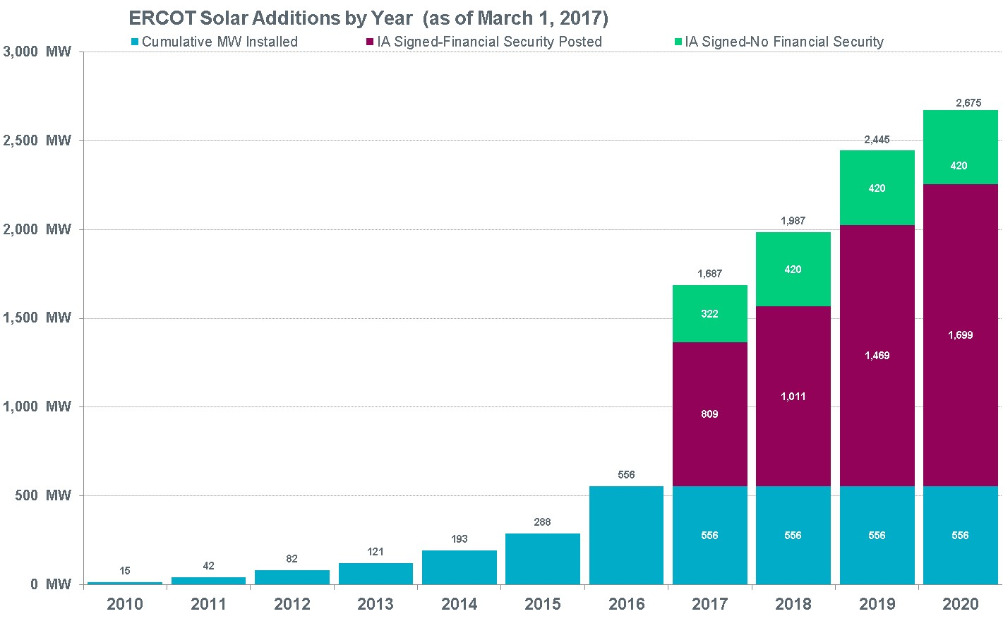
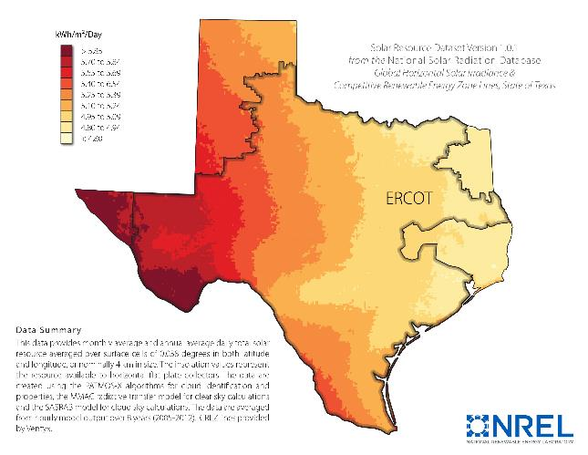
Utility Scale Solar Generation Capacity – February 2017
Utility-scale solar still in early stages in ERCOT
Nearly doubled in 2016; largest increase so far
Potentially fastest-growing resource in future
Incentives, uncertainty and other factors affect construction decisions and schedules.
Historically, not all planned projects are completed.
2,675
The data presented here is based upon the latest registration data provided to ERCOT by the resource owners and can change without notice. Any capacity changes will be reflected in current and subsequent years' totals. Scheduling delays will also be reflected in the planned projects as that information is received. This chart reflects planned units in the calendar year of submission rather than installations by peak of year shown.

Slide 6

Questions?
resmi_surendran@ercot.com

Slide 7
Generation Interconnection Studies

Slide 8
Changing Resource Mix
Notes:
Renewable is increasing. Market HR has shifting from Gas Steam (10) to Gas CT/CCs (7)
Coal capacity still almost same.. But % energy produced decreased a lot.. Mostly taken by CCs

Slide 9
Reliability Challenges for Distribution Level Solar
Volatility and uncertainty of fuel source
  Uncertainty in ramp requirements
  Frequency excursions
  Congestion management problems
Lack of Visibility, Controllability and Dispatchability
  Uncertainty on transmission-level congestion management;
  Load Forecast accuracy
  Uncertainty in Ancillary Service needs
  Less accurate inputs to the State Estimator and Load Adaptation
  Inaccurate Load Distribution Factors (LDFs)
Evolving state of voltage and frequency standards
  Lower reactive power
  Lower voltage control
  Reduced dynamic response to faults
  Coordination of system restoration
Notes:
inherent uncertainty in the magnitude and timing of the ramps required due to high solar penetration.
Degradation of value of soalr if it needs to be curtailed to maintain relailbity. This loss of value could be stopped by increasing system flexibility through enhanced control of variable-generation resources, added energy storage, and motivating electricity consumers to shift consumption to lower-demand periods
Adv
reduced line losses
http://www.vox.com/2015/6/19/8808545/wind-solar-grid-integration
http://greeningthegrid.org/quick-reads
https://ec.europa.eu/energy/intelligent/projects/en/projects/pv-grid
http://energy.gov/eere/sunshot/systems-integration

