Slide 1
Geothermal as a Flexible Resource
May 12, 2017

Slide 2
Disclaimer
Information provided during this presentation may contain statements relating to current expectations, estimates, forecasts and projections about future events that are forward-looking statements as defined in the Private Securities Litigation Reform Act of 1995.
These forward-looking statements generally relate to the company’s plans, objectives and expectations for future operations, and are based on management’s current estimates and projections of future results or trends. Actual future results may differ materially from those projected as a result of certain risks and uncertainties.
For a discussion of such risks and uncertainties, please see risk factors as described in the Annual Report on Form 10-K filed with the Securities and Exchange Commission on March 1, 2017.
In addition, during this presentation, statements may be made that include a financial measure defined as non-GAAP financial measures by the Securities and Exchange Commission, such as EBITDA and adjusted EBITDA. These measures may be different from non-GAAP financial measures used by other companies. The presentation of this financial information is not intended to be considered in isolation or as a substitute for the financial information prepared and presented in accordance with GAAP.
Management of Ormat Technologies believes that EBITDA and adjusted EBITDA may provide meaningful supplemental information regarding liquidity measurement that both management and investors benefit from referring to this non-GAAP financial measures in assessing Ormat Technologies’ liquidity, and when planning and forecasting future periods. This non-GAAP financial measures may also facilitate management’s internal comparison to the company’s historical liquidity.
EBITDA and Adjusted EBITDA are not a measurement of financial performance or liquidity under accounting principles generally accepted in the United States of America and should not be considered as an alternative to cash flow from operating activities or as a measure of liquidity or an alternative to net earnings as indicators of our operating performance or any other measures of performance derived in accordance with accounting principles generally accepted in the United States of America. EBITDA and Adjusted EBITDA are presented because we believe they are frequently used by securities analysts, investors and other interested parties in the evaluation of a company’s ability to service and/or incur debt. However, other companies in our industry may calculate EBITDA and Adjusted EBITDA differently than we do.
Copyright © 2017 Ormat Technologies, Inc. All Rights Reserved. This document contains information proprietary to Ormat Technologies, Inc. Reproduction in any form without prior written permission is strictly prohibited

Slide 3
Geothermal Power in a High Intermittent Renewables Mix - Firm, Flexible and GHG-Free
Fast ramping
  15-30% of net nameplate per minute
  Multiple cycles per day
Flexibility and ancillary services
  Flexible capacity
  Spinning reserve
  Regulation up and down
  Voltage regulation

Slide 4
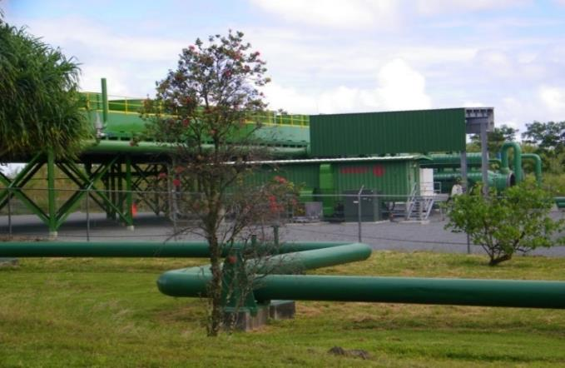
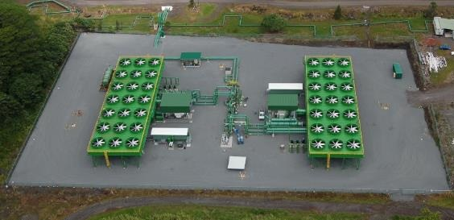
Dispatchable Geothermal Case Study:
38 MW Puna Geothermal Venture
Big Island, Hawai’i
Dispatchable energy
Automatic Generator Control (AGC)
Remotely and automatically controlled by HELCO System Operator
Dispatch: 22 ~ 38 MW
Ramp rate up or down: 2 MW / minute
Spinning reserve at all times: 3 MW

Slide 5
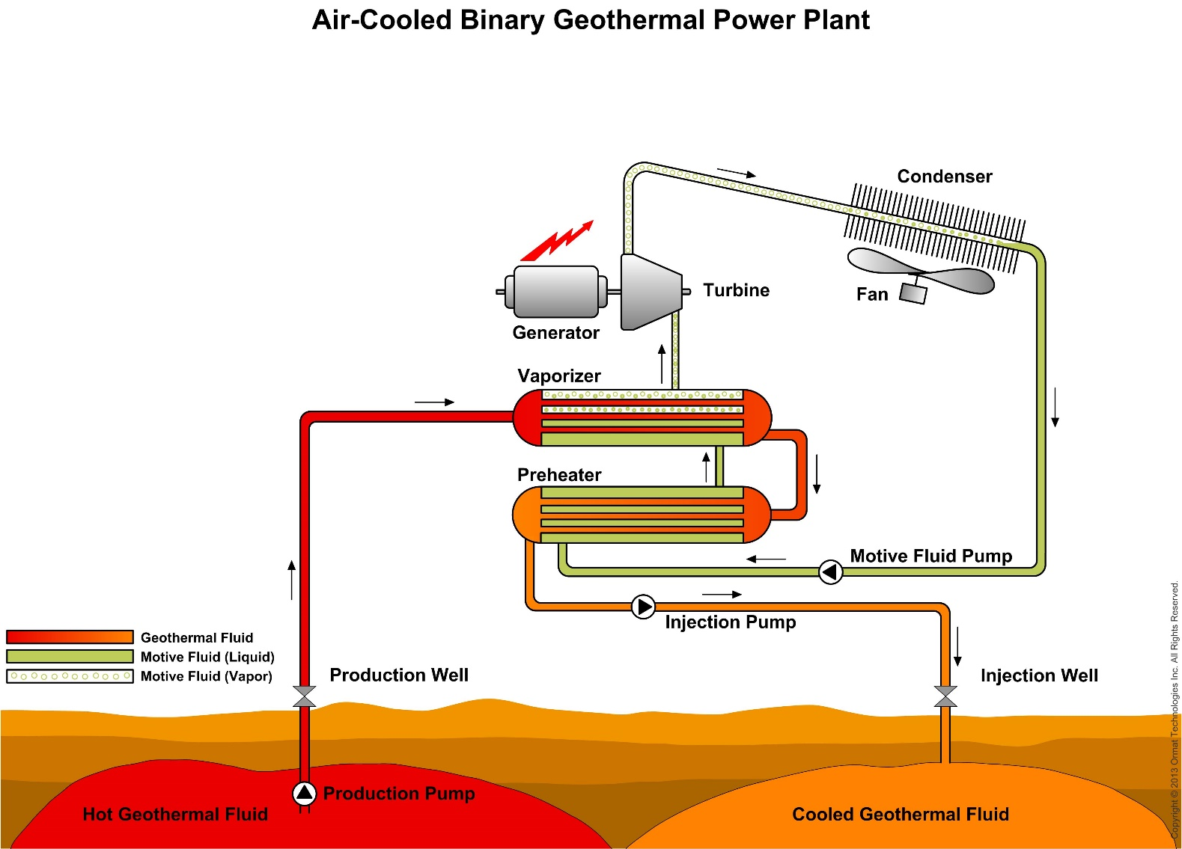
How It Works

Slide 6
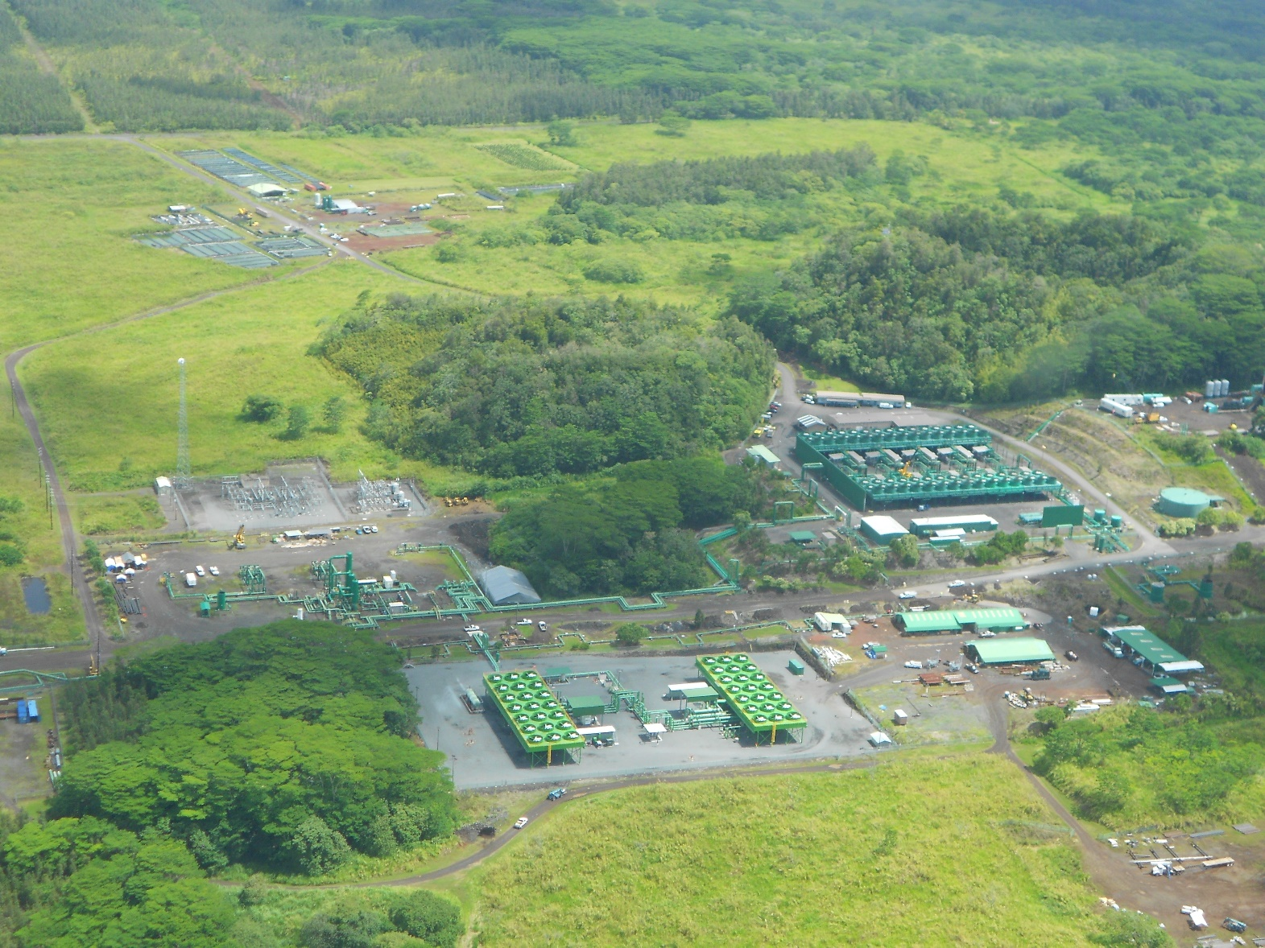
Thank You!
For further information: www.ormat.com / info@ormat.com

