Slide 1
Calpine flexibility solutions
May 12, 2016

Slide 2
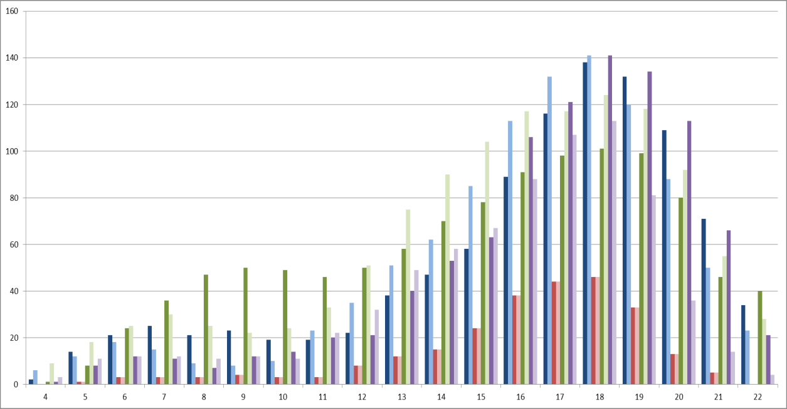
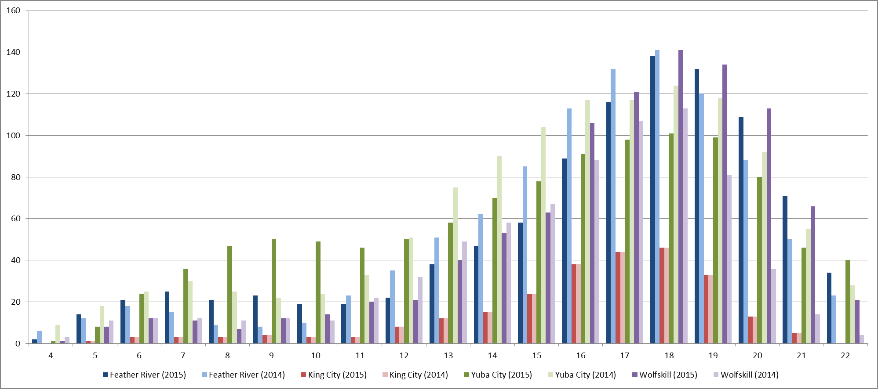
CTs
CTs are used frequently but for few hours to meet net load peaks
Of the four units represented below, the CAISO indicated its intent to designate two for RMR contracts and we currently plan to remove the other two from service
Number of Days Dispatched by Hour in 2014 & 2015

Slide 3
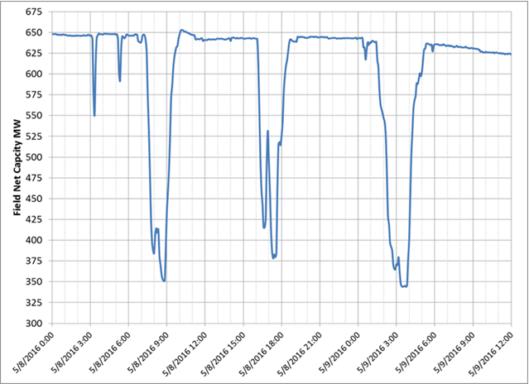
Geothermal
Geysers already capable of dropping 400+ MW for up to 4 hours
CEC grant to explore flexibility enhancements

Slide 4
CCGTs
Flexibility enhancements available at modest cost

Slide 5
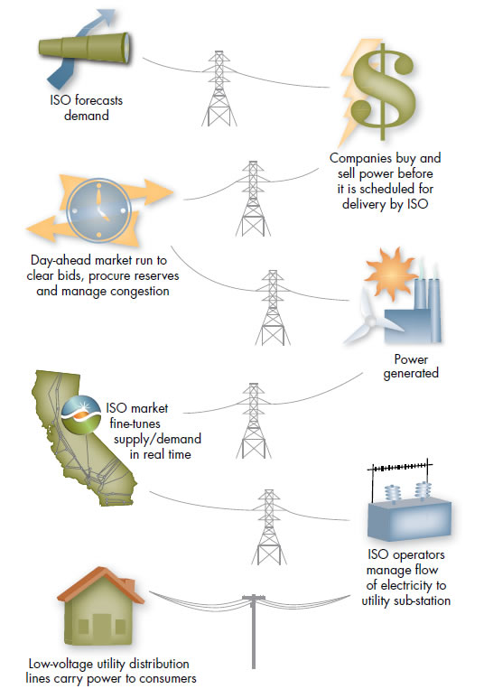

CHP
LOS MEDANOS
Min Load: 190 MW
Load: 30 MW
Los Medanos serves ~60 MW of behind-the-meter load
Current standby tariff encourages uneconomic operation
Exploring potential solutions with PG&E
DOW
GEN TAKEN OFF GRID
X
X
RING BUS
M
POSCO
X
M
Load:
30 MW
X
M
130 MW
RENEWABLE OVERGEN
NEGATIVE LMP
Eliminates 130 MW of excess natural gas generation and GHG emissions off the grid
Adds 60+ MW of industrial load to the grid to absorb the solar
Total impact is nearly 200 MW of avoided renewable curtailments

