Slide 1
Transportation Electrification
Guidance for Publicly Owned Utilities’
Integrated Resource Plans
April 27, 2017
Noel Crisostomo, Air Pollution Specialist
Fuels and Transportation Division
California Energy Commission

Slide 2
Outline
Policy Background and Objective for Transportation Electrification Planning
Recommended Information, Data, and Reports
Thematic Questions for Today’s Discussion

Slide 3

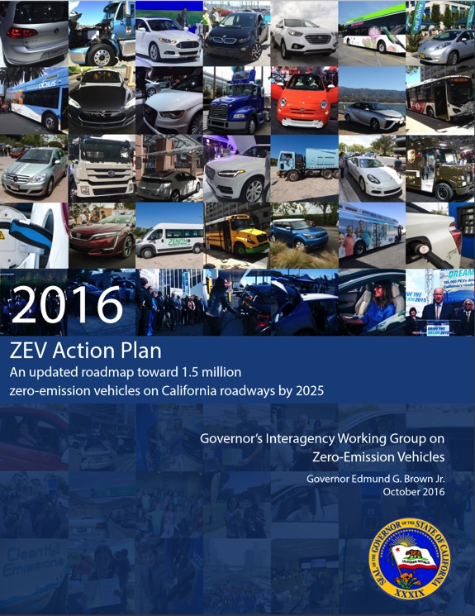
B-16-2012* orders agencies to Establish Benchmarks for a transformation toward Zero-Emission Vehicles
CEC is helping to achieve by 2020:
Infrastructure supporting 1M ZEV
Cost competitiveness
Mainstream accessibility
Widespread transit & freight ZEV
Reduced Transportation GHG
Grid-Integrated charging
Expanding private sector role
*and supplemented by B-32-15 and the Sustainable Freight Action Plan

Slide 4
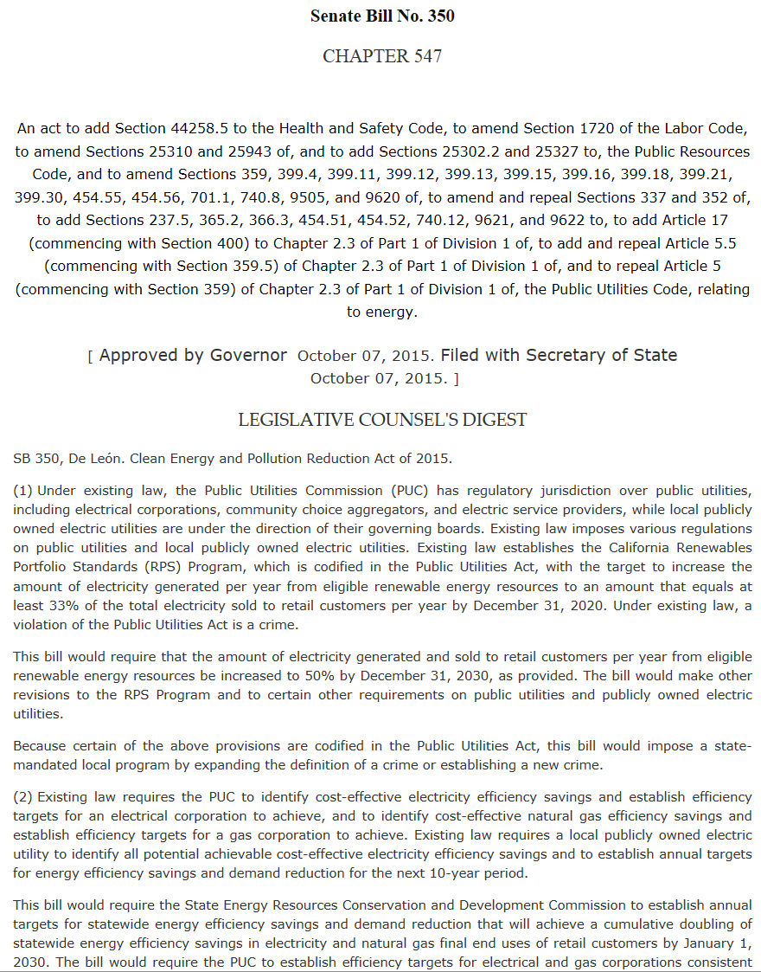
SB 350 requires POU consideration of Transportation Electrification in their Integrated Resource Plans
Publicly-Owned Utilities “shall address procurement for …Transportation Electrification...”
Meet goals of P.U. Code §454.52 (a)(1)(C) through (H)
“CEC may adopt guidelines to govern the submission of information and data and reports needed to support the CEC’s review…”

Slide 5

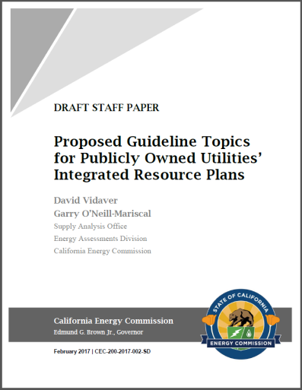
POUs can provide indispensable contributions to Transportation Electrification in CA with their IRPs
Staff recommends the following information, data, and reports to serve as a best practice benchmark for the POUs in order to support charging infrastructure that is integrated with the electricity grid and enables widespread transportation electrification and GHG and air pollution emissions reductions.

Slide 6
Transportation Electrification Recommended Data Information, and Reports
In developing these guidelines, Staff recognizes:
  Gathering and analyzing this information requires additional time and resources.
  The need to account for POU diversity in priorities, capabilities, resources, and technology.
  POUs’ electrification analyses, preparations, and accommodation of customer loads will entail an evolving, ongoing process.
  We welcome your ideas to explore how CEC can support the POUs’ individual progress toward widespread transportation electrification.
For detail, please refer to the Staff Proposal

Slide 7
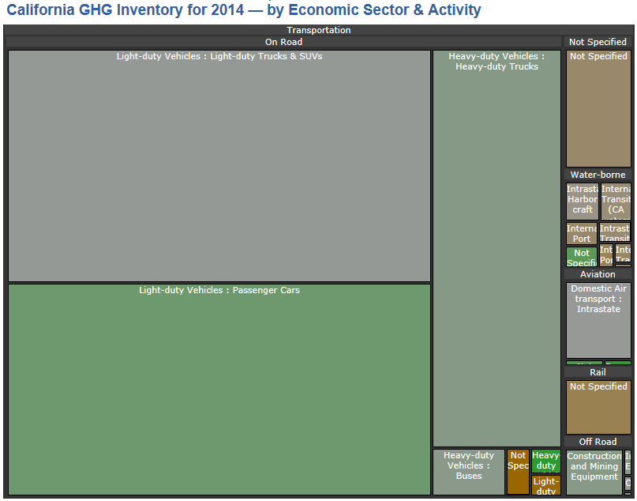
1. Quantification, Characterization, and Location
Number and types of TE, charging, & customers
Incremental Load & Tariffs
GHG & Air Pollution Methodology, aligned to ARB Inventory
Greenhouse Gas Emission Inventory - Air Resources Board

Slide 8
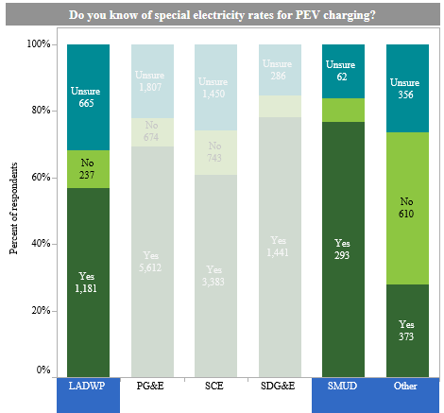
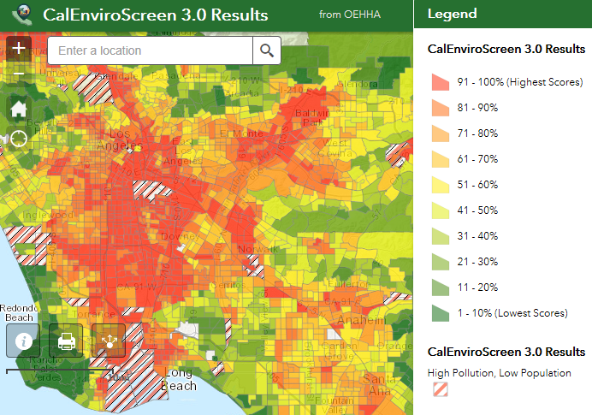
2. Transportation Electrification Programs
Investments, incentives, tariffs/rates, or programs
Specify market barriers & proposed solutions
Prioritization of Disadvantaged Communities
Center for Sustainable Energy
CA OEHHA

Slide 9
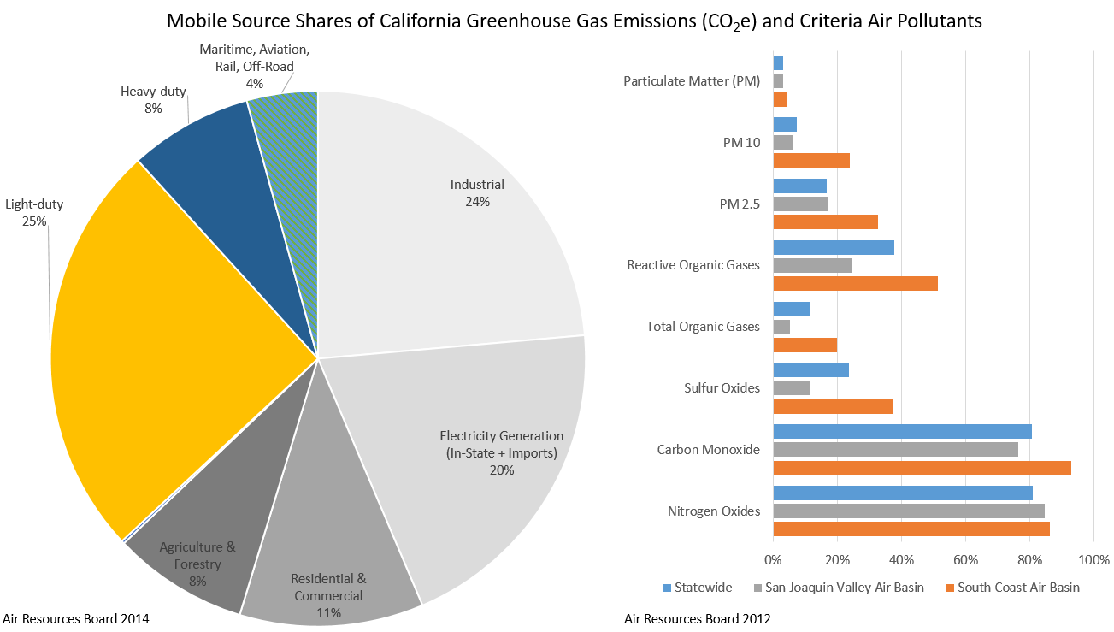
3. Prioritization and Funding Leverage
Design accounting for POU-specific emissions inventory
Alignment with State incentives (e.g. ARFVTP, AQIP, etc.)
Private, Local, or Federal leverage to mitigate rate impacts

Slide 10
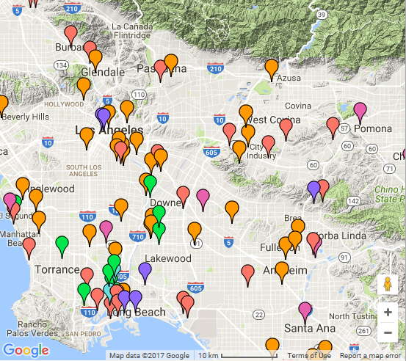
4. Education and Outreach Plans
Efforts to engage with customers on TE Programs
Specify focus on coordinating with facilities accounting for large portions of mobile-source GHG or Air Pollutants within the service territory.
Integrated Emissions Visualization Tool - Air Resources Board

Slide 11
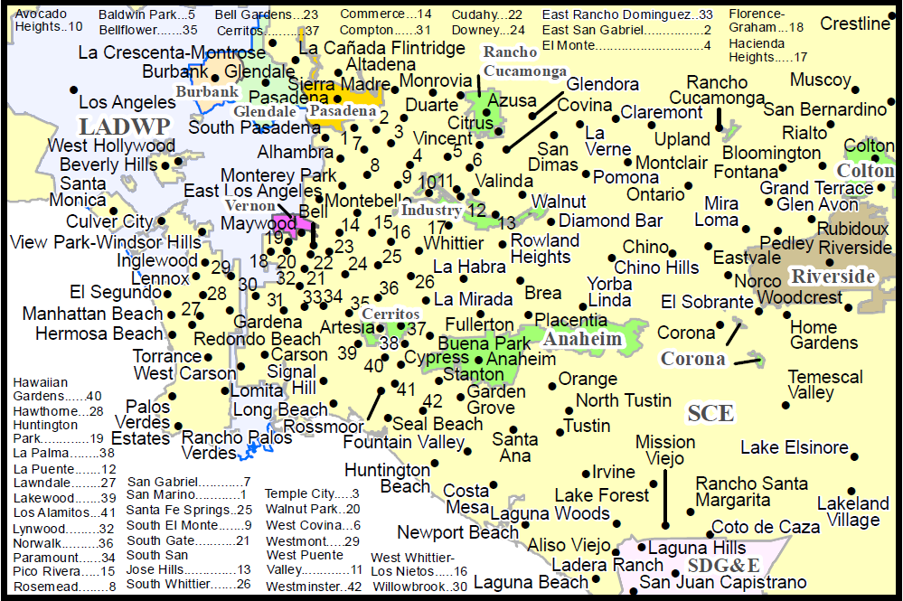
5. Alignment with State Policy and Local Needs
ZEV Action Plan, Mobile Source Strategy, Sustainable Freight, Vehicle-Grid Integration Roadmap Coordination
Efforts to coordinate across utilities to meet regional infrastructure needs, ensure interoperation & accessibility
California Energy Commission

Slide 12
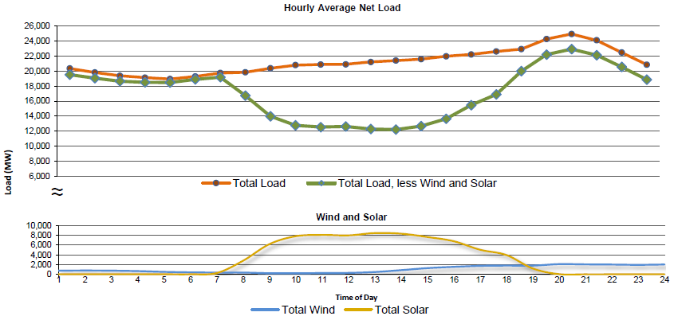
6. Coordination with Distributed Energy Resources
Description of TE Programs with DER planning efforts to ensure charging behaviors are consistent with electrical grid conditions.
Msg. Peak Rates
Dispatch DR
Add Charging
California Independent System Operator

Slide 13
Thematic Questions for Today’s Discussion
What about the Benchmarks and Guidance…
  Is helpful or unhelpful in planning for Transportation Electrification?
  Can be used to inform changing grid operations?
  Can most effectively be used to communicate your contributions to meeting State goals and needs for assistance?
  Would be better enhanced by referencing other reporting or modeling conventions?
  Can be made consistent across the utilities to enable (appropriate) head-to-head comparisons?
  Should be treated carefully to account for the evolving electric transportation industry?
  More discussions will follow during the afternoon panel…

Slide 14

energy.ca.gov/transportation
Questions, comments, and feedback welcome.
noel.crisostomo@energy.ca.gov

