Slide 1
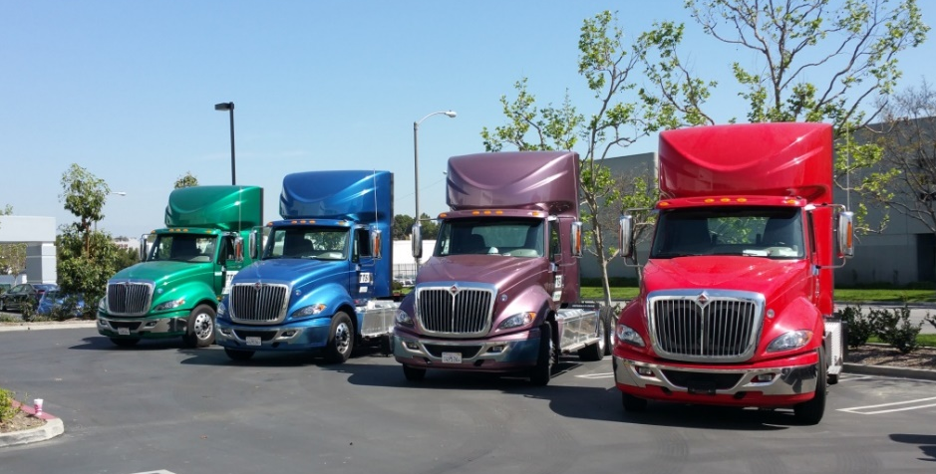
Technology Advancement Program
Demonstration Projects
Naveen Berry
Technology Demonstration Manager, SCAQMD
April 27, 2017

Slide 2
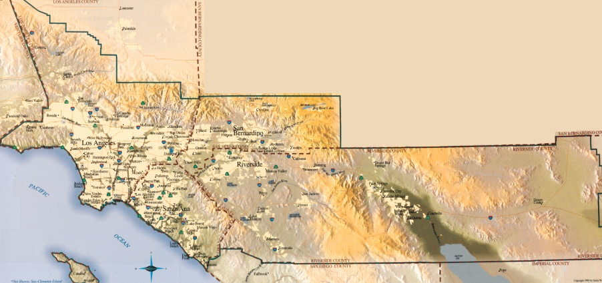
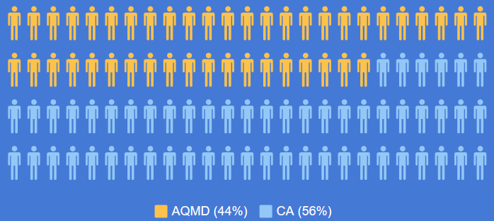
South Coast Air Quality Management District
4 Counties
Los Angeles
Orange
Riverside
San Bernardino
44% of
State’s Population

Slide 3
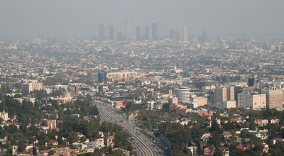
Challenges

Slide 4
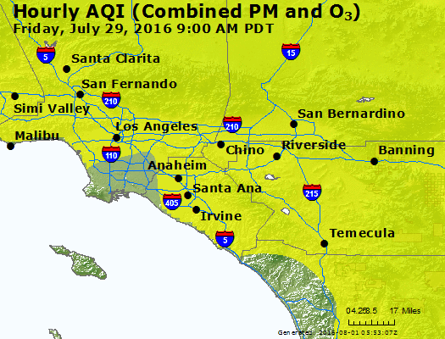
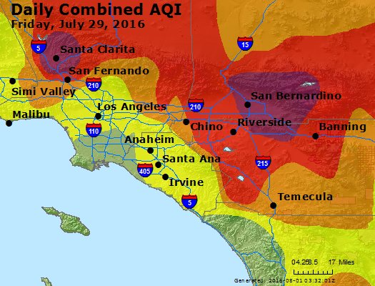

Slide 5
NOx Reductions Needed
43-55%

2023
2023
2032
2032
5

Slide 6
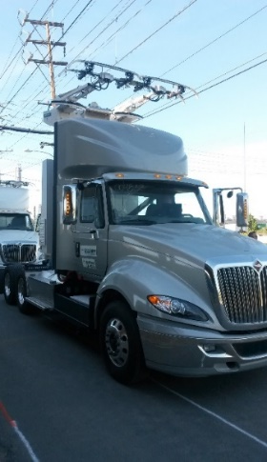


2016 AQMP
National Ambient Air Quality Standard
  2008 8-hr Ozone – 75 ppb
  More recently – 70 ppb standard adopted
Comprehensive Blueprint
  NOx reduction strategy
  Closely aligned with CARB’s Mobile Source Strategy
  Primary focus on on-road and 0ff-road sources
  Continued focus on stationary sources
  Relies heavily on Incentive Funds available
    California Energy Commission – AB118 Funds
    Prop 1B
    Carl Moyer
  http://www.aqmd.gov/home/library/clean-air-plans/air-quality-mgt-plan

Slide 7
2016 AQMP
District Mobile Source Measures
All Feasible Measures
EGM-01: Emission Reductions from New or Redevelopment Projects
Goods Movement Related Facilities
MOB 01: Emission Reductions at Commercial Marine Ports
MOB 02: Emission Reductions at Rail Yards and Intermodal Facilities
MOB 03: Emission Reductions at Warehouse Distribution Centers
MOB 04: Emission Reductions at Commercial Airports

Slide 8
2016 AQMP
District Mobile Source Measures
On-Road Measures
MOB 05: Accelerated Penetration of On-Road Partial Zero-Emission and Zero- Emission Light- and Medium-Duty Vehicles
MOB 06: Accelerated Retirement of Older On-Road Light-Duty and Medium-Duty Vehicles
MOB 07: Accelerated Penetration of Zero- and Near-Zero Emission On-Road Light- and Medium-Heavy-Duty Vehicles
MOB 08: Accelerated Retirement of Older On-Road Heavy-Heavy-Duty Vehicles
Off-Road Measures
MOB 10: Extension of the SOON Provision
MOB 11: Extended Exchange Program
MOB 12: Further Emission Reductions from Passenger Locomotives

Slide 9
2016 AQMP
District Mobile Source Measures
Mobile Source Emission Reduction Credit Generation
MOB 09: On-Road Mobile Source Emission Reduction Credit Generation Program
MOB 13: Off-Road Mobile Source Emission Reduction Credit Generation Program
General Mobile Source Incentives Programs
MOB 14: Emission Reductions from Incentives Programs

Slide 10
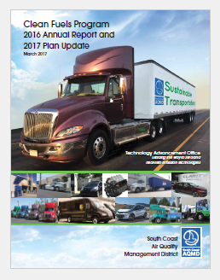
Clean Fuels Program
Annual Report on Clean Fuels Program
(HSC 40448.5.1)
Technology Advancement Plan (Update)
(HSC 40448.5)
Annual public hearing to approve Annual Report and adopt final Plan Update
Submit to Legislature by March 31 every year
18
Notes:
California Legislature, when they created the Clean Fuels Fund, required an annual report for the prior year and plan update to be submitted by the end of March.

Slide 11
2017 Plan Update
$16.5M
19

Slide 12
Zero Emission Trucks Demonstration
Approach/Objectives
Develop HD truck technologies with zero emission operation capability
  Leverage state and federal funding programs
  Collaborate with regional and industry stakeholders
  Engage large truck OEMs
  Leverage previous and on-going projects
Demonstrate in real world drayage operation with fleet partners
  Assess technical and commercial viability
  Promote market acceptance

Slide 13
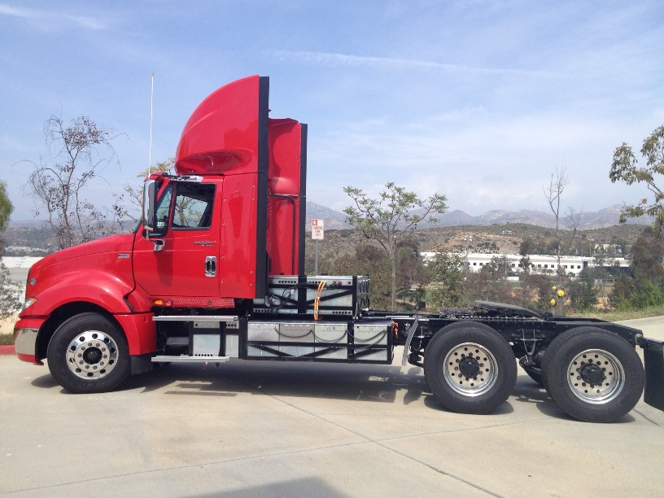
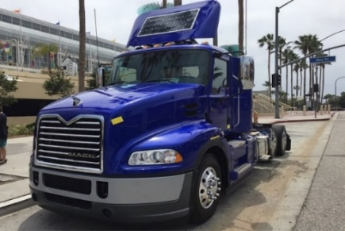
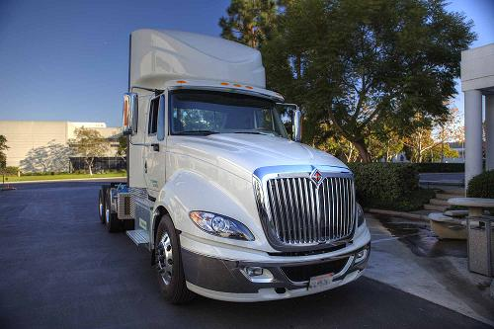
Demonstration Portfolio
Architecture | ZECT I | eHwy | ZECT II | GGRF | Total
BEV | 6 | 1* |  | 37 | 44
PHEV | 5 | 2* | 1* | 6 | 14
FCEV |  |  | 6 |  | 6
 | 11 | 3 | 7 | 43 | 64
*Catenary trucks

Slide 14
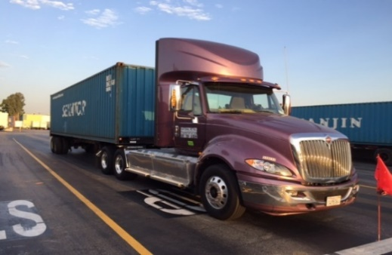
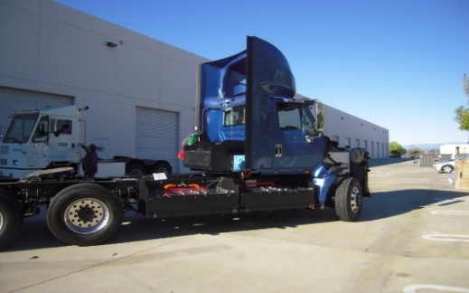
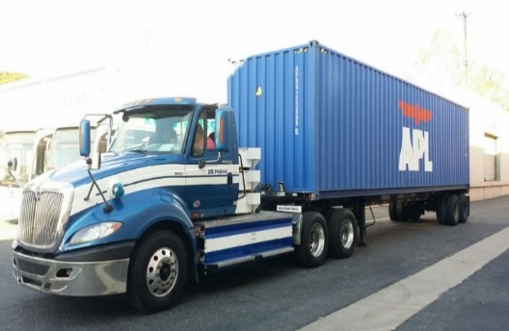
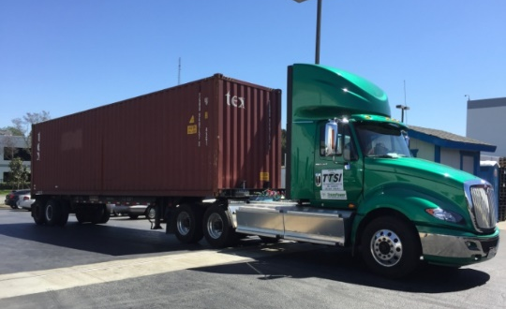
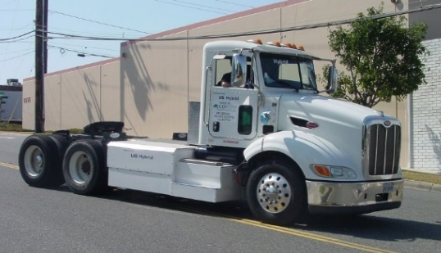
Zero Emission Cargo Transport I & II
18 Trucks
BEV: 70-100 mi
FCEV: 150-200 mi
PHEV: 30-40 mi/150-250 mi
OEMs
Kenworth, Freightliner
Integrators
BAE Systems, TransPower,
US Hybrid, Hydrogenics
Funding Partners
DOE, CEC, POLA, POLB,
LA DWP, SoCalGas
Status
Four BEV trucks in deployment
Four more by Q1 2017

Slide 15

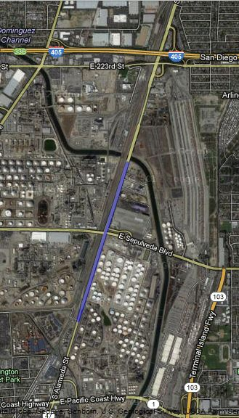
eHighway
3 Trucks
Diesel hybrid, CNG hybrid
Battery electric
OCS Infrastructure
Approx. one mile along
Alameda St. in Carson
OEMs
Siemens, Volvo
Integrator
TransPower
Funding Partners
EPA, CEC, POLA, POLB,
LA METRO
Status
OCS line under construction
Demonstration to begin in
Q1 2017

Slide 16

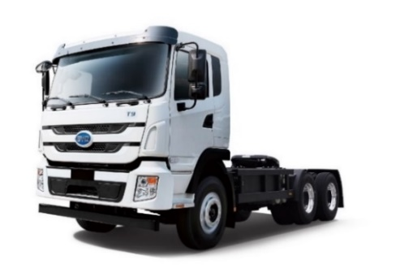
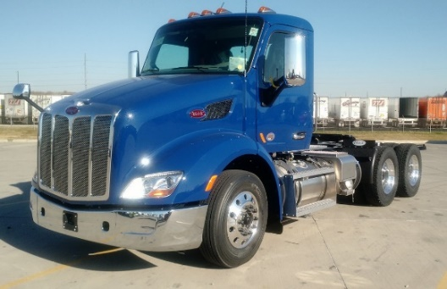
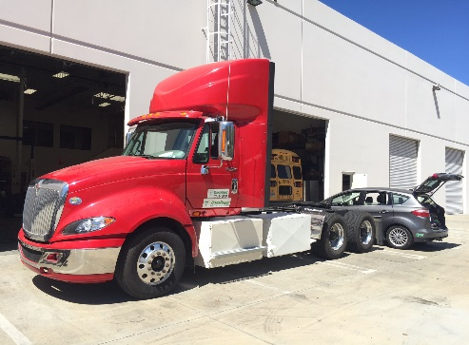

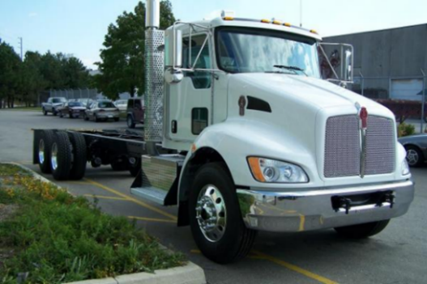
Greenhouse Gas Reduction Fund
43 Trucks
BEV: 70-150 mi
PHEV: 10-30 mi/150-300 mi
OEMs
BYD, Kenworth,
Peterbilt, Volvo
Integrators
BAE Systems, TransPower
Funding Partners
CARB, BAAQMD, SJVAPCD,
SDAPCD, SDG&E
Status
Contracts being processed
Demonstration to begin in Q1/Q2 2017

Slide 17
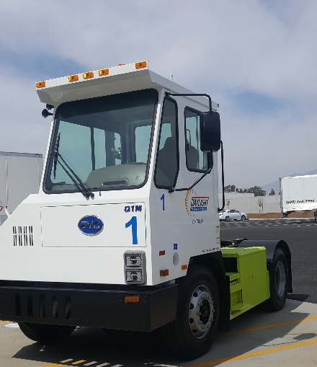
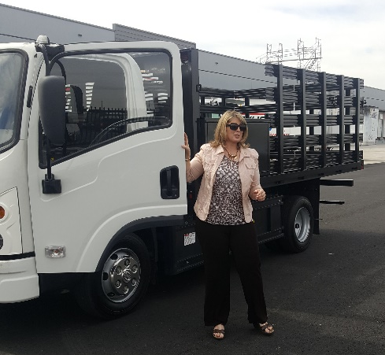
Greenhouse Gas Reduction Fund
27 Yard Tractors/Solar Panels/Medium-Duty Trucks
OEMs
BYD
Status
7 Deployed at DayLight Transportation
10 at BNSF in San Bernardino & 10 in Los Angeles

Slide 18
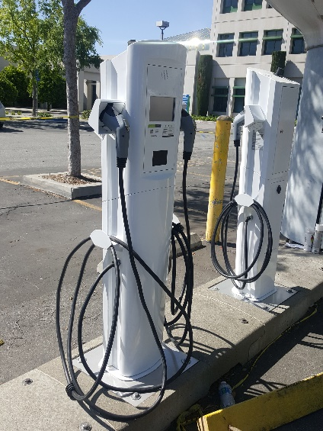
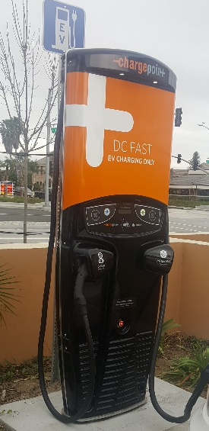
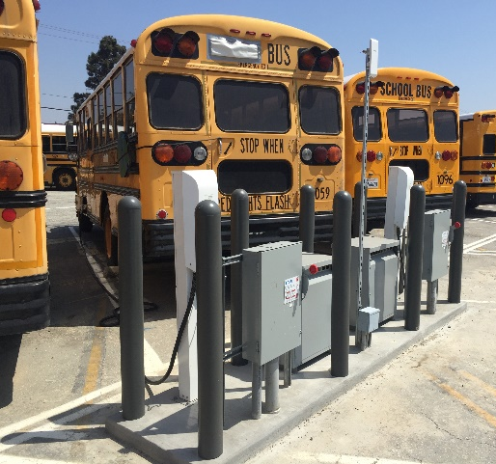
Infrastructure
Investor-Owned Utilities (IOUs)
  Seeking CPUC approval for infrastructure projects for Light- and Heavy-Duty vehicles
  SCAQMD supporting efforts with CPUC
  Incorporating IOU involvement into RDD&D projects
Publicly-Owned Utilities (POUs)
  Some with active EVSE for Light-Duty vehicles
    Residential Level 2 EVSE rebates
    Workplace/Public Level 2 EVSE
  Increasing interest in RDD&D projects
Goals
  Standard Development - common charging plug and receptical
  Review Demand Charges and potential mitigation pathways

Slide 19
Conclusion
SCAQMD Clean Fuels Fund – focus on mobile sources
  Research, Development, Demonstration and Deployment
  Stationary projects typically with a link to transportation fuel
  leveraged with cost share from government/private partners
AQMP – driving force
  Follow-up on control measures with rule development
  Incentive funding
  SCAQMD – ready to partner on beneficial use projects

