Slide 1

IEPR workshop on Light Duty Vehicle Transportation Electrification
Geof Syphers, CEO
April 18, 2017

Slide 2
Community Choice = “Muni Light”
Public agency
Provides all electric generation services, reliability, RA, storage, etc.
Does not own lines or substations
Local public board approves contracts, sets rates, etc.
Community choice is estimated to replace 50% of investor-owned load by 2025.

Slide 3
Sonoma Clean Power’s Purpose
Reduce greenhouse gas emissions
Protect customers from rate shock
Support local economy, renewables, efficiency
Use clean electricity to cut emissions at competitive costs while supporting our local economy.
> Fuel shifting is top priority.

Slide 4

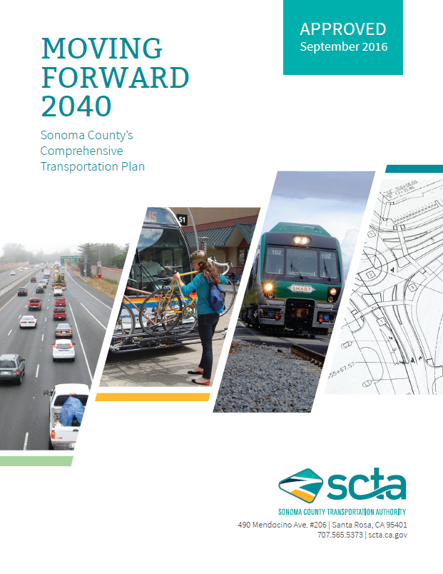
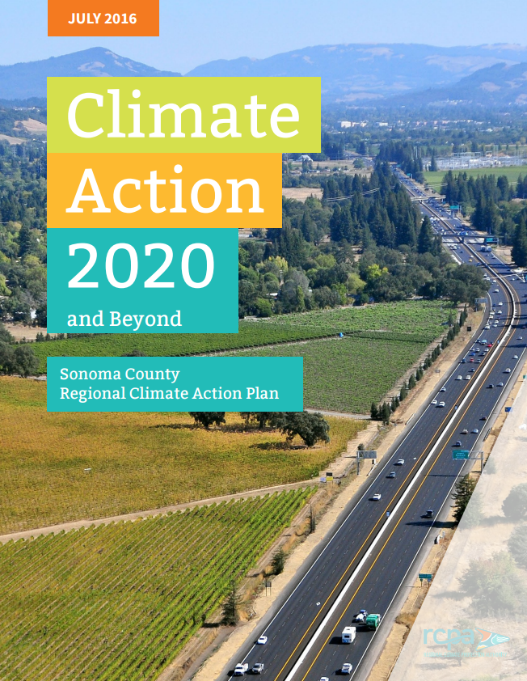

Slide 5
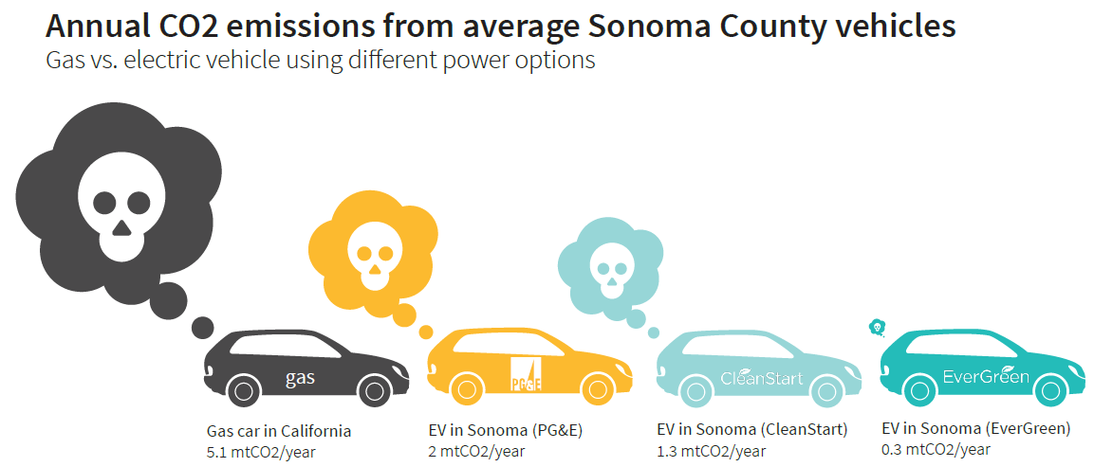

Slide 6
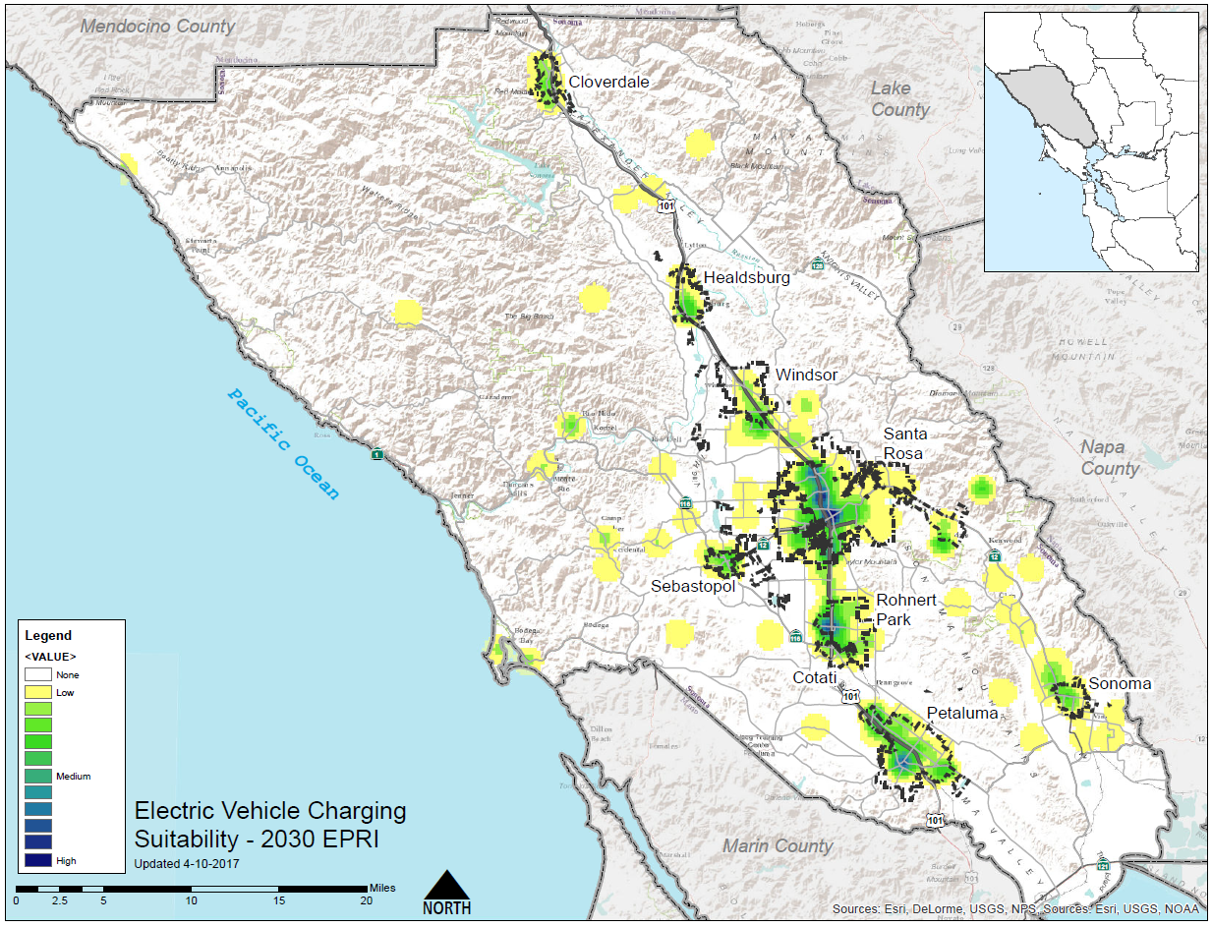

Slide 7
SCP’s Transportation Obligation
Local decision to exceed State requirements, based on 50% reduction in petroleum by 2030
Requires all existing efforts plus ~20% shift to EVs
Current status ~1.8% eVMT

Slide 8
SCP’s Integrated Resource Plan Approach
Over 80% renewable (including hydro) means that load growth from EVs is less important than time-dependent load model
400+ Level 2 chargers in progressive DR market:
  Proxy Demand Response (2017-2018)
  Non Generating Resource (2019-2020)
  Resource Adequacy (2021-2024)
  RA + Customer peak shaving + DSO (around 2025)

Slide 9

Notes:
SB 32 continues where AB32 leaves off (1990 levels by 2020)
80% below 1990 levels by 2050

