Slide 1
CEC GFO 16-303
“Improving Commercial Viability of Fast Charging by Providing Renewable Integration and Grid Services with Integrated Multiple DC Fast Chargers (DCFC)”
IEPR Commissioner Workshop on Integrated Resource Plans – Light Duty Vehicles
Thomas Ashley
Senior Director, Government Affairs & Public Policy
Greenlots
April 18, 2017

Slide 2
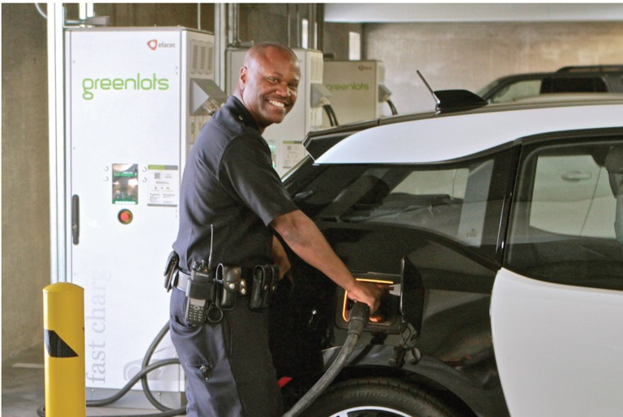
Introduction to Greenlots

Slide 3
DC Fast Charging is Currently Un-Economical…
High Infrastructure / Installation Costs
Low Utilization
High Demand Charges
Increasing Power Demands

Slide 4
Project Goals
Develop an integrated hardware + software platform to control distributed DC fast chargers and energy storage
Evaluate grid service(s) potential from aggregated DCFC loads to offer utility on-peak demand response, renewable integration, and fleet scheduling

Slide 5
Energy Storage Reduces Demand Charges
Integrated energy storage system will shave peak loads, reducing demand charges
Demand savings only “pays” for partial cost of the storage system
There is a need to create additional value streams to cover costs

Slide 6
Individual DCFC Loads are Unpredictable
Single DCFC load will remain unpredictable and peaky, with high stress on the grid
Even during high usage periods, the load is variable
Peaky Load -> Stress on Grid
Unpredictable Charging Loads

Slide 7
But, Aggregated DCFC Loads Can Provide Demand Response
Randomness in charging sessions is reduced by aggregating multiple DCFCs across sites
Most charging sessions occur between 3PM and 9PM, coinciding with system peak demand
Integrating energy storage at one or more of these DCFCs smooth load variations
Multiple demand response strategies will be evaluated, while minimizing driver impact
Note: The four DCFCs are located in a 10 mile radius. Grid benefits will change based on the substation they are connected to, the pricing node they’re associated with, and the dynamics of the sub LAP, etc.

Slide 8
Renewables Integration with Dispatchable Charging
Many public DCFCs are idle or see relatively lower utilization during solar over-generation hours, as private EVs tend to charge mainly in the morning or evening
However, EV fleets with the right incentives can use this capacity with limited modification to their operations
Total Charging across four DCFCs (kWh) (April 2 - 8,2017)
Utilities can sink excess renewable energy without investing in additional capacity

Slide 9
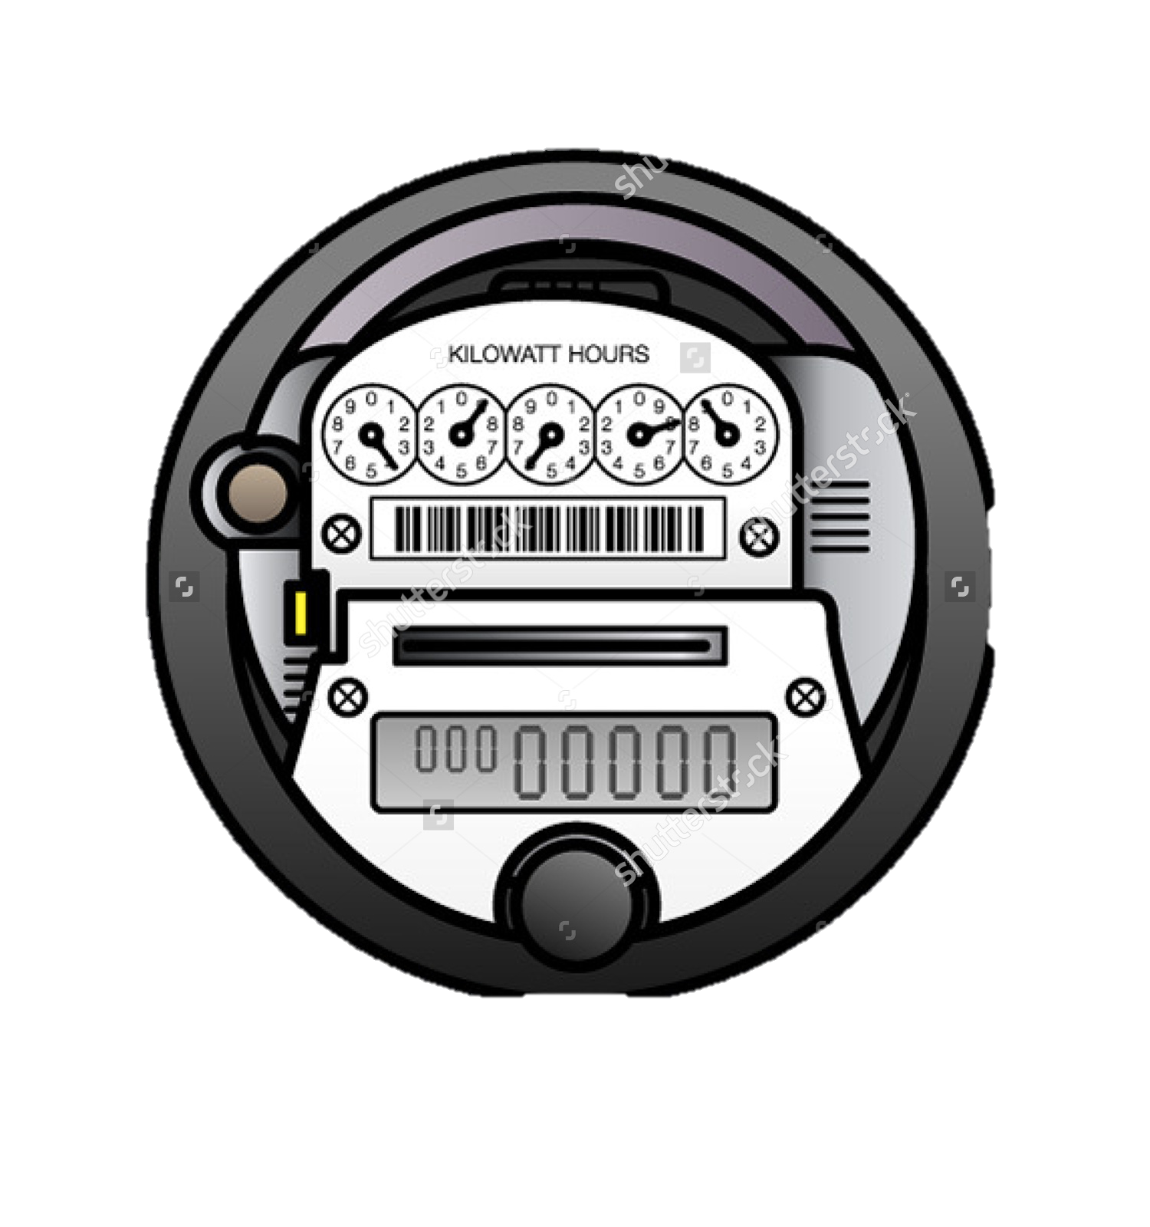
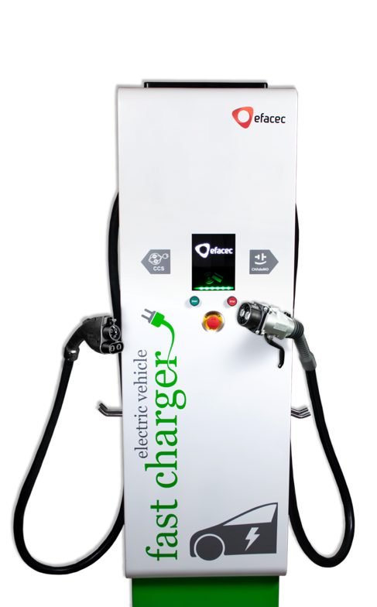
System Architecture
Transformer
Greenlots SKY™
OCPP 1.6
ISO Signals
OpenADR2.0
OCPP 1.6
Utility
Meter
Greenlots
Site Controller
Real-Time Charging
EV Scheduling
Utility/ISO
60kW/
100kWh Storage
Customer Portal/ App
50kW DCFC 1
50kW DCFC 2
50kW DCFC 3
50kW DCFC 4
Test Site Location
Power
Communication

