Slide 1
Burbank Water and Power IRP:
Transportation Electrification
Kapil Kulkarni • 04.18.2017

Slide 2
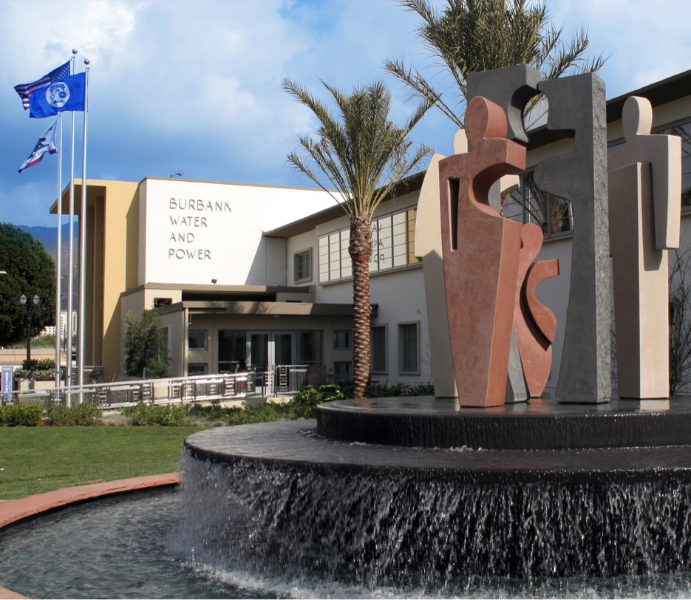
Sectors
Commercial, Residential, Multi-family
Incentives
Rebates
Rates
Marketing
Everything but the car

Slide 3
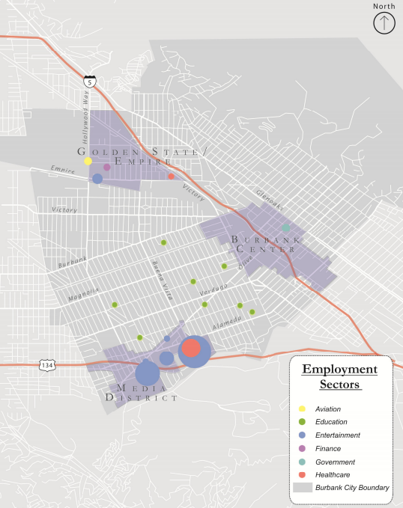
City of Burbank, Department of Water and Power
Population of 105,000 in 17 square miles
History
Full AMI deployment
28 public curbside and parking lot chargers
TOU rates and rebates
Vibrant commercial sector
75% of electric load
~50% increase in daytime population, mostly via light duty vehicles
High potential for workplace charging

Slide 4
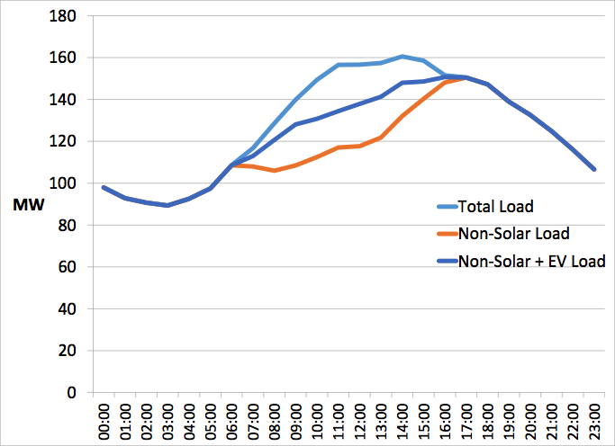
BWP Daily Load Profile

Slide 5
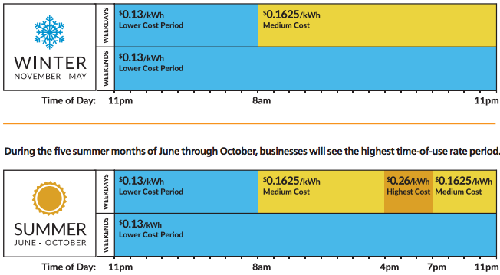
BWP Current Rate Design

Slide 6
Workplace Charging - Next steps
Data collection
Key Account meetings
Surveys and focus groups
More information needed on current and future charging infrastructure, and necessary incentives
Data analysis
Package into customized incentives, such as:
  BWP-built Level 1 infrastructure
  Level 2 rebates based on usage
  Super off-peak rates

Slide 7
Non-Commercial Sector
Residential
Voluntary whole home TOU rate plan, with 3:1 ratio for Peak to Off-Peak rates
$500 rebate for Level 2 charger, with mandatory whole home TOU rate plan
Other incentives?
Multifamily
Access to public curbside chargers
Up to $1,000 rebate, for either property representative or resident
More is needed!

Slide 8
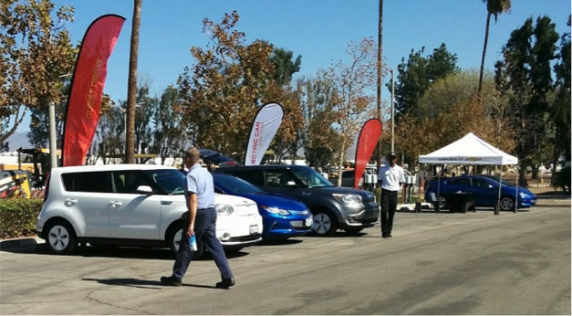
Coordinated Education and Outreach
Tri-City Electric Car Guest Drive
Saturday April 8 at the Rose Bowl
Jointly sponsored by BWP, GWP, and PWP through SCPPA contract
27 EVs for driving and display
237 drivers / 355 attendees / 490 guest drives

Slide 9
The state must continue to provide periodic forecasts of EV sales.
Utilities will continue to set rates that comply with operations and local policy.
Utilities will include TE in IRPs that help inform the state.
Vehicles
Chargers
Rates
Operations
Planning
Private sector must continue deployment of charging infrastructure.
Utilities will manage load that maximizes efficiency.

Slide 10
BWP - Next steps
Commercial sector outreach
Collect data to develop and collaborate on programs that benefit Burbank and its employers
Innovations
Develop incentives, including rebates and rates, to advance the EV market
More Marketing
Determine ROI of current investments

