Slide 1
High Speed DC Network Considerations
Dave Packard
Dave.Packard@ChargePoint.com

Slide 2






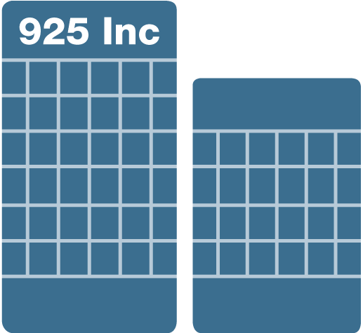



Our Mission: EV Charging, Everywhere
Get everyone behind the wheel of an EV and give them charging wherever they go.
Out of Town
Home
Convenient and connected charging for home, work, around town and out of town.
Work
Around Town

Slide 3
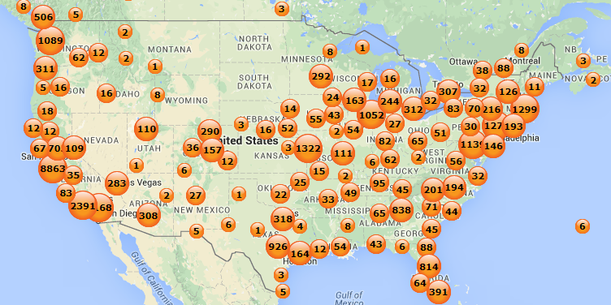
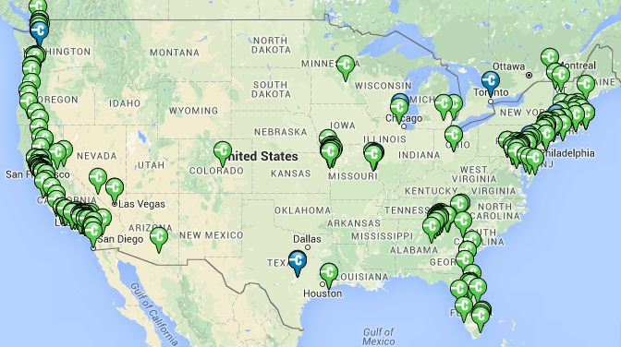
The ChargePoint Network
Level 2 – Over 31,000 Ports
DC – Over 400 Ports

Slide 4
Varying DC Requirements for Different Vehicles
Current Vehicles
Future Vehicles
Battery pack nominal voltage ~ 400V
Most cars limited to ~ 50kW except Tesla
Lower battery capacity on non -Tesla vehicles
Three DC fast charge connectors in US
  SAE Combo
  CHAdeMO
  Tesla
DC fast charge capabilities on BEV’s only
Some cars announced with battery packs up to 800V nominal
Some cars may take up to 350kW of power
Higher power levels = higher current which will require liquid cooled cables
Charging infrastructure must support all vehicles
  Will still mean multiple connectors
  Support for all legacy vehicles
DC fast charge also on some PHEV’s
Charging infrastructure must be flexible and scalable

Slide 5
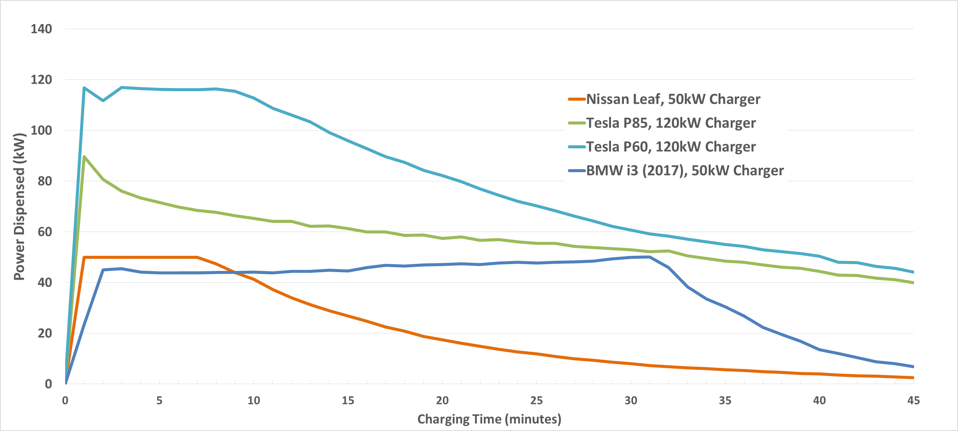
Different Cars Charge at Different Rates
  Vehicle decides how much power it can take based on battery conditions
  Results in unused power for standalone charging stations
  Expect similar profiles on vehicles with higher power charging

Slide 6



Shared Power Will Improve Efficiencies
t = 0
t = 20 min.
t = 30 min.
Centralized
Power Supply
Adjusts power available to all vehicles based on capacity, state of charge, arrival and desired departure time

Slide 7
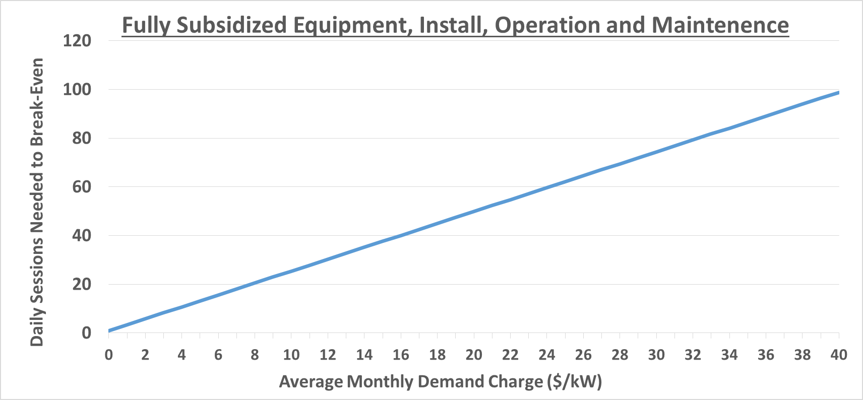
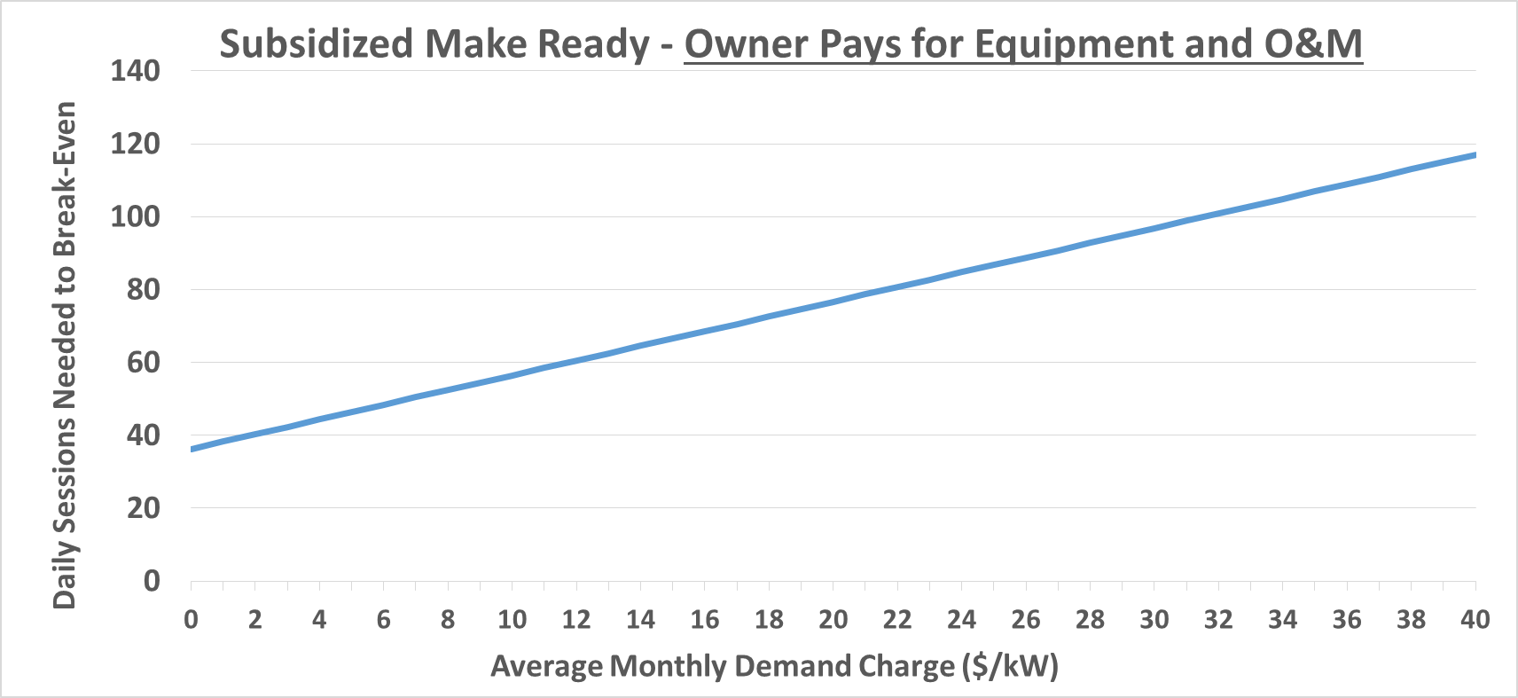
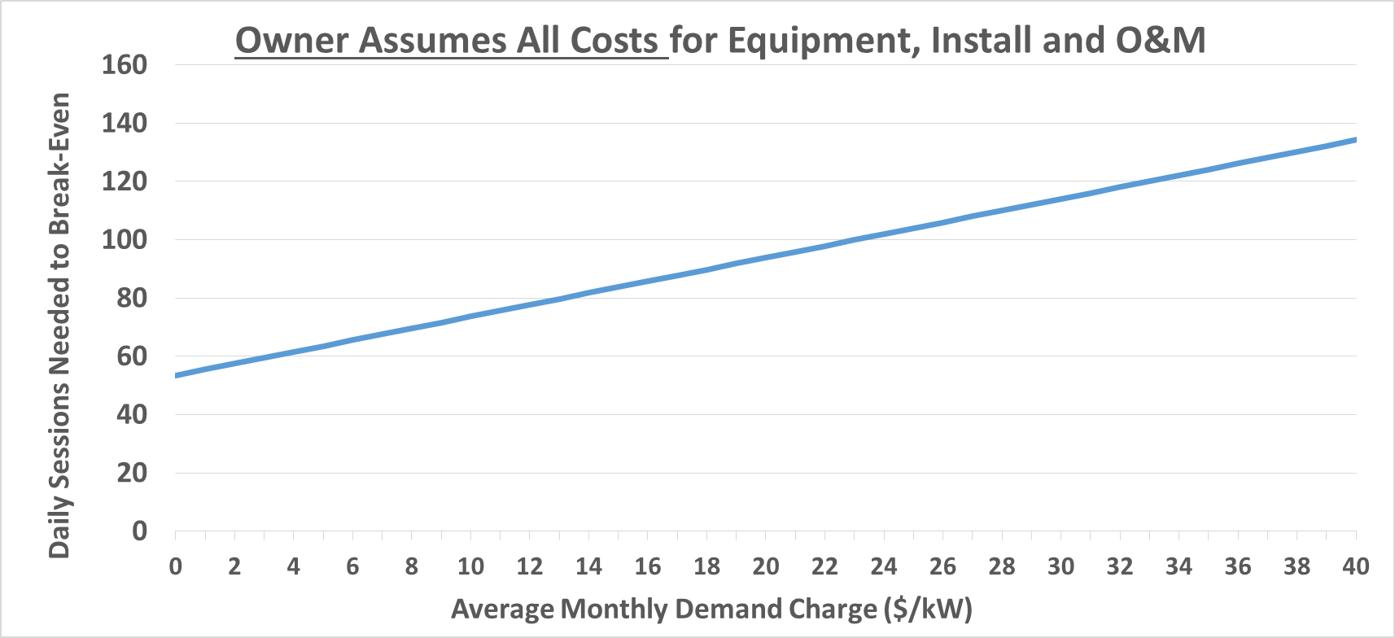
High Power and Demand Charge Implications
In areas with high demand charges, breakeven will be difficult in early stages - even with grants and subsidies
Install scope assumes 350kW of charging infrastructure at each location
Assume peak hits max power at least once per month
Driver pricing set at gas parity for breakeven analysis
Equipment and install costs amortized over 5 years
PG&E
SDG&E
SCE
Georgia
Power
Potomac
Edison

Slide 8
Can On-Site Stationary Storage Help?
Maybe
Must consider driver arrival frequency, load needed and duration
Most on-site storage with DC fast reported on so far is mostly Leaf’s arriving infrequently to charging locations
What happens when there are more cars arriving that take max power for a longer period of time?
Need to make calls on battery sizing based on an upwardly moving utilization target
Today
Leaf
i3
Leaf
Power
2018
i3
Bolt
Ionic
Model 3
Time

Slide 9
Costs and Driver Implications
Until adoption rate is very high, ROI for high power infrastructure is difficult at gas parity pricing
Will drivers have an appetite to pay a “premium” for occasional fast charging?
Drivers interpret pricing higher than what they pay for electricity at home as “gouging”
Higher pricing may be tolerable if drivers have access to home and workplace charging
  L2 at home or workplace typically less than gas parity – will meet most fueling needs
  Blended fueling costs can be less than gas parity
  More difficult problem for drivers living in multi-family housing without access to workplace charging
Absent that, testing alternative cost recovery mechanisms for traditional demand charges related to DC fast charging will help drive infrastructure investments

Slide 10
Introducing Express Plus
Defining the future of emobility
Future proof:
designed for today’s and tomorrow’s cars
Displays and design deliver exceptional
driver experience
Modular system scales without stranded investment
Dynamic power management charges more cars, faster
Lightweight liquid cooled cables are easy for drivers to maneuver
Efficient power conversion
reduces costs & wasted energy

Slide 11

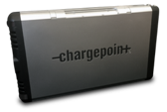
Express Plus – Growing Core Configuration
TOTAL OUTPUT POWER
62,5 kW
125 kW
500 kW
750 kW
31,25 - 62,5 kW
31,25 – 125 kW
RANGE OF MAX OUTPUT
PER PORT
31,25 – 400 kW
31,25 – 400 kW
Notes:
Modularity: All configurations built using the same power conversion modules (31.25 kW each).
Scalability: Modular architecture that scales with need – from 31.25 kW to 1000 kW based on the ratio of Express Plus Stations to Power Cubes.
Powerful: Up to 400 kW per port. Compatible with legacy and future battery pack voltages from 200 V to 1000 V.
Compatibility: Common Station design with up to 3 cables. Supports sequential charging across cables. Choice of CCS Type1, CCS Type2, CHAdeMO, GB, others
Usability: Dual displays - 10” LCD with vandal resistant touch and 20” wide-format LED secondary display. Light weight and flexible liquid-cooled cable.
Support and Maintenance: Configuration, monitoring, diagnostics and reporting through the CP Network.

Slide 12


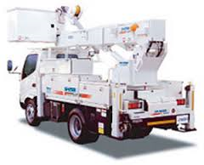

Express Plus: The Missing Link for Fully Electric Transit
Target applications
  Ultra fast DC charging hubs along highways
    Drivers on long trips can take a quick break (15 mins) and refuel, then get on their way
    Retail, restaurants adjacent to major roads
  City centers and transportation hubs
    TNC – Uber & Lyft
    Electric Taxi
    City fleets
  Buses and service trucks (heavy duty)
    Reduce fuel and maintenance costs
    Major benefits for city residents: less noise and pollution
    Improve load factor and operational costs
DC Charging Hub

Slide 13
Summary
Different EV’s will have different charging capacities and requirements
Future hardware will need to be flexible to meet both new and legacy vehicles
Power in charging depots will be optimized to allow most optimal use of assets
  Allow unused kW to be dispensed to other vehicles
Demand charges are the single biggest cost for operation of high power systems
Questionable on how much on-site storage will help
We like the direction from Pacific Power!

Slide 14
Thank You
Dave Packard
912-258-5665
Dave.Packard@ChargePoint.com

