Slide 1
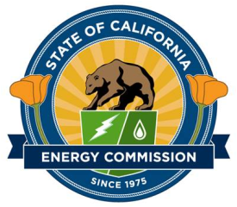
California Refinery Operations, Fuel Supply, and Retail
2017 IEPR Commissioner Workshop on
Transportation Energy Supply Trends
July 6, 2017
Gordon Schremp
Energy Assessments Division
California Energy Commission
Gordon.schremp@energy.ca.gov
California Energy Commission

Slide 2
Presentation Topics
California refinery operations
Transportation fuel supply flows & trends
Retail operations – national & California
California Energy Commission

Slide 3
California Refinery Operations
California Energy Commission

Slide 4
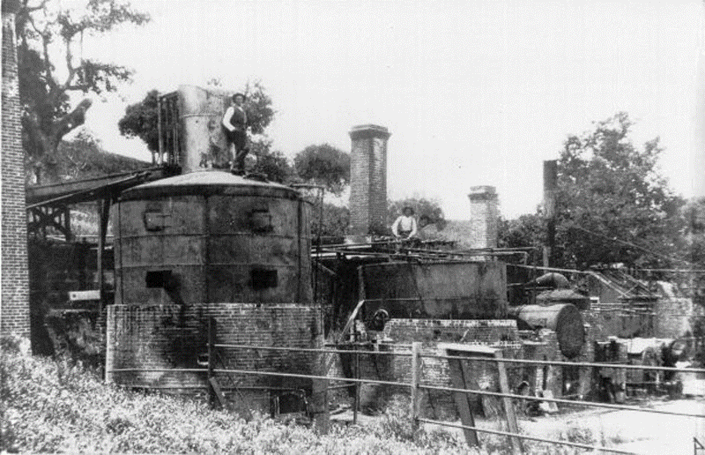
Refineries – Historical Changes
  Initial refining operations date to 1870s
  1982 – 40 operating refineries
    2.565 MM barrels per day (b/d) capacity
      61.8 percent utilization rate
      956 thousand b/d gasoline
      241 thousand b/d distillates
      184 thousand b/d jet fuel
  2016 – 15 operating refineries
    1.884 MM barrels per day (b/d) capacity
      85.6 percent utilization rate
      1,007 thousand b/d gasoline
      360 thousand b/d distillates
      281 thousand b/d jet fuel
  Increased complexity & higher utilization rates enable even greater fuel output with 62 percent fewer facilities
Pioneer Oil Refinery – Newhall - Circa 1877
Source: SCV History.com
California Energy Commission

Slide 5
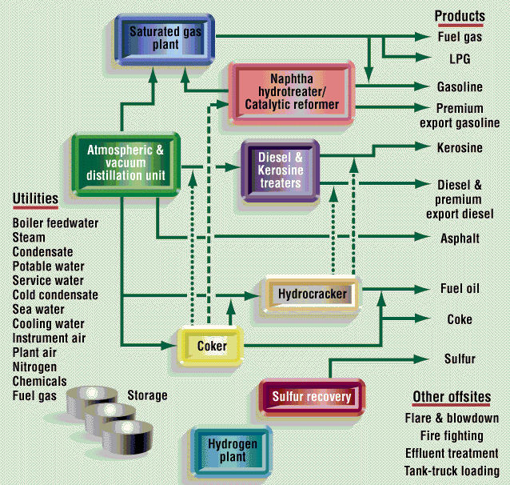
Refineries – Must Maintain Balance
  Refiners must optimize operations to ensure system remains in balance:
    Steam load
    Sulfur plant operations
    Refinery gases
    Cogeneration operations & electrical loads
    Hydrogen use
  All refinery inputs end up being consumed or converted
  Storage capacity is finite
Source: Oil & Gas Journal
California Energy Commission

Slide 6
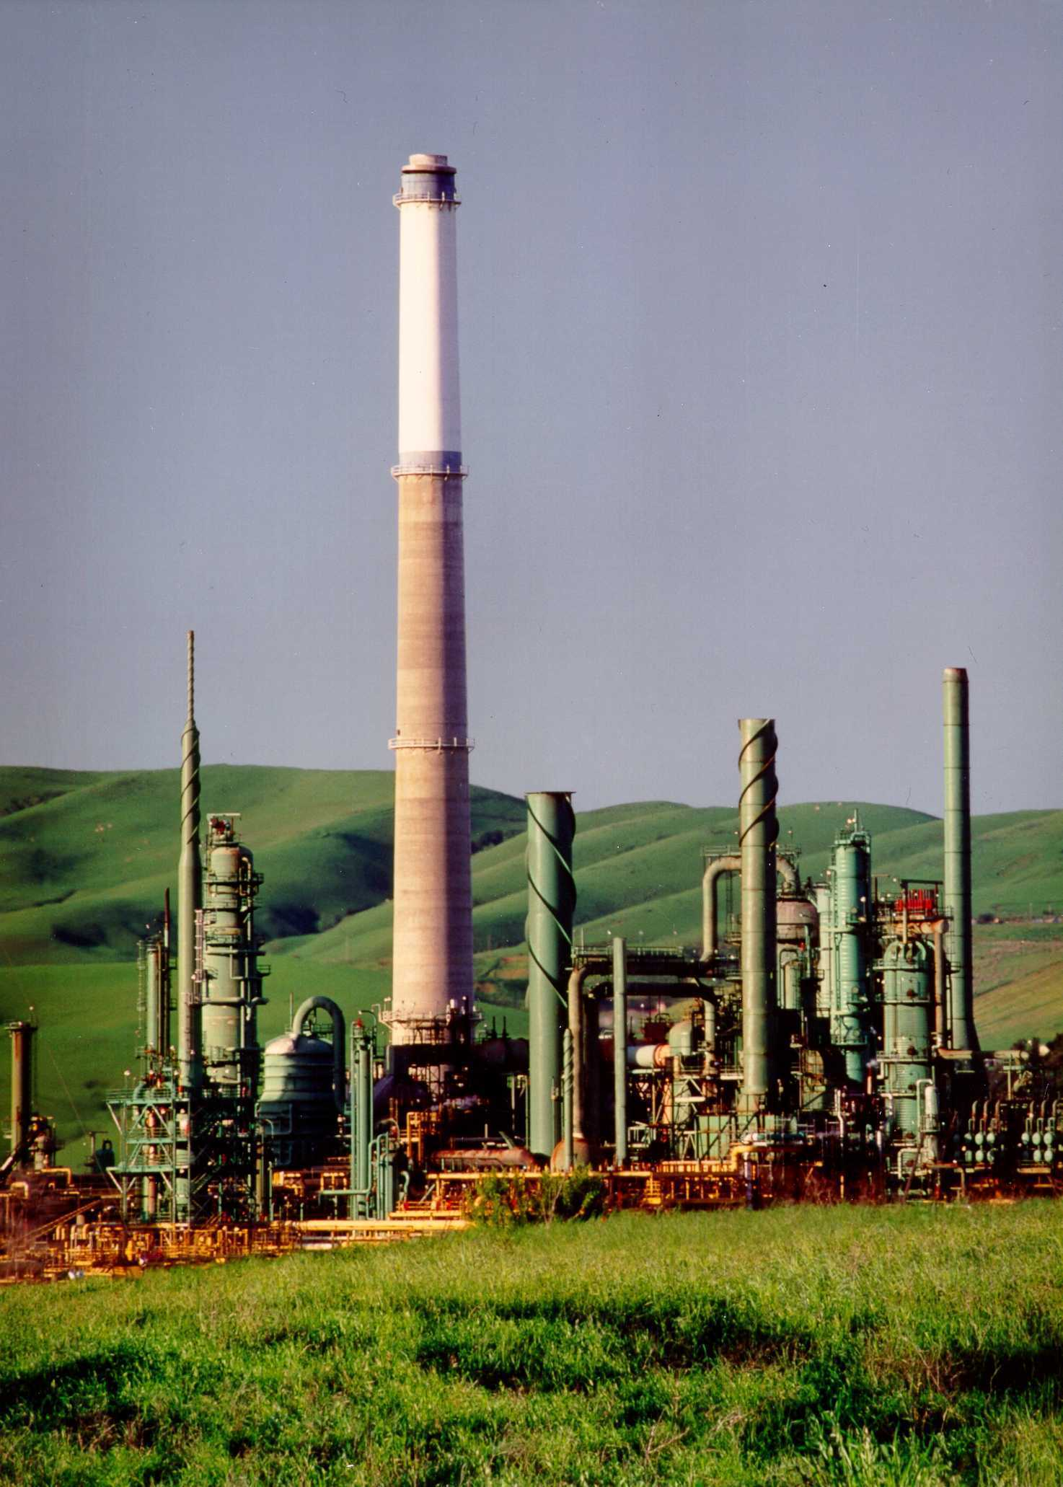
California Refineries - Overview
  Refineries are a primary hub of logistical activity
    15 refineries processed 1.612 million barrels per day of crude oil during 2016
    13 facilities produced California fuels
  Crude oil during 2016 received by
    Marine vessels (foreign) – 887.5 TBD
    Marine vessels (Alaska) – 188.0 TBD
    California source via pipelines – 558.5 TBD
    Rail/truck – 3.0 TBD
  Process units operate continuously at or near maximum capacity, except during periods of planned maintenance or unplanned outages
California Energy Commission

Slide 7
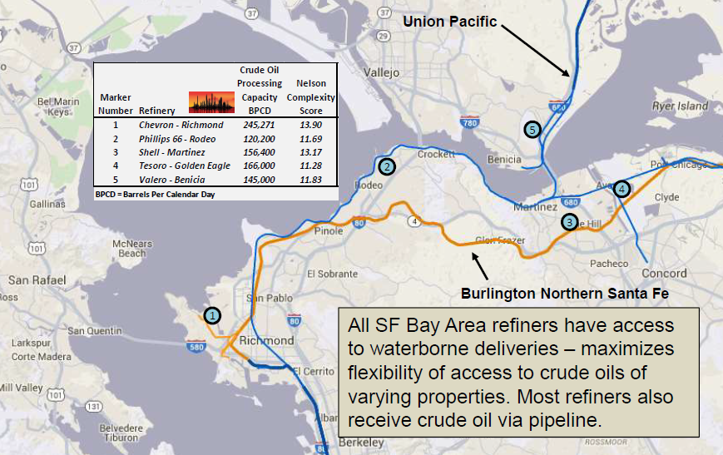
Refinery Locations – Northern California
Sources: Oil Change International map, Energy Information Administration refinery data, and Energy Commission analysis
California Energy Commission

Slide 8
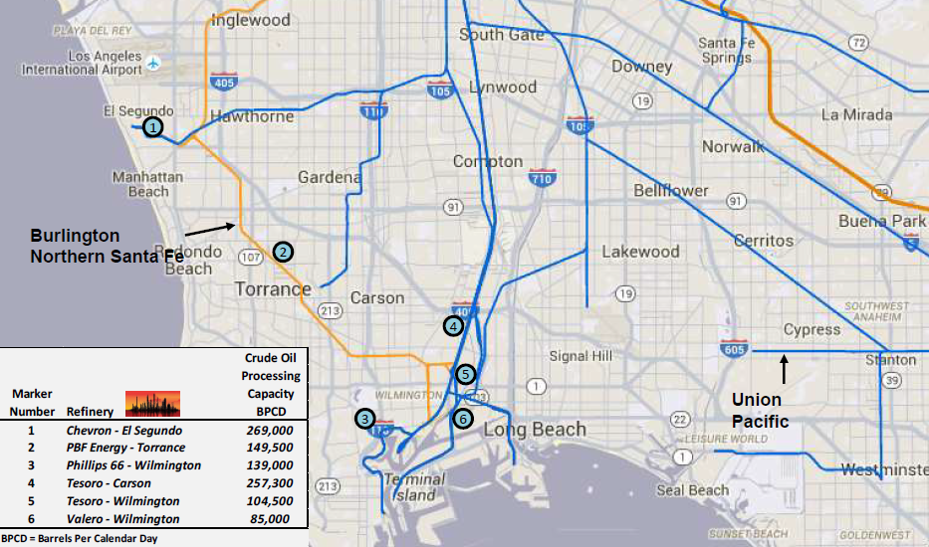
Refinery Locations – Southern California
Northern California refiners all own their marine terminals, whereas the marine terminal docks in Southern California are owned by the cities of Los Angeles and Long Beach and leased to the refining & logistics companies (such as Kinder Morgan).
Sources: Oil Change International map, Energy Information Administration refinery data, and Energy Commission analysis
California Energy Commission

Slide 9
Product Slate of California Refineries (2016)
Source: California Energy Commission
California Energy Commission

Slide 10
Transportation Fuel Consumption Trends
California Energy Commission

Slide 11
California Gasoline & Ethanol Consumption
Although finished gasoline consumption declined 8.9 percent between 2004 and 2012, strong recovery from the recession and continued population growth have pushed consumption up by 6.9 percent between 2012 and 2016, edging closer to a record high.
Ethanol use has increased from an average concentration of 3.75 percent by volume in 2003 to 10.09 percent by volume during 2016.
Source: California Energy Commission analysis
California Energy Commission

Slide 12
California Diesel Fuel, Biodiesel & Renewable Diesel Consumption
Finished diesel consumption declined 15.9 percent between the peak in 2007 and the trough in 2009. The strong recovery from the recession and associated goods movement by truck and rail pushed consumption back up by 15.5 percent between 2009 and 2016.
Source: California Energy Commission analysis
California Energy Commission

Slide 13
California Jet Fuels and Aviation Gasoline Consumption
Commercial jet fuel consumption declined 15.1 percent between the peak in 2007 and the trough in 2009 (same pattern as diesel fuel). The strong recovery from the recession and associated rebound in air passengers and cargo have pushed consumption back up by 29.9 percent between 2009 and 2016 to reach a new record high of 3.87 billion gallons.
Source: California Energy Commission analysis
California Energy Commission

Slide 14
California Gaseous Fuel Consumption
  The natural gas-based fuels usually displace diesel fuel
  Hydrogen transportation fuel usually displaces gasoline in light-duty vehicles
  Hydrogen consumption expected to rise through expanded fueling infrastructure & additional vehicle options
California Energy Commission

Slide 15
California LCFS Credit Portion by Fuel Type
Importance of biomethane increasing under the Low Carbon Fuels Standard.
Source: California Air Resources Board
California Energy Commission

Slide 16
California Transportation Electricity Consumption
Light-duty transportation electricity consumption has grown from 62.2 thousand MWhs in 2012 to 727.0 thousand MWhs by 2016, an increase of more than ten times within four years – a direct consequence of the growing purchase of battery electric and plug-in electric vehicles.
Sources: Federal Transit Administration & California Energy Commission analysis of DMV data
California Energy Commission

Slide 17
Transportation Fuel Supply Flows & Trends
California Energy Commission

Slide 18
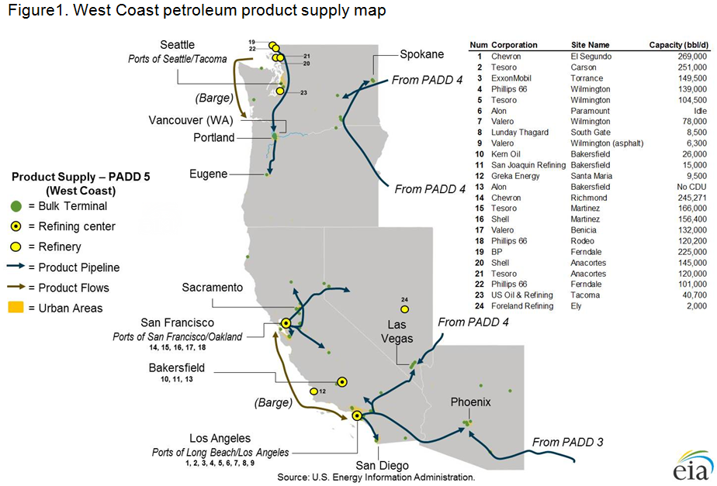
Western States More Isolated than Rest of U.S.
California Energy Commission

Slide 19
California Gasoline Market - Isolated
California’s gasoline market is nearly self-sufficient, so supplies of gasoline from outside of California are not routinely needed to balance out supply with demand
  Imports of gasoline and blending components account for only 3 to 6 percent of supply
The California market is geographically isolated from other locations in the United States that produce refined products
Pipelines connect California refining centers to distribution terminals in Nevada and Arizona, but these pipelines only operate in one direction – sending gasoline and other transportation fuels to these neighboring states
California market is isolated by time and distance from alternative sources of re-supply during unplanned refinery outages
California Energy Commission

Slide 20
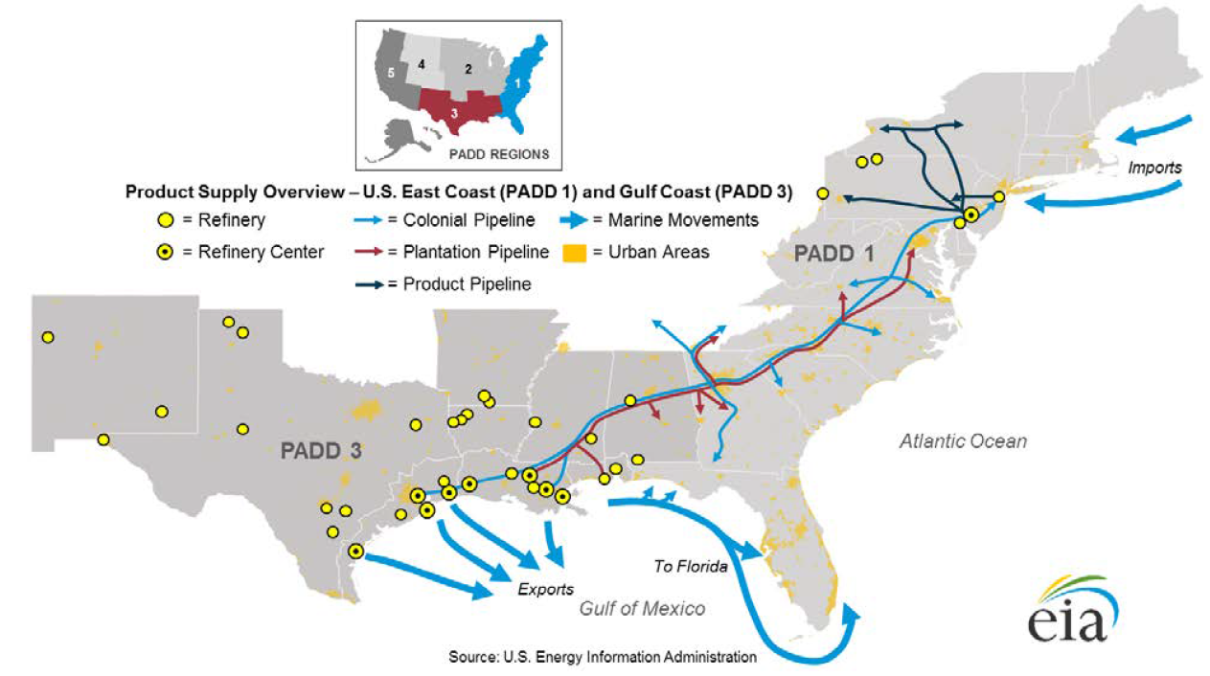
Balance of Other Regions Varies
  U.S. Gulf Coast (PADD 3) large net exporting region
    During 2014, region consumed an average of 2.5 million barrels per day (b/d) of transportation fuels yet produced 7.5 million b/d
  U.S. East Coast (PADD 1) large net importing region
    During 2014, region consumed an average of 4.9 million b/d of transportation fuels but only produced 1.0 million b/d, representing 20 percent of the region’s supply
California Energy Commission

Slide 21
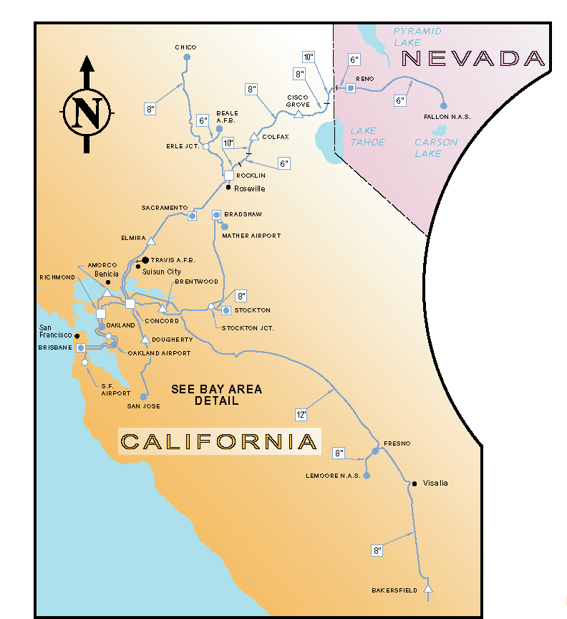
Product Pipelines – Northern California
  The pipeline infrastructure in California is controlled by a combination of common carrier and private companies
  Kinder Morgan is the sole common carrier of petroleum product pipelines in the State and transports the majority of fuels through its system every day
  Other companies, such as Chevron, ExxonMobil, Shell, and Tesoro operate proprietary systems or segments that handle the balance of transportation fuels
Source: Energy Commission revision to Kinder Morgan map
California Energy Commission

Slide 22
Gasolines Flows – Northern California
    Net exporter
    Foreign imports rare
    Domestic imports from WA refiners – steady
    Imports from S. Calif. intermittent & small – refinery outages
    Pipeline exports to Reno
    Foreign exports growing
    Domestic exports to PNW declined – replaced by WA refiners
    Exports to S. Calif. normal portion of their supply – volumes fluctuate based on refinery outages
Source: California Energy Commission
California Energy Commission

Slide 23
Diesel Flows – Northern California
    Large net exporter
    Foreign imports rare
    Domestic imports from WA refiners – not needed
    Imports from S. Calif. Intermittent & small – refinery outages
    Pipeline exports to Reno
    Foreign exports growing
    Domestic exports to PNW small – replaced by WA refiners
    Exports to S. Calif. unusual
Source: California Energy Commission
California Energy Commission

Slide 24
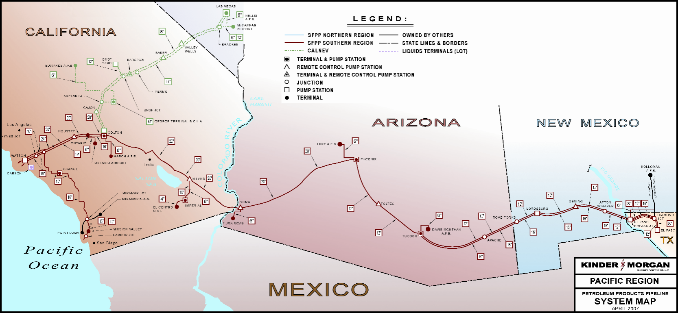
Product Pipelines – Southern California
  Southwestern system includes portions to deliver transportation fuels into Southern Nevada and Arizona
    NV – Over 85% of supply
    AZ – Over 45% of supply
  Dependency on Southern California refineries lessened by deliveries from West Texas and Utah
California Energy Commission

Slide 25
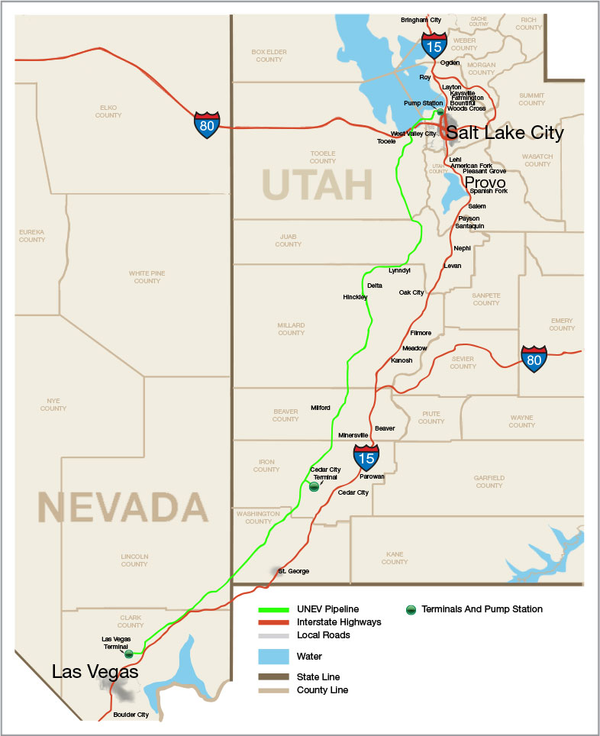
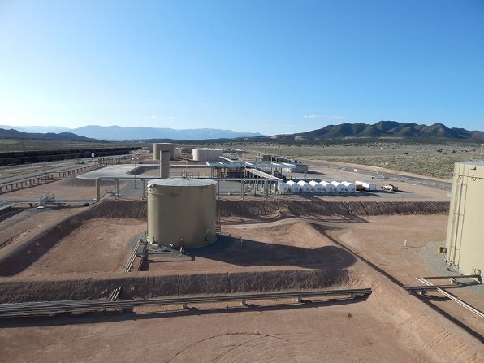
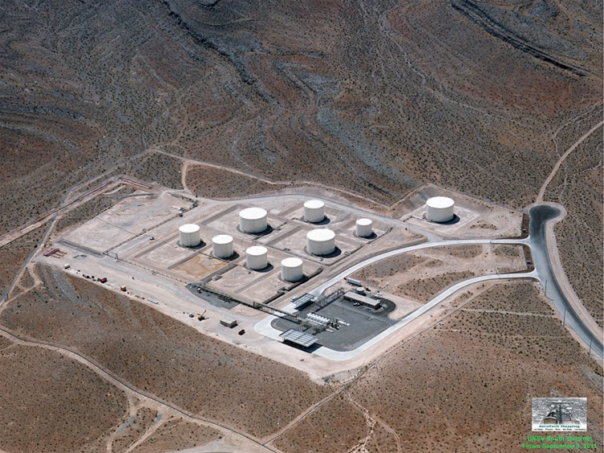
UNEV System – Utah to Las Vegas
  427-mile, 12-inch refined products pipeline – 60,000 bpd capacity
  600,000 bbls storage capacity
  Cedar City, UT
    2 truck loading bays & rail receipt
  North Las Vegas, NV
    2 truck loading bays & truck receipt
California Energy Commission

Slide 26
Gasolines Flows – Southern California
    Net importer via marine
    Usually close to balance
    Foreign imports when needed & economic
    Domestic imports rare
    Imports from N. Calif. normal portion of their supply – volumes fluctuate based on refinery outages
    Pipeline exports to NV & AZ
      5 times N. Calif. volumes
    Foreign exports minimal
    Domestic exports eliminated
    Exports to N. Calif. rare – volumes fluctuate based on refinery outages
Source: California Energy Commission
California Energy Commission

Slide 27
Diesel Flows – Southern California
    Large net exporter
    Foreign imports when needed & economic
    Domestic imports rare
    Imports from N. Calif. Related to refinery outages
    Pipeline exports to NV & AZ
      3 times N. Calif. volumes
    Foreign exports declined
    Domestic exports eliminated
    Exports to N. Calif. rare – volumes fluctuate based on refinery outages
Source: California Energy Commission
California Energy Commission

Slide 28
Retail Operations – National & California
California Energy Commission

Slide 29
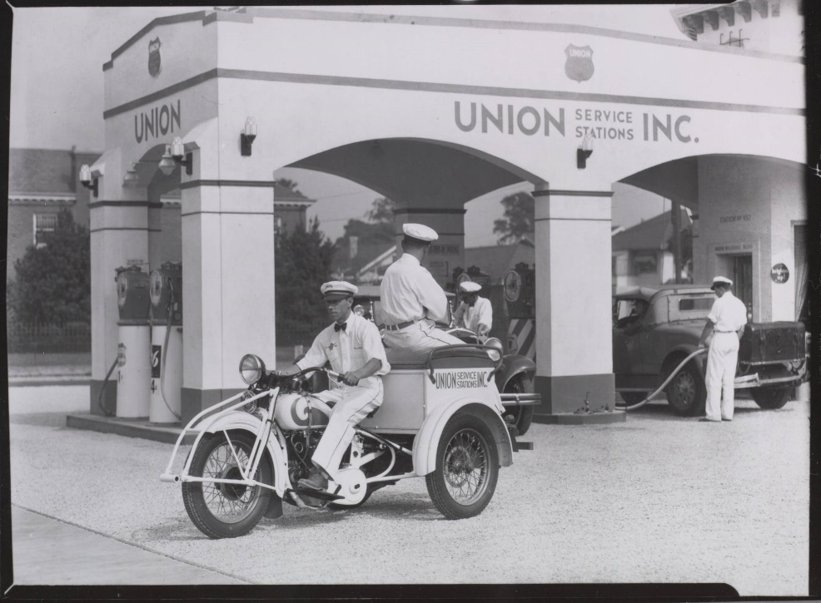
Retail – Historical Changes
  Initial filling stations 1905 to 1907
  1908 – 300,000 vehicles in operation
  1913 – 1st drive-up station opens
    Gulf Refining - Pittsburgh, Pennsylvania
    Provided road maps
  1924 – 1st gas credit cards issued
  1927 – 1st convenience store opens
    Southland Ice Co. – Dallas, Texas
    Changes name to 7-Eleven
  1947 – 1st self-serve store opens
    Frank Urich – Los Angeles, California
  1964 – 1st self-serve auto dispensers
    No attendant needed – Westminster, Colorado
  1986 – 1st pay-at-the-pump dispensers
    AutoGas – Abilene, Texas
Servi-car Service at Union Oil Gas Station - 1932
Source: Theoldmotor.com
Source: NACS History of Fuels Retailing
California Energy Commission

Slide 30
U.S. Convenience Store Ownership (2016)
154,535 convenience stores of which 123,807 were selling transportation fuels. These sales represented over 80 percent of the fuel sold in the U.S. during 2016.
As of June 2016, the top five vertically integrated oil companies (Chevron, Shell, ExxonMobil, BP, and ConocoPhillips) only owned and operated 0.25 percent of the convenience stores selling transportation fuel.
Sources: NACS/Nielsen 2017 Convenience Industry Store Count
California Energy Commission

Slide 31
U.S. Convenience Stores – Pretax Profits
Pretax profits have jumped 42.3 percent from the 2011-13 average of $47,480 per store to the 2014-16 average of $67,605 per store.
Sources: NACS State of the Industry Reports data
California Energy Commission

Slide 32
U.S. C-Stores – Revenue & Fuel Profits
Fuel sales represent majority of revenue but are less than 40 percent of pretax profits. Contribution has been growing since 2010.
Sources: NACS State of the Industry Reports data
California Energy Commission

Slide 33
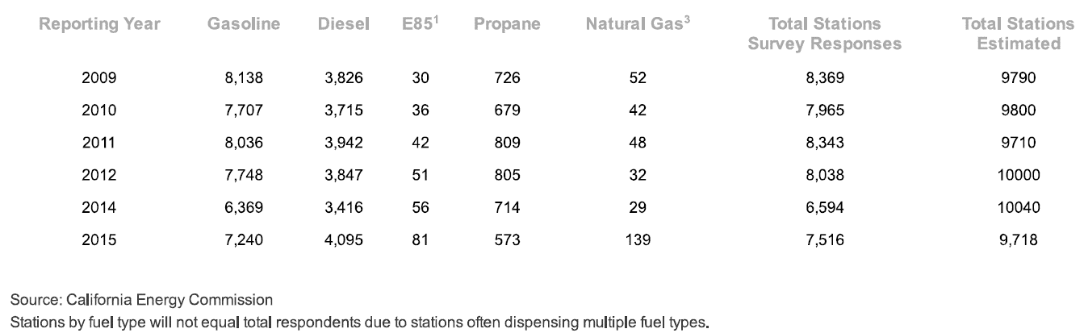
California Annual Retail Fuel Survey
  California Energy Commission conducts annual survey of locations dispensing transportation fuels to public
    Traditional gas stations, card locks, marinas & municipal airports
    Estimate total number of operating stations based on survey results
  Can calculate average sales by county and type of station
California Energy Commission

Slide 34
California Gasoline Sales by County (2015)
    Los Angeles County top sales volume – 3.465 billion gallons or 22.9 percent of statewide totals
    Top 5 counties are located in Southern California and account for 8.191 billion gallons or 54.2percent of statewide totals
    Chart volumes in millions of gallons
Source: California Energy Commission
California Energy Commission

Slide 35
California Average Monthly Gasoline Sales by Site (2015)
    Statewide average gasoline sales – 133,500 gallons per month by retail location
    Orange County top average – 184,200 gallons per month per station
    Majority of the counties above the statewide average sales volume are urban
    Chart volumes in thousands of gallons per month by location
Source: California Energy Commission
California Energy Commission

Slide 36
California Diesel Sales by County (2015)
    Los Angeles County again top sales volume – 313 million gallons or 16.1 percent of statewide totals
    Unlike gasoline, most of the top counties have significant agricultural activities (like Kern and San Joaquin)
    Chart volumes in millions of gallons
Source: California Energy Commission
California Energy Commission

Slide 37
California Average Monthly Diesel Sales by Site (2015)
    Statewide average diesel sales – 17,700 gallons per month by retail location
    Tehama County top average – 96,300 gallons per month per station
    Majority of the counties above the statewide average sales volume are rural in nature & have agricultural activity
    Chart volumes in thousands of gallons per month by location
Source: California Energy Commission
California Energy Commission

Slide 38
Top Five Hypermarket Companies Selling Fuel
Hypermarketers are a more recent entrant to the retail fuels business. These locations dispense twice as much fuel as a typical service station in the U.S. Greater volumes and lower overhead usually enable very competitive pricing for consumers.
Sources: NACS/Energy Analysts International
California Energy Commission

Slide 39
California Gasoline Sales by County – Non-Hypermarts vs. Hypermarts (2015)
    California Hypermarketers or Hypermarts sell even more gasoline compared to the U.S. locations – an average of 5.3 times more compared to non-hypermart locations
    Excludes marinas, resorts, card locks & general aviation airports not normally accessible to the typical motorist
    San Mateo County has the highest average volume – 1.171 million gallons per month per site
    Tulare County shows the largest ratio – 16.8 times greater than the non-hypermart locations
    San Mateo County has the largest ratio for an urban region at 8.7 times
    Chart volumes in thousands of gallons
Source: California Energy Commission
California Energy Commission

Slide 40
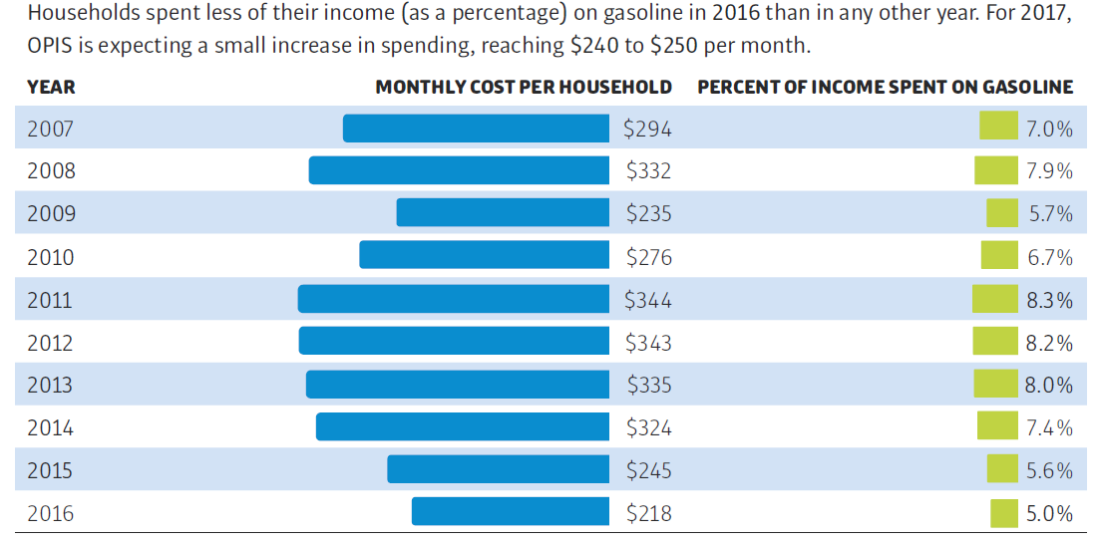
U.S. Fueling Costs for Gasoline Declining
Sources: Oil Price Information Service (OPIS) and CSP Magazine – May 2017
California Energy Commission

Slide 41
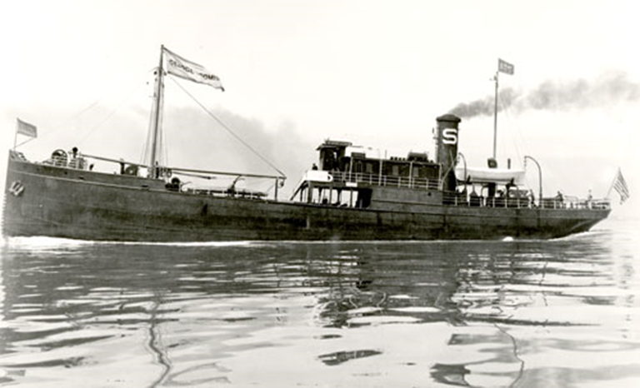
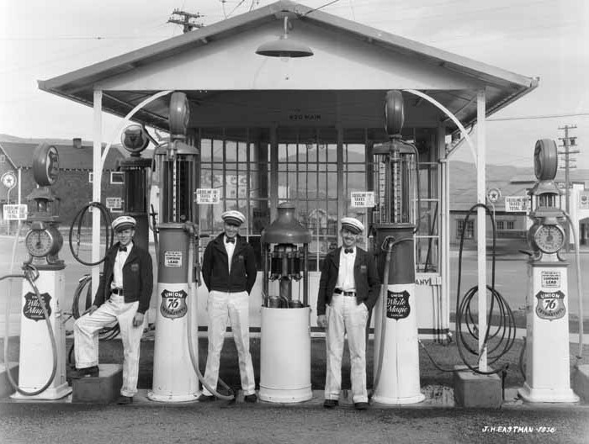
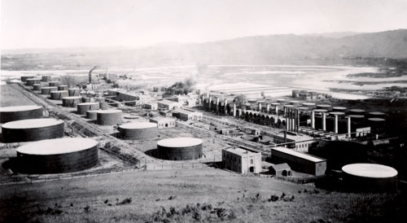
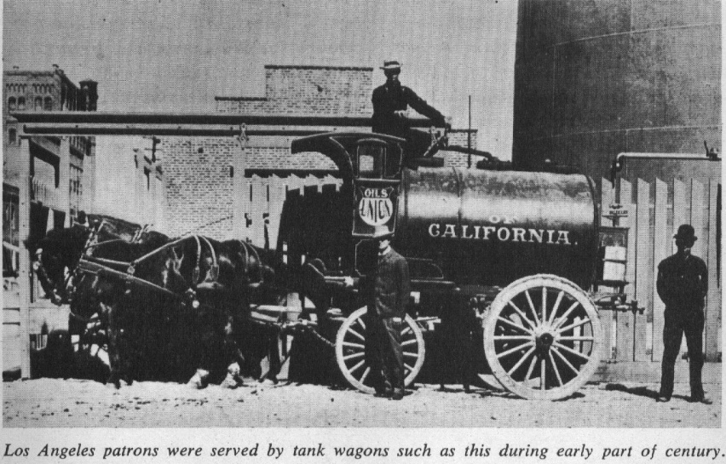
Additional Q & A
1896 - Pacific Coast Oil Co. – 1st Oil Tanker
1936 – Service With A Smile
1902 – Richmond Refinery Opens – 3,000 b/d Capacity
Circa 1900s – 750 Gallon Capacity
California Energy Commission

