Slide 1

Crude Oil Trends
2017 IEPR Commissioner Workshop on
Transportation Energy Supply Trends
July 6, 2017
Gordon Schremp
Energy Assessments Division
California Energy Commission
Gordon.schremp@energy.ca.gov
California Energy Commission

Slide 2
Presentation Topics
California crude oil production & receipts
United States crude oil trends
Global oil developments
Updates for oil exports & crude-by-rail
California Energy Commission

Slide 3
California Crude Oil Trends
California Energy Commission

Slide 4
California Oil Production (1865 to 2016)
Crude oil production for over 150 years in California. Declining output now at a level last seen in 1934.
Sources: California Division of Oil, Gas, and Geothermal Resources (DOGGR) and the California Energy Commission.
California Energy Commission

Slide 5
California Refinery Oil Sources (1982–2016)
1.65 million barrels per day in 2016 – foreign receipts expected to grow.
Sources: DOGGR, Energy Information Administration, Class 1 Railroads and the California Energy Commission.
California Energy Commission

Slide 6
Annual Crude Oil Imports into California
Diversity of foreign sources increasing.
Sources: Energy Information Administration and the California Energy Commission.
California Energy Commission

Slide 7
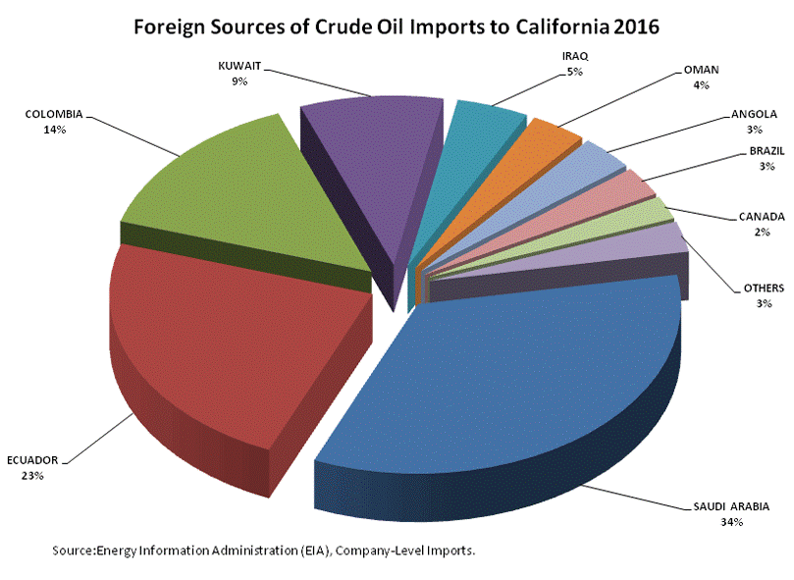
Near-source countries (North & South America) 45 percent of totals.
California Energy Commission

Slide 8
U.S. Crude Oil Trends
California Energy Commission

Slide 9
U.S. Oil Production by Shale Basin
Development of tight or shale oil formations through improved drilling techniques and hydraulic fracturing has resulted in a crude oil renaissance for the United States. The Permian Basin has become the second highest daily average production field in the world, trailing Ghawar in Saudi Arabia.
3 U.S. fields - Combined 4.396 MM BPD
Source: Energy Information Administration.
California Energy Commission

Slide 10
U.S. Crude Oil Production (1981-Jan. 2017)
Source: Energy Information Administration.
California Energy Commission

Slide 11
U.S. Change in Crude Oil Production
California & Alaska oil production continue declining.
Source: Energy Information Administration.
California Energy Commission

Slide 12
U.S. Crude Oil Imports (1990 thru 2016)
Source: Energy Information Administration.
Crude oil imports declined 27.4 percent between the peak of 2005 and 2014. Have rebounded 7.3 percent since.
California Energy Commission

Slide 13
U.S. Oil Rig Deployment (1987 thru April 2017)
Deployment of drill rigs looking for oil are down 57.5 percent from the peak of October 10, 2014 but have rebounded by 116.1 percent since hitting bottom on May 27, 2016.
Source: Baker Hughes data – through April 13, 2017.
California Energy Commission

Slide 14
Crude Oil Basins – DUC Backlog
Source: Energy Information Administration.
Record backlog of 5,005 wells awaiting hydraulic fracturing.
Drilled & Uncompleted wells enable rapid response to oil price increases.
California Energy Commission

Slide 15
Global Crude Oil Trends
California Energy Commission

Slide 16
Global Oil Production Change 2016 vs. 2008
U.S. incremental oil output has outpaced the 3 next highest producers.
Source: 2017 BP Statistical Review and Energy Commission analysis.
California Energy Commission

Slide 17
Global Crude Supply Imbalance
OPEC oil production cuts holding but glut not yet eliminated.
Source: International Energy Agency and Energy Commission analysis.
California Energy Commission

Slide 18
Daily Brent Crude Oil Prices (Thru 6/19/17)
Global oil inventories still too high and U.S. production still climbing.
Source: Energy Information Administration.
California Energy Commission

Slide 19
Updates for Oil Exports & Crude-by-Rail
California Energy Commission

Slide 20
Crude Oil – Export Restrictions - Before
  Domestically‐produced crude oil exports to foreign destinations allowed under specific "license exceptions" identified under federal statute - primary exceptions include:
    Alaska crude oil shipped on the Trans‐Alaska Pipeline System (TAPS) and exported via a Jones Act vessel directly from Valdez Harbor
    California heavy crude oil production with API gravity of 20.0 degrees or lower, limit of no more than 25,000 barrels per day
      First export license for California heavy crude oil was granted on December 9, 1991 – no heavy crude oil exports for several years
    Exports of domestic crude oil to Canada for processing by Canadian refineries
    Exports in connection with refining or exchange of Strategic Petroleum Reserve crude oil
  Companies can also apply to the federal Bureau of Industry and Security (BIS) for an export license that basically requires Presidential approval
Restrictions lifted beginning January 1, 2016
California Energy Commission

Slide 21
Crude Oil Exports (2012 thru February 2017)
Lifting of oil export restrictions has enabled record exports.
Source: Energy Information Administration.
California Energy Commission

Slide 22
Crude Oil Transportation by Rail Tank Car
Source: Energy Commission analysis of data from the Energy Information Administration.
Expanded crude oil pipeline takeaway capacity has allowed oil producers to shift away from more expensive rail transport back to pipeline movements. Domestic oil “discounts” have narrowed.
California Energy Commission

Slide 23
California Crude Oil Imports Via Rail Tank Cars
California also experiencing decreased rail imports of oil. Less than 0.2 percent of total oil supply for refiners during 2016.
Source: PIIRA data, Energy Commission analysis.
California Energy Commission

Slide 24
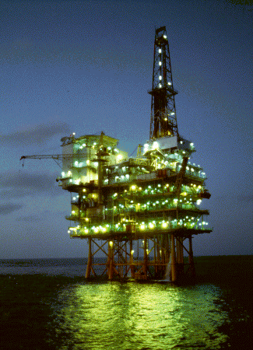
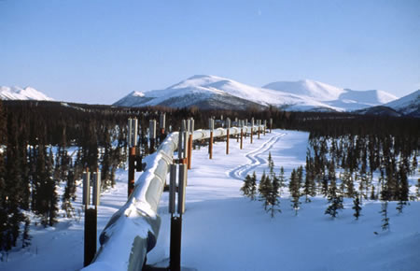
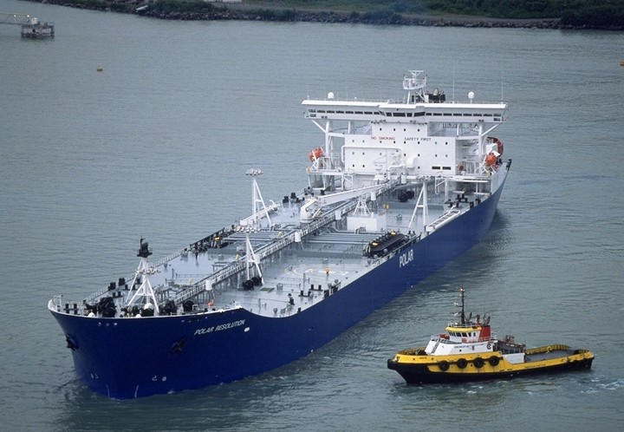
Additional Q & A
California Energy Commission

