Slide 1

Renewable and Alternative Fuels
2017 IEPR Commissioner Workshop on
Transportation Energy Supply Trends
July 6, 2017
Gordon Schremp
Energy Assessments Division
California Energy Commission
Gordon.schremp@energy.ca.gov
California Energy Commission

Slide 2
Presentation Topics
Ethanol overview
Biodiesel overview
Other emerging fuels
California Energy Commission

Slide 3
Ethanol Overview
California Energy Commission

Slide 4
United States Ethanol Production
Output reached a record 15.33 billion gallons during 2016 attributed to rising gasoline demand and the profitability of export markets outside of the United States. The phase-out of MTBE (due to ground water contamination concerns) and passage of the RFS are the events that resulted in a further expansion of ethanol use as a transportation fuel.
Sources: U.S. Department of Agriculture (USDA) and EIA.
California Energy Commission

Slide 5
California Fuel Ethanol Consumption
The transition to ethanol and away from MTBE began in California following Governor Gray Davis’ March 25, 1999 executive order to eliminate its use due to concerns of potential widespread contamination of drinking water sources.
Approximately 60 percent of gasoline was using ethanol by 2003
Transition away from MTBE completed by 2004
Ethanol use jumps from 6 to 10 percent by volume by January 2010
Sources: U.S. Federal Highway Administration (U.S. FHA), BOE) and California Energy Commission analysis.
California Energy Commission

Slide 6
United States Ethanol Supply and Demand
Since mid-2010 demand for ethanol has fluctuated, somewhat closely mirroring changing gasoline demand as the average concentration of ethanol stays at or near 10 percent by volume.
Ethanol demand set a record in August 2016 of 974 thousand barrels per day
Sources: EIA and California Energy Commission analysis.
California Energy Commission

Slide 7
United States Ethanol Imports
The oversupply of domestic ethanol and relatively low prices in the United States have resulted in declining ethanol imports over the last three years. Most recently the predominant source country has been Brazil, a consequence of sugarcane ethanol’s lower carbon intensity value.
Sources: EIA and California Energy Commission analysis.
California Energy Commission

Slide 8
United States Ethanol Imports & Exports
Net exports have been rising since the summer of 2013.
65.6 TBD for 2016
Declining imports
Increasing exports
Sources: EIA, USDA Global Agricultural Trade System (GATS), and California Energy Commission analysis.
California Energy Commission

Slide 9
U.S. Ethanol Concentration in Gasoline
During the latter portion of 2016, ethanol concentration exceeded the blend wall during multiple months, a sign that sales of E15, E85 and other mid-range blends continue to grow as more of these types of fueling dispensers are installed throughout the country.
E15 offered for sale in 29 states, 809 sites
  Seasonal restriction
  No California locations
E85 offered for sale at more than 3,200 sites
Sources: California Energy Commission analysis of EIA data.
California Energy Commission

Slide 10
Ethanol Industry Profitability
Declining ethanol prices eroded profitability during most of 2015 & early portion of 2016.
Sources: Data from Ag Decision Maker, Iowa State University.
California Energy Commission

Slide 11
Ethanol Plant Revenue
Ethanol plants obtain revenue from the sale of fuel ethanol and to a lesser extent, co-products of ethanol production.
California facilities produce wet DGS, uses less energy
Corn oil production is an increasing revenue stream
Sources: Data from Ag Decision Maker, Iowa State University.
California Energy Commission

Slide 12
Ethanol Plant Feedstocks
The majority of fuel ethanol in the United States is produced in facilities that use corn as the primary feedstock.
Corn use to produce ethanol accounted for a record 5.266 billion bushels during 2016
Sorghum grain is also used to produce fuel ethanol, albeit in much smaller portions, estimated to have accounted for roughly 120 million bushels or 340 million gallons (2.2 percent) of all ethanol production during 2016
Source: USDA - National Agricultural Statistics Service.
California Energy Commission

Slide 13
United States Corn Demand by End Use
Source: USDA - National Agricultural Statistics Service.
California Energy Commission

Slide 14
U.S. Ethanol Plant Numbers and Capacities
The pace of construction and expansion of additional ethanol plants that use corn for a feedstock slowed because the RFS2 regulations allow obligated parties to use a maximum 15.0 billion gallons of year by that type of ethanol.
As of May 2017 there was an estimated 330 million gallons of idle ethanol production capacity in the United States, about 2.0 percent of total production capacity of 15.987 billion gallons
Sources: Renewable Fuels Association (RFA) and Energy Commission Analysis.
California Energy Commission

Slide 15
California Ethanol Supply Sources
88 percent of California’s ethanol supply was imported during 2016. Importance of marine infrastructure expected to grow as demand for Brazil sugarcane ethanol increases due to the LCFS.
CA rail imports averaged 72.36 gCO2e/MJ carbon intensity during 2016
CA producers averaged 70.23 gCO2e/MJ
Brazil imports averaged only 49.75 gCO2e/MJ
Sources: EIA, California Air Resources Board, and California Energy Commission analysis.
California Energy Commission

Slide 16


Brazilian Ethanol Overview
The ethanol market in Brazil varies significantly from U.S.
  Seasonal ethanol production
  Conversion flexibility – sugar vs. ethanol
  73 percent smaller annual output per ethanol facility
  23 percent higher ethanol yield per acre
  Higher concentration in gasoline fuels – 27 versus 10 percent by volume
Sources: Various and California Energy Commission analysis.
California Energy Commission

Slide 17
Brazil Ethanol Production
U.S. eclipsed Brazil as top global ethanol producer in 2006.
Hydrous ethanol used in flexible fuel vehicles
Sources: UNICA, MAPA, USDA FAS, and California Energy Commission analysis.
California Energy Commission

Slide 18
Brazil Ethanol Exports
Exports during 2016 totaled 474 million gallons, a decrease of 65 percent compared to the peak of 1.352 billion gallons during 2008.
United States is the destination that normally receives the greatest quantity of imports from Brazil for any single country, accounting for 44.3 percent of Brazil’s exports for 2016.
Sources: UNICA, Secex, and California Energy Commission analysis.
California Energy Commission

Slide 19
Brazil & U.S. Imports & Exports of Ethanol
U.S has shifted from a net importer from Brazil of 21 TBD in 2012 to a net exporter to Brazil of 15 TBD by 2016.
Sources: EIA, USDA Global Agricultural Trade System (GATS), and California Energy Commission analysis.
California Energy Commission

Slide 20
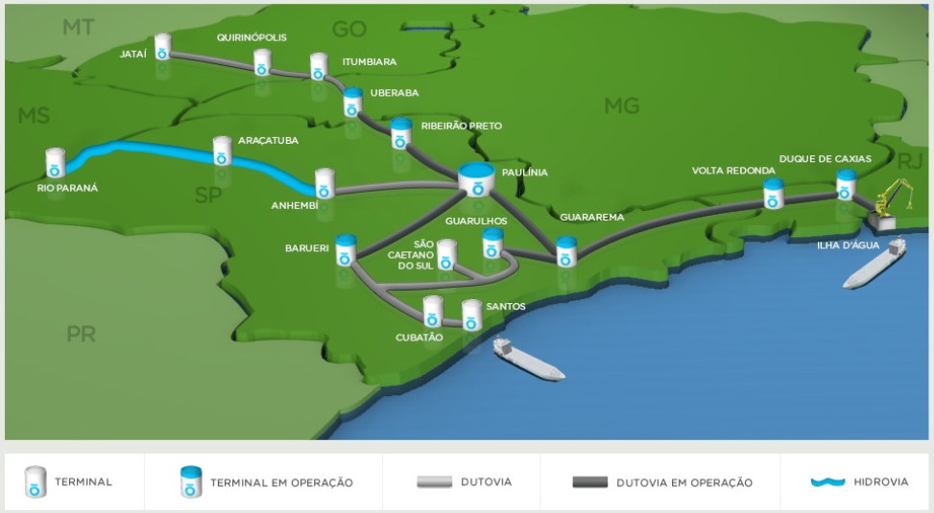
Expansion of Brazil Ethanol Export Infrastructure
During 2015, ethanol exports from the Port of Santos accounted for 90 percent of Brazil’s totals, followed by 7 percent from Paranaguá and 1 percent from Maceió.
Brazilian ethanol exports are forecast to grow from 474 million gallons in 2016 to 713 million gallons by 2025.
Brazil’s ability to supply significantly greater quantities of ethanol to the United States and California from excess production output over the next several years may be insufficient to meet the growing needs of federal and state renewable fuel programs.
Source: Empresa de Pesquisa Energética (EPE).
California Energy Commission

Slide 21
Biodiesel Overview
California Energy Commission

Slide 22
United States Biodiesel Production
Production of biodiesel in the United States dramatically increased in response to the RFS2 requirements and federal legislation that included a $1 per gallon blending credit for all biodiesel blended with conventional diesel fuel that went into effect in 2005.
The blending credit has been allowed to expire at the end of 2009, 2011, 2013, 2014, 2015, and 2016
Source: Energy Information Administration.
California Energy Commission

Slide 23
United States Biodiesel Supply and Demand
Demand for biodiesel as a transportation fuel has been erratic, primarily a consequence of changing subsidy policies and expensive feedstock costs.
Biodiesel consumption set a record in April 2016 of 166.3 thousand barrels per day
Growing net imports raising unfair trade practice concerns – 29 percent of 2016 demand
Source: EIA and California Energy Commission analysis.
California Energy Commission

Slide 24
U.S. Biodiesel Exports and Percentage of Total Supply
Exports as measured against total biodiesel supply have continued to decline, reaching a record low of 3.9 percent during 2016.
Source: Energy Information Administration.
California Energy Commission

Slide 25
U.S. Biodiesel Blending Levels
Average concentration of biodiesel in diesel fuel during July 2016 reached 4.75 percent, an all-time record.
Early year declines have likely been due to the expiration of the blenders’ tax credit that temporarily decreased the profitability of biodiesel sales and caused facilities to either reduce output or temporarily shutter operations
Sources: EIA and California Energy Commission analysis.
California Energy Commission

Slide 26
U.S. Biodiesel Operating Margins
Domestic biodiesel industry has periodically been under economic pressure due to: excess supply capacity; temporary loss of a $1 per gallon blenders’ credit; and expensive feedstock costs.
Source: Center for Agricultural and Rural Development, University of Iowa.
California Energy Commission

Slide 27
U.S. Feedstocks for Biodiesel Production
Significant diversity of feedstocks.
Soybean biodiesel can be used for RFS2 compliance
Source: Energy Information Administration.
California Energy Commission

Slide 28
U.S. Feedstocks – Less Soybean Oil - for Biodiesel Production
Corn oil, fats & greases more desirable feedstocks for biodiesel production under the LCFS.
Lower carbon intensity
Source: Energy Information Administration.
California Energy Commission

Slide 29
California Biodiesel Use by Type & Carbon Intensity
Soybean oil represented nearly 55 percent of all U.S. biodiesel production during 2016 but only 1.9 percent of all the biodiesel consumed in California during 2016.
Corn oil represented 11.7 percent of feedstock type for the U.S. during 2016 but a much higher portion (46.5 percent of supply) for California
Source: Analysis of California Air Resources Board LCFS data by Energy Commission.
California Energy Commission

Slide 30
California Biodiesel Sources & Average Carbon Intensity
Like ethanol, majority (75 percent) of biodiesel supply was imported.
Source: Analysis of California Air Resources Board LCFS data by Energy Commission.
California Energy Commission

Slide 31
Biodiesel Issues
  Biodiesel use in California would be expected to continue increasing to help achieve compliance with the LCFS – but near-term issues remain:
    Current biodiesel use is less than 5 percent - to enable an expansion of biodiesel use to an average concentration of 10 percent will likely require a combination of infrastructure investments (storage tanks & blending equipment) and possibly specific types of financial assistance to producers.
      One example of assistance could be some form of loan guarantee that enable producers to increase their purchase of feedstocks (higher monthly expenses). Even if a biodiesel producer has the equipment in place to produce more biodiesel, they may not have sufficient lines of credit nor be able to obtain a traditional loan to pay the higher up-front costs of expanded feedstock purchasing activities.
    Biodiesel blending limits could be capped at 5 percent by CARB‘s Alternative Diesel Fuel Regulation – effective January 1, 2018
      Purpose of regulation is to mitigate the potential oxides of nitrogen (NO_{x}) emissions associated with the use of biodiesel with diesel fuel
      Could last into 2022
California Energy Commission

Slide 32
Biodiesel Issues – Feedstock Availability
  A number of biofuels have superior carbon intensity values. However, the potential production volumes for these fuels will ultimately be limited to availability of the necessary feedstocks.
    Used Cooking Oil (UCO) Biodiesel
      California used 35.3 million gallons or 22 percent of the available domestic production during 2016
      Theoretical availability of biodiesel produced from used cooking oil could be as great as 3.0 billion gallons per year for the entire United States, if one assumes that the waste oil from every hotel and restaurant is collected and processed into biodiesel – possibly unrealistic due to increasing cost of collection
    Animal Fats Biodiesel
      California used only 2.6 million gallons or 1.7 percent of the available domestic production during 2016
      This feedstock yields a higher carbon intensity biodiesel that is less desirable compared to UCO and corn oil
      Animal fats and fish oils are a more significant feedstock resource to produce renewable diesel
California Energy Commission

Slide 33
Biodiesel Potential from Corn Oil Exports
California used 76.2 million gallons or 45 percent of the available domestic production of corn oil sourced biodiesel during 2016.
Conversion of all corn oil exports could yield up to 140 million additional gallons
Additional production of corn oil from ethanol plants is expected to only be of modest potential as nearly 95 percent of plants already extracting corn oil
Conversion of all other corn oil could yield another 428 million gallons – less likely due to more valuable end-uses
Source: Analysis of U.S. Department of Agriculture data.
California Energy Commission

Slide 34
Other Emerging Fuels
California Energy Commission

Slide 35
Other Emerging Fuels & Renewable Diesel
  Other alternative transportation fuels (such as conventional hydrogen, propane, compressed natural gas, and liquified natural gas), as well as other renewable transportation fuels (such as biomethane and renewable hydrogen) are not discussed here
    Fuels and Transportation Division of the California Energy Commission has a number of programs and projects designed to help foster expanded penetration of various alternative and renewable transportation fuel infrastructure and use
    Highlighting just one example would be the recent public workshop held on January 30, 2017 that focused on renewable hydrogen developments and activities
  Renewable diesel fuel is the remaining emerging fuel covered here due to its current commercial viability and LCFS effectiveness
California Energy Commission

Slide 36
LCFS Credit Sources by Fuel Type
Renewable diesel fuel accounted for 23.8 percent of ALL credits under the LCFS program during 2016 & 46.0 percent of the renewable liquid fuel credits.
Despite the fact that renewable diesel volumes only amounted to 15.8 percent of renewable liquid fuel (biodiesel, ethanol and renewable diesel) volumes that year.
Sources: California Air Resources Board.
California Energy Commission

Slide 37
California Renewable Diesel Consumption
Use over the last four years has steadily climbed to reach a record 249 million gallons by 2016 as additional production facilities came online and obligated parties under the state’s LCFS turned to ever greater quantities of renewable diesel to help achieve compliance with their carbon deficit for both gasoline and diesel fuel sales.
Sources: California Air Resources Board and Energy Commission analysis.
California Energy Commission

Slide 38
California Renewable Diesel Average Carbon Intensity
Fats & oils are the primary feedstocks. But corn oil use growing most recently due to much lower carbon intensity.
Source: Analysis of California Air Resources Board LCFS data by Energy Commission.
California Energy Commission

Slide 39

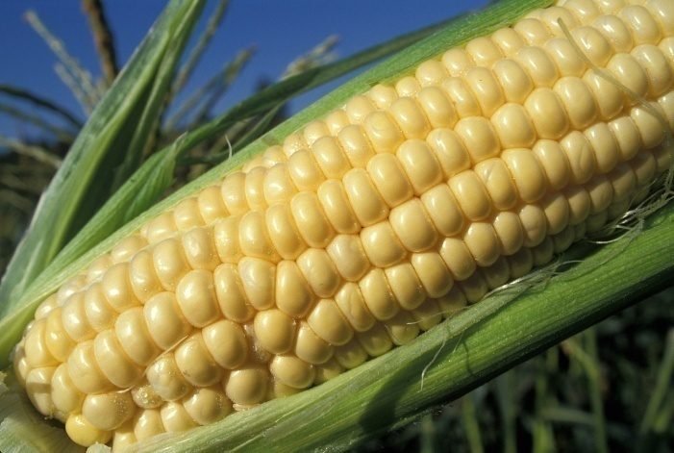
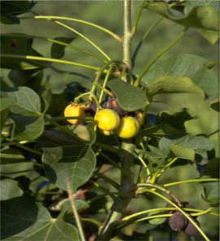

Additional Q & A
California Energy Commission

