Slide 1
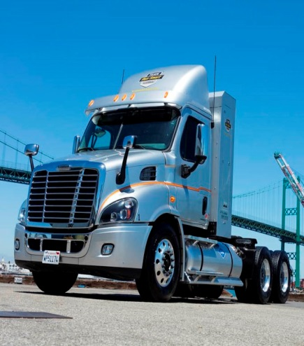
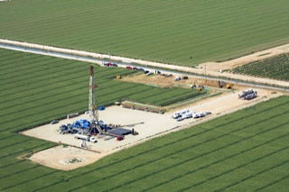

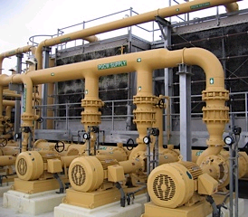
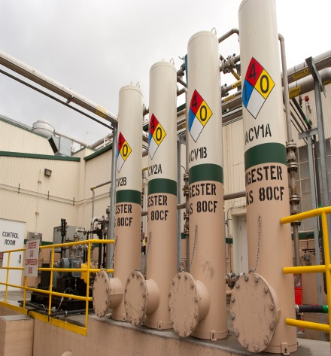
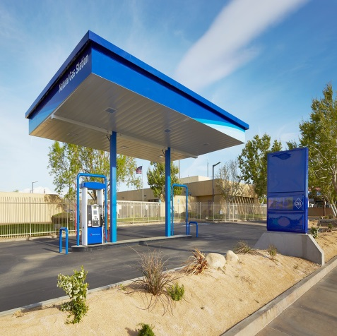


2016 California Gas Report
SoCalGas and SDG&E Forecast Overview
August 2016

Slide 2
Contents
Pages
3-6 Economic and Gas Price Outlook
7-17 SoCalGas Demand Forecast
18-25 SDG&E Gas Demand Forecast
26-28 Summary & CGR Team

Slide 3
Southern California Economic Outlook
Projected new housing is the main driver of forecasted residential
customer and demand growth.
Projected employment growth is the main driver for the
commercial and industrial demand forecasts.
From 2016 to 2035, annual employment growth is forecasted to average 0.8% in SoCalGas’ area and 1.1% in San Diego County.
The next few years should see continued gradual recovery in Southern California’s new home building and job growth.
Long-term job and housing growth trends slow as Baby Boomers retire.
Long-term job growth should stay slightly stronger than the U.S. average, with continuing foreign immigration of relatively younger workers into Southern California.
Notes:
US jobs (total nonfarm payroll employment) forecasted to grow an average of 0.78% per year from 2016 to 2035 –from Global Insight Feb 2016 Long Term Forecast of the US Economy (consistent with the Feb 0216 Regional forecast used in CGR).

Slide 4
Southern California New Home Building is in a Gradual Recovery
Up from a low of 21,000 in 2009 to 50,000 in 2015 to forecasted 86,000 in 2020.
Notes:
The 12 counties are: Fresno, Imperial, Kern, Kings, Los Angeles, Orange, Riverside, San Bernardino, San Luis Obispo, Santa Barbara, Tulare, and Ventura. Since portions of some of these counties are not served by SoCalGas, the exact SoCalGas territory is somewhat smaller than the 12-county total.

Slide 5
SoCalGas Customer Base Projected to Grow at Annual Rate of 0.5% from 2016 to 2035
2015 Active Meters totaled 5.67 million.

Slide 6
Projected Natural Gas Prices
Short-Term: NYMEX Futures
Long-Term: CEC, PIRA, Wood Mackenzie
Notes:
Rose Marie Payan’s nominal-price forecast, deflated by “JPGDP “ (US GDP deflator from Global Insight’s Feb 2016 forecast).

Slide 7
SoCalGas Demand Forecast Summary
From 2016 to 2035, SoCalGas’ total annual gas throughput decreases by an average of 0.6% per year.
Reductions from ambitious energy efficiency programs more than offset modest meter and employment growth.
Total Electric Generation (EG) load –including cogeneration--is expected to decline an average of 1.1% annually, from 288 Bcf in 2016 to 232 Bcf in 2035, mainly due to growth of renewable power and electric energy efficiency.
Natural Gas Vehicles (NGV) is the only market with fairly strong growth potential.

Slide 8
SoCalGas Demand Forecast Summary
Total load is expected to fall from 981 Bcf in 2016 to 869 Bcf in 2035, declining an average of 0.6% per year. (For comparison, annual decline of 0.3% was forecasted in the 2014 CGR, and annual growth of 0.1% in the 2012 CGR.)

Slide 9
SoCalGas Residential Gas Demand
Annual residential gas demand declines 0.5% per year from 239 Bcf in 2015 to 218 Bcf in 2035. Declining use per meter more than offsets new meter growth.
Aggressive energy efficiency programs --with tighter building shell and appliance efficiency standards -- are driving the declines in use per meter.
Since 2001, weather-normalized residential use per active meter has been dropping by 0.6% per year.
Adjusted for normal weather, 2015 use per active meter averaged 474 therms for single-family and 312 therms for multi-family.

Slide 10
SoCalGas Residential Gas Demand
Expected residential demand declines an average of 0.5% per year from 2015 to 2035.

Slide 11
SoCalGas Commercial Demand Forecast
SoCalGas Commercial Gas Demand (Bcf)
Commercial gas demand is expected to fall average of 1.0% per year, from 97 Bcf in 2015 to 80 Bcf in 2035.

Slide 12
SoCalGas Industrial Demand Forecast
Industrial load expected to decline by 0.6% per annum from 2015 to 2035.

Slide 13
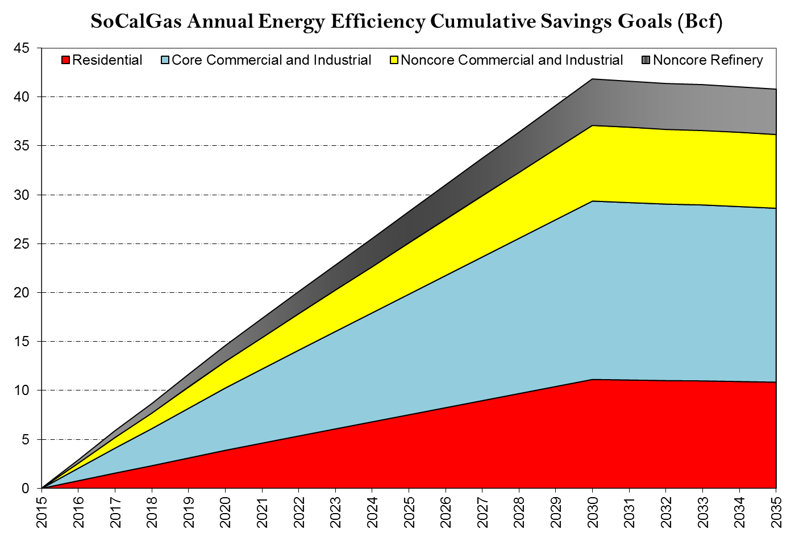
SoCalGas Energy Efficiency Goals
Most of the EE savings are in the Residential and Core C&I sectors.
Notes:
Goals are from CPUC Decision D. 15-10-028 “Energy Efficiency Goals for 2016 and Beyond”.

Slide 14
SoCalGas Gas-Fired Electric Generation (Bcf)
EG gas throughput declines 1.5% per year for Base Hydro and declines 1.25% per year for Dry Hydro.
Factors: Declining statewide electricity demand, higher renewable assumptions, and gas-fired generation mix.

Slide 15
Senate Bill 350
SB 350 was passed in October 2015.
  Renewable Portfolio Standards
    Before: 33% by 12/31/2020 and 33% thereafter.
    Current: 33% by 12/31/2020 and 50% by 12/31/2030.
  Energy Efficiency Programs
    To achieve a cumulative doubling of statewide energy efficiency savings in electricity and natural gas by 1/1/2030.
  California Independent System Operator (CAISO)
    It provides for the transformation of ISO into a regional ISO, with the approval of the Legislature.
    CAISO started the study process in December 2015, and published a report in July 2016; California ratepayers would save $Ms each year under a regional ISO.

Slide 16
Sempra-Wide Dispatchable Electric Generation Demand
Gas-fired generation capacity additions and retirement in the service areas:
  In SoCalGas’ service territory, approximately 2,000 MW of new thermal resources are projected to be added by 2025 and about 7,400 MW of older plants to be retired in the same period.
  In SDG&E’s service territory, about 800 MW of new thermal resources are predicted to be added by 2025, and about 1,100 MW of older plants to be retired.
This forecast assumes the shutdown of units from the state’s once-through-cooling (OTC) regulation.

Slide 17
SoCalGas Wholesale and Other Markets
SoCalGas provides wholesale transportation service in California to SDG&E, the City of Long Beach Gas and Oil Department, Southwest Gas Corporation, the City of Vernon, and to Ecogas in Mexico. Wholesale load excluding SDG&E is expected to increase from 25 Bcf in 2016 to 28 Bcf in 2035. SDG&E’s gas demand is forecasted to decrease an average of 0.4% per year from 131 Bcf in 2015 to 120 Bcf in 2035. (SDG&E details are in the following slides.)
NGV load in 2015 totaled over 13 Bcf and is expected to grow 3.3% per year, largely due to low natural gas prices relative to gasoline and diesel, as well as government incentives.
Annual EOR steaming demand is forecasted to remain steady at about 17 Bcf throughout the forecast period.

Slide 18
SDG&E Gas Demand Forecast Summary
From 2015 to 2035, SDG&E’s total annual gas throughput decreases by an average of 0.6% per year—about the same rate as SoCalGas’.
SDG&E’s decrease is mainly due to forecasted gas-fired Electric Generation (EG) load decline—which drops by an average of 1.1% annually from 2015 to 2035.
Residential gas load grows at a modest 0.5% per year, as customer growth more than offsets gas energy efficiency savings.
Commercial and Industrial gas demand drops an average of 0.7% annually, as energy efficiency effects outpace economic growth.

Slide 19
SDG&E Gas Customer Base Projected to Grow an Average of 1.2% per year from 2015 to 2035
2015 gas meters totaled 870,125

Slide 20
SDG&E’s Demand to Decline Moderately from 126 Bcf in 2015 to 112 Bcf by 2035
Requirements for Average Temperature and Normal Hydro Year (Bcf)
SDG&E’s demand decline averaging 0.6% per year is mainly due to declining EG load.

Slide 21
SDG&E Residential Market Expected to Experience Moderate Load Growth
SDGE’s residential load in 2015 was 31 Bcf – and is expected to grow an average of 0.5% per year to 34 Bcf by 2035.

Slide 22
SDG&E Commercial Demand Expected to Drop by 2 Bcf Over the Forecast Horizon
Annual Commercial Demand Forecast (Bcf)
From 2015 to 2035, combined core and noncore commercial load is expected to decline an average of 0.5% per year, from 19 Bcf to 17 Bcf.

Slide 23
SDG&E Industrial Demand Expected to Decline by nearly 1 Bcf Over the Forecast Horizon
In 2015, the combined core and noncore industrial load was 3.68 Bcf.
By 2035, the load is expected to drop to 2.72 Bcf, with annual declines averaging 1.5%.

Slide 24
SDG&E Gas-Fired Electric Generation Expected to Decline
SDG&E Total Electric Generation Gas Demand (Bcf)
Total EG gas demand (including cogeneration) is forecasted to decline an average of 1.1% per year, from 72 Bcf in 2015 to 58 Bcf in 2035.
EG gas demand would be relatively higher in dry years, as gas-fired EG compensates for less available west-coast hydropower.

Slide 25
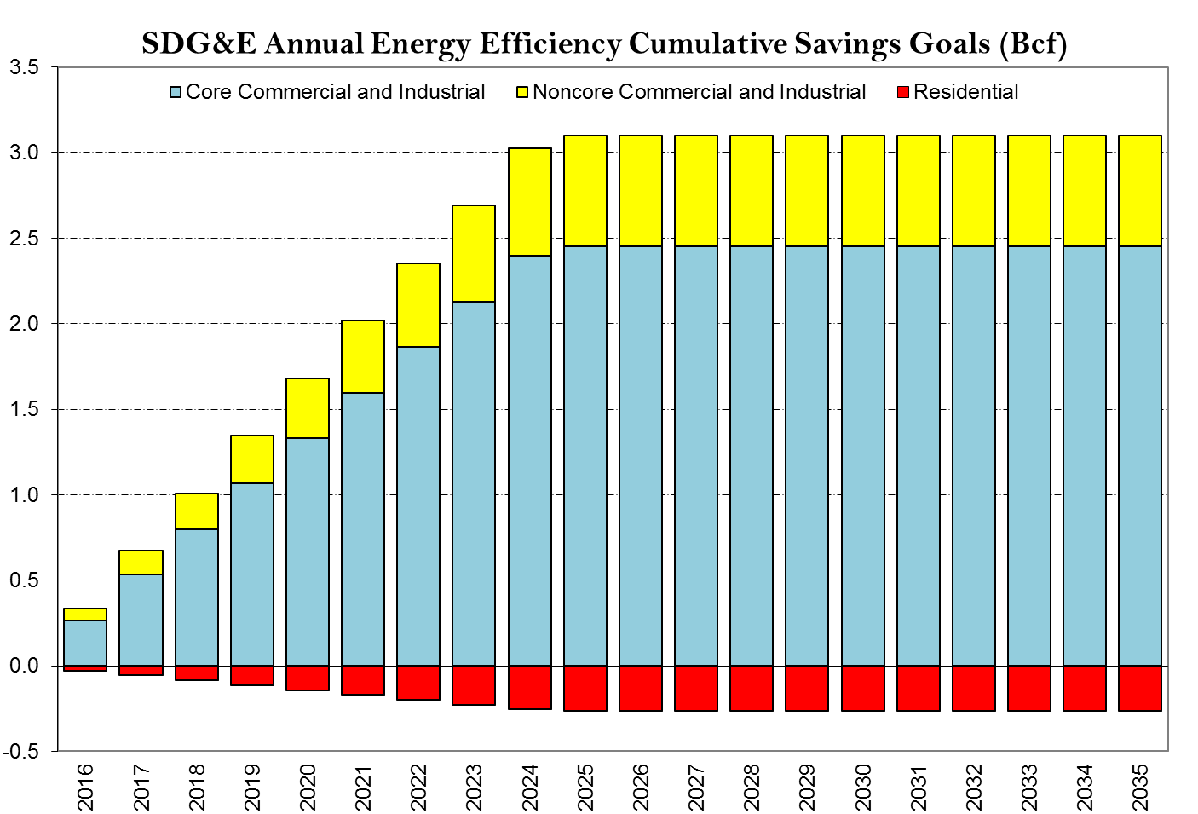
SDG&E Energy Efficiency Goals
Core C&I programs comprise the bulk of the EE savings.
25
Notes:
25
Goals are from CPUC Decision D. 15-10-028 “Energy Efficiency Goals for 2016 and Beyond”.

Slide 26
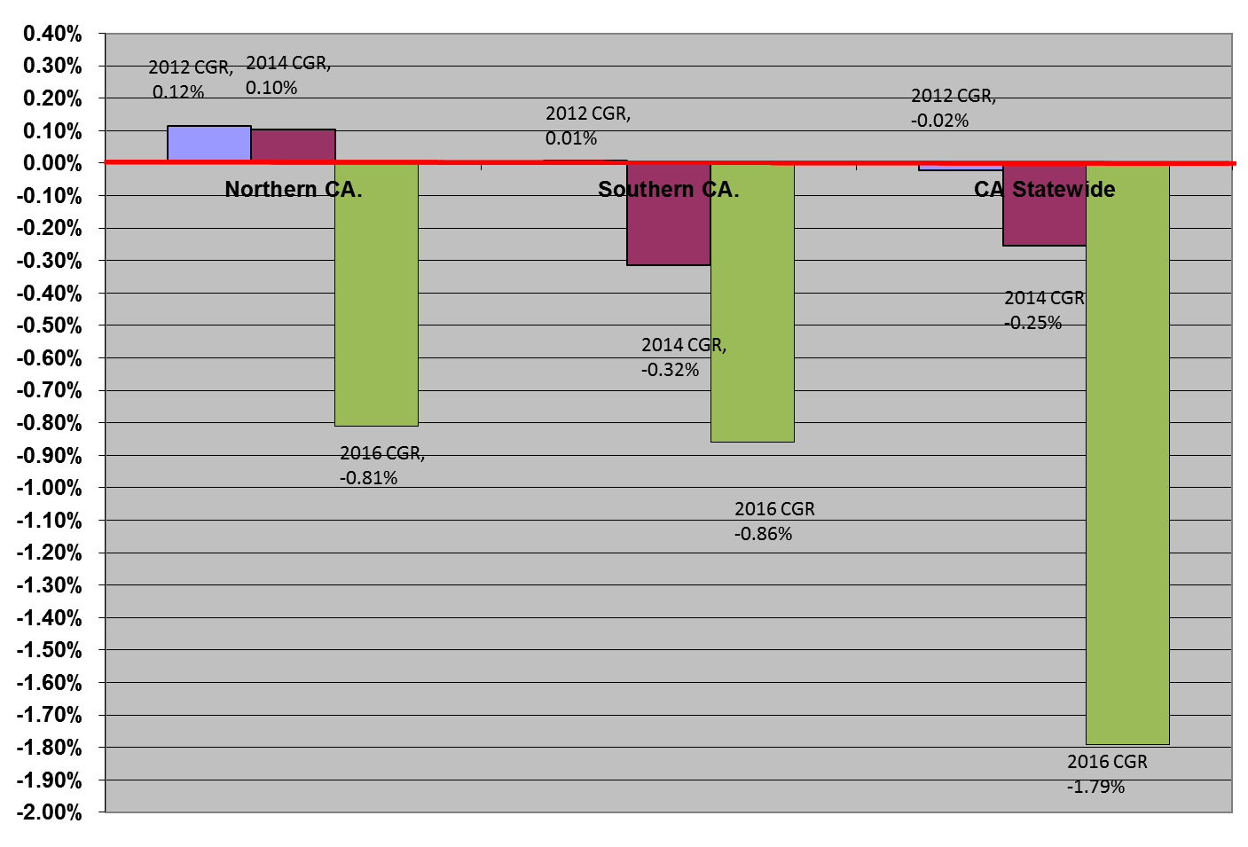
The 2016 CGR projects a demand decline for California from 2016-2030
Annual Growth Rates (%)
From 2016 to 2030, projected gas demand is declining at an annual average rate of 0.81% for Northern CA and -0.86% for Southern CA. Statewide growth expected to decline by -1.79%

Slide 27
Summary
California’s gas demand is projected to decrease an average of 1.79% per year from 2016 to 2030.
The SoCalGas end use demand forecast is expected to decline by -0.86% per year over the forecast period (2016-2030)
Moderate customer growth and a slow economic recovery, renewed efforts on EE and a 50% renewables target by 2030 for electricity generation are the main reasons for the slow decline.
Energy Efficiency programs will have a significant cumulative gas demand reduction effect in the commercial and industrial market segments.

Slide 28
Thanks to the 2016 CGR Team
Coordination and Consolidation | Rose Marie Payan, William Guo, Sharim Chaudhury, Scott Wilder
Economic Outlook | Scott Wilder
Gas Price & Alternative Fuels Forecast | Rose-Marie Payan
Gas Margin and Gas Rates | Marjorie Schmidt-Pines
Weather Assumptions | Greg Teplow
SoCalGas & SDG&E Customer Forecast | Rose-Marie Payan
SoCalGas & SDG&E Residential | Greg Teplow
SoCalGas & SDG&E Core Commercial | Rose-Marie Payan
SoCalGas & SDG&E Core Industrial | Clara Chu
SoCalGas & SDG&E Noncore C & I | William Guo; Scott Wilder
Oil Refineries | William Guo
Electric Generation | Jeff Huang
Enhanced Oil Recovery and Exchange | Gary Lenart and Rose-Marie Payan
Natural Gas Vehicles | Stan Sinclair
Wholesale and Mexicali | Gary Lenart, Tim Loon
Energy Efficiency Forecast | Athena Besa, Loan Nguyen, Andre Nih, Andrew Sickles, Andrew Steinberg
Recorded Data | Michelle Clay-Ijomah, Kathleen Donalson, Debbie Liou, Nancy Thom, Jungchi Wang
Regulatory Issues | Rafi Ahmed, Shirley Amrany, Elizabeth Baires, Greg Healy, Yvonne Mejia, Joe Mock
Document Layout Support | Chris Stephens
28
Notes:
28

