Slide 1
PROPOSED SCOPE OF THE
2017 NATURAL GAS OUTLOOK REPORT
California Energy Commission
IEPR Commissioner Workshop
April 25, 2017
Anthony Dixon
Supply Analysis Office
Energy Assessment Division

Slide 2
Background
About the Natural Gas Outlook Report:
  Produced every two years as part of the California Energy Commission’s Integrated Energy Policy Report (IEPR)
  Energy Commission statutory requirements:
    Section 25302 of the California Public Resources Code requires that the IEPR contains an overview of major energy trends and issues facing the state.
    Section 25303 of the California Public Resources Code requires the Energy Commission to conduct natural gas (and electricity) forecasting and assessment activities in support of the IEPR.

Slide 3
Topics: Modeling Results
Importance of Data Needs
2017 IEPR Common Cases/NAMGas Modeling Results:
  NAMGas (North American Market Gas - trade model)
  Mid demand case
  High demand/low price case
  Low demand/high price case
  Understanding market uncertainty
  Price trends
  Overview of the inputs and assumptions

Slide 4
Topics: Natural Gas Resources and Issues
Natural Gas Resources and Associated Issues
  U.S. and California production
  U.S. and California storage
  Reserves for U.S. and California
  Mexican and Canadian resources
  Hydraulic fracturing
  Emerging technologies

Slide 5
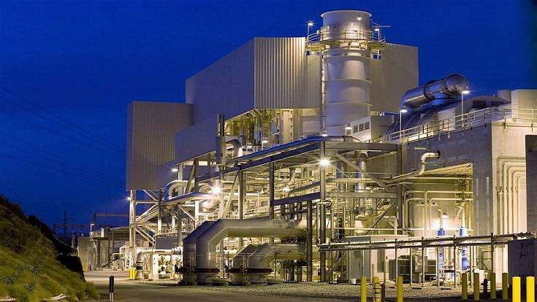
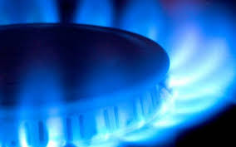
Topics: Natural Gas Demand
Understanding Demand for Natural Gas in North America:
  Discussion about the U.S. and California’s total demand
  Power generation demand
  Growth of renewables and their impact on natural gas demand

Slide 6
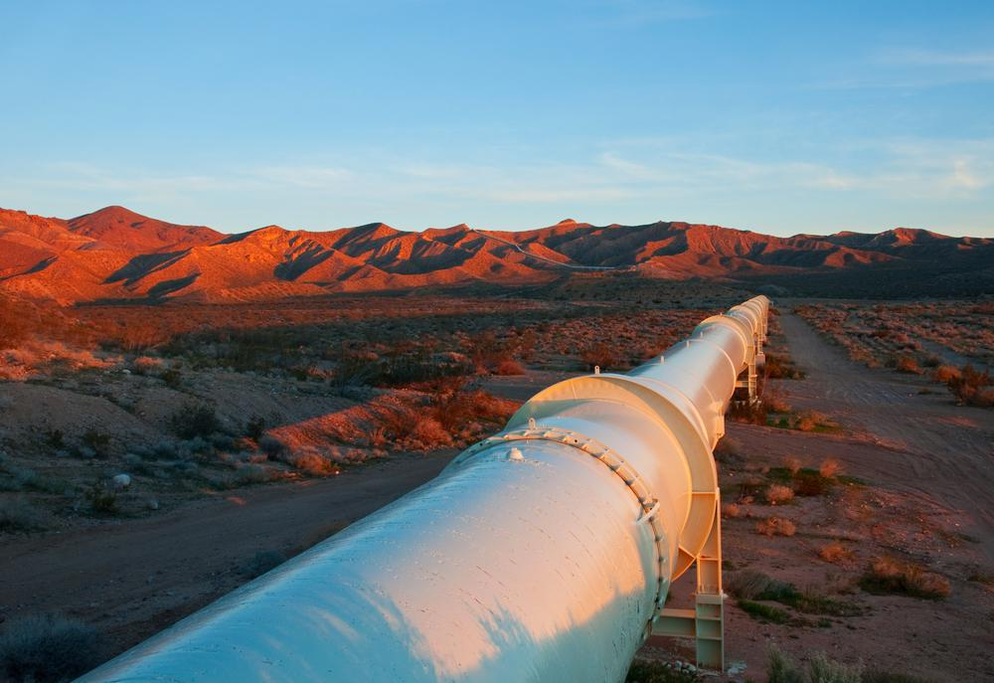
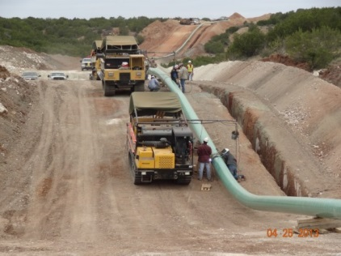
Topics: Development and Imports/Exports
Infrastructure Development and North American Import/Export
  Pipeline changes
  Pipeline development
  Pipeline safety
  Pipeline development in Mexico and Canada
  LNG imports and exports

Slide 7
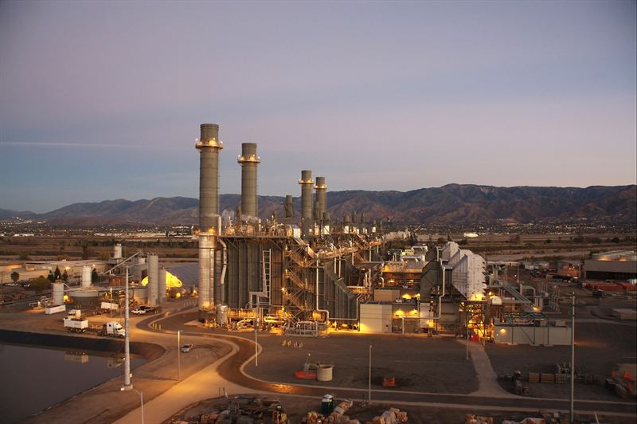

Topics: Power Generation Demand
Natural Gas Demand in the Power Generation Sector
  Discussion of PLEXOS
  Scenario development
  Renewable portfolio
  GHG price projections

Slide 8
Topics: Additional Issues
Additional emerging issues and areas of interest:
  Additional methane leakage studies
  Natural gas use in the transportation sector
  Impacts from hydro-electric generation variation
  Pipeline and LNG export
  El Paso South and exports to Mexico
  Declining California natural gas production
  U.S. and California subsidence issues
  Fuel switching in relation to ZNE

Slide 9
Future Modeling Issues
Possible future modeling considerations:
  Weather event scenarios, i.e. well freeze-offs
  Climate change (at the national level)
    Scripps is developing national heating and cooling degree days dataset
  Natural gas liquids
    Produced from ‘wet’ gas underground natural gas reservoirs

Slide 10

Questions and Comments
Public Questions and Comments?
Filing written comments:
Due May 9, 2017
File online here: http://www.energy.ca.gov/2017_energypolicy/
Select docket 17-IEPR-04 Natural Gas Outlook
Staff Contact:
Anthony Dixon
anthony.dixon@energy.ca.gov
(916) 654-4882

