Slide 1
Production Cost Model Common Case Input Assumptions and Selected Results
2017 Integrated Energy Policy Report
California Energy Commission
February 22, 2017
Angela Tanghetti
Supply Analysis Office
Energy Assessment Division
Angela.tanghetti@energy.ca.gov/916-654-4854

Slide 2
Topics to Cover
Common Case Overview
Load Forecast and Load Profile Update – Mr Load Shape
Energy Efficiency Projections
OTC Compliance Plans
Hydro Generation Projections
RPS Projections and RPS Portfolios
Selected Simulation Results

Slide 3
Preliminary 2017 IEPR
Common Cases
3

Slide 4
Preliminary 2017 IEPR
Load Forecast
California Loads - IEPR 2016 Update
http://www.energy.ca.gov/2016_energypolicy/documents/#02152017
Rest of WECC Loads – TEPPC 2026 Common Case
https://www.wecc.biz/SystemAdequacyPlanning/Pages/Datasets.aspx
Year 2027-2028 load forecast applies average annual growth rate from 2019-2026 to 2026 loads

Slide 5
Non California 2026 WECC Demand Forecast
Preliminary IEPR 2017 to IEPR 2015

Slide 6
Preliminary 2017 IEPR
Load Forecast
Hourly Load Profile Update – Mr Load Shape Tool
Spreadsheet tool that develops synthetic hourly load profiles based on the most recent 5 years historic loads.
Revised IEPR 2017 simulations will use the Demand Office Hourly profiles for California. Continue to use the Mr Load Shape synthetic hourly load profiles for rest of WECC.

Slide 7
Preliminary 2017 IEPR
Energy Efficiency
California Additional Achievable Energy Efficiency (AAEE)
http://www.energy.ca.gov/2016_energypolicy/documents/2016-12-08_workshop/additional_efficiency.php
The High AAEE Common Case starts with the Mid Case AAEE and applies the scaling factor provided in http://www.energy.ca.gov/2016publications/CEC-200-2016-007/CEC-200-2016-007.pdf
Rest of WECC Energy Efficiency assumptions are already included in the TEPPC 2026 Common Case

Slide 8
Preliminary 2017 IEPR
High Additional Achievable Energy Efficiency Case

Slide 9
Preliminary 2017 IEPR
OTC Compliance Plan Updates from 2015 IEPR
Encina Units 2-5 retirement deferred to 12/31/2018 and Encina Unit 1 retires 3/3/2017
Moss Landing Units 6-7 retired 12/31/2016
Moss Landing Units 1-2 expected to comply by 12/31/2020 and remain in service
Pittsburg Unit 5-7 retired 1/1/2017
Diablo Canyon Unit 1 retires 11/2/2024 and Unit 8/26/2025 per PG&E’s Joint Proposal Settlement Agreement
Compliance plans are identical across all common cases

Slide 10
California Monthly Hydroelectric Generation
2012-2016*
(Plants 10 MW and Larger)
Source: QFER CEC-1304 Power Plant Reporting Statistics

Slide 11
Preliminary 2017 California Average Monthly Hydroelectric Generation (Plants 10 MW and Larger)
Source: QFER CEC-1304 Power Plant Reporting Statistics

Slide 12
WECC State by State
Average Annual Hydroelectric Generation
Source: Energy Information Administration Forms 906 and 923, Alberta Electric System Operator
Average hydro generation forecast is identical across all three common cases

Slide 13
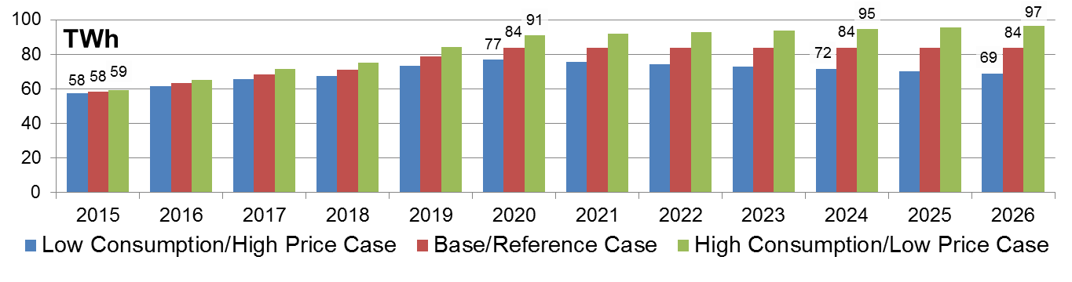
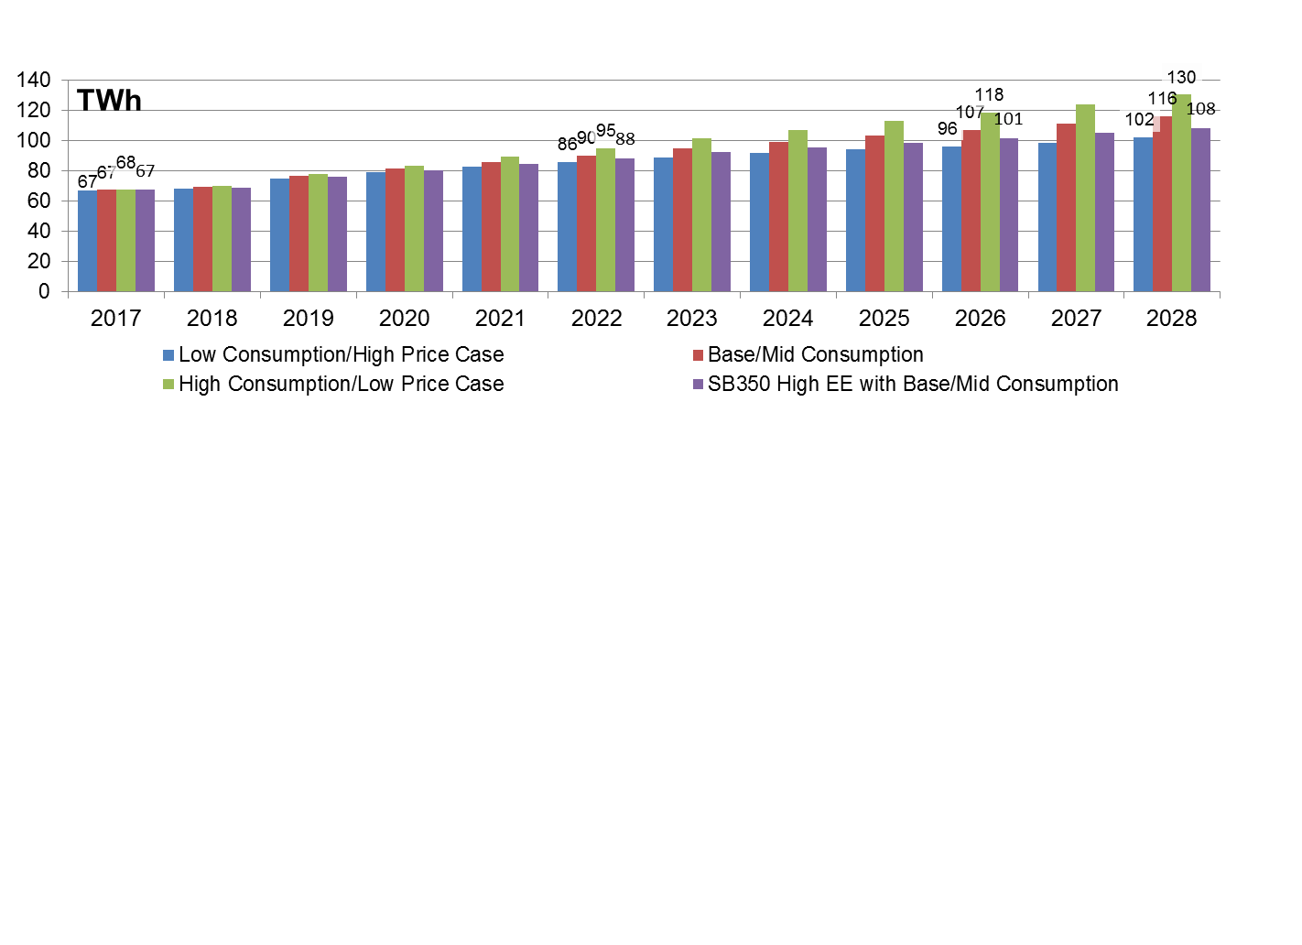
Annual RPS – Preliminary 2017 IEPR
Annual RPS – 2015 IEPR

Slide 14
California Natural Gas Use For Electric Generation
Input to NAMGas Model
2015 IEPR Compared to Preliminary 2017

Slide 15
WECC Wide Natural Gas Use For Electric Generation
Input to NAMGas Model
2015 IEPR Compared to Preliminary 2017

Slide 16
QUESTIONS

