Slide 1
Timeline, Forecast Structure, and Remaining Inputs and Assumptions for 2017 IEPR Demand Forecast
IEPR Workshop on Inputs and Assumptions for IEPR Modeling and Forecasting Activities
February 22, 2017
Chris Kavalec
Energy Assessments Division
Chris.Kavalec@energy.ca.gov / 916-654-5184
Notes:
Updated 1252013

Slide 2
IEPR Demand Forecast Process/Timeline
2017 IEPR demand forecast is full forecast rather than update as in 2016
Demand Forms and Instructions requested from LSEs at the end of 2016 (to be filed in February and April)
Workshop on forecast assumptions
Preliminary forecast/workshop (August 3, 2017)
Revised forecast/workshop (December 2017)

Slide 3
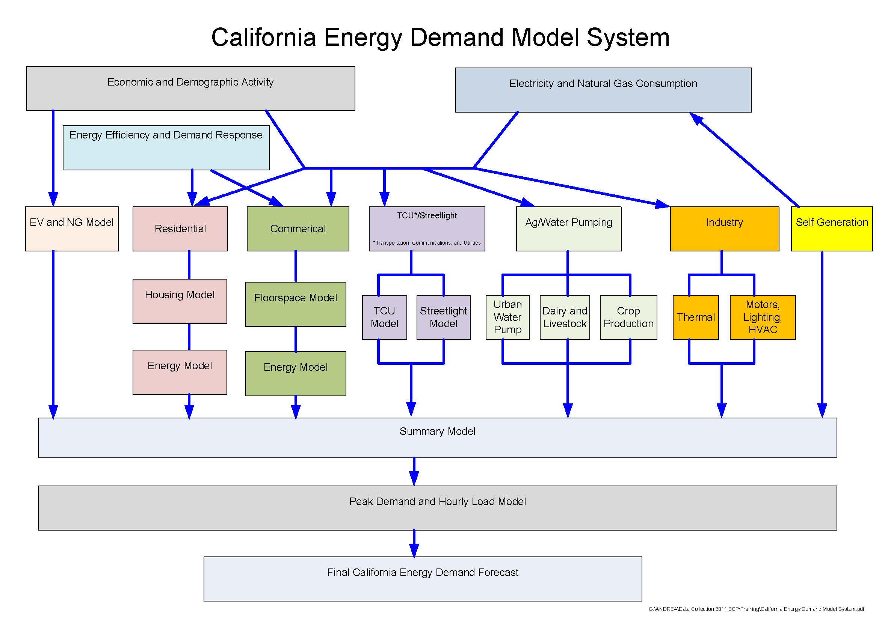
Forecast Summary: California Energy Demand Preliminary Forecast (CED 2015 Preliminary)
New geographic scheme
Electricity consumption down slightly compared to the 2014 forecast update because of lower EV forecast and update of standards impacts
Greater decrease in electricity sales and peak demand for IOUs because of higher PV projections
Baseline forecast only—no AAEE savings until revised forecast

Slide 4
Remaining Major Inputs and Assumptions
Efficiency
Demand Response
Other

Slide 5
Efficiency
IEPR demand forecasts distinguish between “committed” savings from initiatives that have been finalized, approved and/or implemented and additional achievable energy efficiency (AAEE)
“Baseline” forecast includes committed efficiency savings only
“Managed” forecast adjusts baseline to account for AAEE

Slide 6
Committed Efficiency
From forecast to forecast, some AAEE initiatives become committed. For the 2017 IEPR demand forecast, this includes:
  2016 Title 24 Building Standards
  2016 Appliance Standards
  2016 and 2017 IOU programs
  2016 POU programs

Slide 7
AAEE Savings
Because of timing of analyses, will be included in revised forecast, not in preliminary
IOU 2018 and beyond efficiency goal setting scheduled for completion in August 2017
  Energy Commission staff translates to AAEE
POU AAEE will come from potential studies, individual utility plans, and SB 350 target setting

Slide 8
Load-Modifying Demand Response
Non-event based: time-of-use rates and permanent load shifting
Event-based: critical peak pricing and peak time rebates
From annual IOU load impact reports
Impact on load typically 200-300 MW (IOUs combined)
Notes:
Mention possibility of additional achievable DR from potential studies

Slide 9
Other Inputs/Assumptions
Climate change impacts based on scenarios provided by Scripps Institute of Oceanography
Projected transportation electrification and high-speed rail impacts provided by Transportation Unit
Industrial CHP self-generation provided by Supply Analysis Office
Impact of legalized marijuana up for discussion

Slide 10
Questions/Comments?

