Slide 1

Retail Electric Rate Scenarios:
Inputs and Assumptions
2017 Integrated Energy Policy Report
California Energy Commission
February 22, 2017
Lynn Marshall
Supply Analysis Office
Energy Assessment Division
Lynn.Marshall@energy.ca.gov/916-654-4767

Slide 2
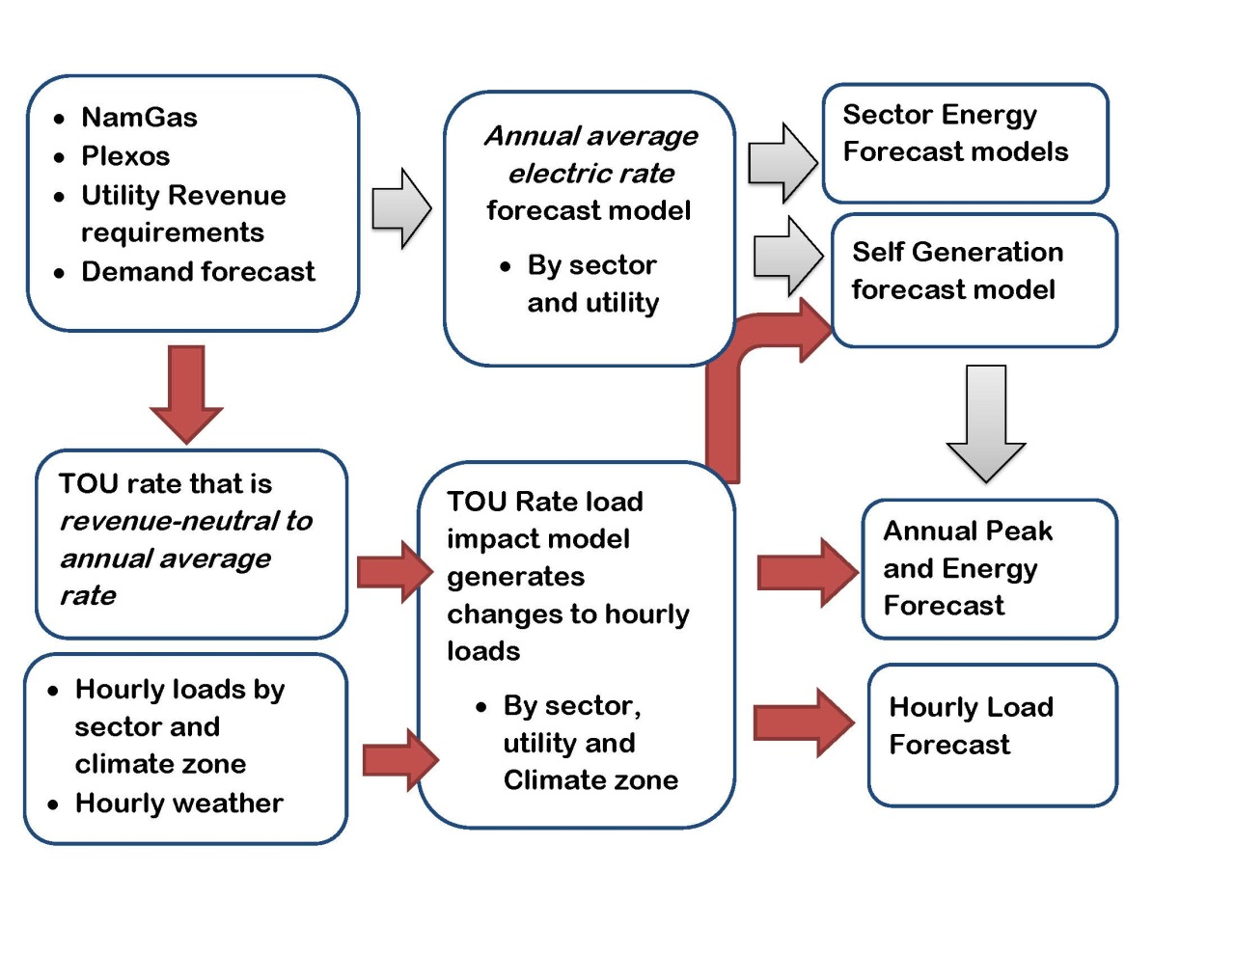
Electric Rate Projections:
Annual and Time-of-Use (TOU)

Slide 3
Annual Revenue Requirements Data Sources
Utility-specific data from IEPR supply and demand forms for IOUs and larger public utilities
Evaluation of GRC and electrification Applications
Distribution revenue requirement cases vary capital expenditure with demand, customer growth, and “grid modernization” capital.
Annual CAISO transmission charge forecast update
Joint Parties Petition to reduce IOU rate of return
  Reset each IOU's authorized cost of long-term debt and preferred stock in 2018; and
  Reduce each IOU’s authorized return on equity in 2018. (10.45 to 10.3%)

Slide 4
Fuel and Purchased Power
Market Price
  Forthcoming update to Cost of Generation model estimates for renewable resources and capacity costs
  Updated heat rate from 8,000 to 7,700
  Carbon Credit Allowance price forecast based on proposed CARB regulations
  Forthcoming Namgas hub prices
Utility-owned and existing contracts
  Utility-submitted forms will include current and projected energy and capacity resource mix by fuel type and associated procurement costs for non-gas-fired resources

Slide 5
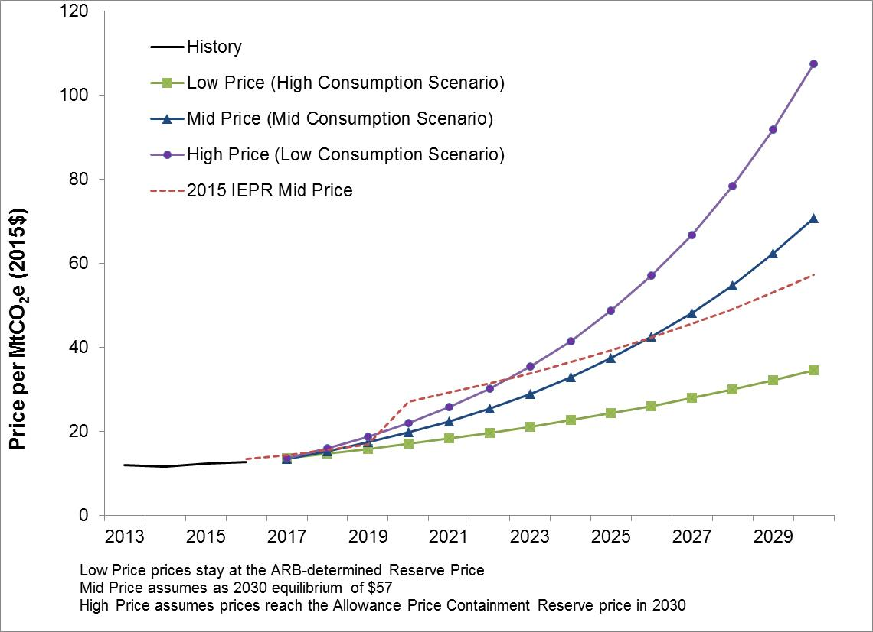
Preliminary Carbon Allowance Price Projections
Natural gas supply basins
Connected to
Interstate and Intrastate Pipelines
Connected to
Demand centers

Slide 6
Wholesale Energy and Renewable Price Projections
Natural gas supply basins
Connected to
Interstate and Intrastate Pipelines
Connected to
Demand centers

Slide 7
Hourly Costs and Cost Allocation
Allocate energy revenue requirements to sectors proportionate to sector load
  Use PLEXOS hourly prices for each scenario to shape energy costs to TOU periods
  IOU hourly (2020) capacity costs allocations.
Adjust sector allocations from current allocation proportionate to marginal cost trend.
Aggregate hourly costs to TOU period as reference for TOU rate design
Natural gas supply basins
Connected to
Interstate and Intrastate Pipelines
Connected to
Demand centers

Slide 8
Background on Residential TOU Activity
IOUs
Opt-in pilot of various rate designs began summer 2016 and continues through 2017
Default pilot begins 2018
Residential Default rollout in 2019
  Decision on exempt customers in 2017
Peak period shifting from late afternoon to early evening
SMUD Board has committed to default TOU
  Staff will model on the IOU timeline for now.
Natural gas supply basins
Connected to
Interstate and Intrastate Pipelines
Connected to
Demand centers

Slide 9
Nonresidential TOU Impacts
IOUs have been transitioning small/medium commercial and agriculture customers to time-varying rates for several years.
SDG&E and PG&E completed in 2016 and 2017.
SCE will simultaneously implement new TOU periods and default CPP for 500,000 accounts in late 2018.
Most effects are embedded or will be in 2017
Load impact studies for already-defaulted customers can be used to estimate the incremental impact of final migration and TOU period changes.
Natural gas supply basins
Connected to
Interstate and Intrastate Pipelines
Connected to
Demand centers

Slide 10
Modeling Incremental TOU impacts
  Calculate elasticities by climate zone, season or month, and day-type. For example, the CES (constant elasticity of substitution) formulation has two components:
    Peak/off-peak substitution elasticity accounts for load shifting from peak to off-peak (or super-off peak).
    Daily price elasticity measures reduction in total usage in response to a higher average daily seasonal price relative to the flat rate (i.e., the rate used in the sector forecasts).
  TOU rate must be calculated to be revenue neutral to the flat rate to capture incremental price effects
  Estimated elasticities should reflect effects of projected temperatures and air conditioning saturations

Slide 11
Modeling Incremental TOU impacts (2)
2. Estimate number of participating customers
3. Aggregate hourly customer loads to TOU periods.
  Load shapes should be adjusted for energy efficiency, distributed generation, and electrification
4. Apply elasticities to aggregated loads to produce modified hourly loads.

Slide 12
Elasticity Source Options
Statewide Pricing Pilot (SPP) 2003-2004:
  All 3 IOUs, varied climate zones, 18 months
  Econometric estimation of CES specification as a function of peak-to-offpeak temperature differential and AC saturation, by winter and summer.
  Opt-in only
  Somewhat different TOU periods (2-7) ; more focused on CPP rate
  2-period rate only
Staff has an initial model implemented using SPP model coefficients.

Slide 13
Elasticity Source Options (2)
SMUD SmartPricing Options Pilot (SPO) 2012-2013
SMUD only (90% saturation of air conditioning)
  Requires statistical adjustment for other climate zones
  Unawareness & complacency could vary by climate zone and utility
Summer only
Included both default and opt-in rates
One-third of defaulted customers were unaware they were on the rate.
SPO could be a basis for adjusting elasticities downward.

Slide 14
Elasticity Source Options (3)
2016-2017 IOU Opt-in Pilot
Evaluation results will include load impacts, but estimation of adjusted elasticities was not a study objective
  Various time periods and rate designs were studied, and sampling needed to address particular vulnerable groups.
Opt-in but “pay to play” design to attract “complacents”
Evening peak periods
Some three period rates, including weekends
Evaluation of summer load impacts are available now; full year results available in Sept. 2017; customer research is ongoing.
These results could provide a basis for evaluation and adjustment of adjustment of staff elasticities.

Slide 15
Key Rate Design Assumptions
Peak to off peak rate differential
  CPUC Resolutions on default pilot rates should indicate likely starting point.
  “The shift toward more fully cost-based price differentials may be made later, informed by data and experience ….” (CPUC D.15-07-001)
Number participating=Total – exempt- opt-out
  Decision in 2017 on exempt customers
Accounting for unawareness
Fixed charges may be allowed in 2020, reducing volumetric rates.

Slide 16
Rate Scenarios
  Mid Energy Demand Case:
    Mid demand, natural gas, and carbon prices
    Capital expenditure consistent with existing infrastructure plans, and customer and peak forecast
  High Energy Demand Case (Low Rates)
    Low natural gas and carbon prices
    More sales to recover transmission and distribution and other relatively fixed costs
    Less investment in infrastructure
  Low Energy Demand Case (High Rates)
    High natural gas and carbon prices
    Lower demand means fixed costs per kwh of sales are higher
    More investment to support distributed resources

Slide 17
TOU Scenarios
Mid Case
  Gradual increase in peak-to-off peak rate differential
  Moderate opt-out/unawareness (slight reduction in elasticity)
Low Demand/High Rates/High Engagement
  Fixed charge (or time-differentiated distribution charges) enables a lower off-peak rate, higher differential
  more engagement (higher substitution elasticity)
High Demand/Low Rates/Low Engagement
  Maintain differential at starting point
  Larger reduction to elasticities
Input from DAWG (March 17th) and revisit in Q3

Slide 18
Conclusions
Questions and Comments

