Slide 1

IEPR Workshop on California’s Economic and Demographic
Outlook
January 24, 2017
Presentation by
Karen Norene Mills
California Farm Bureau Federation
2300 River Plaza Dr.
Sacramento, CA 95833
(916) 561-5655
kmills@cfbf.com

Slide 2

Providing support for 2.5 million jobs, $56 billion in crop value...
California Farm Bureau Federation is a nonprofit organization of farmers and ranchers consisting of county Farm Bureaus from nearly every county in California, established in 1919 to work for the betterment of family farmers and ranchers in California. We are deeply committed to our mission, which is to improve the well-being and quality of life for California farmers and ranchers. We do this through advocacy, ongoing outreach, and economic services and products for those involved in agricultural production.
According to the California Department of Food and Agriculture, California’s agricultural abundance includes more than 400 commodities. Over a third of the country’s vegetables and two-thirds of the country’s fruits and nuts are grown in California. California’s top–10 valued commodities for 2015 are:
Milk — $6.29 billion Strawberries — $1.86 billion
Almonds — $5.33 billion Tomatoes — $1.71 billion
Grapes — $4.95 billion Poultry/Eggs — $1.7 billion
Cattle, Calves — $3.39 billion Walnuts — $977 million
Lettuce — $2.25 billion Hay — $945 million

Slide 3
PG&E Electricity Sales to Agricultural and
Pumping Customers, 1993-2012
(California Energy Commission, ECDMS http://www.ecdms.energy.ca.gov/elecbyutil.aspx)

Slide 4
California DWR Water Allocations, 2006-2016
(DWR Press Release)
 | DWR Water Allocation (% of requests) | 3‐Year Average Allocation (% of requests)
2006 | 100% | n/a
2007 | 60% | n/a
2008 | 35% | 65%
2009 | 40% | 45%
2010 | 50% | 42%
2011 | 80% | 57%
2012 | 65% | 65%
2013 | 35% | 60%
2014 | 5% | 35%
2015 | 20% | 20%
2016 | 60% | 28%

Slide 5
The CVP and SWP allocations are each assigned to an allocation bucket, and the average of those two buckets is charted against PG&E Ag sales in each year. Lower buckets represent lower allocations.
Buckets
Bucket 3: allocation >=50%: low load year
Bucket 2: allocation: 25-50%: medium load year
Bucket 1: allocation <25%: high load year

Slide 6
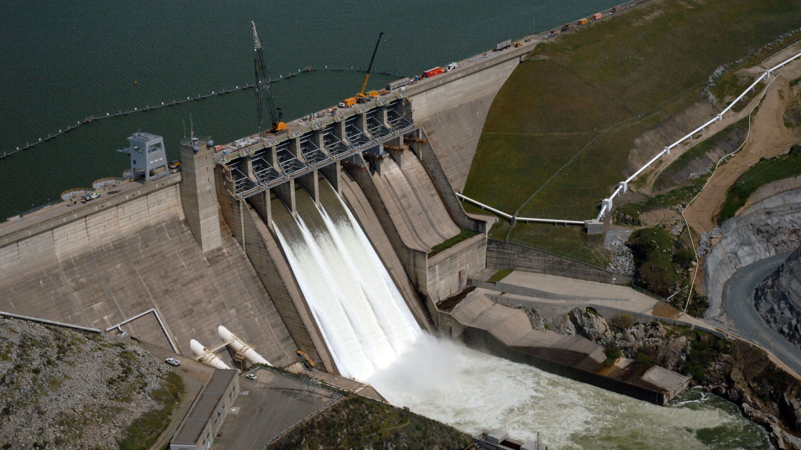
California built its last major reservoir in 1979 when the State’s population was 23 million people. Now the population is at 39 million.
This winter highlights the lost opportunity from the lack of new reservoirs to store more storm water when rain is delivered.

Slide 7
OTHER ISSUES IMPACTING AGRICULTURAL ELECTRICITY DEMAND
Changing TOU Periods
Sustainable Groundwater Management Act of 2014
On-Site Generation
Marijuana Legalization

