Slide 1
Energy Equity Indicators
Overview of
Draft Tracking Progress Report
Pamela Doughman, Ph.D.
April 4, 2018
California Energy Commission

Slide 2
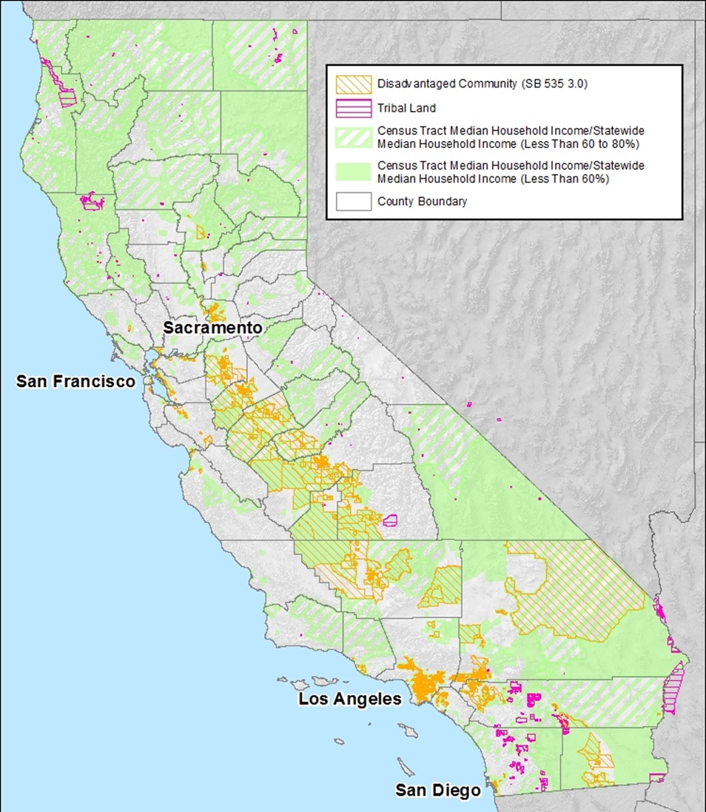
Overview of Indicators
Tracks Barriers Study Recommendations
Clean Energy Performance in Low-Income and Disadvantaged Communities
Points to Key Data Gaps and Additional Future Analysis

Slide 3
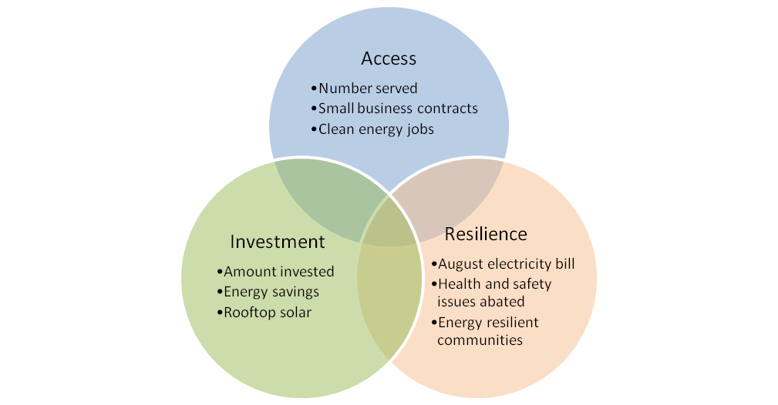
Energy Equity Objectives

Slide 4
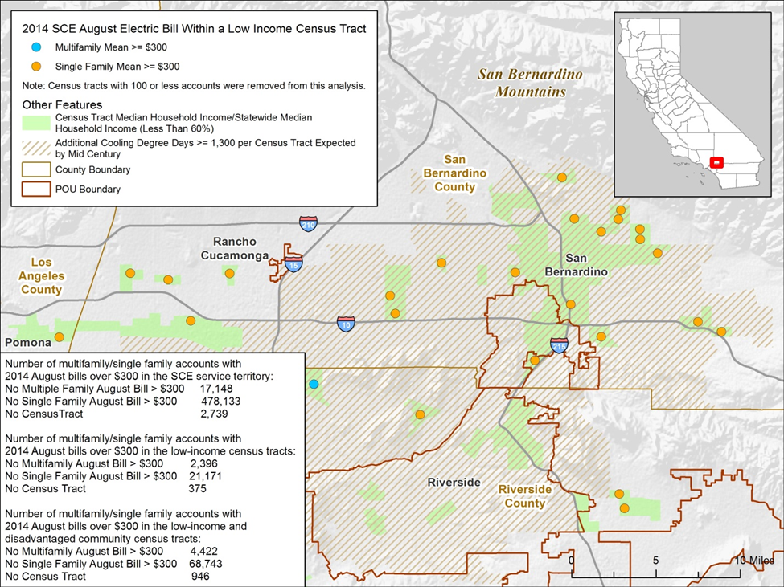
August Electricity Bill
Source: Energy Commission analysis based on CPUC historical data, CalAdapt for cooling degree days;
U.S. Census Bureau 2010 census tract boundaries; 2011-2015 ACS.

Slide 5
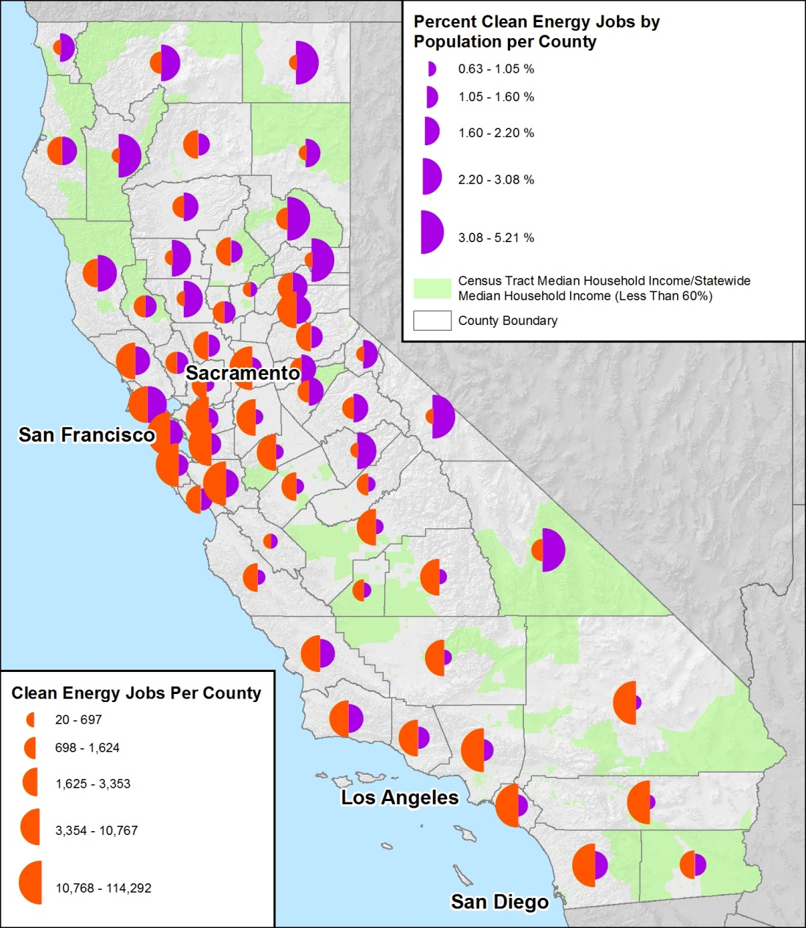
Clean Energy Jobs
Sources: Advanced Energy Economy Institute; U.S. Census Bureau. Semicircles are placed in the center of each county but represent data for the whole county.

Slide 6
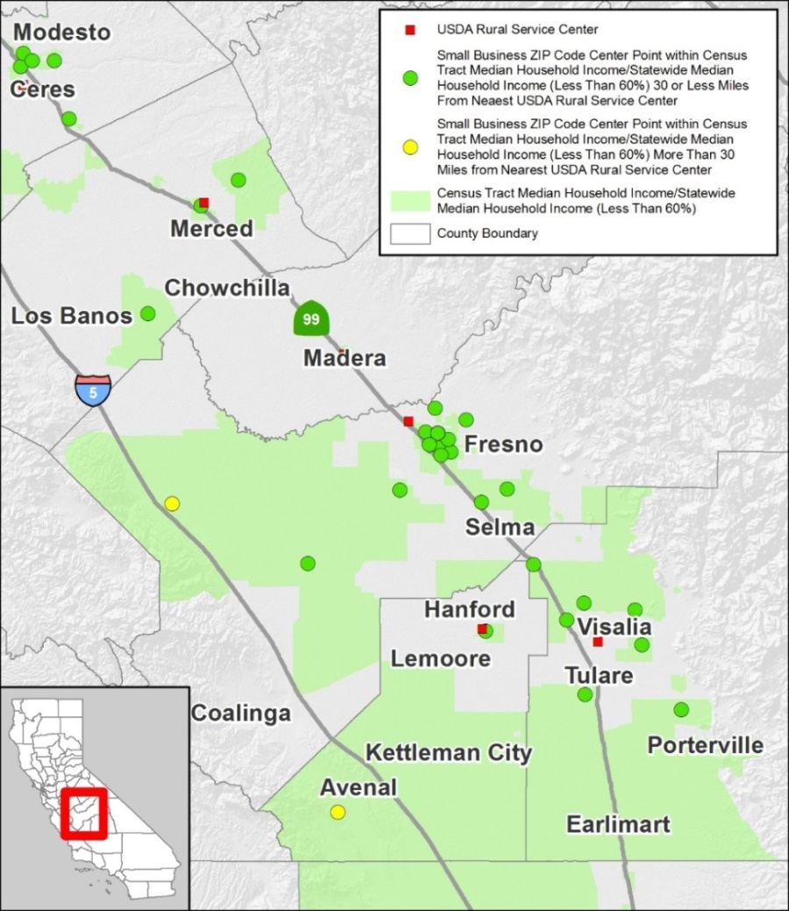
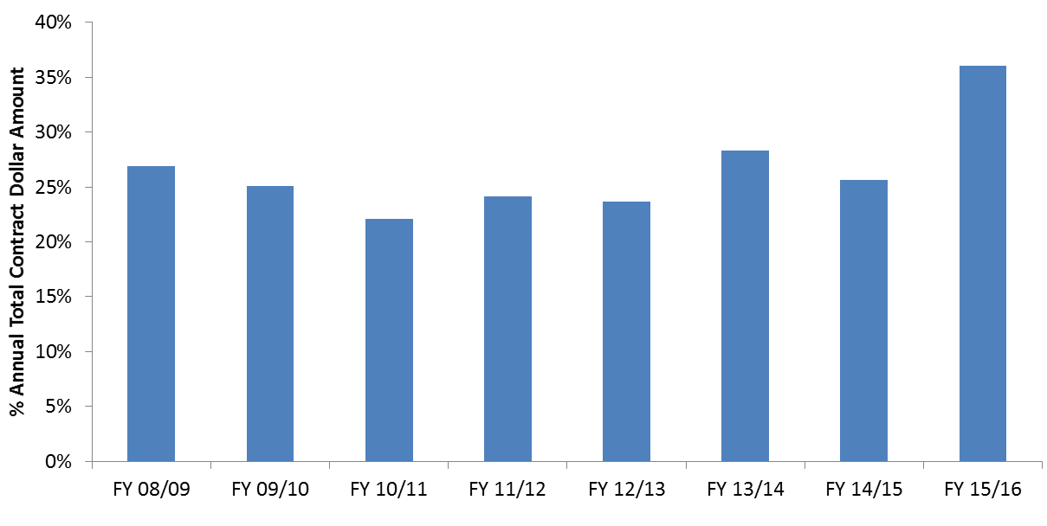
Small Business Opportunities
California Small and Microbusinesses
in Low-Income Areas
Percentage of California State Government Contract Dollars Awarded to Small Businesses and Microbusinesses:
Annual Results (Fiscal Year 2009-2015)
Source: Department of General Services
Source: U.S Department of Agriculture Service Center Locator; U.S. Census Bureau. https://offices.sc.egov.usda.gov/locator/app?state=us&agency=rd.

Slide 7
Process and Next Steps
Barriers Study Posted – December 2016
Draft Framework and Indicators – May 2017
Draft Tracking Progress Report – March 2018
Final tracking Progress Report – April 2018
Interactive Mapping Tool – Summer 2018
Annual Equity Indicators Update – December
Data Collection and Stakeholder Coordination – Ongoing

Slide 8
More Information
Energy Commission Tracking Progress Reports http://www.energy.ca.gov/renewables/tracking_progress/
Draft Energy Equity Indicators Tracking Progress Report http://www.energy.ca.gov/2018_energypolicy/documents/#03022018
Energy Commission Low-Income Barriers Study, Part A http://www.energy.ca.gov/sb350/barriers_report/
California Air Resources Board Clean Transportation Access Guidance Document (Barriers Study, Part B) https://www.arb.ca.gov/msprog/transoptions/transoptions.htm
SB 350 Disadvantaged Communities Advisory Group http://www.energy.ca.gov/sb350/DCAG/

Slide 9
Questions or Comments?
Pamela Doughman
Pamela.Doughman@energy.ca.gov
916-654-5166

