Slide 1

Introduction to CPUC Clean Energy Programs
Melicia Charles
Disadvantaged Communities Advisory Group Meeting
April 4, 2018

Slide 2
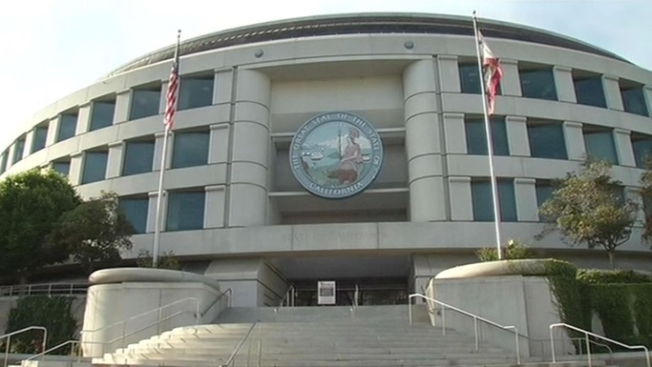
The Role of the CPUC
Regulates electricity, natural gas, telecommunications, water, and transportation
Oversight of the investor-owned utilities, including the three large electric utilities: PG&E, SCE, and SDG&E
“The CPUC regulates services and utilities, protects consumers, safeguards the environment, and assures Californian’s access to safe and reliable utility infrastructure and services.”
Notes:
CPUC works on energy, communications, water, and rail
Establishes rules and guidance for the utilities
Reviews and authorizes utility spending and program proposals
oversight and policy issues.

Slide 3

The CPUC regulates and oversees:
Retail rates through general rate cases
Quality of service, including safety and reliability
Resource Planning and Clean Energy Programs
  SB 350 and related legislation are key drivers of clean energy activities
Notes:
CPUC’s mission is to provide safe, reliable electricity and gas service at reasonable rate and to be a leader in environmental policies and programs.
There are other bills, but these are the two key guiding goals we are responding to
SB 350 – Clean Energy and Pollution Reduction Act of 2015
GHG emissions – 40% below 1990 levels by 2030
Renewables – 50% by 2030
EE – double EE savings for natural gas and electricity by 2030

Slide 4
CPUC SB 350-related Programs
Program | Program Purpose | Current Status
Multifamily Affordable Housing Solar Roofs Program (SOMAH) | Provides incentives for solar technology for multifamily housing in or outside DAC | An RFP was released for contracting an administrator of this statewide program
Single-family Affordable Solar Homes (SASH) Multifamily Affordable Solar Housing (MASH) | Provide incentives for solar technology on single and multifamily housing (both programs are for eligible buildings in or outside of DAC) | SASH- Program is underway MASH- Total budget committed
Alternatives for Expanding Solar in DAC (Proposed Decision) | Expand access to solar in DACs, generally for CARE/FERA customers | A proposed decision and the alternate have been issued proposing new green tariff, single family solar, and community solar programs
Notes:
Following the passage of SB 350, the CPUC has established, and is currently considering, a number of clean energy programs that focus on disadvantaged communities.
This list does not include other procurement and planning activities, such as Integrated Resource Planning and RPS, which also direct the IOUs to place a priority on disadvantaged communities when making procurement decisions.

Slide 5
CPUC SB 350-related Programs (cont.)
Program | Program Purpose | Current Status
Self-Generation Incentive Program Equity Program Budget | Provides incentives for (mostly) customer side storage for residents, non profits, and small businesses in disadvantaged communities and low income customers throughout State | Budget approved in October 2017. Applications are being accepted and/or are under review
Renewables Portfolio Standard (RPS) | Increase utility purchases of renewables to 33% by 2020 and 50% by 2030 | For 2018, procurement will be from the bioenergy (BioMat) and the Renewable Auction Mechanism (RAM) programs
Electric Vehicle Pilots | Provides rebates for Allocates 10-15% of budget to DACs | Programs are underway. $42 million approved for additional transportation electrification pilots
Electric Program Investment Charge (EPIC) Natural Gas Research and Development Program | EPIC- allocates 25% of budget to R&D projects in disadvantaged communities. 10% of budget must be allocated to low-income communities. (AB 523, Reyes) NG R&D –allocates a portion of budgets to projects in DACs | CEC Budget for third investment cycle approved in Jan 2018 IOU 2018 Natural Gas R&D Program Plan to be submitted in March
Notes:
On March 30th, the CPUC issued a proposed decision approving an additional $589 million in transportation electrification projects.

Slide 6
Other Programs for Low Income Households or Communities
Program | Purpose | Current Status
Energy Savings Assistance (ESA) Program | Provides no-cost weatherization services to low-income households | Programs are underway
California Alternate Rates for Energy (CARE) | Provides 30-35 percent discount on low-income customer bills | Programs are underway
San Joaquin Valley Affordable Energy Proceeding | Examines affordable alternatives to existing propane and wood fuels within the San Joaquin Valley. | IOUs will implement pilots for up to 12 communities.
Green Tariff Shared Renewables | Allows ratepayers to get 50 -100% of electricity from solar. 100 MW set aside for DACs | Programs are underway
Energy Storage | Allocates 500 MWs of storage at the distribution level, with priority given to public sector and low-income customers. | IOU applications were submitted on March 1.
Notes:
The CPUC has several energy programs that target low income households (in all parts of IOU territories) and others that have low income or disadvantaged communities’ goals, as defined by a statute other than SB 350. Most of those listed here aim to increase access to clean energy technologies or energy efficiency. The CARE program is a bill discount to qualifying households, wherever they reside.

Slide 7

Activities in 2018
Develop and implement clean energy programs to meet GHG reduction goals
Continued coordination with sister agencies to address SB 350 barriers
Develop an EJ Action Plan

Slide 8

Thank you!
For Additional Information:
http://www.cpuc.ca.gov/discom/

