Slide 1

Introduction to Energy Commission Clean Energy Programs
SB 350 Disadvantaged Communities Advisory Group Meeting
April 4, 2018
Michael J. Sokol
Special Coordinator – SB 350
California Energy Commission

Slide 2








About the Energy Commission
The agency driving our clean energy future
STANDARDS
RENEWABLES & TRANSPORTATION
LICENSING
EMERGENCIES
FORECASTS
RESEARCH

Slide 3
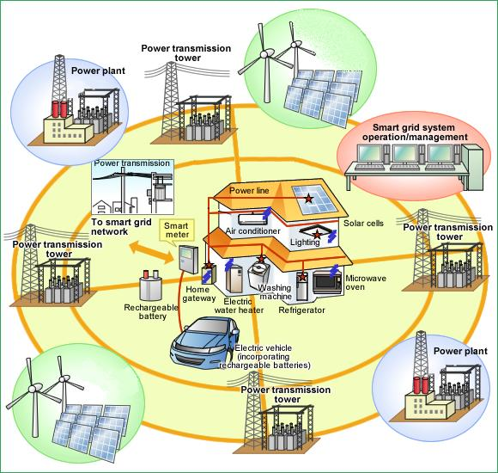
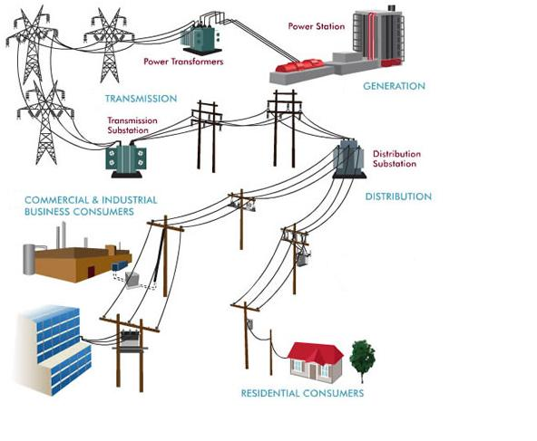
Supporting the Evolution of the Electricity Grid
Historical Grid → “Smart” Grid

Slide 4

SENATE BILL 350:
The Clean Energy and Pollution Reduction Act of 2015
50% renewable energy by 2030
Doubling energy efficiency savings by 2030
Encourages widespread transportation electrification
Integrated resource planning to reduce greenhouse gas emissions
Address barriers for low-income residents & disadvantaged communities

Slide 5
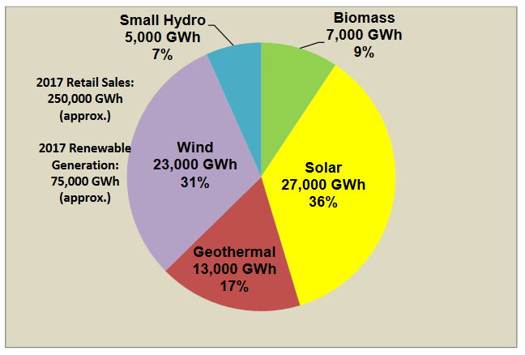
50% Renewable Portfolio Standard
“…require that the amount of electricity generated and sold to retail customers per year from eligible renewable energy resources be increased to 50% by December 31, 2030, as provided.” PRC § 25310(c)
More info at: http://www.energy.ca.gov/portfolio/
From Energy Commission Renewable Energy Tracking Progress – Updated November 2017 http://www.energy.ca.gov/renewables/tracking_progress/documents/renewable.pdf

Slide 6
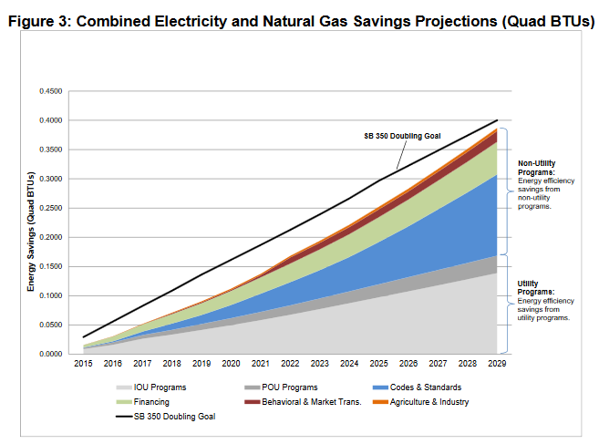
Doubling Energy Efficiency Savings
“…establish annual targets for statewide energy efficiency savings and demand reduction that will achieve a cumulative doubling of statewide energy efficiency savings in electricity and natural gas final end uses of retail customers by January 1, 2030.” PRC § 25310(c)
More info at: http://www.energy.ca.gov/sb350/doubling_efficiency_savings/

Slide 7
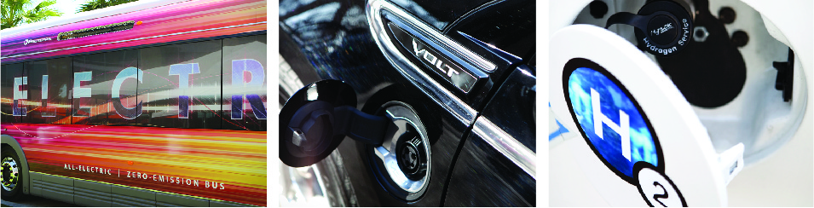
Transportation Electrification
“It is the policy of the state and intent of the Legislature to encourage transportation electrification as a means to achieve ambient air quality standards and the state’s climate goals.” PRC § 25310(c)
Utilities are required to address transportation electrification in integrated resource planning
More info at: http://www.energy.ca.gov/altfuels/2016-TRAN-01/

Slide 8
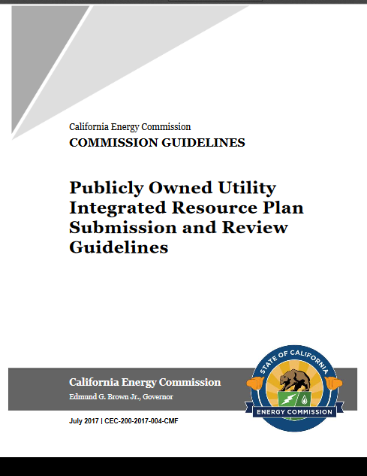
Integrated Resource Planning
“…adopt guidelines to govern the submission of information and data and reports needed to support the Energy Commission’s review of the [publicly owned] utility’s integrated resource plan…” PUC § 9622(c)
Guidelines adopted August 9, 2017
More info at: http://www.energy.ca.gov/sb350/IRPs/

Slide 9
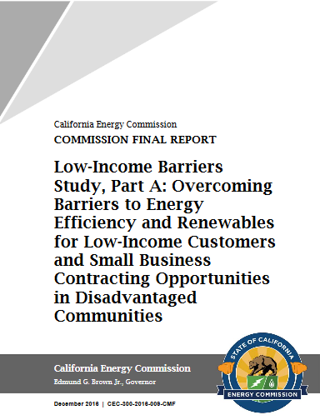
Low-Income Barriers Study
“conduct and complete a study on…
Barriers to, and opportunities for, solar photovoltaic… other renewable energy by low-income customers… contracting opportunities for local small businesses in disadvantaged communities… energy efficiency and weatherization investments...”
Report adopted December 14, 2016
http://www.energy.ca.gov/sb350/barriers_report/

Slide 10

Disadvantaged Community Advisory Group
“Establish an advisory group consisting of representatives from disadvantaged communities… shall review and provide advice on programs proposed to achieve clean energy and pollution reduction…” PUC § 400(g)
  More info at: http://www.energy.ca.gov/sb350/DCAG/

Slide 11

Grid Regionalization
“It is the intent of the Legislature to provide for the transformation of the Independent System Operator into a regional organization to promote the development of regional electricity transmission markets in the western states …” PUC § 395.5
More info at: http://www.energy.ca.gov/sb350/regional_grid/

Slide 12
Other SB 350 Requirements
“Review technology incentive, research, development, deployment, and market facilitation programs… provide benefits to disadvantaged communities...” PUC § 400(d)
“Establish a publicly available tracking system to provide up-to-date information on progress…” PUC § 400(f)
“...adopt, implement, and enforce a responsible contractor policy for use across all ratepayer-funded energy efficiency programs” & “establish consumer protection guidelines for energy efficiency products and services.” PUC § 25943(a)
Energy Data Collection Rulemakings to support SB 350 and AB 802 Implementation

Slide 13

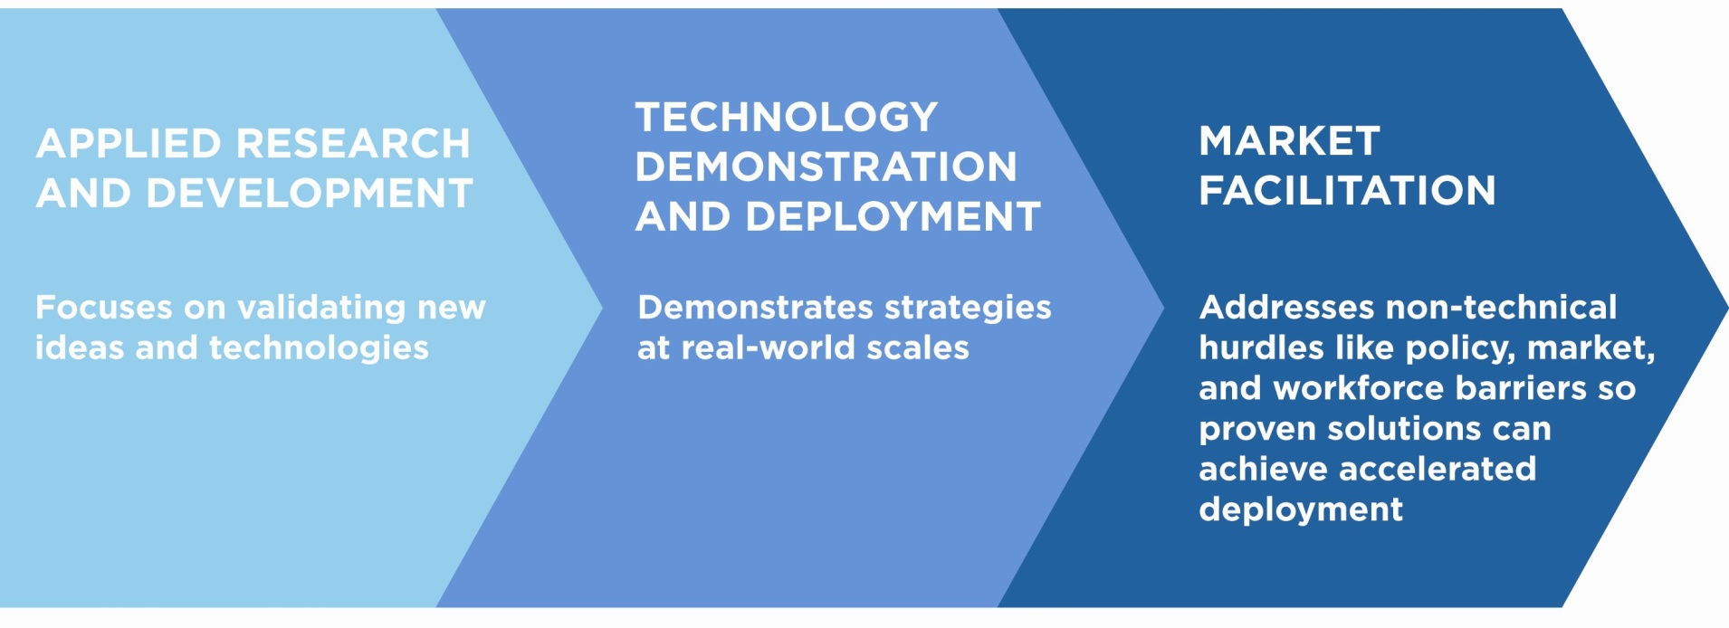
Electric Program Investment Charge (EPIC)
Established by CPUC in 2012 to fund investments to advance clean energy technologies and approaches for the benefit of investor-owned utility electricity ratepayers.
The Energy Commission administers approximately $130 million per year.
EPIC uses an energy innovation pipeline approach to creating new energy solutions, fostering regional innovation, and bringing clean energy ideas to the marketplace

Slide 14
Upcoming SB 350 Events
April 20: North Coast Regional Energy Perspective (Arcata)
May 15: Kern County Renewable Energy Perspective (Bakersfield)
May 16: Energy Equity Regional Workshop (Central Valley)
May 30: Energy Equity, Multifamily Buildings Distributed Energy Resources Action Plan (Sacramento)
June (TBD): Energy Equity Indicators Staff Webinar (Online)
August 29: Joint Agency Workshop on SB 350 Equity Achievements (Sacramento)
For more information, materials, and to sign up for listserve, go to: http://www.energy.ca.gov/2018_energypolicy/
*Most of the above workshops relate to 18-IEPR-08 Energy Equity

Slide 15
Information and Resources
2017 Integrated Energy Policy Report (IEPR) - http://www.energy.ca.gov/2017_energypolicy/
Energy Commission Funding Opportunities - http://www.energy.ca.gov/contracts/
Energy Commission Tracking Progress Reports - http://www.energy.ca.gov/renewables/tracking_progress/
Energy Commission Research and Development - http://www.energy.ca.gov/research/
California Alternative and Renewable Fuel and Vehicle Technology Program - http://www.energy.ca.gov/altfuels/
California Energy Almanac - http://www.energy.ca.gov/almanac/
California Climate Change Portal - http://climatechange.ca.gov/

Slide 16

Questions / Comments
Michael J. Sokol
Special Coordinator – SB 350
Michael.Sokol@energy.ca.gov
916-654-4516

