Slide 1
2016 Integrated Resource Plan: Imperial Irrigation District
April 18th, 2016

Slide 2
Integrated Recourse Plan Overview
Objectives of the Integrated Resource Plan (IRP)
IRP Development Process
Key Drivers Status
Accurate Load Forecast
Adjusting to SB350 Requirements
RPS Position

Slide 3
Objectives of the IRP
Support IID’s mission as a fiscally responsible public agency to provide reliable, efficient and affordably priced energy service to the communities it serves
Integrated Resource Plan Development
Transmission
Load Serving Requirements
Energy Commodity Trading
Local Renewables Development
Current and Future Generation Assets
Legislative & Regulatory

Slide 4
IRP Development Process
Each section within the Energy Department works together in a collaborative team effort
Key phases of the development process
Gather Key Input/Assumptions
Identify Strategic Alternatives & Scenarios
Simulate and Study Alternatives
Present and Review Findings

Slide 5
Key Drivers of IID IRP
Maintain System Reliability
Provide Competitive Rates
Environmental and Regulatory Responsibility
Balancing Authority Requirements
Maintain System Reliability
Env. & Reg. Resp.
Provide Competitive Rates
Balancing Authority Requirements

Slide 6
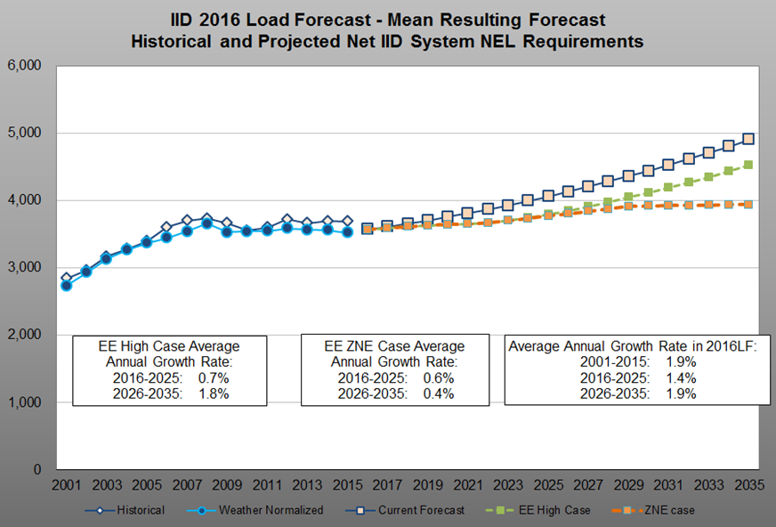
Accurate Load Forecast
3,616 GWH in 2017

Slide 7
Adjusting to SB350 Requirements
  GHG reduction requirements - 40% below 1990 levels by 2030
  Exit of coal agreements
  Renewable procurement (localized goal)
  Meet EE targets
  Acquisition of more emission efficient resources; or, the repowering of existing facilities
RPS targets – 50% by 2030
  Acquisition of cost effective renewable energy
  On target to meet 2020 internal goal of 35% and through 2025 (straight line approach)
  Sensitivity analysis within load forecast to ensure compliance within range of potential outcomes in load and renewable production

Slide 8
Adjusting to SB350 Requirements (Cont.)
  Vehicle Electrification/TOU rates/EE
    Study and recommend programs
    Impacts on Demand/Energy Forecasts
    Integration of other considerations that are affected by Vehicle Electrification
    Ensure that an ongoing process is developed to determine best approach

Slide 9
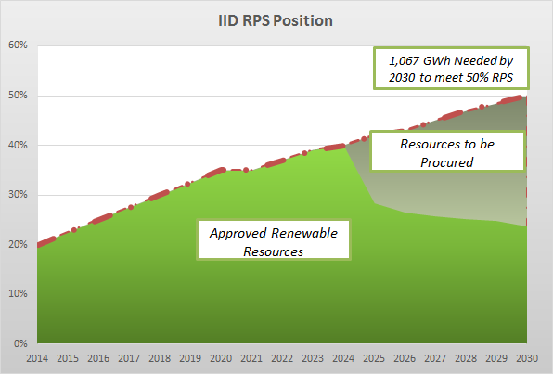
RPS Position

Slide 10
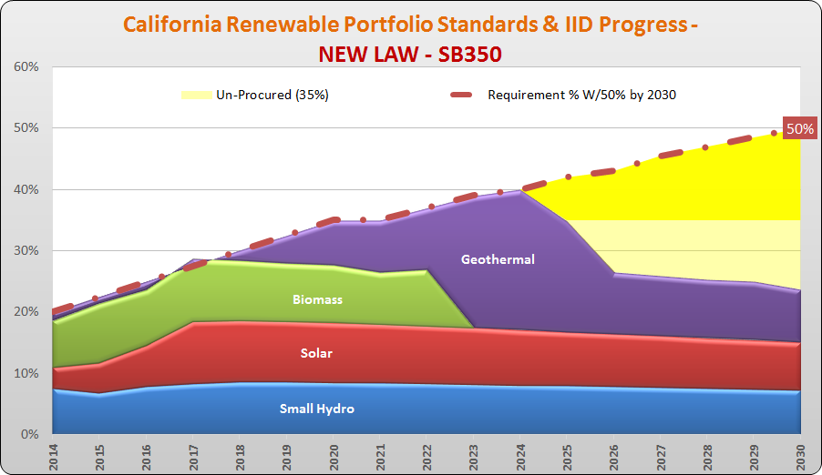
RPS Diversification

Slide 11
Elements of IID’s Base Case (Preferred Plan)
Competitive Rates
Optimal RPS portfolio
Regulatory/Legislation
Reliability Service
BA Requirements
Transmission
System Upgrades
CPS 1&2
Renewable integration
Reg up/down
Ancillary service
Optimal emissions reduction portfolio
SB350/SBx1-2
AB32
Cap & Trade
Emissions reduction
Energy efficiency
Electric vehicles
Clean Power Plan vs Cap & Trade
Program structure
Integration of various activities
Economic Dispatch
Unit cycling
New units
Retirements
Interconnection Control
Notes:
- These elements will be used and integrated in the IRP study process to allow for consideration of all IID energy dept goals and sectional objectives

Slide 12
Questions to be Addressed in IRP
What is best resource to add?
  Are new resources needed?
  When do old units need to retire?
How will IID meet 50% RPS?
  Are compliance mechanisms possible?
  Baseload vs Intermittent?
  Storage?
How does transmission expansion impact supply?
  Import opportunities?
  Export opportunities?
  Economic dispatch for sales opportunities?
Load Forecast
  Loss of Load Growth?
  Severe and Mild Cases?
  Impact on RPS?
Marketing Power?
  Economic dispatch and seasonal requirements?
  EIM? Avoid or join or use to our advantage?
  Buy/Sell Renewables?
New EE programs
  Vehicle Electrification?
  PV/NEM/DG?
  Community Solar?
Does RPS meet Cap and Trade requirements beyond 2020?
  What are allowances distribution outcomes beyond 2020?
  Impact if allowances are not original cost burden based?
  Carbon market portfolio?

