Slide 1
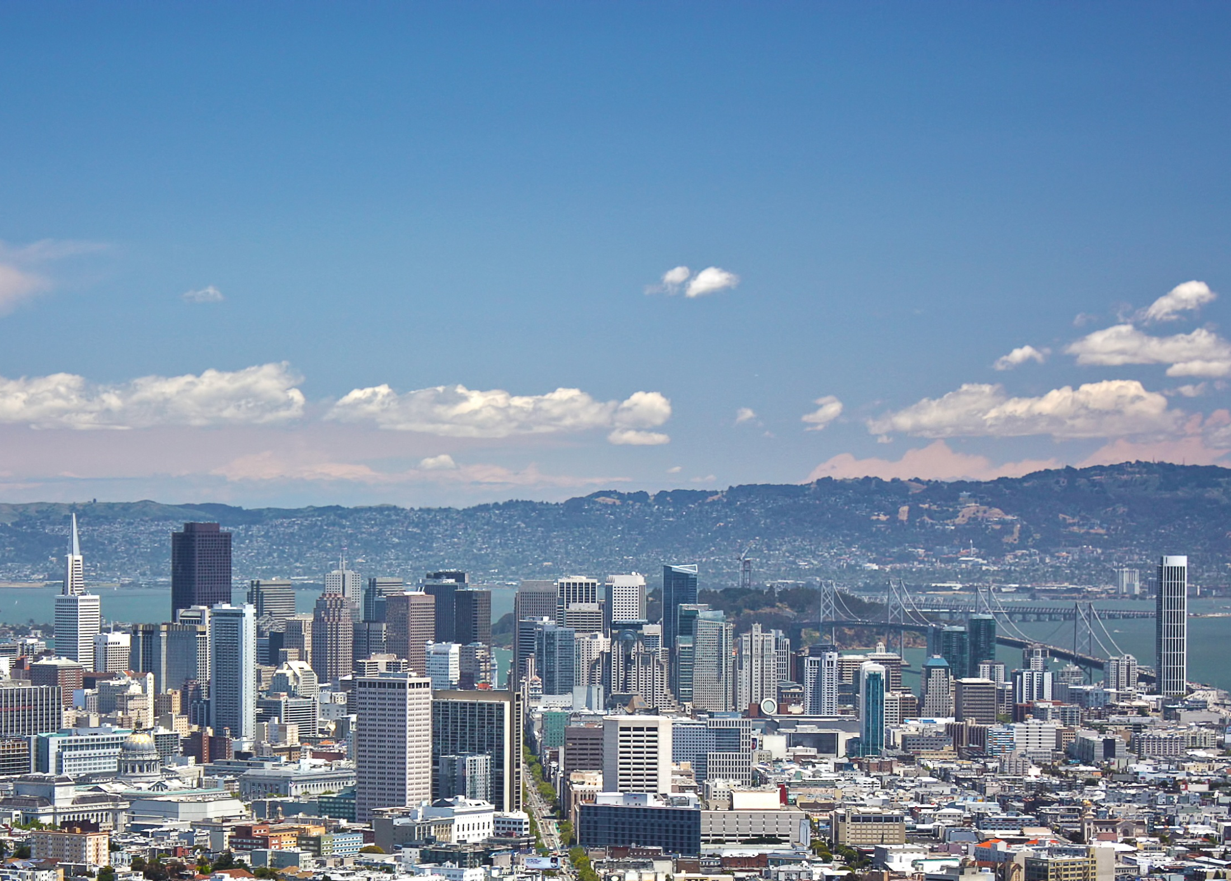

INTEGRATED RESOURCE PLANNING
SAN FRANCISCO PUC
JAMES HENDRY
SAN FRANCISCO PUC
1
Notes:
Image: San Francisco Downtown Aerial (shutterstock.com)

Slide 2

Hetch Hetchy Water & Power System
Capacity: 382 MW (hydro)
10 MW (solar/biomass)
Generation: 1,600 GWH
Lake Lloyd Reservoir (Cherry Lake)
Holm Powerhouse
Lake Eleanor Reservoir
Hetch Hetchy Reservoir
Foothill
Tunnel
Transmission
Cherry Power Tunnel
Mountain Tunnel
Canyon Power Tunnel
Illustration by Obscura
San Joaquin Pipelines
Moccasin Powerhouse
& Reservoir
Kirkwood Powerhouse
O’Shaughnessy Dam
Notes:
System is 380 MW
Transmission to Newark
PG&E for T&D
Load of 150 MW
Image: Illustration by Obscura for SFPUC

Slide 3
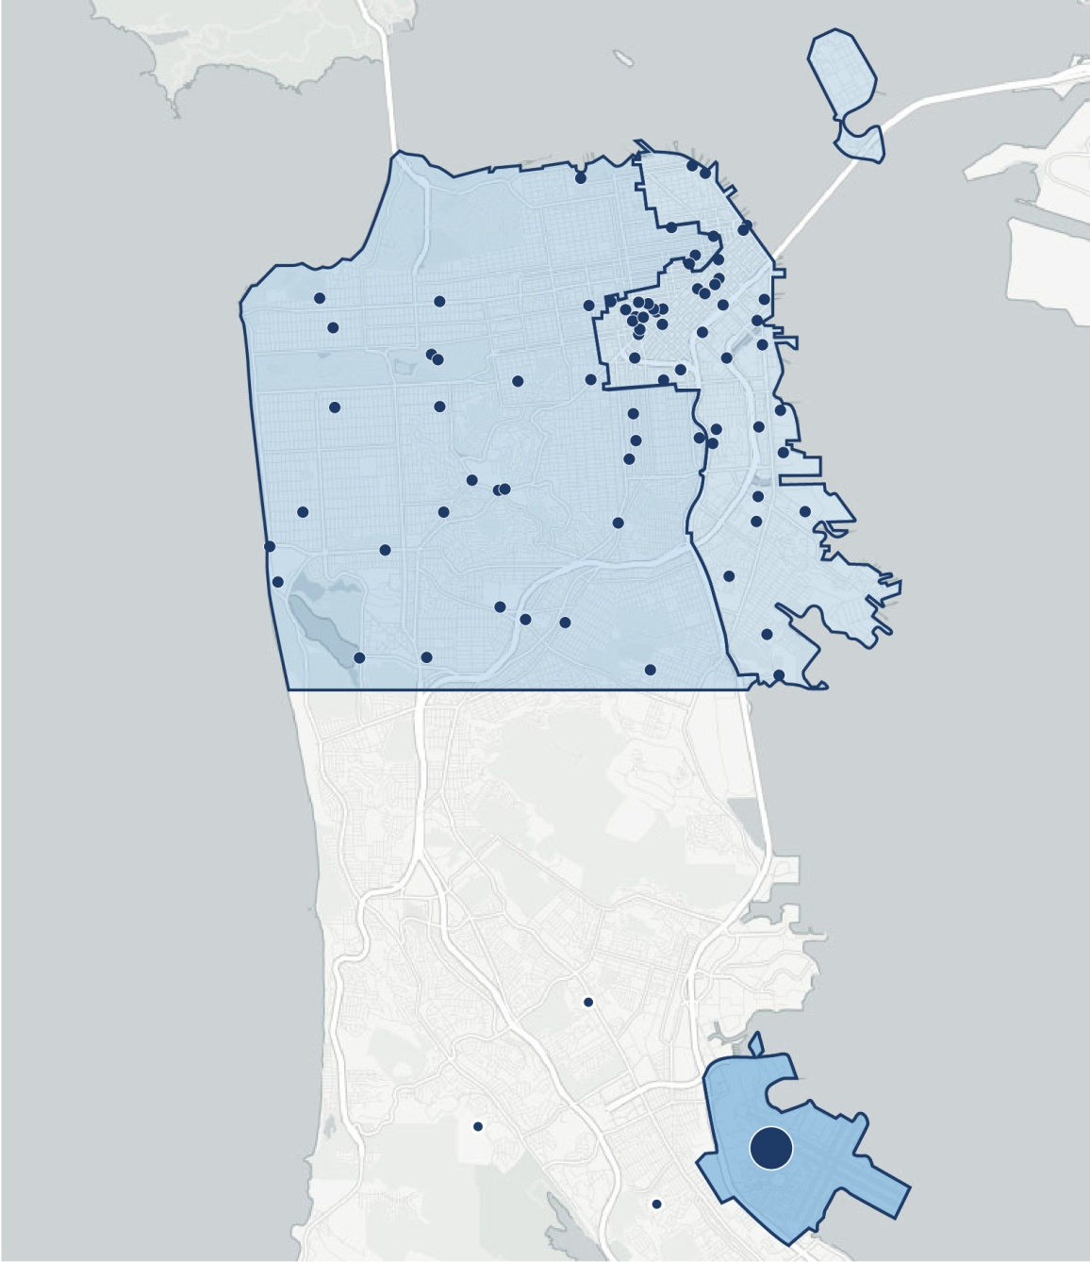


Power’s Full-Service Customer Base
Retail Sales
975 GWh
Other SF
50MW
Waterfront & Mid-Market
50MW
150 MW peak
2,600 accounts
Largest Customers
130 MW
100 accounts
Airport
50MW
In-City RPS
10 MW

Slide 4
Resource Planning at the SFPUC
Every Budget Cycle (2 yrs)
2015
Under Development
RPS Procurement Plan
SFPUC Business Plan
Integrated Resource Plan

Slide 5
RPS Procurement Plan
Resolution 12-0217
Requirement: Identify supply, demand, RPS needs in conjunction with SFPUC budget process (2 year budget cycle/10 year capital plan)
Results
SFPUC owns sufficient GHG-free and RPS resources to meet its needs in 5 out of 6 years
In dry years (1 out of 6) needs to procure small amounts (5 to 10%) of energy to meet demand
Given unpredictability of dry years, incremental needs should be met by short-term purchases

Slide 6

SFPUC Business Plan (2015)
Develop strategy to prioritize needed investments in Hetch Hetchy generation and transmission assets
Identify new load growth and business opportunities
Identify options to build-out and expand in-city distribution infrastructure

Slide 7

Integrated Resource Plan
SFPUC supported SB350 IRP requirement
Is developing IRP process / retained Black & Veatch (B&V)
Provides opportunity to better coordinate on-going planning
Will develop IRP before SB350 deadline
PG&E’s distribution system required for affordable access, unless we build our own system
Notes:
Image: San Francisco Aerial (Credit: Flickr Creative Commons Thomas Hawk)

Slide 8
General Conclusions from
SFPUC Planning Process
The SFPUC;
Will be 100% GHG-free and meet its RPS requirements
Has surplus GHG-free resources to accommodate additional growth
Has system RA equal to 150% of need
Can utilize hydro system to provide “storage-type” benefits such as ramping, flexible response, A/S
Continues to invest in local energy efficiency and solar

Slide 9
IRP – Current Status and Programs
Public Utilities Code | Integrated Resource Plan (IRP) Requirement | SFPUC Status
9621(b)(1) | Meet GHG reduction targets established by CARB | SFPUC is 100% GHG-free
9621(b)(2) | Meet RPS goals consistent with Article 16 of PU Code | SFPUC meets its alternative compliance obligation of procuring 100% of its energy from its own GHG-free and RPS-resources
454.52(a)(1) (C) and (D) | Minimize cost to ratepayers with just and reasonable rates | Cost-of-Service Study nearing completion to establish rates SFPUC Business Plan identifying ways to enhance utilization of existing resources
(E) | Ensure system/local reliability | SFPUC Business Plan studying build-out of in-city distribution system NERC Compliance efforts strengthening SFPUC transmission assets SFPUC active participant in CAISO Extreme Events Study resulting in upgrades to significantly improve resiliency of San Francisco transmission system
(F) | Strengthen sustainability of T&D system
(G) | Enhance distribution system/DSM
(H) | Minimize local air pollutants | SFPUC is 100% GHG-free SFPUC continues to develop in-city solar/energy efficiency programs Adopted Environmental Justice policy GoSolarSF program provides incentives for in-city solar development
9621(c)(1)(A) | Energy efficiency and demand response | FY 2014-15 energy efficiency projects saved 1,619 MWh (net savings) of electricity per year, at a utility cost of $2.5 million (CMUA SB1037 Report) 18,000 streetlights to be converted to LED in next 3 years
9621(c)(1)(B) | Energy storage requirements | Last AB2514 study determined Hetch Hetchy system provided same benefits as storage (e.g. ramping, ancillary services, flexible dispatch)
9621(c)(1)(C) | Transportation electrification | SFPUC provides 100% GHG free power to the nation’s largest fleet of electric buses and MUNI light-rail system
9621(c)(1)(D) | Diverse portfolio | SFPUC continues to develop in-city solar projects despite being long on resources; short-term needs met through diverse market purchases
9621(c)(1)(E) | Meet resource Adequacy Requirements | Available system RA capacity >150% of CAISO requirement

Slide 10

Thank You
CEC Integrated Resource Planning Workshop
April 18, 2016
Notes:
Image: Hetch Hetchy Reservoir (shutterstock.com)
Questions for next time: How do we implement the plan?
How do we access the achievable discretionary revenue?
How will we contain costs?
How will we mitigate risks?

