Slide 1

Silicon Valley Power
April 18, 2016
Notes:
Title Page
Calibri Font
No more than 3 lines
No smaller than 28 point font

Slide 2
Overview
Background
Ongoing Integrated Resource Planning Process
Incorporation of State Environmental Goals

Slide 3
Background

Slide 4
What is Silicon Valley Power
City of Santa Clara’s Municipal Electric Utility
Serve 120,000+ population, 53,000 customers
>500 MW peak, >3,000GWh/yr sales, flat load
  About 13 MW DER/PV, 19MWh/yr production
>90% of sales are Commercial and Industrial
  High Tech/Data Centers—reliability top concern
Long Term history of diverse generation portfolio

Slide 5
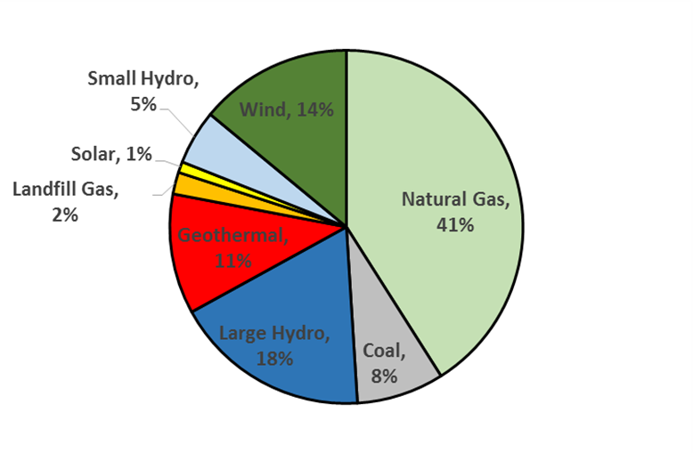
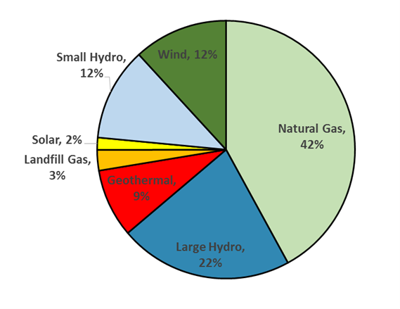
Power Resource Portfolio
SVP Resources Mix in 2014
Planned SVP Resources Mix in 2018
Generation by Ownership

Slide 6
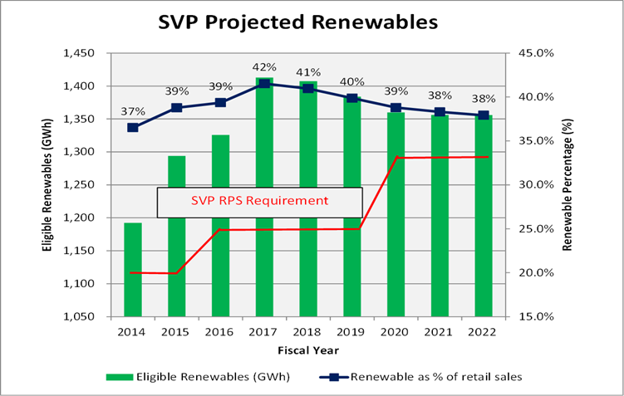
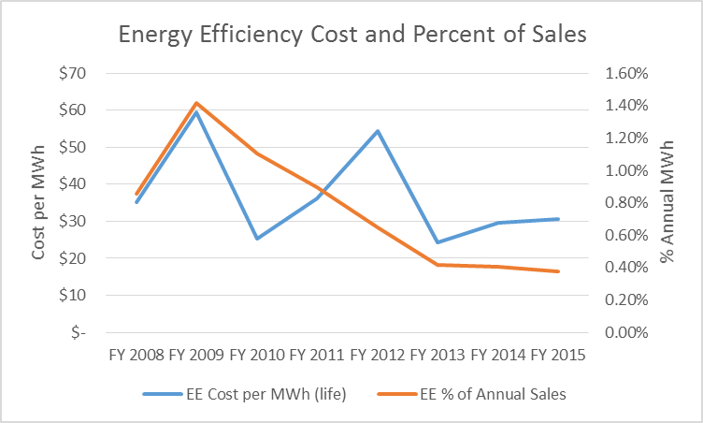
Power Resources Portfolio, cont.

Slide 7
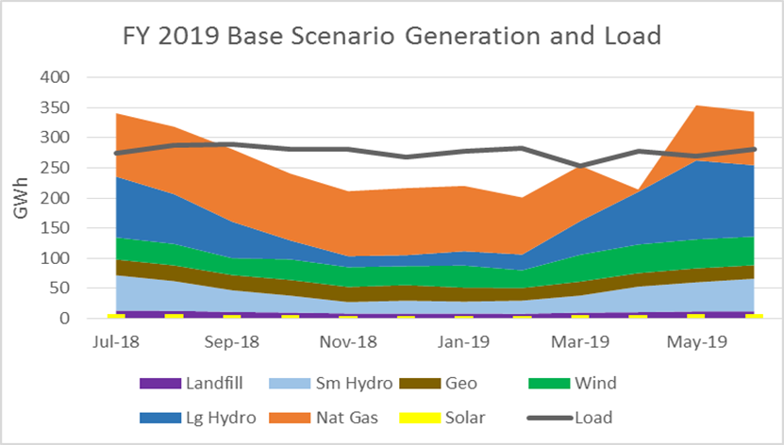
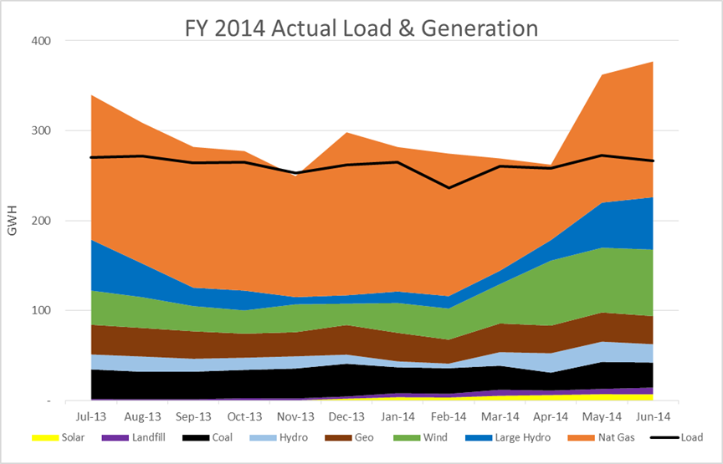
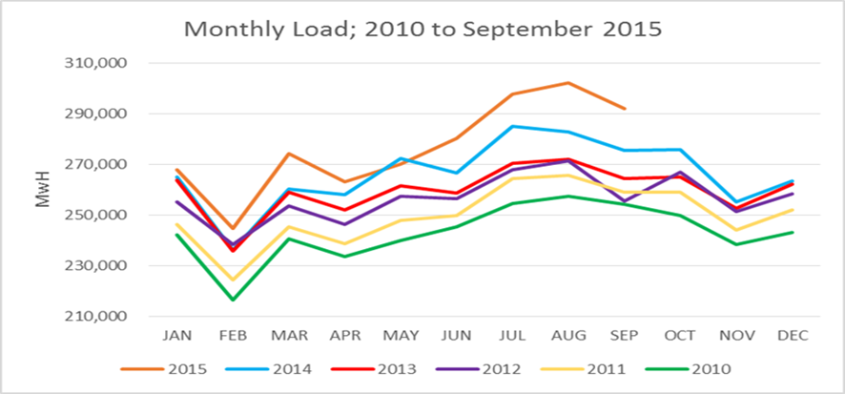
Load &
Generation

Slide 8
Ongoing Integrated Resource Planning Process

Slide 9
Planning Process
Silicon Valley Power maintains a diverse portfolio of resources to enhance reliability, environmental responsibility and price for its customers.
When making resource acquisitions, SVP considers whether needs could be supplied through demand side opportunities, renewable energy or traditional generation sources.
Carbon allowance pricing is added to the analysis for resources that emit GHG.
This decision metric combined with its long-term history of concern for the environment and RPS requirements has led SVP to pursue a portfolio that has a broad array of resources, including high percentages of energy from carbon free and renewable facilities.

Slide 10
Planning Process, Continued
After consultation with Key Account and Public Benefit staff, SVP prepares annual load forecasts for 20 years
  Estimates are completed based on low, medium and high changes in load.
  Load is adjusted for expected energy efficiency and distributed generation output (including PV).
Production Models for resources availability are run.
  Models include expected life of project, output and/or length of PPA
  Availability of current resources is developed and pricing compared under low/high green house gas costs, low/standard/high hydro, low/high costs for resources and expected changes in state policies.
Future needs are developed and resources acquired based on
  Comparison of expected load and generation available from previous analyses.
  Expected increases in Energy Efficiency and local Distributed Resources.
  State policies, both current and expected changes.
  Capabilities and pricing of supply technologies, both current and future.

Slide 11
Documents Produced
Report to City Council, State, Regional and Federal Agencies including these areas:
Carbon Reduction
  City of Santa Clara Climate Action Plan; Adopted December 2013
  RPS Policy Statement to CEC
Load and Supply
  City of Santa Clara Budget; includes Energy Demand & Supply forecasts to CEC
    Quarterly Form 1304 on Actual Sales to the CEC
  Energy Efficiency Reports to Council and to CEC with CMUA/NCPA
    Annual Third Party Measurement, Evaluation and Verification Reports
    Tri-Annual Energy Efficiency Potential Report
  Annual Reports on Solar PV and Distributed Gen. to DOE, CEC SEPA and CAISO
  Annual Power Source Disclosure and Content Label to Council and to CEC
  Mandatory Cap Trade MRR Reporting to CARB on GHG Emissions
  Monthly, Quarterly and Annual Resource Adequacy Reports to CAISO
  Energy Storage Procurement Plan to CEC
Planning
  Western Integrated Resource Plan; every five years with annual update
  Integrated Resource Plan (2014 with 2015 Update)

Slide 12
Incorporation of State Environmental Goals

Slide 13
Incorporation of State Environmental Goals
State goals and requirements are included in all planning.
City carbon reduction goals.
The vast majority of documents produced are reported to the state through the California Energy Commission or California Air Resources Board.
Documents are approved in a public process through the board of governors, the Santa Clara City Council.
Documents and achievements are publicly available, include web posting (some at SVP and some at the Northern California Power Agency).

Slide 14
Santa Clara Climate Action Goals
  1.1 Coal-free by 2020; Silicon Valley Power
  1.2 Renewable energy resources; Silicon Valley Power
  1.3 Utility-installed renewables; Silicon Valley Power
  2.1 Community electricity efficiency; Silicon Valley Power
  2.2 Community natural gas efficiency (coordination with PG&E)
  2.3 Data centers Near-Term; Planning & Inspection
  2.4 Customer-installed solar; SVP & Public Works
  2.5 Municipal energy efficiency; Public Works
  2.6 Municipal renewables; Public Works
  3.1 Urban Water Management Plan targets; Water and Sewer
  4.1 Food waste; Public Works
  4.2 Increased waste diversion; Public Works
  5.1 Lawn and garden equipment; Planning and Inspection
  5.2 Alternative construction fuels; Planning and Inspection
  6.1 TDM program; Planning and Inspection
  6.2 Municipal TDM; Planning and Inspection
  6.3 Electric vehicle parking; City Government
  7.1 Urban forestry; Planning and Inspection
  7.2 Urban cooling; Planning and Inspection

Slide 15
Continue to integrate EV and EV charging centers into City-wide planning.

Slide 16
Thank you
Joyce Kinnear
Jkinnear@svpower.com

