Slide 1


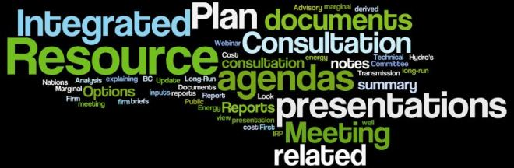
SB350 IRP Overview
CEC IRP Workshop - Sacramento
Tanya DeRivi
Southern California Public Power Authority
Scott Tomashefsky
Northern California Power Agency
April 18, 2016

Slide 2
SB350 IRP Requirements
Basic Criteria
Outlined in Section 9621of PUC
Applies to POUs with demand exceeding 700 gigawatt hours, based on three-year average
First one required by 1/1/19, updated at least once every five years
Meets GHG targets established by CARB, in coordination with CPUC and CEC, for the electricity sector and each POU that reflect the electricity’s sectors percentage in achieving the economy-wide GHG reductions of 40% from 1990 levels by 2030
Ensures procurement of at least 50% eligible renewable resources by 2030, consistent with Article 16 of Chapter 2.3, (commencing with Section 399.11)
Address procurement for the following:
  Energy Efficiency/DR (Section 9615)
  Energy Storage (Section 2835)
  Transportation Electrification (Undefined)
  Diversified portfolio (Short-term/ Long-term electricity, DR, electricity-related)
  Resource Adequacy Requirements (Section 9620)
Meets following goals
  Enables just and reasonable rates
  Minimize impacts on ratepayer bills
  Ensure system and local reliability
  Strength bulk transmission and distribution systems, and local communities
  Enhances distribution systems and DSM
  Minimize local air pollutants and GHG emissions with priority focused on disadvantaged communities

Slide 3
SB350 IRP Requirements Related to CEC Activities
IRPs and plan updates shall be submitted to the CEC
CEC reviews IRPs and plan updates
  If CEC determines they are inconsistent with Section 9621 requirements, CEC shall provide recommendations to correct deficiencies
CEC may adopt guidelines to govern submission of information and data and reports needed to support CEC review of IRPs and plan updates
  30 days public notice for initial adoption of guidelines with 10-day review thereafter
Basic Criteria
Outlined in Section 9622of Public Utilities Code

Slide 4
NCPA/SCPPA Viewpoints on IRP
Planning Elements Already Being Addressed
SB350 Integrated Resource Planning
GHG Reductions (Cap-and-Trade, MRR, Scoping Plan)
Energy
Efficiency
(SB1037 Report)
50% RPS by 2030
(RPS Program)
Energy Storage (Storage Assessment)
Resource Adequacy
Diversified Portfolio (SB1305 Reports, RPS Program)
Electrification (GHG Allowance Allocation)
Grid Reliability
Just and Reasonable Rates

Slide 5
NCPA/SCPPA Viewpoints on IRP
Reports Feed GHG Reduction Efforts
RPS
Power Content Label
Compliance Reports
SB1 Solar Report
CEC 1306A
2030 Statewide Climate Targets
GHG Reports
  Cap-and-trade
  Mandatory Reporting
  Use of Allowance Value Reports
Energy Efficiency
SB1037 Report
AB2021 Target Setting
Energy Storage
AB2514 Assessment
Others
IEPR

Slide 6

NCPA/SCPPA Viewpoints on IRP
Basic Messages for Today
POUs do integrated resource planning, although format might differ.
Any CEC guidelines that come out of this
process must be designed to be flexible.

Slide 7












NCPA/SCPPA Viewpoints on IRP
Diversity of Statewide POUs
Four NCPA Members
Eight SCPPA Members
Nation’s largest muni utility
Nation’s largest irrigation district
State’s smallest incorporated city/industry center
Inland suburban areas
Coastal urban areas
High PV rooftop penetration
Ongoing commitment to thermal energy storage
Powers the heart of the Silicon Valley
100% Carbon Neutral Portfolio

