Slide 1
Overview of Turlock Irrigation District’s Integrated Resource Plan
CEC IRP Workshop
April 18, 2016

Slide 2
TID Overview
Established in 1887 (first irrigation district in CA), began electric service 1923.
Serves portions of Stanislaus, Merced, and Tuolumne counties.
  Turlock, Ceres, Hughson, Patterson, portions of Modesto, Keyes, Denair, Hickman, Delhi, Balico, Crows Landing, La Grange and Hilmar.
  662 square miles electric service area
In 2015, 518 MW peak, ~2.0 Mil MWh retail sales, ~ 101,000 customers.
Balancing Authority Area

Slide 3
TID Electric and Fuel Resource Portfolio
Diversified Portfolio
Fuel Source: Large Hydro, Small Hydro, Geothermal, Wind, Solar, Specified Resource Purchase, Natural Gas, Coal (expiring 2018)
Unit Type: baseload, intermediate, peaking, intermittent/VER
Ownership and Term: own, LT contracts, ST contracts
Location: within service area, CA, NW
Transmission Rights to NW
Natural Gas Assets: gas reserves in WY and TX, pipeline capacity rights from Alberta, Canada to CA, gas storage rights in CA.
Energy Efficiency Programs (reflected in load forecast):
  non-residential: motors, refrigeration, lighting……..
  Residential: LED lighting, ag pumping, hvac, pool pump…….
Customer Distributed Generation (reflected in load forecast).
Demand Response (future)

Slide 4

Load Forecast
Historical Customer Data
Historical Temp. Data
Losses
No. of Customers by Rate Class
Economic and Demographic Data (Hist. and Proj)
Energy Consumption by Rate Class
Non-Coincident and Coincident Demand by Rate Class
Historical Load Profiles
Energy Efficiency
1-in-5 and 1-in-10
Sensitivity
Twenty+ Year Load Forecast (updated yearly)
Customer DG (Solar)
Low, Base, High Scenario
Annual, Monthly, Hourly Projections
EV
(EV Rate)

Slide 5

Integrated Resource Plan
Load Forecast
(inc. EE and DG effects)
Power Supply Cost Projections
Capacity and Energy Deficits/Surplus
Generation,
Transmission, and Contract Parameters
Reserve Requirements and RA Deficits/Surplus
Pricing Data
(Electric, Gas, CCA, Renewable, CAISO Fees)
RPS Compliance
(%, buckets, banked amounts)
Reserve Requirements
GHG Emissions
Twenty+ Year Integrated Resource Plan (updated yearly/periodically)
RPS Goals
Fuel, Term, Location, Ownership Mix
GHG
(Emissions Rates and Prices)
Annual, Monthly, Hourly Projections
Energy Storage
Sensitivity/Scenario Runs

Slide 6
In 2030, 64% GHG Free resource supply.

Slide 7
Integrated Resource Plan Conclusions
Portfolio is diversified in terms of fuel source, unit type, ownership and term, location, asset types (gen, trans, gas reserves, gas pipeline and storage).
Surplus energy and capacity most times of the year.
Projected to meet reserve and RA requirements.
Existing and contracted renewable sufficient to meet RPS goals until 2020.
Benefits of acquiring renewable or specified source resource are quantified to support GHG goals.
Benefits of energy storage are quantified.
High/Low Hydro years can have a substantial effect.

Slide 8
External Reporting
CEC IEPR Data Request
Board Adopted Energy Efficiency Goals – TID Board meeting and CEC
Board Adopted Energy Storage Goals – TID Board meeting and CEC
Energy Efficiency EMV reports - CEC
Power Source Disclosure - CEC
Annual RPS Compliance Filing – CEC
MRR Reporting - ARB

Slide 9
END

Slide 10
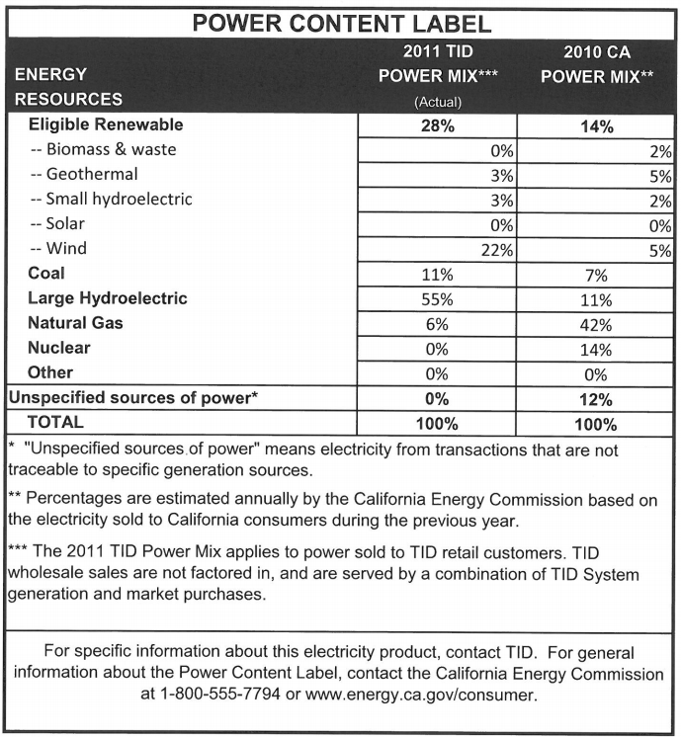
Power Content Label
2011 – High Hydro Year
  Renewables + Lg. Hydro = 83%
2014 – Low Hydro Year
  Renewables + Lg. Hydro = 36%
Notes:
One thing important to note about our portfolio is the variability it has to large hydro. You can see in an excellent hydro year that the combination of our certified renewables and large hydro was 83% of our retail load, and in a drought year it is 36%. Of course we have had some load growth and there are some other variables, but it is true that our portfolio and emissions can swing significantly, and that has to be accommodated in our IRP.

Slide 11
Power Content Label

