Slide 1
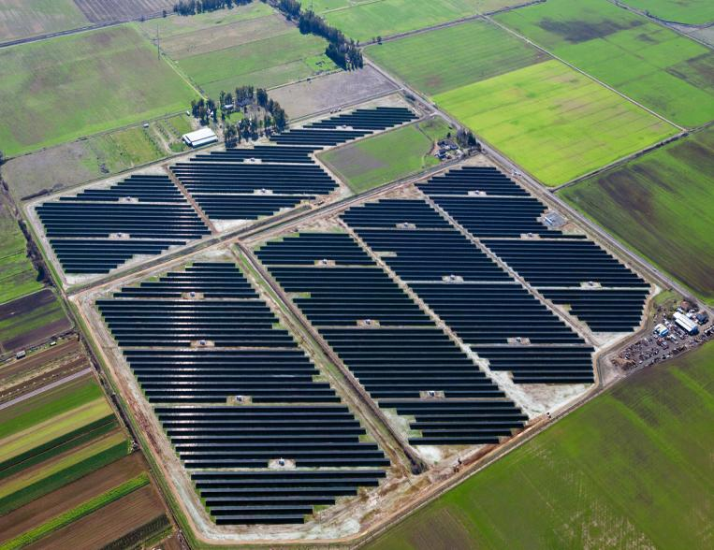
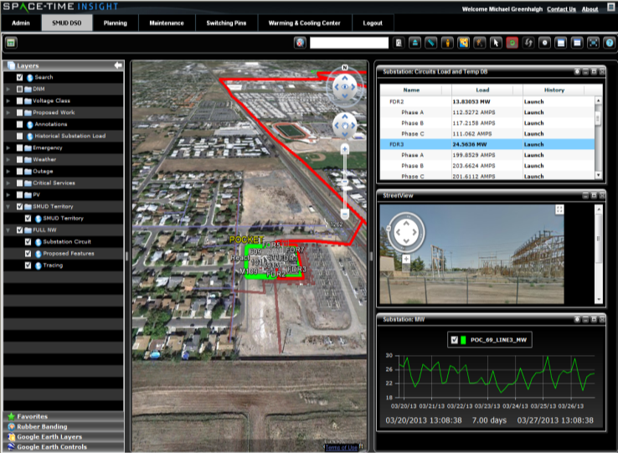


SMUD: Integrated Resource Planning
Greg Brownell
Manager Resource Planning
April 18, 2016
Powering forward. Together.

Slide 2
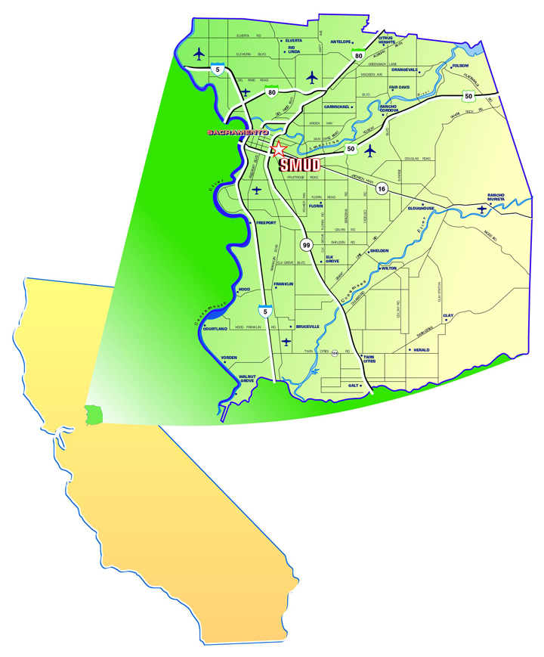
Fifth Largest California Utility;
3300 MW Peak, 11,000 GWh Sales
Publicly-Owned; Governed By
Seven Member Elected Board
Board Adopted Goals
    33% Renewables By 2020
    15% Efficiency Savings
    90% Reduction In GHG
    Emissions By 2050
Notes:
SMUD is a community-owned, community-led, non-profit….
Not associated with a city or county government; special district governed by a Seven-Member locally Elected Board of Directors.
Our board has adopted significant sustainability goals
In effect, it is really the community that has adopted these goals through the Board.

Slide 3
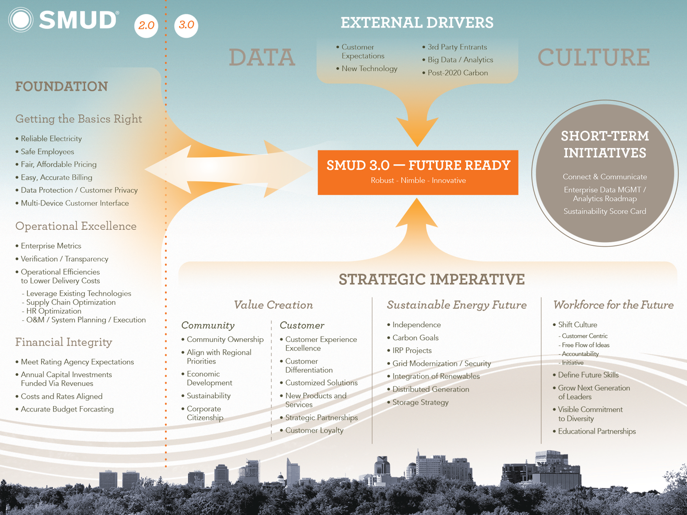

Notes:
Our ultimate goal is to be our customers’ first choice for energy services and to build on our role as a “Trusted Advisor.”
We are also looking at strategic partnerships with innovative third parties whose technology and business offerings align with our desired outcomes.
We are putting in place an enterprise-wide data governance structure that among other things will look at our capabilities and capacity around data.
While we boldly move forward into this uncertain new future, society’s reliance on energy and a resilient and reliable grid is enormous.

Slide 4




Some Key Policy Drivers
Storage: Scaling & becoming cost-effective due to cost declines, policy, solar + storage
DR: Aggregation increasing economic viability, opening new markets, emerging direct residential ISO access
EV: State will reduce CO2 emissions in transport market, IOUs rolling out 1000s of charging stations
SB350: must double in CA by 2030, real-time M&V to drive creative financing
SMUD Strategic Directives (SDs): Competitive Rates (SD2), Access to Credit Markets (SD3), Reliability (SD4), Environmental Leadership (SD7), Resource Planning (SD9), Public Power Business Model (SD11), Enterprise Risk Management (SD17), Emerging Technologies (SD18)
5
Notes:
Big changes coming in distributed energy resources.
Will clearly impact in some way what is needed from remote renewables, and what transmission may be necessary.

Slide 5
SMUD’s Planning Processes
Customer DER Resources
  Optimizing shared value of customer resources (locational, operational characteristics)
  Getting rates, incentives to provide right investment and operational signals
T&D and Supply Planning
  T&D Planning
  Supply Planning
Grid Assets
  Defer unnecessary grid investments with DER’s
  Grid and equipment upgrades that are designed for a DER future
Grid Operations
  Visibility and Control of DER’s through integrated platforms
  Grid automation and optimization
Notes:
Utilities across the country are scaling up efforts in a variety of areas around grid modernization strategy to prepare our grid for an increasing share of energy services being provided through Distributed Energy Resources, including solar, demand response, distributed storage, EV’s, energy efficiency and combined heat and power.
Implies substantial changes in the way distribution planning has historically been done -- to leverage the capabilities that customer-sited distributed energy resources can provide in terms of deferred or displaced utility investments in our distribution systems. For those utility investments that cannot be deferred, ensuring that the investments are made with an eye toward a distributed energy future is also a critical component to minimize costs during this transition in our industry.
Emerging technology control platforms like distribution management systems (DMS) and distributed energy resource management systems (DERMS) are expected to provide sophisticated forecasting and optimization of these resources to maintain reliability on the distribution system.

Slide 6
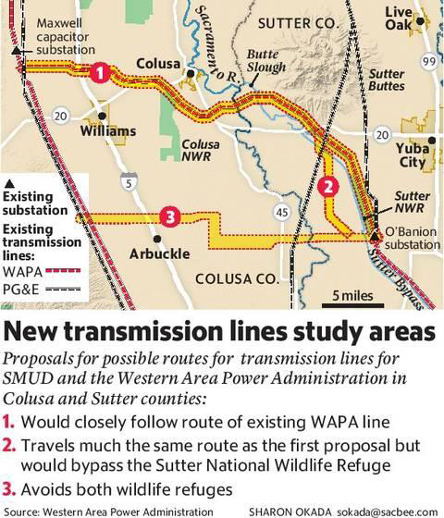
CoSu Line Being Studied
Benefits
  Increased Access to Pacific Northwest Clean Power
  Direct COTP Interconnection
  Supports GHG Reduction from SMUD Thermal Generators
    Preserves Reliability at high load Levels
    Increases import limits
Notes:
With respect to transmission, we are considering, along with WAPA, a transmission line that will provide a direct COTP connection to the O’Bannon substation.
This line, if constructed, would allow increased options to access clean power resources in the Pacific Northwest
The intent is to reduce the potential need for generation from SMUD’s thermal generators with a resource that preserves local reliability at high load levels

Slide 7
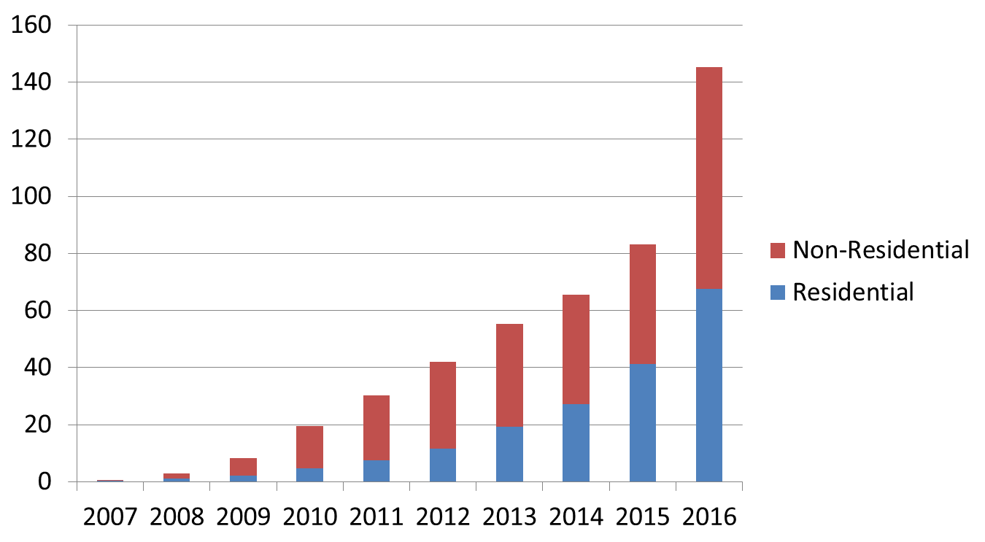
Behind The Meter PV
(GWH)
Notes:
At the same time, there is strong growth in customer-sited renewable generation that is expected to continue as costs decrease, including a big increase expected this year with the ITC extension.
These distributed generation systems serve customer load with renewable energy, just like other RPS resources.
But I would just note that RPS rules devalue these resources to the point that sometime in the next decade for most utilities, they can’t be fully counted for the RPS.

Slide 8
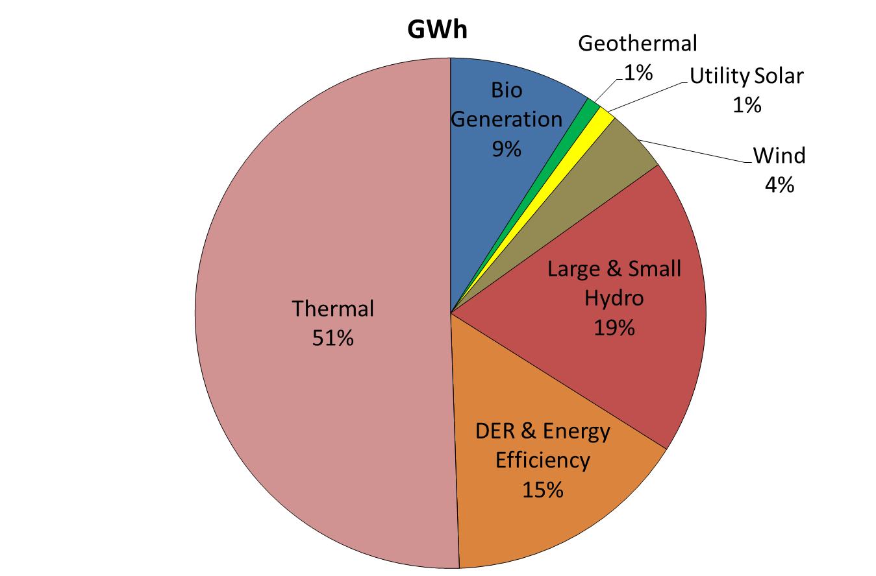
SMUD’s Resource Mix : 2015
Notes:
Truly believe in “portfolio” concept – we procure a wide mix of renewables, with no particular flavor covering more than about a quarter of retail sales.

Slide 9
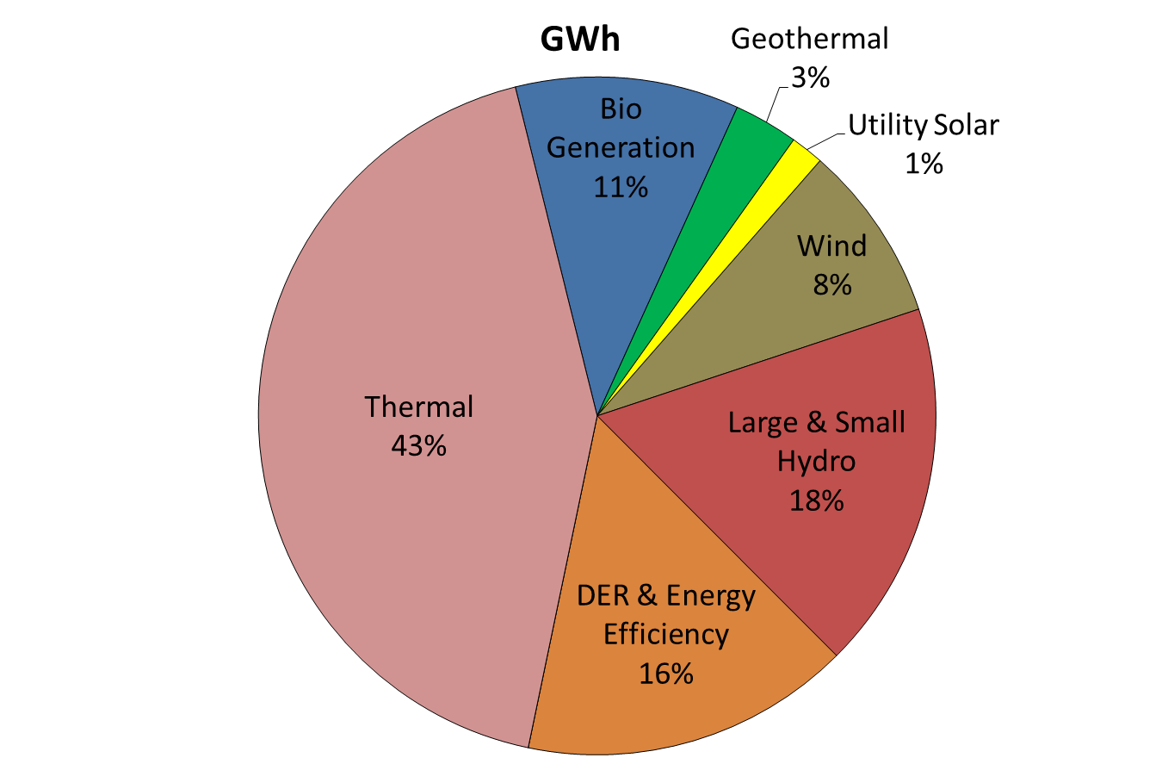
SMUD’s Expected Resource Mix : 2020
Notes:
However, costs are changing. In particular, along with everyone else, we see falling solar and wind costs in our offers.
We have recently signed up a big wind plant in New Mexico and have just released a RFO for large scale solar procurement in the West.

