Slide 1

BWP’s Integrated Resource Planning
Presentation to CEC Staff
April 18, 2016
LEB 04/13/2016

Slide 2
Defining an Integrated Resource Plan
An IRP is a comprehensive, integrated, long-term planning process by which a utility communicates the opportunities and challenges associated with the community’s projected energy demands.

Slide 3
Why?
99.999%
34%
Lowest (or 2nd lowest) all-in
… multiplied by 20 years … to the power of game-changing uncertainty

Slide 4
IRP Process
Outreach
Modeling
Analysis
Documentation
Approval
Communicate
Communicate
Communicate

Slide 5
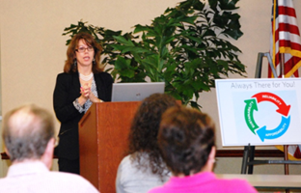
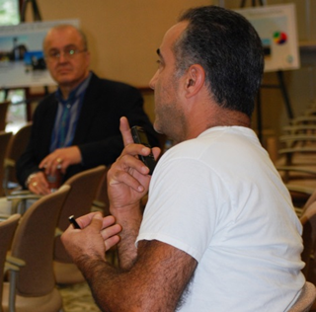
Outreach and Modeling
Outreach
More Renewables
Coal Exit
Rooftop Solar Subsidy
Modeling
Leidos (fka SAIC, RW Beck)
Scenarios
Assumptions
Directional, not Determinitive
With our ratepayers and City policy-makers at the center

Slide 6
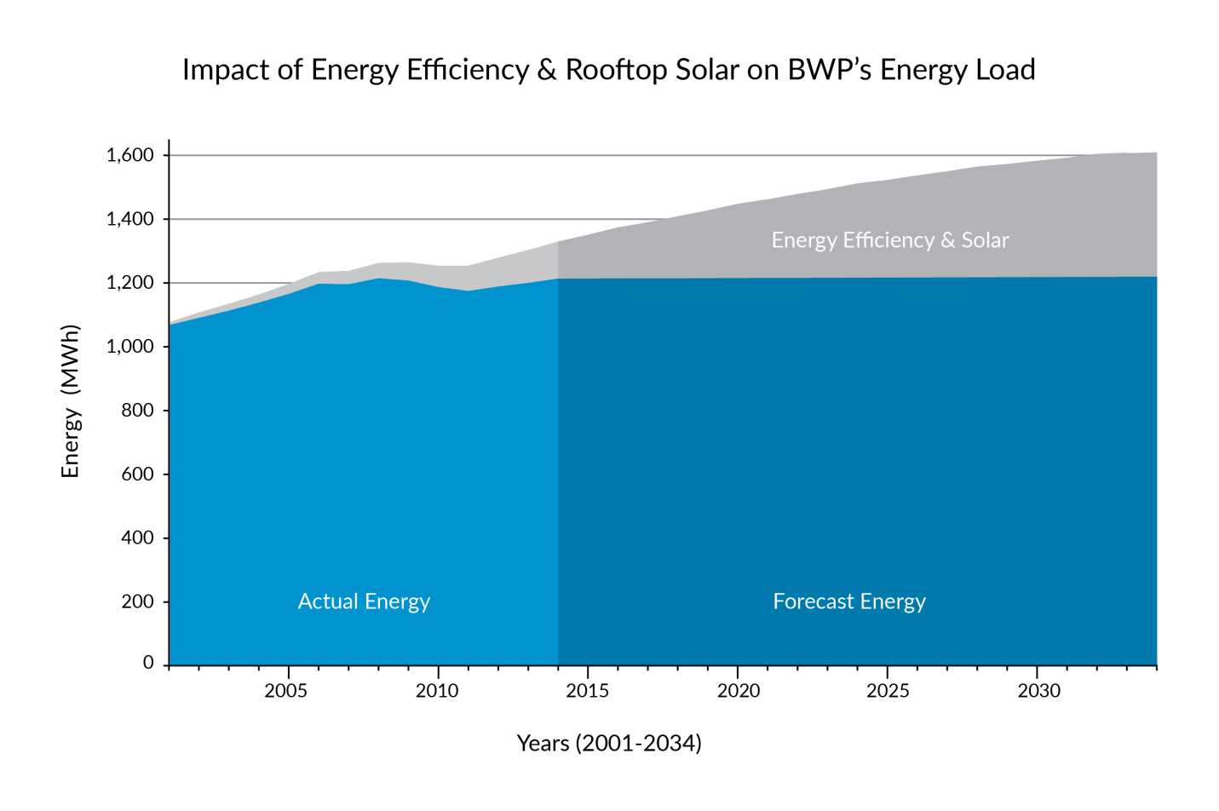
BWP’s Fundamental Challenges (1)
… while meeting federal and state mandates, including transition to 50% renewable energy by 2030

Slide 7
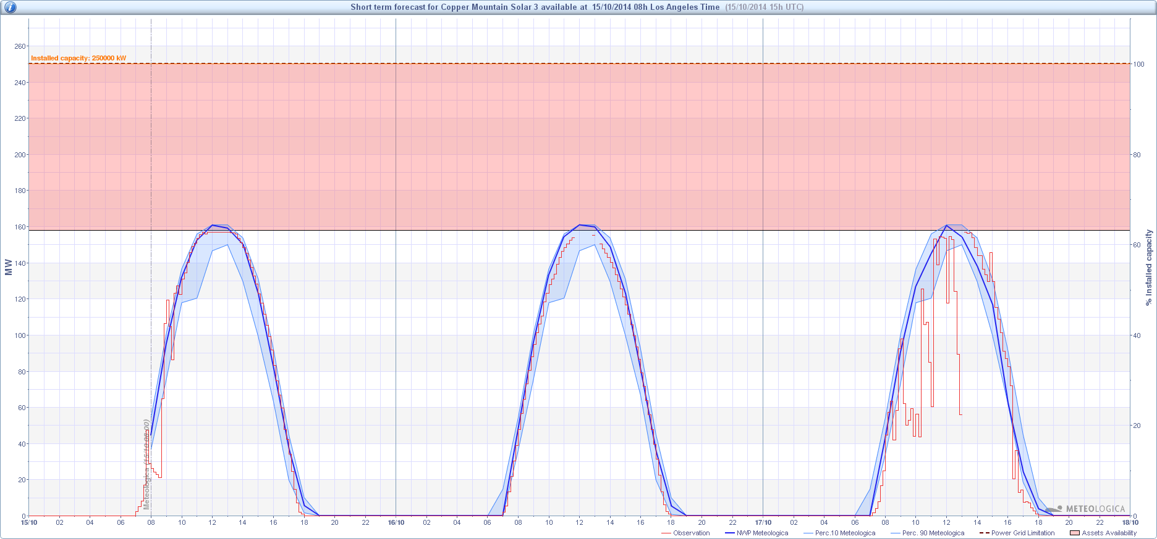
BWP’s Fundamental Challenges (2)
Moderately Cloudy
Clear Skies
Very Cloudy
… trading dispatchable fossil generation for intermittent renewable generation is not 1:1

Slide 8
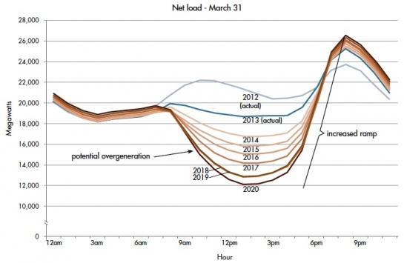
BWP’s Fundamental Challenges (3)
… after decades, turning customer behavior 180◦ with rate design and education + adding storage

Slide 9
Guiding Principles
Stay the Course
  based on strategic decisions already made
  based on investments already made
  based on visibility on mandates, esp. to 2020
Take the Time to Get It Right
  focus on measured, thoughtful long-term planning
  study, think, discuss, plan, repeat

Slide 10
Action Item Highlights
Plan for 80% of 1990 GHG by 2030
Maximize BWP’s investment in IPP
  cost-effectiveness and reliability now
  flexibility for the future
Redesign rates for the “new normal”
Continue energy efficiency and conservation
Improve load factor from 42% to 50-60%
Derive value from innovation

Slide 11
Already Planning for Next IRP
SB350 requirements
50% RPS by 2030
De-carbonization
Peak mitigation strategies
Fuel supply challenges, both physical and regulatory
Community solar
Utility > customer but also customer > utility
(not to mention 3rd parties)
Across silos, not just within silos
With our ratepayers and City policy-makers at the center

Slide 12
Lincoln Bleveans
Burbank Water and Power
818-238-3651
lbleveans@burbankca.gov

