Slide 1
Integrated Resource Planning
“IRP”
April 18, 2016
Leesa Nayudu, Resource Planning Manager

Slide 2
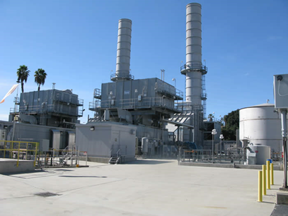
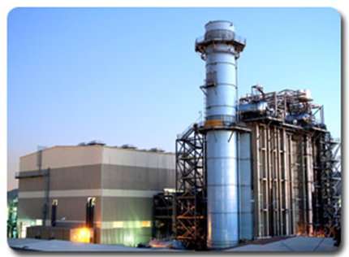
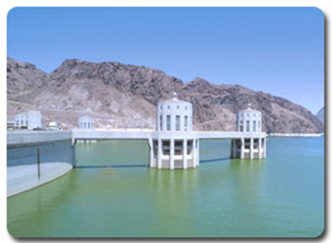
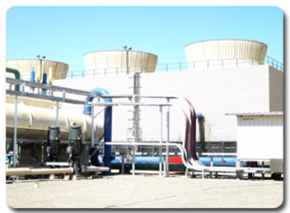
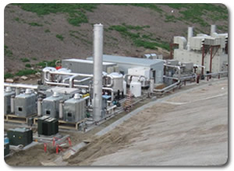

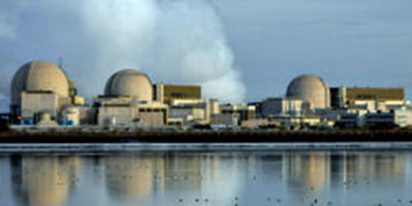
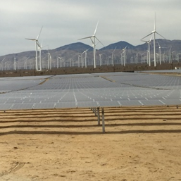


PWP’s Current/Ongoing IRP Efforts
Originally Developed in 2009; Updated in 2012 and 2015
Available On the Web at www.PWPweb.com/IRP
20 minute Video to Introduce the IRP to the Public (2014)
PWP’s IRP Is Approved and Adopted By the City Council
RPS Recommendations Implemented Through Annual Procurement Plan
WAPA compliance filing

Slide 3
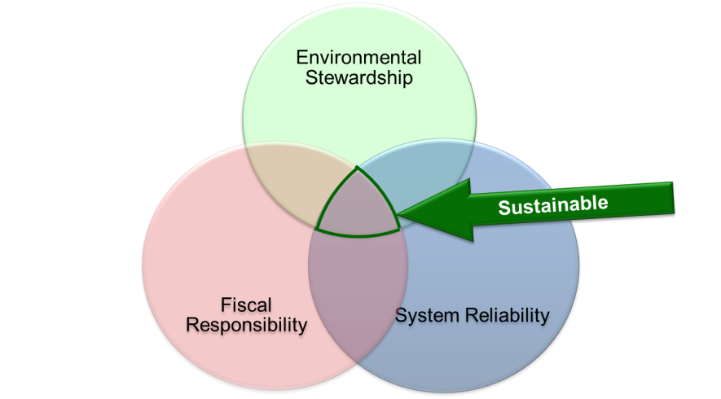
PWP’s IRP Process
Identify Needs
Identify & Evaluate Resource Portfolios
Updates & Uncertainty Analysis
Load Forecast
Regulatory Requirements
Reliability Requirements
Resources (Supply and Demand)
Scenarios & Sensitivities
Changes in Contracts
Changes in Load Profile
Public / Stakeholder Involvement
Action Plan
Short-Term Recommendations
Advisory Group
Public Meetings
Website
Social Media
Survey
Supply & Reliability Adequacy
Contractual Compliance
Least Cost
Environmental Impact
Societal Factors
Flexibility
Regulatory Compliance
Changes in Law
Changes in Market
Video
Sustainable 20-Year Strategic Resource Plan
Updated Every 2-3 Years
Incorporates State Energy and Environmental Policies

Slide 4
IRP Terminology
Portfolios
1
Stay the Course
(Preferred Portfolio)
2
IPP (Coal) Reduction
40% RPS (by 2020)
Scenarios
Base Case
B&V Energy Market Perspective
“Green” Market Influence
Higher Carbon Pricing
Sensitivities
Higher Energy Efficiency
IPP Early Retirement in 2025
(original contract expires in 2027)
5
Carbon (GHG) Neutral (by 2030)
3
50% Renewable Portfolio Standard (by 2025)
4
70% Renewable Portfolio Standard (by 2030)
Low Gas Prices
High Gas Prices
IPP (Coal) Economic Dispatch
(slightly higher generation than Business As Usual)
Groups of Power Supply Resources
Sets of Market Assumptions
Basic Model Variations

Slide 5
Preferred Portfolio: Stay the Course =
60% GHG Reduction by 2030
STAY THE COURSE
Eliminate Coal
Energy Efficiency
Renewable Energy
Local & Community
Renewable Programs
60 % GHG REDUCTION FROM 1990 LEVELS BY 2030¹
¹ Statewide GHG targets are 40% reduction by 2030 & 80% by 2050 from from 1990 levels.

Slide 6
Specific Recommendations
Reduce GHG emissions by at least 60% from 1990 levels by 2030
  Eliminate coal fired generation no later than 6/16/2027.
Continue to acquire all cost-effective and viable energy efficiency.
  At least 1% of annual net energy load (12,750 MWh/year) and 0.7% of annual peak demand 2.3 MW/year) through 2023.
Continue to acquire cost effective renewable energy.
  Renewable Portfolio Standard Policy & Annual Procurement Plan
  Local target = 40% by 2020; SB350 target 50% by 2030
Support local renewable energy resources and community solar efforts.
  Establish Feed-in Tariff by the end of 2016.
  Launch a Community Solar pilot project by the end of 2016.
Continue to ensure reliability and flexibility to respond to electric industry changes.
  Explore and procure viable, cost-effective new technologies and efficient conventional technologies as needed to meet reliability and flexibility requirements (Including distributed generation and energy storage).
Preserve existing local generation.

Slide 7
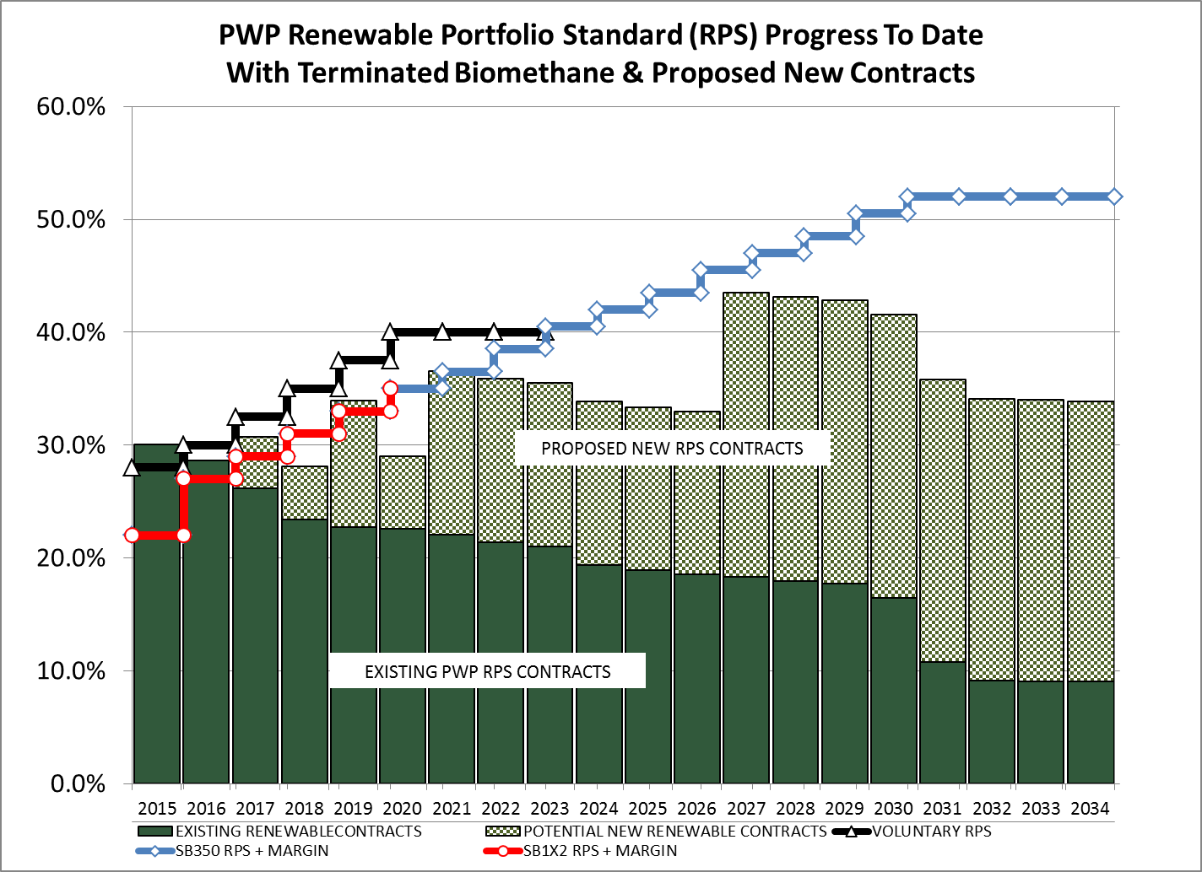
Adapting to SB350 Requirements
Revised RPS Procurement Targets
Developed SB350 Requirements Checklist
Future IRPs Will Include An Index to Identify Where Each Requirement Is Addressed in PWP’s Master IRP Document
  Section and Page Numbers
  Hyperlinks

Slide 8
CEC Guidelines, Filings, Review
Guidelines: Include a Common SB350 Requirements Checklist for POUs
  Flexibility re: Individual POU IRP Process, Structure
To Facilitate CEC Review, POU IRPs Should Include an Index to Reference/Link Specific Requirement Locations
  Should provide explanation if any requirement is not met/applicable
Submit Draft IRP Filings to CEC Electronically, and/or Link to IRP Location on POU Website
If All Checklist Requirements Met, IRP Should Be Deemed Compliant
  CEC to identify any shortfalls/questions to be addressed by POU
  If CEC review takes longer than [30?] days, POU may adopt IRP, subject to revision/addendum if necessary

