Slide 1
POU integrated resource plans
California energy commission
Developing regulations, guidelines, and policies for
Implementing sb 350 and ab 802
SIERRA MARTINEZ
LEGAL DIRECTOR, CALIFORNIA ENERGY PROJECT
April 18, 2016

Slide 2
SB 350

Slide 3
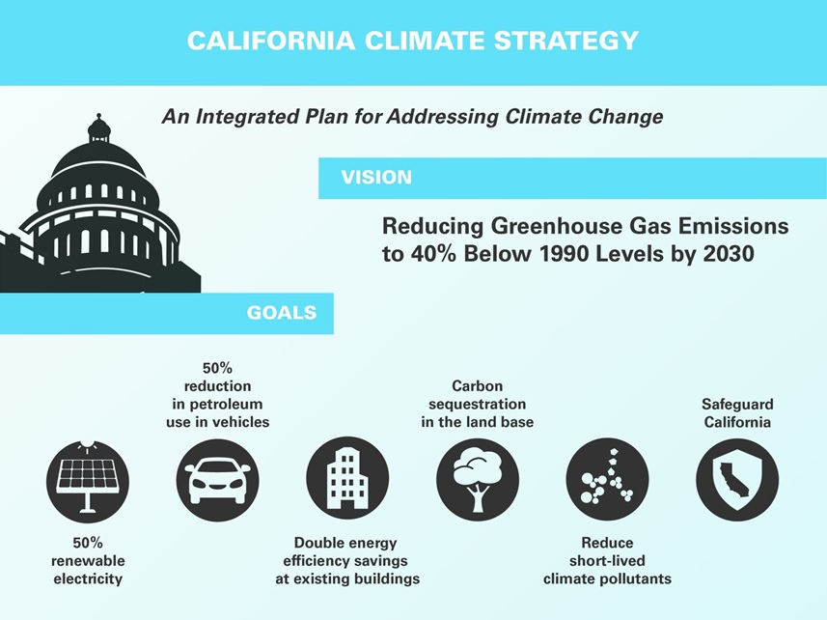
SB 350: Overview

Slide 4
SB 350: POU Integrated Resource Plans - Requirements
POU boards shall adopt IRPS that achieve all of the following:
Meets GHG targets set by ARB & CEC that reflect the electricity sectors portion of economy-wide GHG reductions of 40% by 2030
Procurement of at least 50% eligible renewables by 2030
Minimize impacts on ratepayers’ bills
Ensure system and local reliability
Strengthen the diversity, sustainability, and resilience of T&D systems
Enhance distribution systems and demand-side energy management
Minimize localized air pollutants and GHGs with early priority on disadvantaged communities

Slide 5
SB 350: POU Integrated Resource Plans - Procurement
POU IRPS shall address procurement of the following:
Energy efficiency and demand response resources
Energy storage requirements
Transportation electrification
A diverse procurement portfolio including electricity, electricity-related, and demand response products
Resource adequacy requirements

Slide 6
SB 350: CEC Role in IRP Process
CEC adopts guidelines to govern submission of data, info, and reports to support review of IRPs
POUs submit IRPs to commission
CEC offers all interested parties an opportunity to comment on IRPs
CEC reviews IRPs and shall provide recommendations to correct (any) deficiencies

Slide 7
PUBLICLY OWNED UTILTIIES

Slide 8
POUs – Important Part of CA’s Clean Energy Future
POUs (average annual sales > 700 GWh)
Collectively serve a load greater than the entire state of Colorado or Oregon
Since 2006, POUs have ramped up energy efficiency
Saved more than 4,000 GWh of electricity
Reduced the state’s peak demand by over 800 MW
Saved customers over $2B on electricity bills
Notes:
53,609 GWh sales in 2014 for top 16 POUs. CO 53,396 GWh, OR 47,334 GWh in 2014. EIA data.

Slide 9
GOALS OF IRPs

Slide 10
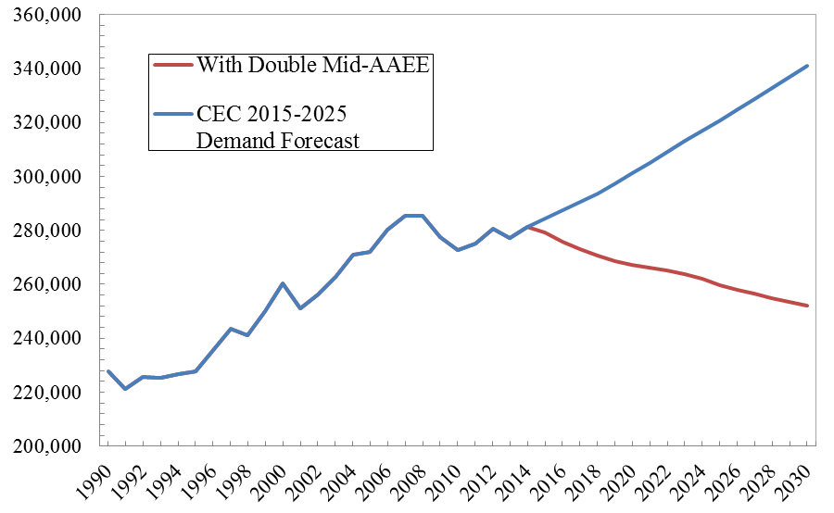
Meeting SB 350 Goals
- Goals to Increase Energy Efficiency Savings
Doubles Additional Achievable Energy Effiency (AAEE) from the California Energy Demand Managed Forecast 2015-2025 for the Mid-IEPR, Mid-Savings case by 2030
Managed Forecast
10

Slide 11
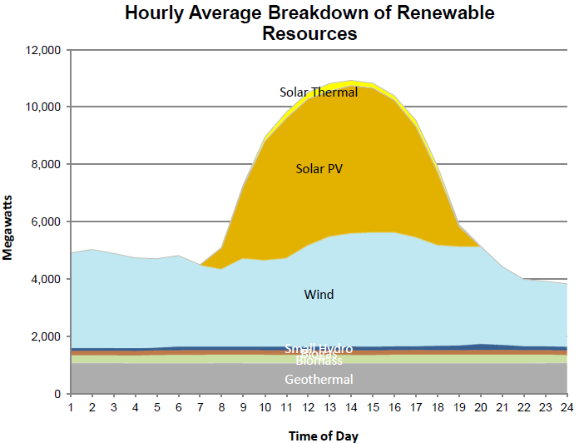
Meeting Renewable Integration Challenges
Source: CAISO, 2013
Source: Cal ISO, May 31, 2015 (Actual)

Slide 12
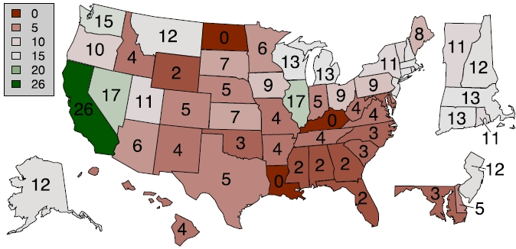
Continuing CA’s Energy Efficiency Leadership
Number of 10-year Periods with Declining Weather-Adjusted Per Capita Residential Energy Consumption (1985-2010)
Source: ACEEE Scorecard, 2012
Notes:
12

Slide 13
Per Capita Electricity Consumption
Source: EIA, 2014

Slide 14
Recommendations for Rulemaking
Orient rulemaking to ensure that POU integrated resource plans take necessary strides toward:
Reducing GHG emissions commensurate with electricity sector’s proportion of economy-wide reductions
Achieve RPS of 50% (and using clean integration solutions)
Doubling of energy efficiency (including cleaner heating fuels)
Electrifying the vehicle fleet
Provide adequate time for meaningful public process, including stakeholder review and input
Use a quadrennial cycle to align the IRP process with existing cycles:
Biennial IEPR and demand forecasts
Quadrennial POU potential studies
Biennial CPUC IRP cycles

Slide 15
THANK YOU

