Slide 1
Workshop on Publicly Owned Utility Integrated Resource Plans
April 18, 2016
Todd White
Senior Manager, Energy Portfolio
Notes:
Need name and title of presenter here

Slide 2
Outline
Introduction to Roseville Electric Utility
Roseville Electric Utility’s resource planning process
Roseville Electric Utility’s recent and upcoming IRPs

Slide 3
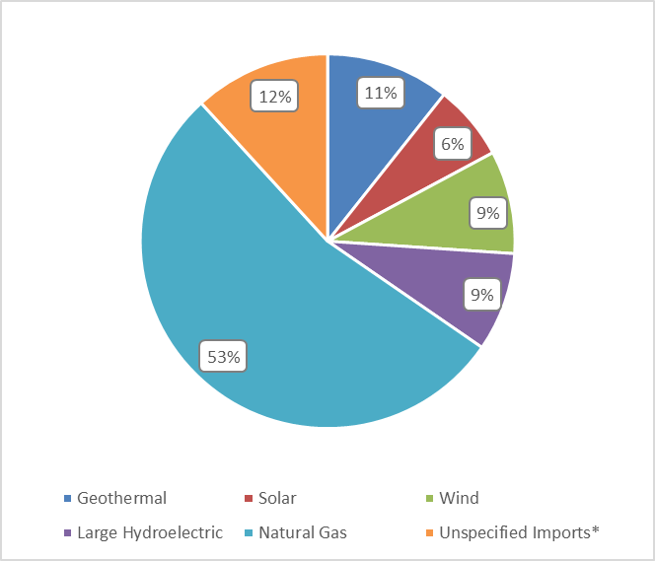
Roseville Electric Utility
Located in Northern California
Population: approximately 130,000
Over 57,000 customers
High residential rooftop PV penetration
Peak load: 330 MW in 2015
Annual load: over 1.1 million MWh
Roseville Electric Utility
Resources Mix, 2015 (estimated)
Notes:
We could mention more here about what Roseville Electric does (specific programs such as low-income weatherization, upcoming AMI/street lighting), for example, but these are the basics
From the IRP: “Roseville Electric has one of the highest solar photovoltaic (PV) penetration levels in the United States at about 2.5% of all residential customers.” An article recently mentioned we were #6 (in terms of watts/customer) in the nation. We may also want to mention our upcoming solar park. Note: Palo Alto is #2, ahead of us. I didn’t see it emphasized too much in the most recent draft of their presentation, but we probably shouldn’t overly brag about it in ours.
Resources mix has not been completely vetted; these numbers are estimates and may vary from the final numbers submitted in our power content label.
Unspecified imports are generally assumed to be gas fired.
Roseville Electric Utility is projected to meet its RPS obligations through 2024

Slide 4
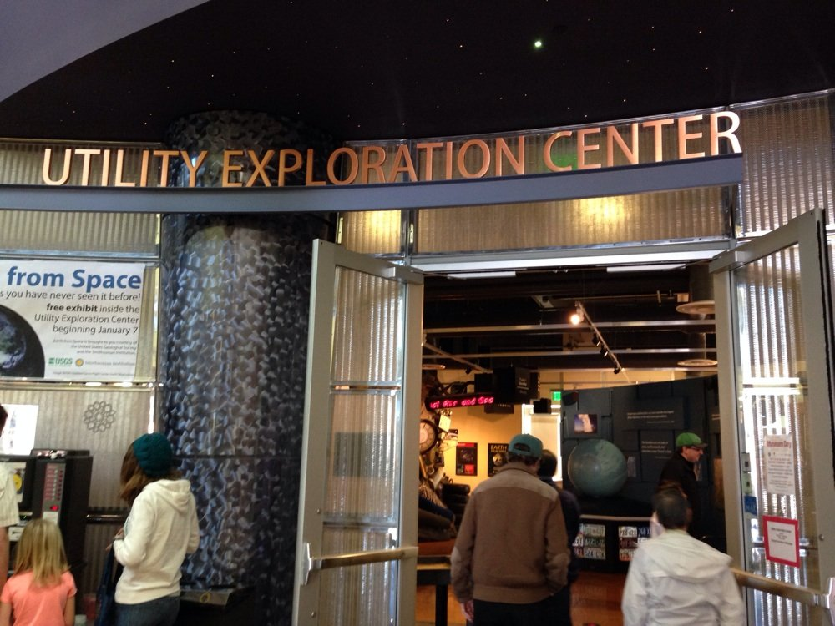

Full Service Utility; Full Service City

Slide 5
Requirements of SB 350 for POU IRPs
PU Code Section 9621
  By 2019, adopt an IRP and update every 5 years, addressing the following:
    Reach 2030 GHG emissions reduction target
    Reach 2030 RPS target (50% or more)
    Meet goals of Section 454.52
    EE and DR, per Section 9615
    Energy storage, per Section 2835
    Transportation electrification
    Diversified procurement portfolio
    Resource Adequacy, per Section 9620
Notes:
Can be skipped if previously covered in workshop (likely); included for the sake of completeness
PU Code 454.52: reasonable rates, grid reliability, DSM, and minimizing pollution
(C) Enable each electrical corporation to fulfill its obligation to serve its customers at just and reasonable rates.
(D) Minimize impacts on ratepayers' bills.
(E) Ensure system and local reliability.
(F) Strengthen the diversity, sustainability, and resilience of the bulk transmission and distribution systems, and local communities.
(G) Enhance distribution systems and demand-side energy management.
(H) Minimize localized air pollutants and other greenhouse gas emissions, with early priority on disadvantaged communities identified pursuant to Section 39711 of the Health and Safety Code.

Slide 6
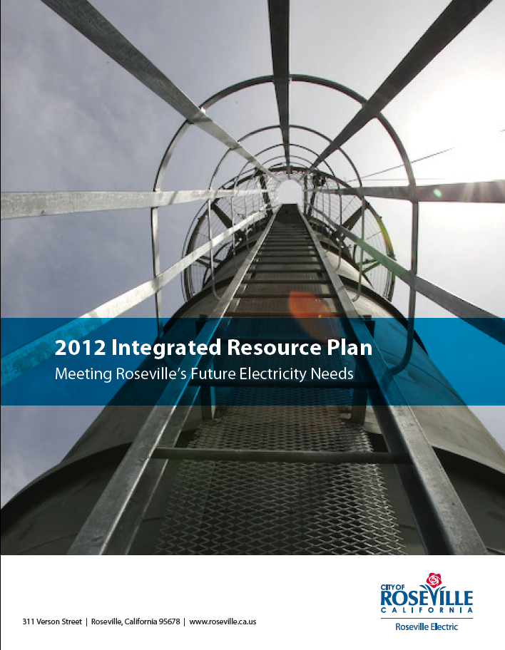
Resource Planning Process
Regular resource planning is integral to Roseville Electric Utility’s business practices
Recent IRPs have been on a 4 year cycle (2008, 2012, 2016)
20 year planning horizon
Regulatory compliance (RPS, GHG) integral to resource planning
IRP is approved by local RPUC and City Council via a public process

Slide 7
2012 IRP Process
Long term demand forecast through 2031
Evaluation of current and potential regulatory requirements (RPS, GHG) and steps to fulfill them
  Assessment of current generation resources
  Research pricing and availability of renewable resources
  Develop several resource portfolios and evaluate on cost, risk, diversity, and fit with current resources
Workshops to present preliminary results and receive public input
Action plan incorporating public input to meet current and anticipated regulatory requirements
Notes:
From page 5 of our IRP
We expect our next IRP to follow a similar process

Slide 8
2012 IRP
2012 IRP contains most elements required by SB 350
* = related reports filed with the CEC (does not include reports filed with other agencies)
Reporting Requirement | Where Covered in IRP
GHG Reduction | 3.4, 6.4; Appendices C, D, H
RPS Procurement**** | 3.4, 5.1, 6.2-6.4, 7; Appendices B, E, G
Section 454.52 | 3.3, 4.2, 4.5, 6.4; Appendix F
EE and DR*** | 3.4, 4.2; Appendix D
Energy Storage* | N/A
Transportation Electrification | N/A
Diversified Portfolio* | 4.3, 6.3, 6.4, 7.1; Appendices G, H
Resource Adequacy | 3.4, 6.4, 6.5
Notes:
Section 3.4 discusses all regulatory requirements- thus it pops up a lot
Note: GHG reductions are economywide; no specific POU target, only electricity sector target.
* = related reports filed with the CEC (does not include reports filed with other agencies); reports are explained below
GHG Reduction
N/A (related reports would be with CARB)
RPS Procurement
Power content label/SB 1305 power source disclosure (MWh)
RPS report and notice- per SB X1-2
SB 1 solar program annual status report
RPS Compliance Report- For annual retail sales determining REC obligation and REC retirement, every July.
PU Code 454.52
N/A
EE and DR
CEC 1311- ANNUAL expenditures, actual savings, and expected savings for each public owned utility's electricity efficiency and demand reduction programs. The form includes information about energy and peak demand savings.
SB 1037- ANNUAL report of public benefit programs and results
AB 2021- TRIANNUAL Summary of EE programs and power partners; next due in 2017.
Energy Storage
AB 2514 (storage not cost effective); one-off report
Transportation Electrification
N/A
Diversified Portfolio
Power content label/power source disclosure (MWh)
Resource Adequacy
N/A

Slide 9
Future Reporting
Roseville Electric Utility just kicked off its 2016 Integrated Resource Planning process
Will release next IRP by early 2017
IRP is expected to address all areas required by SB 350
Focus on regulatory compliance, adapting to industry change
Notes:
Commissioner Scott’s questions
Please provide an overview of how you are incorporating transportation electrification into your upcoming IRP.
EVs are considered a distributed energy resource (DER), alongside Demand Response and Energy Storage
Will consider impact of DER on net load, distribution circuits- will affect procurement planning, as well as potential transformer overloads, voltage issues
How is this different from or similar to the way you have incorporated transportation electrification into previous IRPs?
In the 2012 IRP EVs are mentioned a few times qualitatively (essentially, they may supply energy when plugged in and could increase load volatility) but I don’t think that qualifies as “incorporation.”
If you haven’t already incorporated transportation electrification into your upcoming IRP, what is your schedule and plan for doing so?
N/A
May point out submitting IRP in 2019 with updates is similar with what the CEC does with IEPR

Slide 10
Transportation Electrification
First time incorporating quantitatively into IRP; part of overall DER analysis
Will review EV ownership, rates, targets
Analysis will look at a range of potential penetration rates
Will consider impact on net load, distribution circuits
Independent of IRP process, utility developing EV business plan

Slide 11
Closing Thoughts
Integrated Resource Planning is a key business activity
Prudent for proactive regulatory compliance and sound fiscal stewardship
We do this very well
  Low rates, high reliability
Need to focus on making sound decisions

Slide 12
Thank you!
Notes:
Add contact info of presenter

