Slide 1
Linking Climate Scenarios to Planning and Decision Making
2016 Joint IEPR Workshop on
Climate Adaptation and Resiliency for the Energy Sector
Adaptation Efforts: A Practitioner Panel Discussion
Neil Millar, Executive Director of Infrastructure Development
June 21, 2016

Slide 2
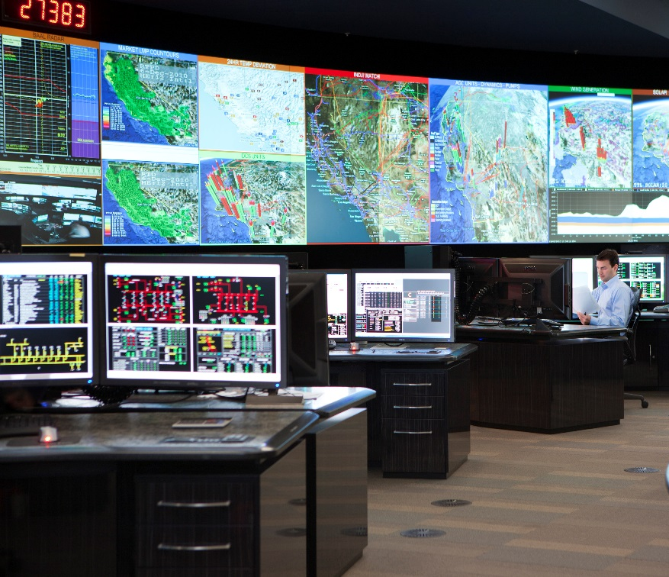
What does the California ISO do?
Operate the grid reliably and effectively
Operate efficient spot markets for energy and reserves
Provides fair and open transmission access and scheduling
Manage new generation interconnections
Plan and identify future grid infrastructure needs

Slide 3
Climate adaptation impacts a number of grid infrastructure issues:
Physical resilience of assets – transmission owners lead
  Sea level threat, fire, flooding, other risks
Customer issues – demand side
  Consider monsoonal heat or extended heat waves?
Generation issues – supply side
  Hydro resource issues affecting local reliability?
Planning criteria
  Changes for emerging needs? Like other “extreme event” planning?
Need for statewide agency coordination
  Planning efforts coordinated with permitting processes?

