Slide 1
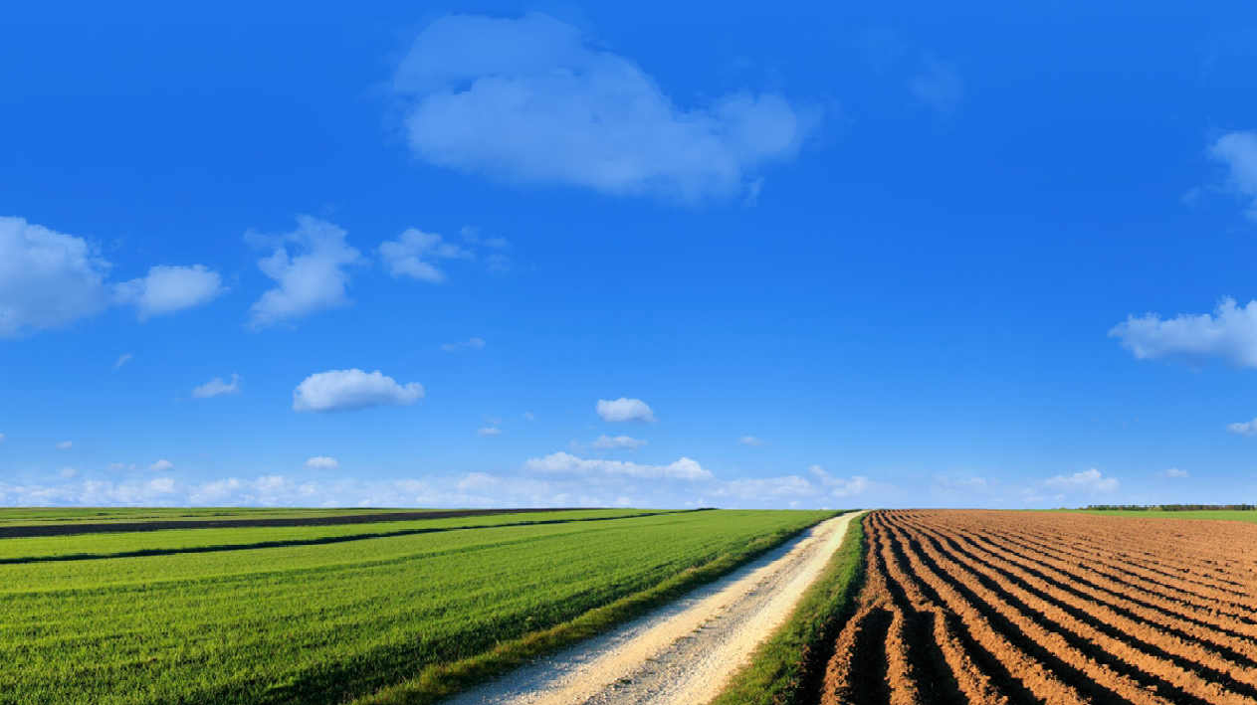

Water, Drought, Climate Change,
and
Social Vulnerability
Dr. Peter Gleick
Pacific Institute, Oakland, California

Slide 2
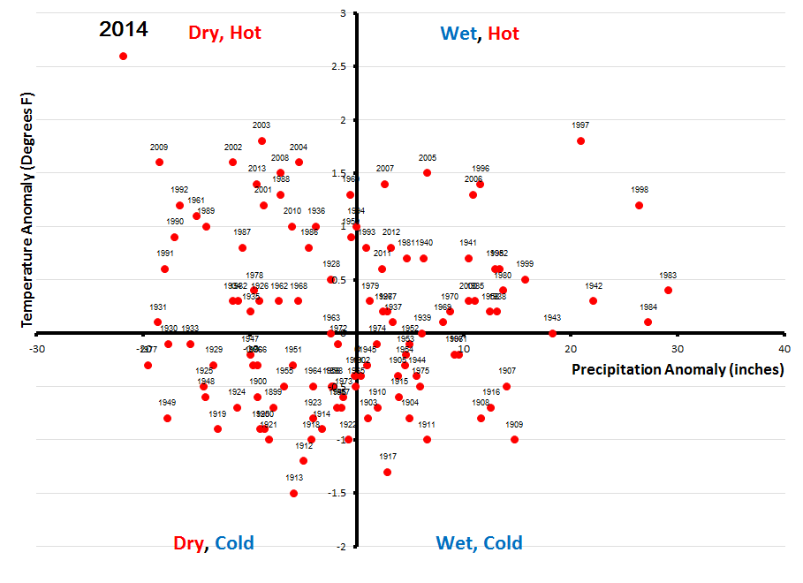
California Temperature and Precipitation Anomalies (1895-2014) (36-month periods)
Source: Mann and Gleick, 2015, PNAS. NOAA/NCDC ClimDiv data

Slide 3
Climate and Social Vulnerability
Pacific Institute’s modified California Social Vulnerability Index (to Climate Change Impacts), calculated for all Census 2000 Tracts in California:
http://pacinst.org/reports/climate_vulnerability_ca/maps/

Slide 4
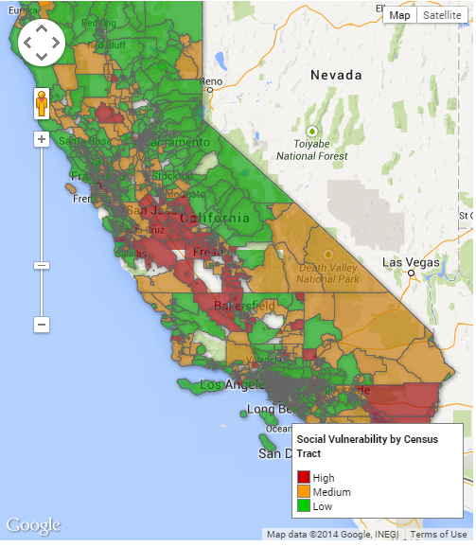
Vulnerability to Climate Change
Agricultural production
Water supply and delivery
Water quality
Heat stress
Forest fires
Ecosystem functioning
Human health
Recreation
Others
Social vulnerability to climate change
Pacific Institute 2013

Slide 5
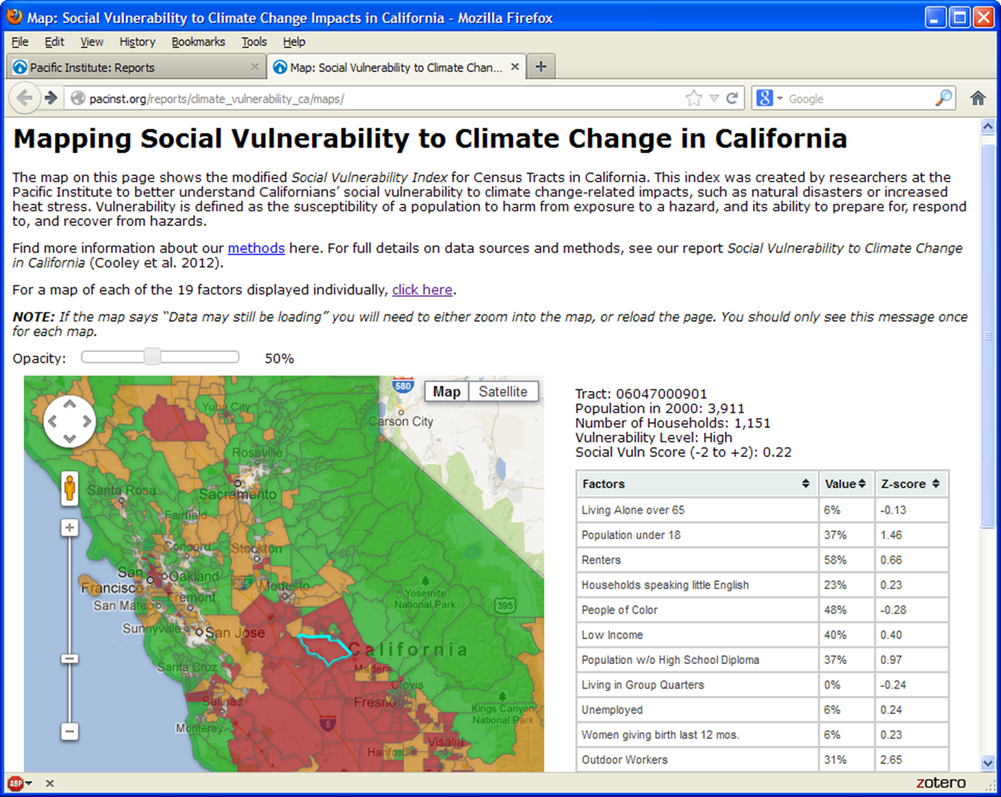

Slide 6
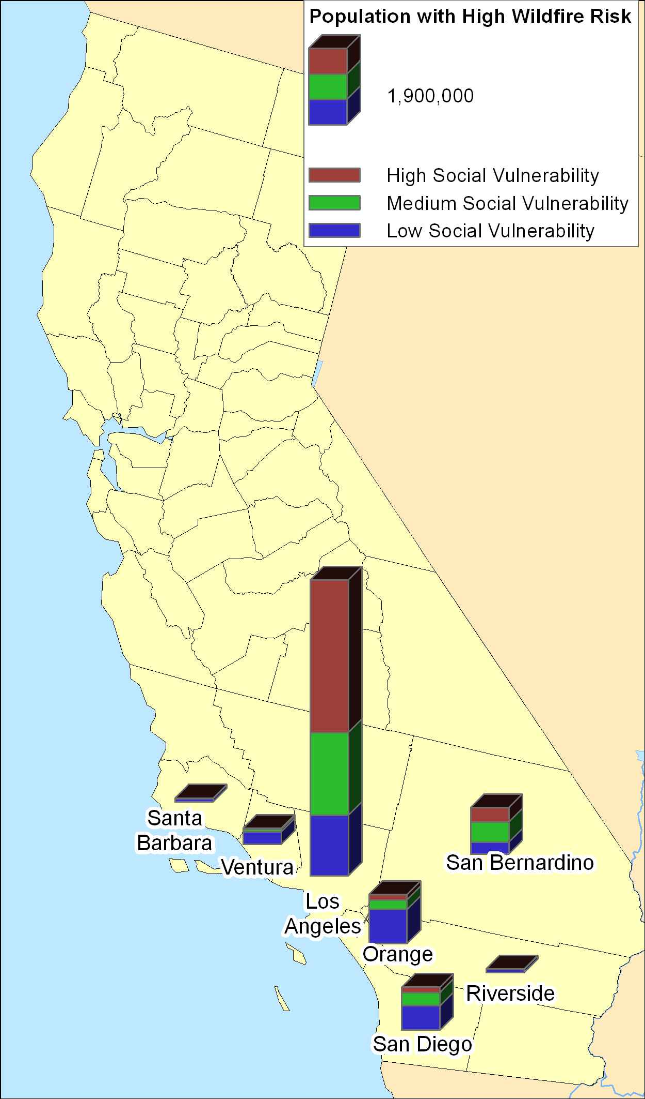
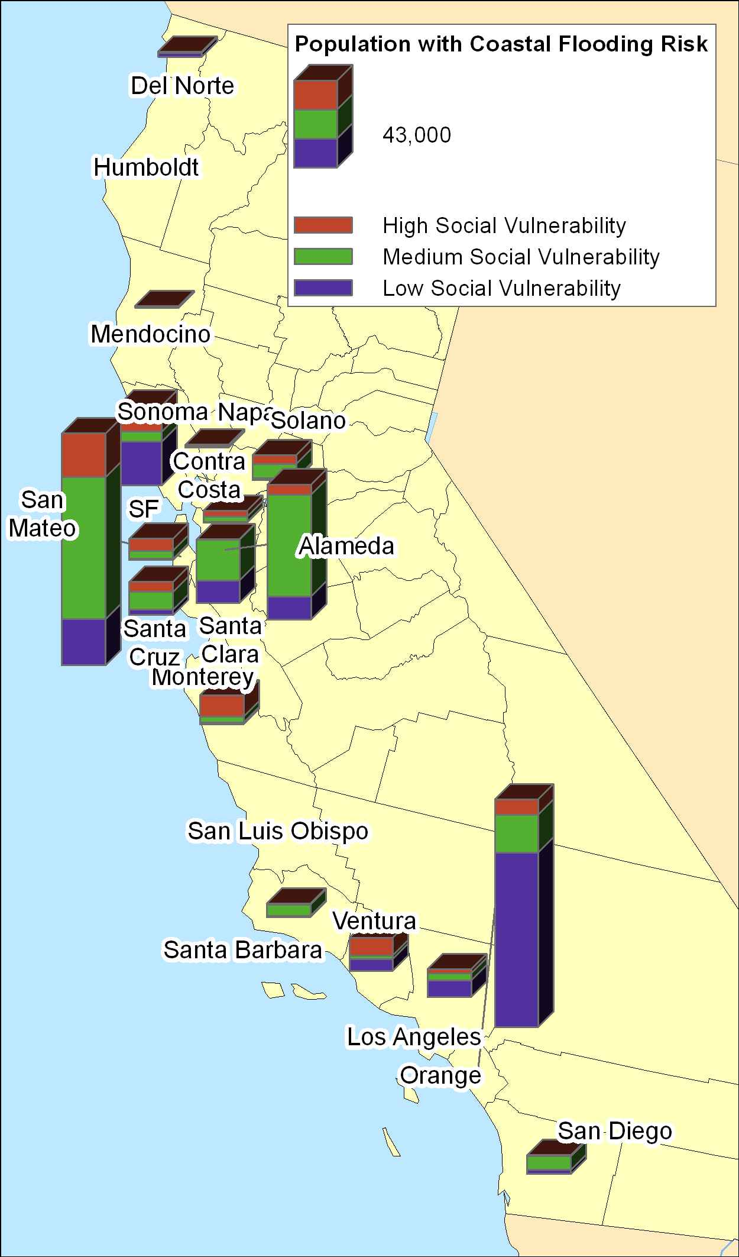
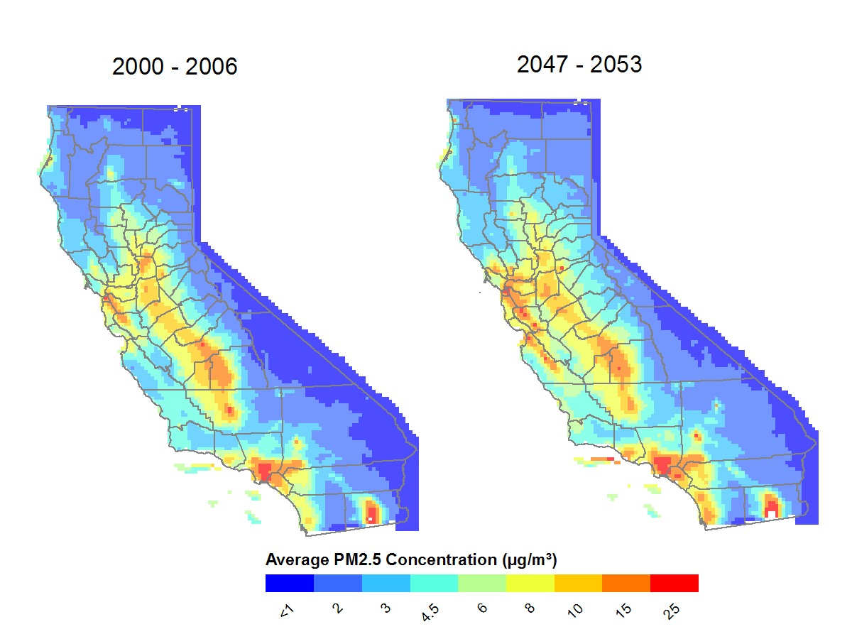
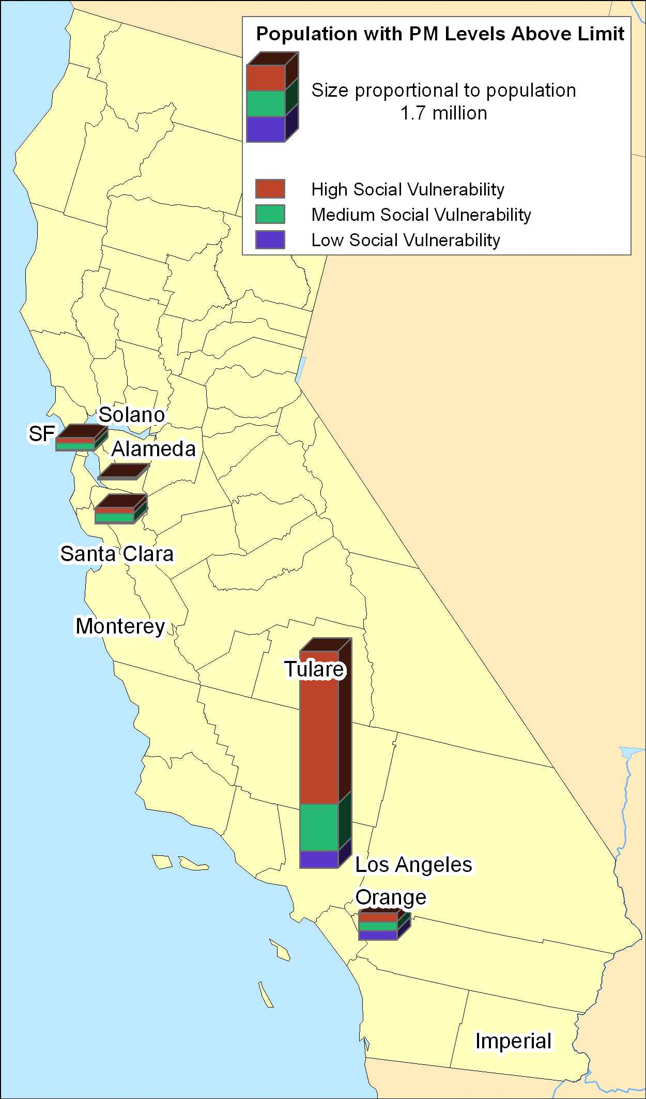

Slide 7
Ongoing Work: Pacific Institute
SF Bay Area drought and equity
  To be released this month
California drought and equity
  To be released Fall 2016
California energy and drought/with GHG update
  To be released late 2016
California drought and climate change links
  Ongoing

