Slide 1
Climate Change Resilience and Preparedness
Joint IEPR Workshop on Climate Adaptation and Resiliency for the Energy Sector
Barry Anderson
Vice President, Electric Distribution
June 21, 2016

Slide 2
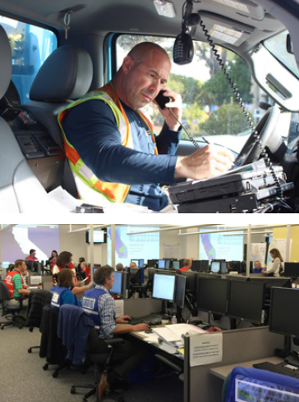
PG&E’s Approach to Climate Change Resilience
Robust emergency response plans and procedures to address near-term risks, including storms and wildfires
Active engagement at the federal, state, and local level
Risk assessment and operational planning to assess longer-term risks and prioritize infrastructure investments
Staying abreast of the science through in-house climate change science team

Slide 3
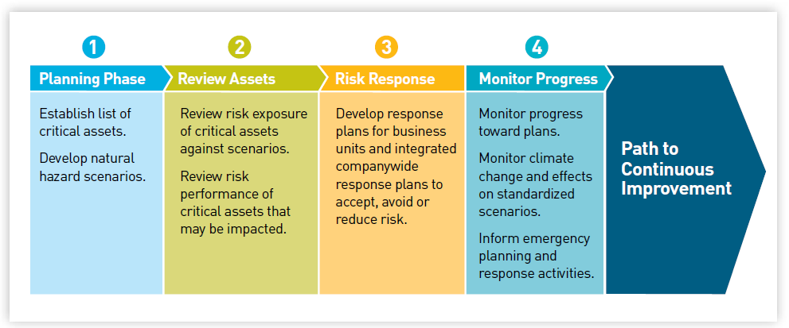
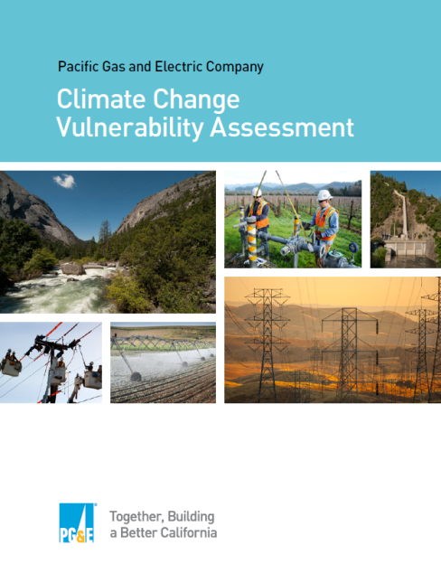
Risk Assessment: Natural Hazard Asset Performance
Phases of the NHAP initiative
Long-term, multi-year, and holistic assessment of the risks from multiple natural hazard scenarios on PG&E assets:
  Identifying potential impacts to PG&E assets
  Enabling the evaluation of climate-change-related risks to facilities and the development of necessary adaptation strategies

Slide 4
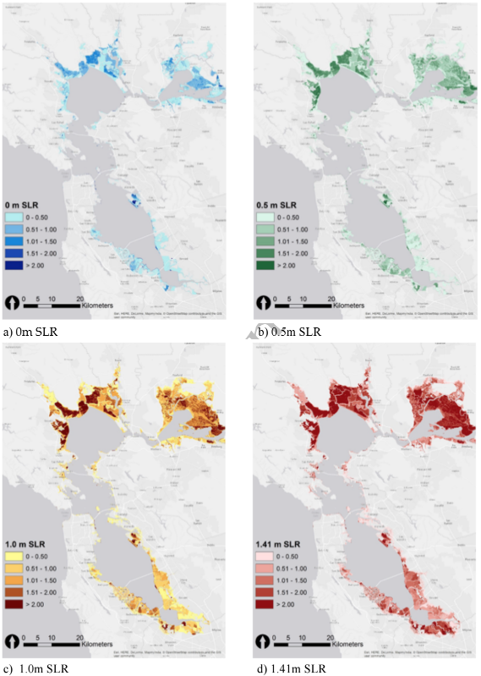
Collaborating on Resilience
  Partnering with UC Berkeley Center for Catastrophic Risk Management to assess potential impacts to our natural gas transmission system from long-term sea level rise coupled with extreme storm event
  Research focuses on San Francisco Bay Area, Sacramento-San Joaquin Delta, and Coastal California
  Results will inform our ongoing efforts to better understand, plan for and respond to climate change risks
  Research funded through California Energy Commission Public Interest Energy Research (PIER) program
Research uses state‑of‑the-art hydrodynamic model to simulate various increments of sea level rise coupled with an extreme storm event

Slide 5
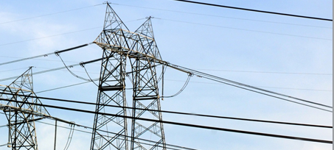
Collaborating on Resilience
Participated in Bay Area Council study to explore economic impact of superstorm and associated flooding on substation infrastructure
Collaborating with U.S. DOE and EPRI to assess vulnerabilities and share best practices among utilities
Partnering with local governments on studies to assess vulnerability and develop resilience strategies
Supported Measure AA for a Clean and Healthy Bay to fund critical flood protection around San Francisco Bay
PG&E announced a new $1 million Resilient Communities Grant Program to support local climate resilience planning efforts
Grant proposal criteria:
  Replicability
  Partnerships
  Disadvantaged communities focus

