Slide 1
Cal-Adapt 2.0: Enhancements to Support Resilience Efforts
Dr. Susan Fischer Wilhelm
Research Lead on Climate Change
Energy Research and Development Division
California Energy Commission
Notes:
A number of enhancements have been made in the past 6 to 9 months.

Slide 2
Outline
What is Cal-Adapt?
Goal of Cal-Adapt enhancements
Tour of new features:
  Improved data for temperature and precipitation
  Supporting California’s Fourth Climate Change Assessment
  New aggregation options (e.g., disadvantaged communities)
  Extreme heat tool
  New inundation data (forthcoming)
Notes:
But for those of you who aren’t familiar with it, I’ll start with a brief reminder of what Cal-Adapt is before moving on to recent and ongoing enhancements and a tour of “new” features.

Slide 3
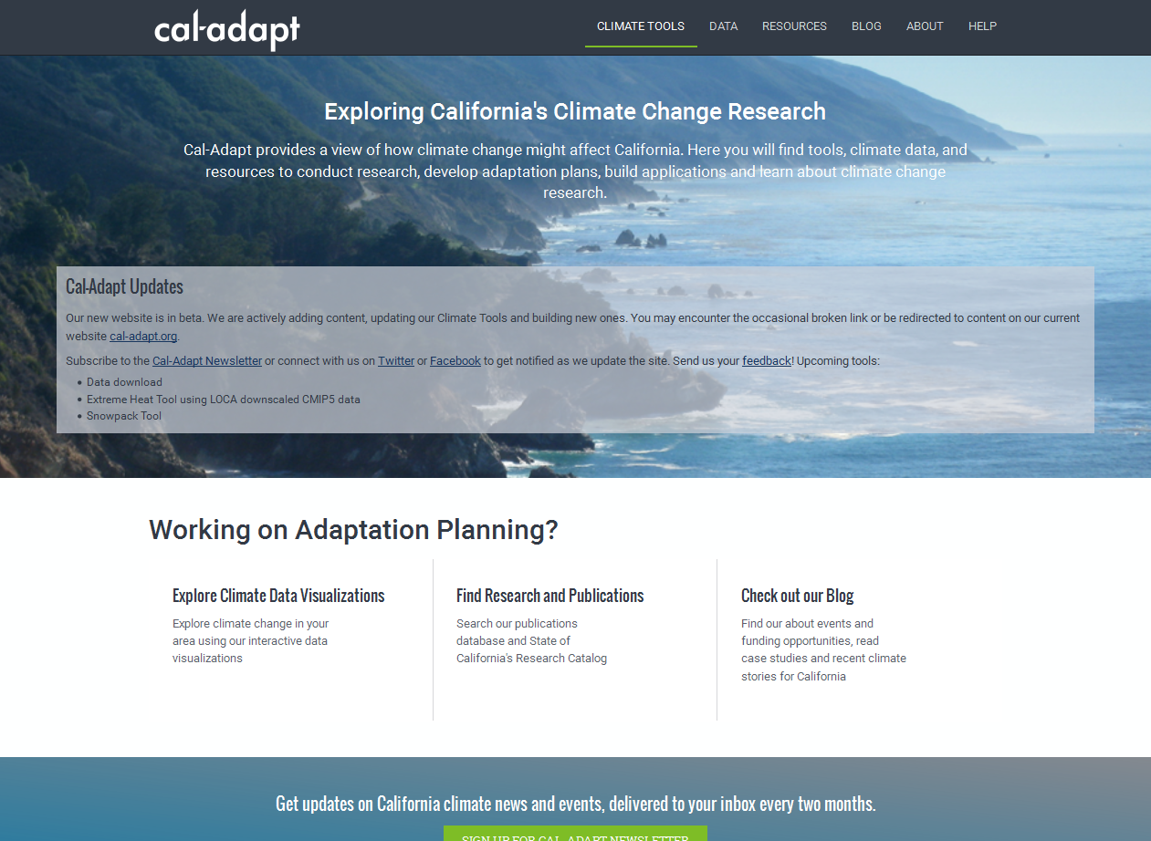
http://beta.cal-adapt.org/
Notes:
Cal-Adapt is an online, interactive resource for visualizing climate risks. It is in the process of being rolled out at this site.

Slide 4
What is Cal-Adapt?
Resource created by State of California to convey local climate risks based on peer-reviewed science
Climate change projections presented in easy-to-understand format with plain English descriptions
Interactive maps and charts provide a variety of approaches to explore different aspects of climate change
Access to primary climate change data for further analysis
Complements other tools (e.g., Climate Console and COSMoS)
Notes:
Originally launched in 2011, Cal-Adapt was created by the State to convey local climate risks based on peer-reviewed science.
Aims to offer easy to understand visualizations to a diverse audience, with a primary emphasis on energy sector planners, managers, and operations who need to consider climate science but are not climate scientists.
Also offers access to primary climate change data for those who need to perform additional analysis regarding climate-related vulnerabilities and adaptation options.
It complements other tools that are available for analyzing local climate-related risks. For example, Climate Console is tailored to support analyses involving ecological conservation and protection, whereas Cal-Adapt has evolved with a focus on man-made infrastructure. We are working to link the two so that, for example, if you’re viewing a dataset on Cal-Adapt, you can click a link to view the same dataset on Climate Console.

Slide 5
Goal of Cal-Adapt Enhancements
Higher resolution, higher fidelity data
  temperature (daily)
  precipitation (daily)
  inundation (Delta as well as open coast and bay)
  observed historical data (daily temperature, precipitation)
  wildfires (forthcoming fall 2016)
Enhanced usability, including support for interpreting data and visualizations
Public API* supports third-party tool development
Responsiveness to utilities’ resilience needs
  Technical Advisory Committee
* Applications Programming Interface
Notes:
The goals of the recent and ongoing enhancements to Cal-Adapt include …
Providing higher resolution regionally downscaled data that align with IPCC’s 5th Assessment report as well as new, high-fidelity data portraying wildfire, sea level rise, and hydrological changes.
Helping users understand how to use climate change projections and how to interpret visuals.
Offering the capacity to support third-party tool development.
Responding directly to resilience needs voiced by utilities…

Slide 6
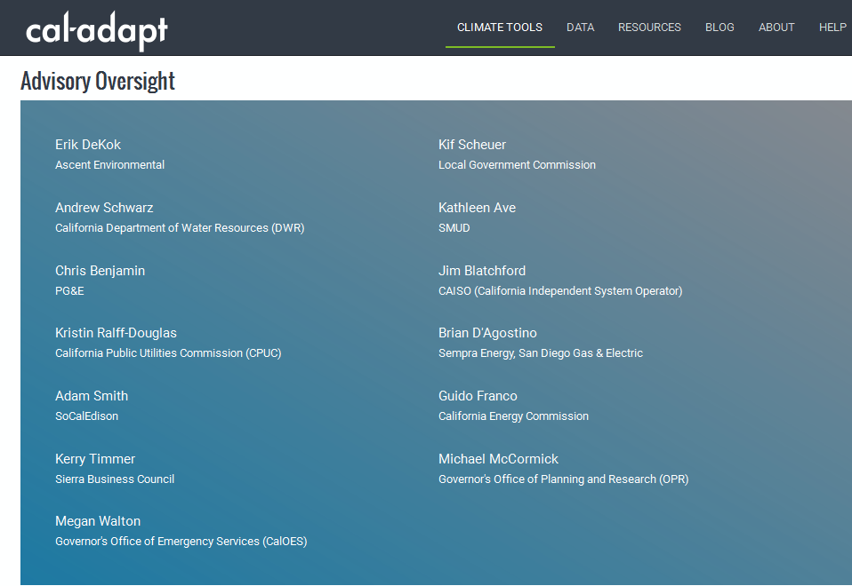
Brian D’Agostino
Sempra Energy, San Diego Gas & Electric
Chris Benjamin
PG&E
Jim Blatchford
CAISO (California Independent System Operator)
Adam Smith
SoCalEdison
Kathleen Ave
SMUD
Erik DeKok
Ascent Environmental
Kerry Timmer
Sierra Business Council
Kif Scheur
Local Government Commission
Guido Franco
California Energy Commission
Michael McCormick
Governor’s Office of Planning and Research (OPR)
Kristin Ralff-Douglas
California Public Utilities Commission
Andrew Schwarz
California Department of Water Resources (DWR)
Megan Walton
Governor’s Office of Emergency Services (CalOES)
Notes:
To foster responsiveness to energy sector resilience needs, we’ve assembled an advisory committee that includes all Investor-Owned Utilities in the state, a Publicly Owned Utility, and the California Independent System Operator. We also include local government representation and sister state agencies/offices, namely DWR, CalOES, CPUC, and OPR.

Slide 7
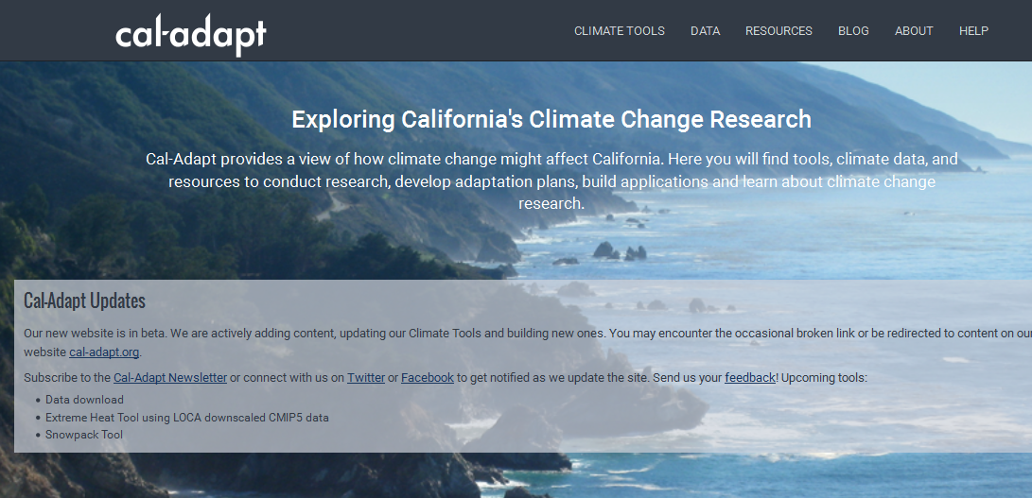
Notes:
Let’s have a look at the climate tools currently available. (Over the next 6 weeks to 6 months you will see many additional tools rolled out.)

Slide 8
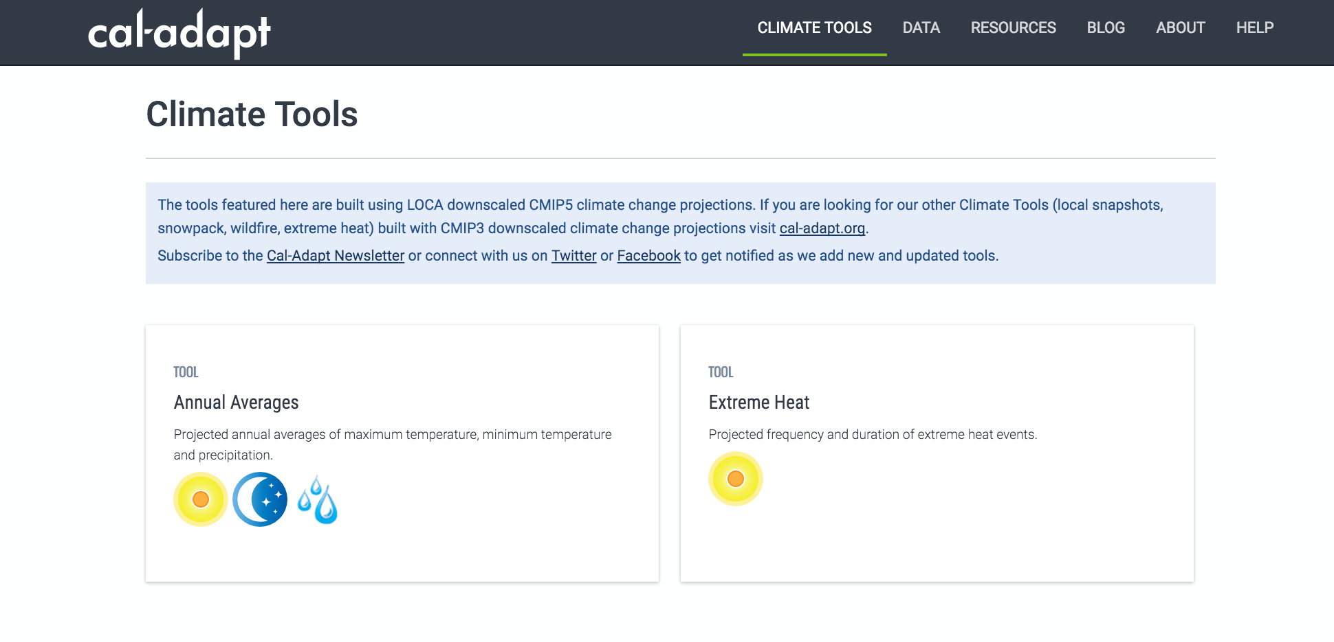
Notes:
Today I will preview the annual averages and extreme heat tools.

Slide 9
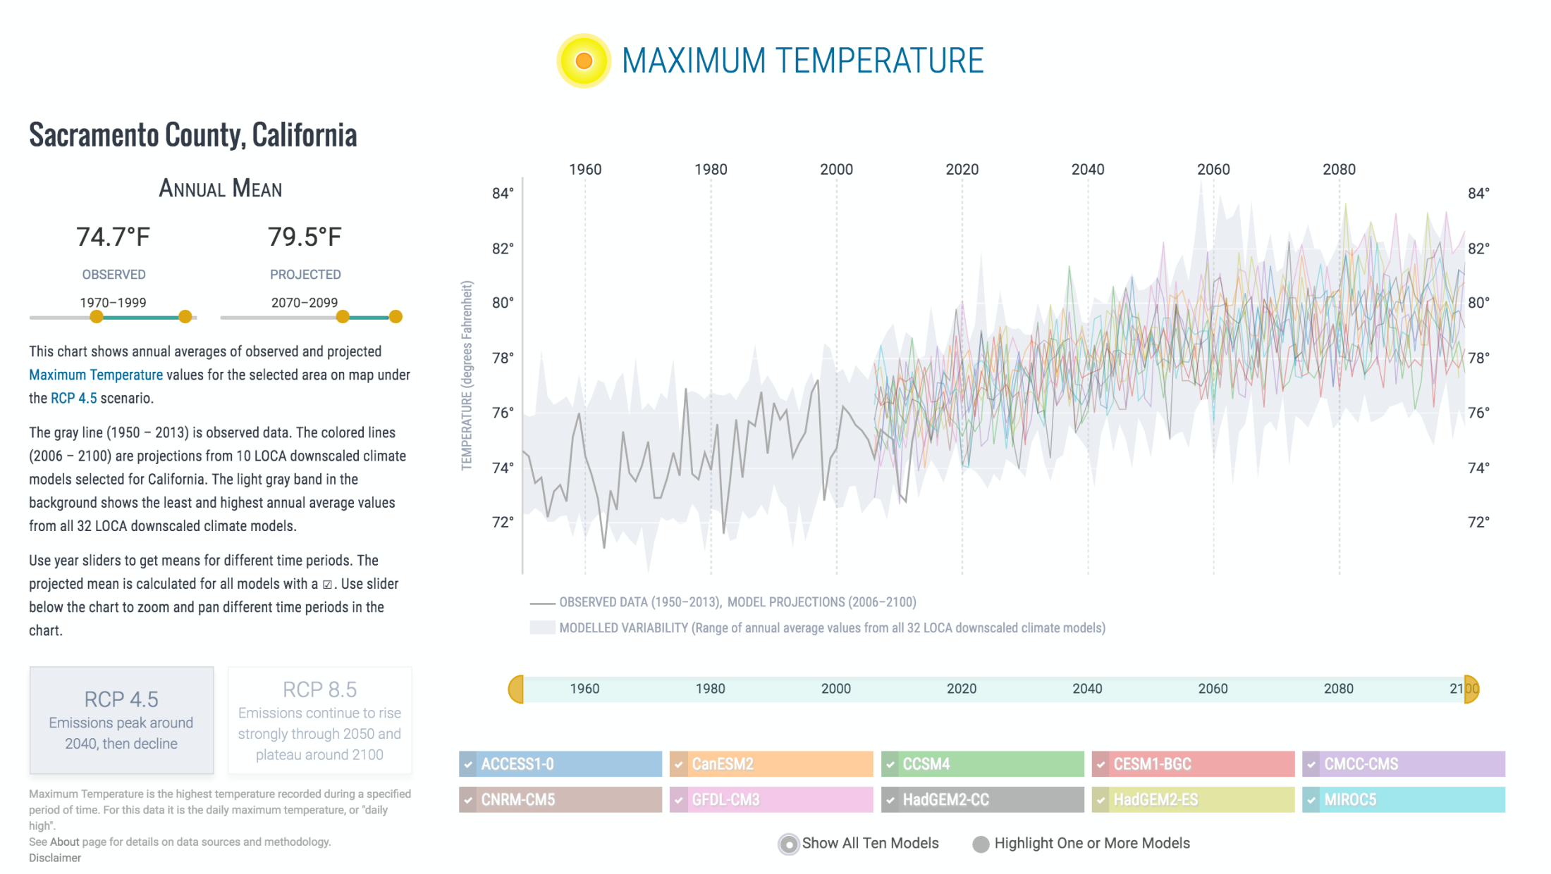
Projected data
Historical observed data
Envelope of
model variability
Alignment with current
IPCC emissions scenarios
Notes:
Tour of new features: #1 Improved data for temperature and precipitation
You’re looking here at historical and projected data for annual averages maximum temperature for Sacramento County. (consider changing to California Energy Commission grid cell, RCP8.5?)
Historical gridded data (same grid– daily resolution, 1/16 degree)
Envelope of variability
10 models selected by DWRs CCTAG on basis of representation of processes key to California water resources
Alignment w/ IPCC’s AR5
Plain English descriptions

Slide 10
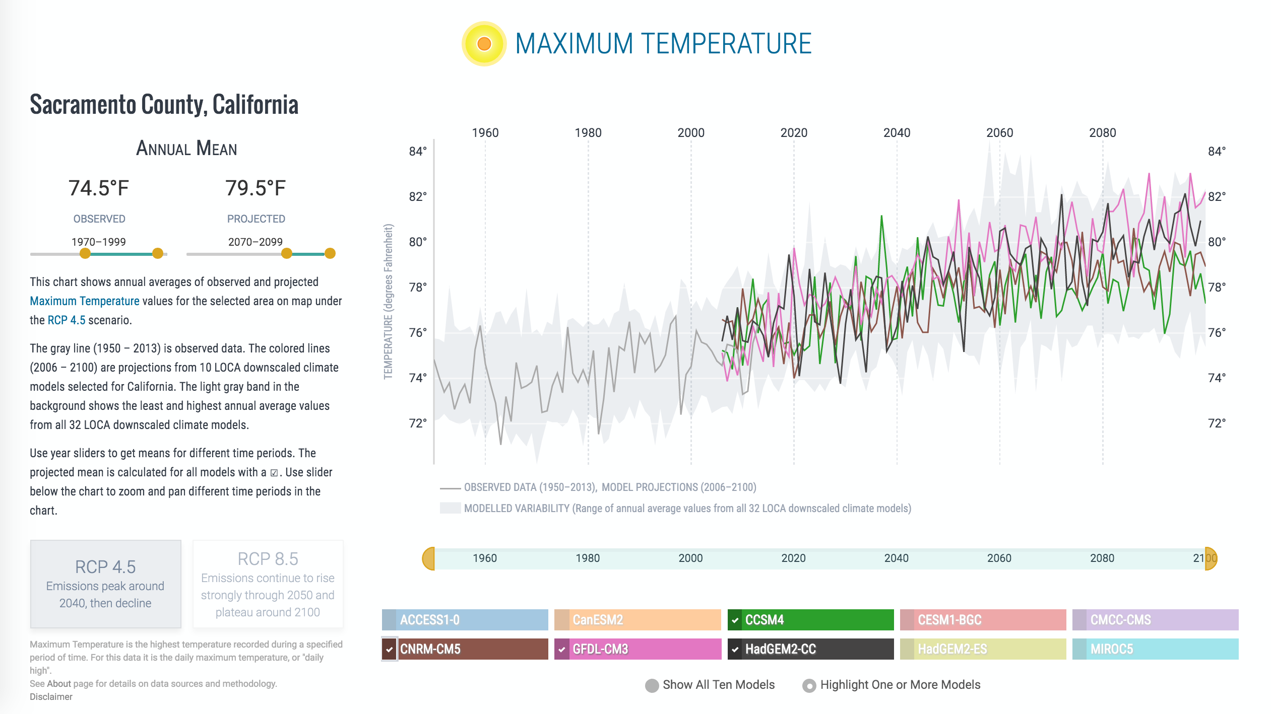
Select which global climate
models to consider
Notes:
Tour of new features: #1 Improved data for temperature and precipitation
One can also look at a single, or a subset of the 10 GCMs. These are the four GCMs that David Pierce will later discuss… and a low-emissions scenario for Sacramento County.
Re: the 4 models suggested by Scripps for use by Fourth Assessment (GFDL-CM3: warm/dry, CCSM4: “average”, CNRM-CM5: cooler/wet, HadGEM2-CC: complement to prior models’ variability)
Multi-decadal averages (in accord with best practices for using climate projections)

Slide 11
Supporting California’s Fourth Climate Change Assessment
Cal-Adapt to serve key data sets:
Consistent set of peer-reviewed regionally downscaled climate projections to facilitate cross-study integration
  Model projections 2005-2100 (next slide shows full list of variables)
Observed historical data
  (1/16° grid, daily time step)
  1950-2005
Envelope of modeled variability
Dynamically downscaled data (UCLA)—working to integrate this on Cal-Adapt
Notes:
Tour of new features: #2 Supporting California’s Fourth Climate Change Assessment
Indicate how Cal-Adapt serves the data that support the Assessment’s consistent use of peer-reviewed scenarios… [ask Guido for input—do we want this slide?]
Peer-reviewed regionally downscaled projections (2005-2100) for Tmin, Tmax, and precip, RCP 4.5 or 8.5, choose from 10 CCTAG models
Serve observed historical data
Serve envelope of modeled variability
Working with Alex Hall to get the dynamically downscaled dataset

Slide 12
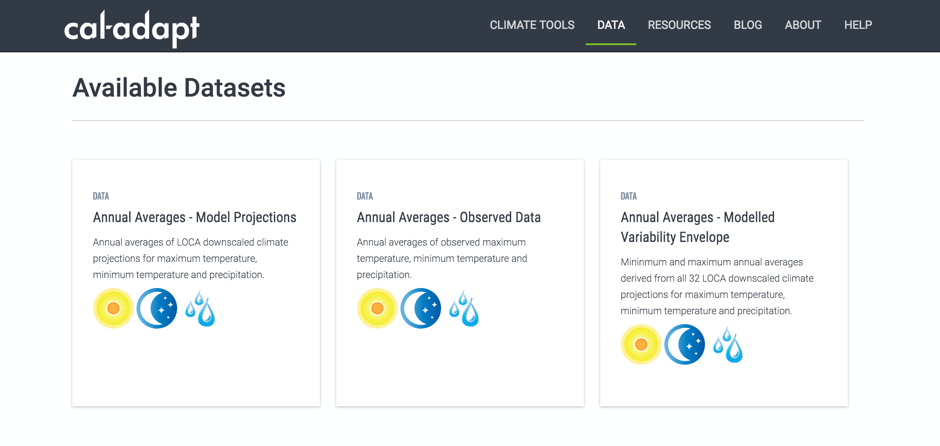
Data download tool: available variables
Notes:
Tour of new features: #2 Supporting California’s Fourth Climate Change Assessment
Screenshot showing the variables that are available…
Mention
Ease of use
User-defined boundaries (space and time) for download
GeoTIFF files or (responding to TAC input) csv/tabular data

Slide 13
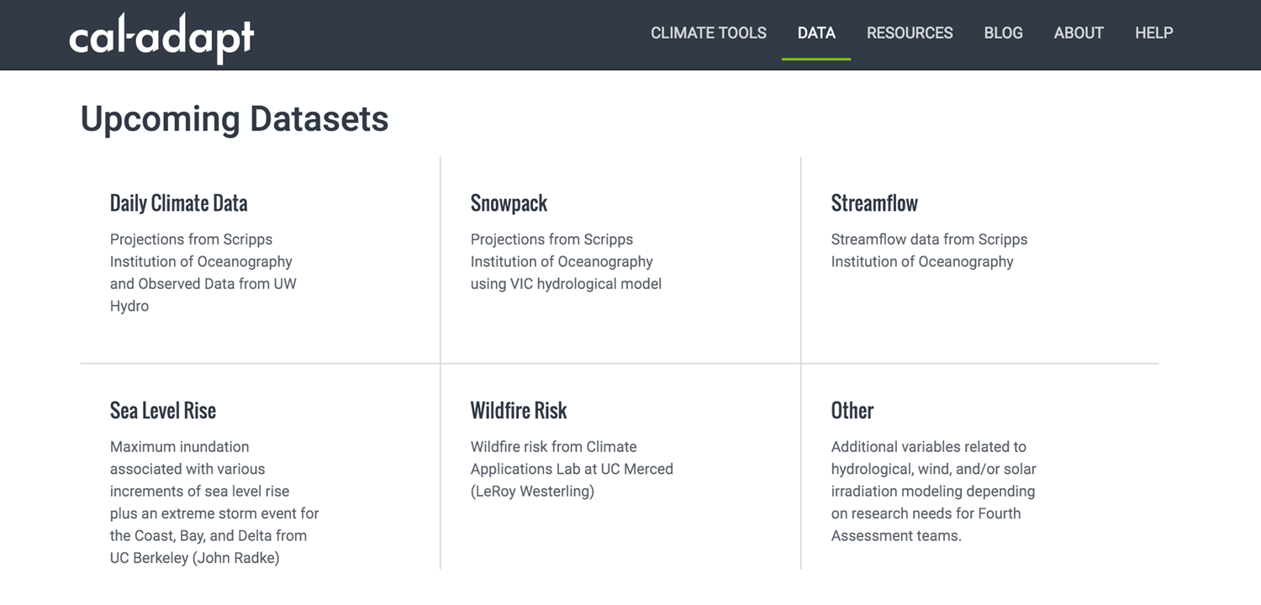
Data download tool: coming soon
Notes:
Tour of new features: #2 Supporting California’s Fourth Climate Change Assessment
Screenshot showing the variables will soon be available…
Mention
Timelines
Integration with Assessment
Use by PG&E (SLR / Radke’s data)—Ask Guido… OK to mention this?

Slide 14
New Aggregation Options
Several pre-loaded shape files to support aggregation by:
Watersheds
Climate zones (Western Regional Climate Change Center)
Integrated regional water management boundaries (DWR)
Census tracts
Census-designated places
Legislative district boundaries
Disadvantaged communities (as defined by CalEnviroScreen)
Additionally, Cal-Adapt 2.0 will support upload of user-specified shape files.
Notes:
Tour of new features: #3 New aggregation options
Indicate the genesis of these options (TACs, including utilities)

Slide 15
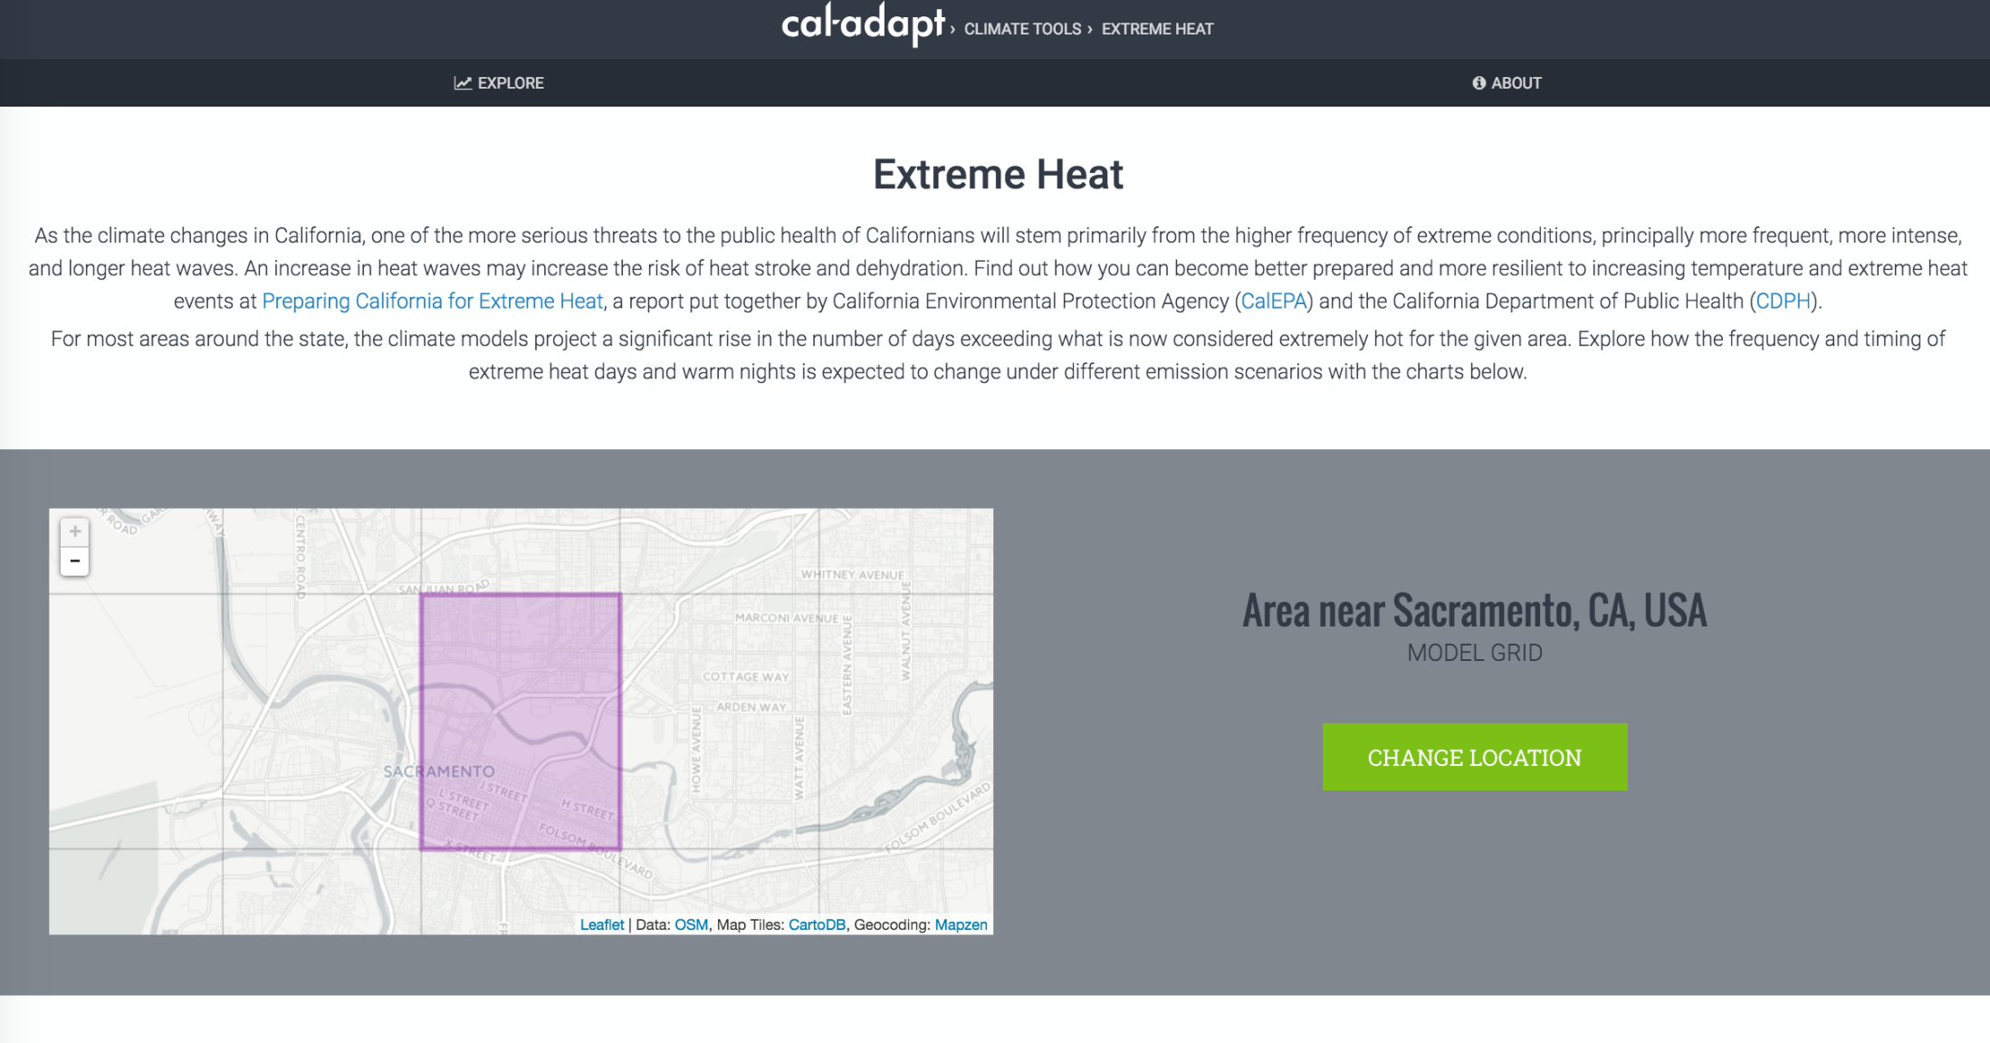
Notes:
Tour of new features: #3b New aggregation options + extreme heat tool
Let’s have a look at applying these aggregation options to the extreme heat tool…

Slide 16
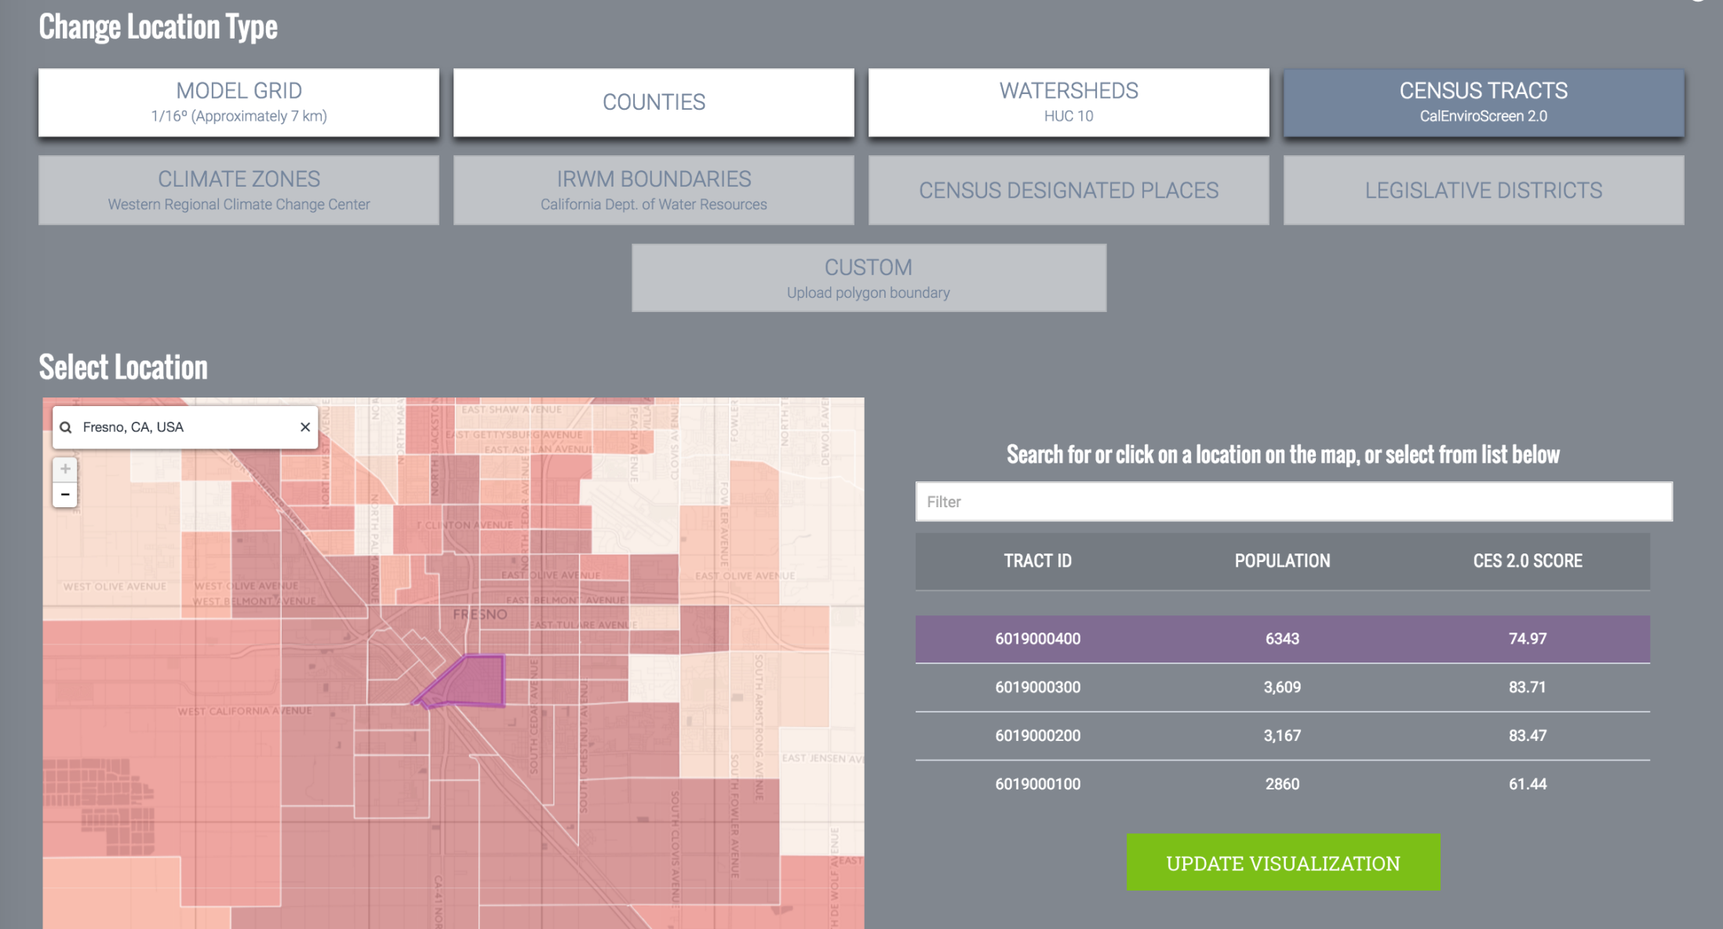
High scores indicate vulnerable “hotspots” according to CalEnviroScreen 2.0
Notes:
Tour of new features: #3b New aggregation options + extreme heat tool
… Looking at the CalEnviroScreen data, which were developed to identify socially vulnerable “hotspots” to support legislatively mandated, preferential investment of GHG emissions reductions funds in disadvantaged areas, we see that Fresno is particularly vulnerable to extreme heat.

Slide 17
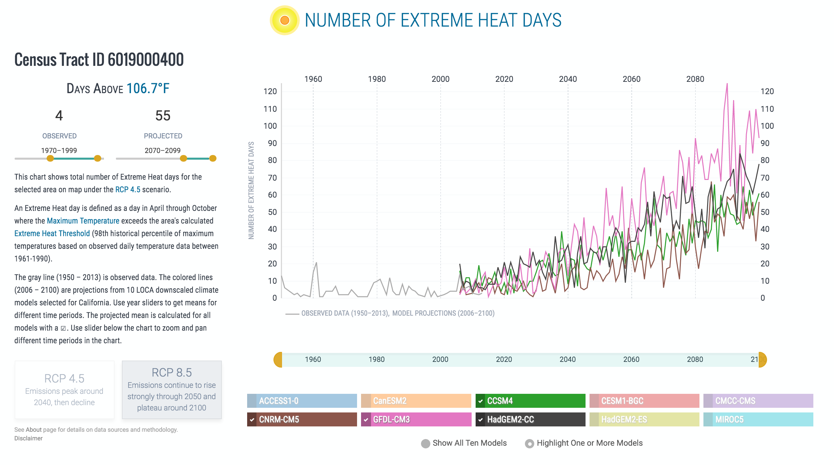
Notes:
Tour of new features: #3c … extreme heat tool
Number of extreme heat days for the Fresno County Census Tract selected in the prior screen (the four models suggested by Dave) and multidecadal averages as centered around 2084 and 1984 show a 14-fold increase in extreme heat days, which are defined for this area as exceeding 106.7 deg F.

Slide 18
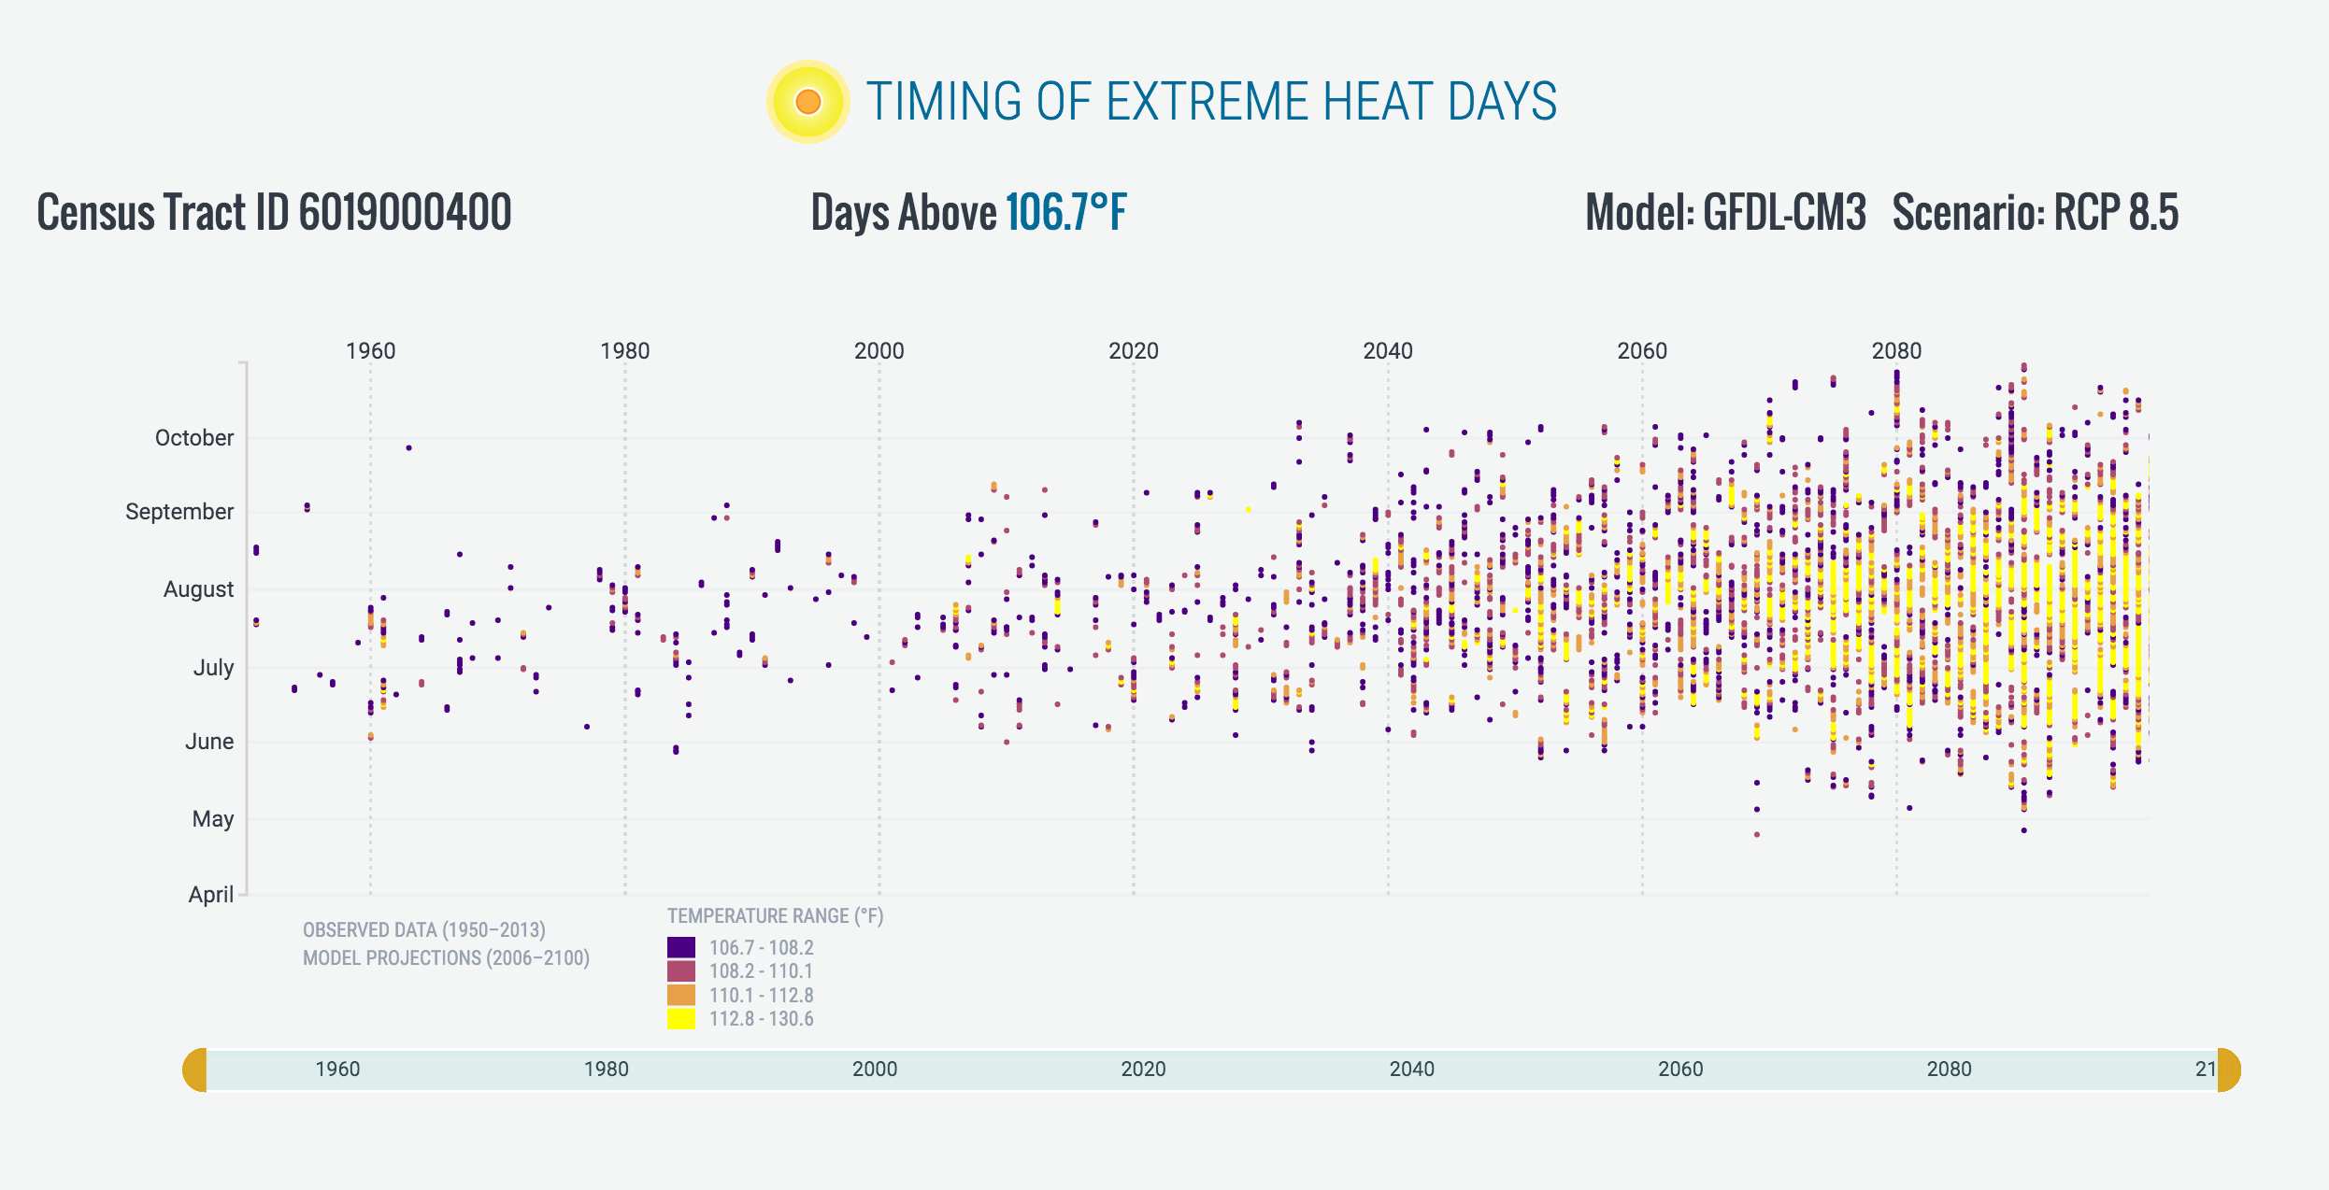
Notes:
Tour of new features: #3c … extreme heat tool
We also see a lengthier extreme heat season. Historically the hottest days generally occurred between early June and September, but by the end of the century, this census tract in Fresno would expect a season that spans early May through late October. And the color coding shows that by century’s end, the hottest (yellow) days routinely rech the 113 to 131 degrees F range!

Slide 19
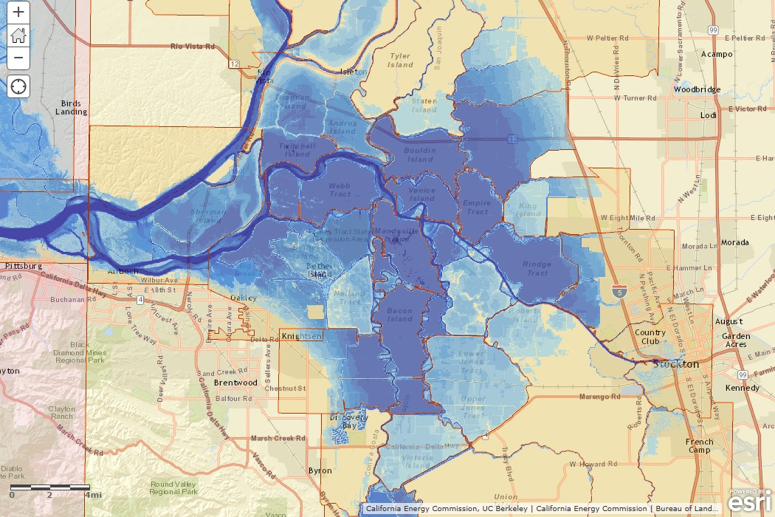
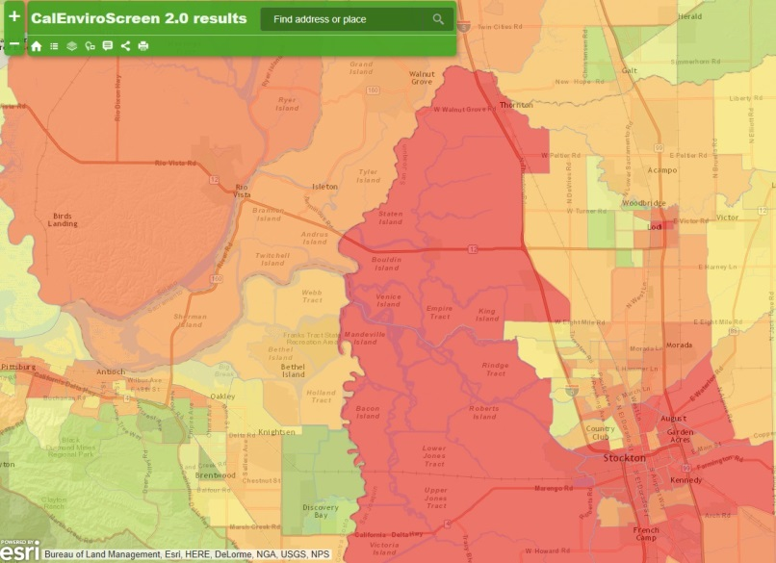
Delta Flooding: 1.41m sea level rise + extreme storm event
Infrastructure:
McDonald Island
Sherman Island
Social Vulnerability:
Solano County
Sacramento County
Contra Costa County
San Joaquin
Notes:
The final new dataset that is in production mode (to be publicly released within another month or two) uses a high-resolution, hydrodynamical model to portray inundation associated with various increments of SLR coupled with an extreme storm event. These data show Delta flooding at a resolution of 3-5 m. Here we see that with 1.4 m SLR, which is within the range of plausible end-of-century values, extensive flooding in areas with important energy infrastructure, such as Sherman and McDonald Islands, would be expected due to levee overtopping. Additinally, CalEnviroScreen allows us to look at the social vulnerability of the communities at risk (we see many hotspots, esp in SJ county).
Sherman Island
Extensive flooding
Nexus for a lot of infrastructure including NG pipelines, electricity transmission, surface transportation
McDonald Island:
Extensive flooding
Gas storage (as well as pipelines)
The good news?
Delta levee system appears to be “prepared” for extreme event with 0 m SLR (minimal or no levees overtopping)

Slide 20
Thank you
DISCLAIMER
A staff member of the California Energy Commission prepared this presentation. As such, it does not necessarily represent the views of the Energy Commission, its employees, or the State of California. The Energy Commission, the State of California, its employees, contractors and subcontractors make no warrant, express or implied, and assume no legal liability for the information in this presentation; nor does any party represent that the uses of this information will not infringe upon privately owned rights. This presentation has not been approved or disapproved by the Energy Commission nor has the Commission passed upon the accuracy or adequacy of the information in this presentation.
20

Slide 21
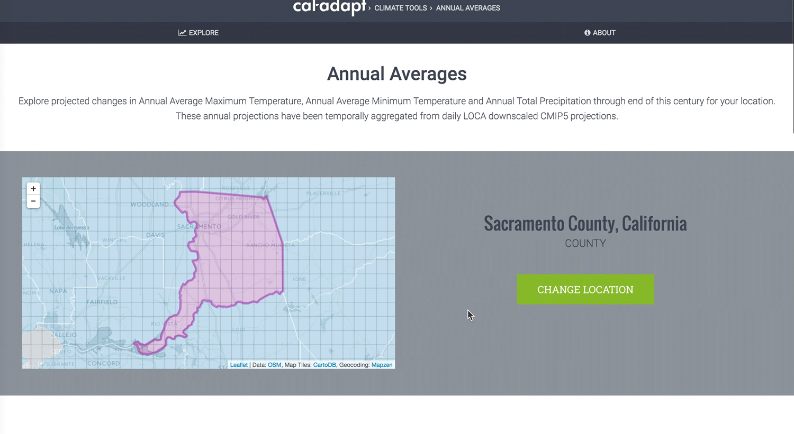
Thank you
DISCLAIMER
A staff member of the California Energy Commission prepared this presentation. As such, it does not necessarily represent the views of the Energy Commission, its employees, or the State of California. The Energy Commission, the State of California, its employees, contractors and subcontractors make no warrant, express or implied, and assume no legal liability for the information in this presentation; nor does any party represent that the uses of this information will not infringe upon privately owned rights. This presentation has not been approved or disapproved by the Energy Commission nor has the Commission passed upon the accuracy or adequacy of the information in this presentation.
21

