Slide 1
Joint IEPR Workshop on Climate Adaptation and Resiliency for the Energy Sector
Energy Sector Climate Resilience
CRAIG ZAMUDA, Ph.D.
Senior Policy Advisor
Office of Energy Policy and Systems Analysis
U.S. Department of Energy

Slide 2
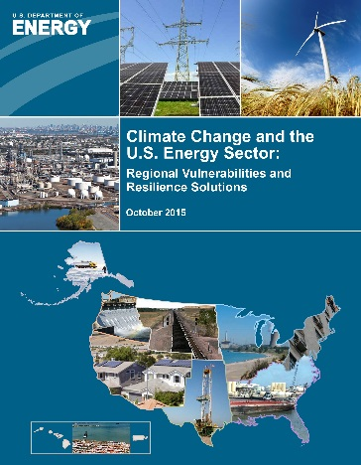
DOE Framework for Integrating Climate Resilience into the Energy Sector
  Enhance the understanding of climate change and extreme weather at regional level - Issued report: “Climate Change and the U.S. Energy Sector: Regional Vulnerabilities and Resilience Solutions” (October 2015)
  Improve methodologies, tools and information for climate resilience planning
  Collaborate with other agencies and organizations to provide down-scaled climate science information for assessing current and potential future vulnerabilities
  Conduct research, development, demonstration and deployment of 21st century climate resilient energy technologies
  Establish public-private partnerships to accelerate investments in climate resilience

Slide 3
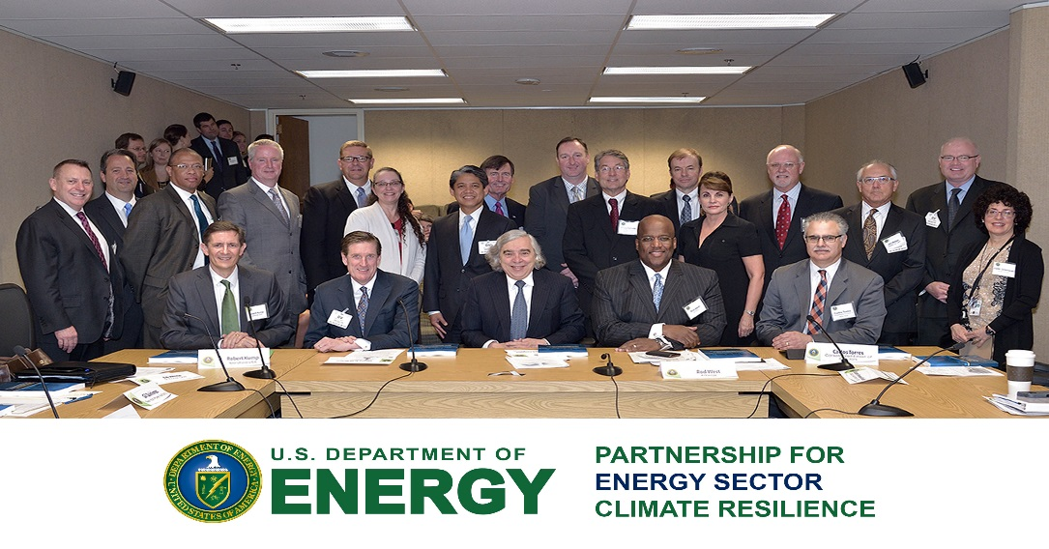
  Establish Public- Private Partnerships:
  “Partnership for Energy Sector Climate Resilience”
Partnership for Energy Sector Climate Resilience announced on April 21, 2015
Provides a mechanism for sustained engagement between DOE and electric utilities:
    Partners commit to identify priority vulnerabilities to electricity infrastructure, and identify and pursue priority climate resilience solutions
    Creates a forum where companies pursuing action on climate resilience can exchange best practices and receive recognition for their achievements
19 power companies have officially joined the Partnership
    Represents approximately 20% of U.S. generating capacity, serving approximately 25% of U.S. customers
    Includes broad array of investor-owned, federal, state, municipal and cooperatives geographically dispersed across the U.S.

Slide 4
Partnership for Energy Sector Climate Resilience:
Members
Investor-Owned
AVANGRID (formerly Iberdrola USA)
Consolidated Edison of New York
- Dominion/Virginia Power
Entergy
Exelon Corporation
National Grid
Pacific Gas and Electric
- Pepco Holdings Inc.
Public Service Electric and Gas
San Diego Gas and Electric/ Sempra
Southern California Edison
- Xcel Energy
State/Municipal
- Austin Energy
- New York Power Authority
- Seattle City Light
- Sacramento Municipal Utility District
Federal
- TVA
Cooperative
- Great River Energy
- Hoosier Energy

Slide 5
Current “Partnership” Work Streams
    Assessing Vulnerabilities to Extreme Weather and Climate Change: Developing and deploying guidance, methodologies, tools, best practices and other relevant information to assist companies conducting vulnerability assessments and developing resilience strategies
            Partners conducted vulnerability assessments (VA) (Feb 2016)
            DOE developed lessons learned and best practices of VA’s (June 2016)
            Guide for Assessing Electricity Sector Vulnerabilities to Sea Level Rise and Resilience Solutions (June 2016)
            Guide for Climate Resilience Planning in the Electricity Sector (July 2016)
    Making the Business Case for Resilience Investments: Developing generalized methodology and case studies for characterizing costs and benefits of resilience investments related to climate change and extreme weather. Case studies include:
          Severe drought and extreme heat/inland electricity infrastructure
          Review of Public Utility Commission decisions on utility reliability and resilience applications - focus on role of economic evaluations in supporting regulatory decisions (CA, Fl, Washington DC)
Notes:
Develop case studies:
Sea Level Rise/Storm Surge:
- Apply the general methodology to flooding impacts and resilience investments in a specific coastal region such as Norfolk/New Port News, VA with a current utility Partner, Virginia Dominion Power
Drought and Heat Waves:
Apply a general methodology and produce an initial demonstration, using one of the current utility partners, TVA, as a case study, and examine climate risks from drought and heat waves
Future plans are to use the results from the case studies to refine and expand the general methodology and analysis beyond considerations of SLR, storm surge, drought and heat waves to other climate change risks.

Slide 6
Approaches of CA Partner Utilities:
Vulnerability Assessments
 | Approach | Scope | Climate Data | Approach | Other | Timeframe | Sources
PG&E | Internal assessment | Assets and operations | Historic and projections | Quantitative risk assessment | Average temps, extreme temps, sea level rise, water availability, flooding and precip, subsidence | 2050 (data for 2020-2100) | Internal scenarios, FEMA, CA Climate Center, CA Coastal Commission, NOAA, CA Climate Assessment, Cal-Adapt
SCE | Internal assessment | All assets | Projections | Qualitative risk assessment | Average temps, extreme temps, sea level rise, flooding & precip, summer storms | 2085 | CEC-provided downscaled models using IPCC scenarios; literature
SDG&E | Internal assessment and literature review | Assets and operations | Historic and projections | Qualitative risk assessment | Average temp, extreme temps, sea level rise, water availability, flooding and precip, summer storms | 2050 and 2100 | IPCC, DOE, EPA, NCA, San Diego Foundation/ Scripps, NOAA, and other sources
SMUD | Internal assessment and literature review | Assets and operations | Historic and projections | Qualitative risk assessment | Average temps, extreme temps, water avail, flooding and precip, summer storms, regional hydrology | Mid century, end of century, 2030s, 2085 | California Climate Change Center, California Climate Action Team, region-specific academic literature

Slide 7
Lessons Learned/Opportunities
Scenarios for climate change impacts and the vulnerabilities of power systems: Need for standardized and accepted scenarios for future conditions to use as the basis for planning and investing
  Vulnerability Assessment Methods: Need for Improved information about the ways that electric power systems will be affected by climate change and extreme weather to facilitate planning to avoid impacts
Design Standards: Need for updated equipment and facility design standards to better reflect changes in extreme weather and storm surge.
Cost-Benefit Tools: Need for accepted models and tools to make the business case for resilience investments
Educating Regulators and Stakeholders: Need to educate decision makers and other stakeholders about the efficacy of investments in resilience
Interdependencies: Interdependencies among the electricity system and other energy systems, supply chains, communication networks, transportation systems, water and waste water systems, health care and other critical community needs must be addressed
Climate Mitigation & Resilience Nexus - Capitalizing on the synergy between mitigation and resilience actions
9

Slide 8
For Additional Information
Contact
Craig Zamuda, Ph.D., Senior Policy Advisor
Partnership Coordinator
Office of Climate, Environment and Efficiency
Office of Energy Policy and Systems Analysis
U.S. Department of Energy
Craig.Zamuda@hq.doe.gov
Partnership website:
http://www.energy.gov/epsa/partnership-energy-sector-climate-resilience

