Slide 1
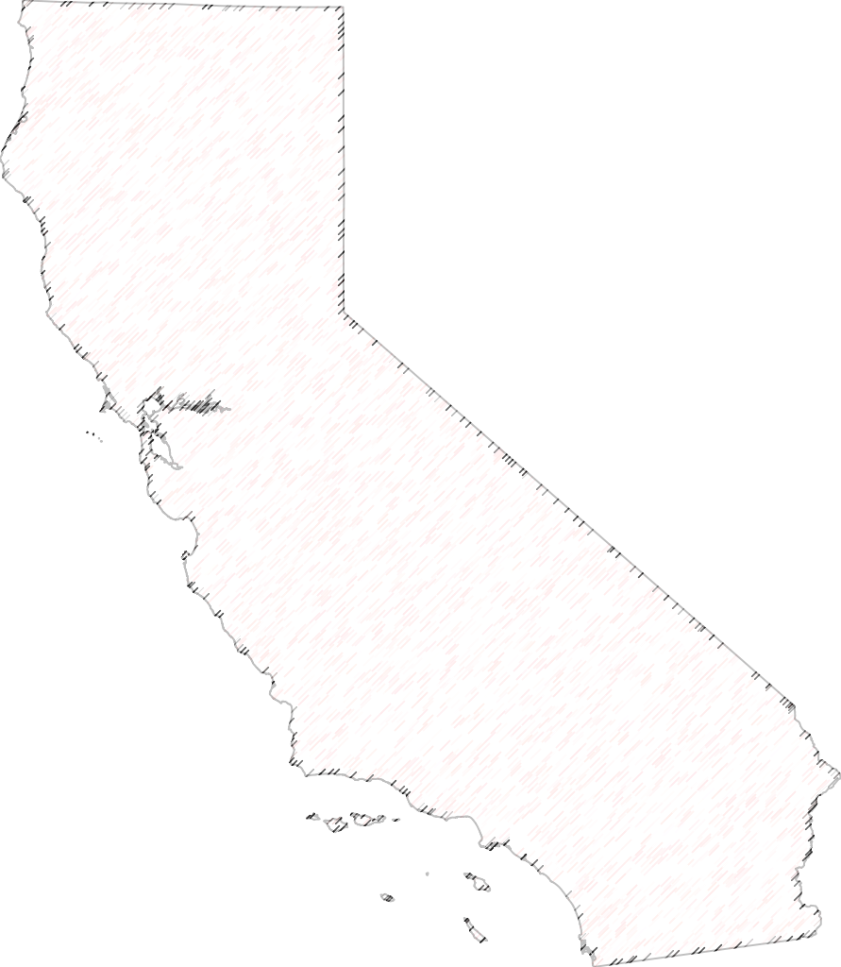


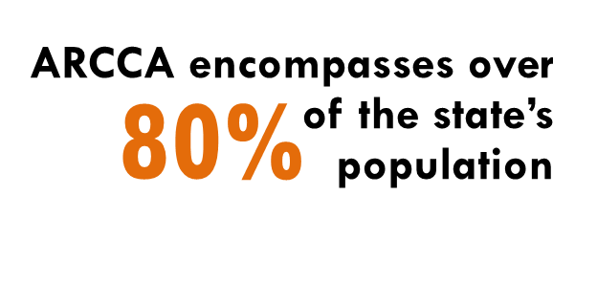



ARCCA
Alliance of Regional
Collaboratives for Climate Adaptation
Sacramento
Formed in 2012, ARCCA is a network of regional collaboratives in California coordinating and supporting climate adaptation efforts to enhance public health, protect natural systems, build economies, and improve quality of life.
Bay Area
Central Coast
Los Angeles
ARCCA members have come together to share best practices and lessons learned, collaborate on opportunities and strategies, and amplify a voice for regionalism at the state and federal levels.
San Diego

Slide 2
ARCCA
Alliance of Regional
Collaboratives for Climate Adaptation
Our Work and Successes
Bringing a regional voice to state work
Named as a resource for state agencies in the Climate Change Research Plan and the Governor’s Executive Order B-30-15
A model for new adaptation collaboratives
Developed model toolkit for new collaboratives
Helped to organize and participated in national training for 12 regional adaptation groups hosted by the Institute for Sustainable Communities
Outreach and education
Participated in and helped to frame the program for the Bi-annual National and California Adaptation Forums
In 2015, hosted 4 regional listening sessions on climate adaptation needs and concerns for CNRA
Georgetown Climate Center case studies on forming collaboratives, governance, and funding.
Briefed Senate Committee on Environmental Quality (2015) and Sea-Level Rise (2014)
Participating in the Technical Advisory Group created by SB 246
Supporting formation of new Central Coast collaborative
Hosted ARCCA Learning Sessions on business resiliency, adaptation funding through resilience bonds, and more.
All collaboratives regularly host regional discussions of adaptation issues

Slide 3
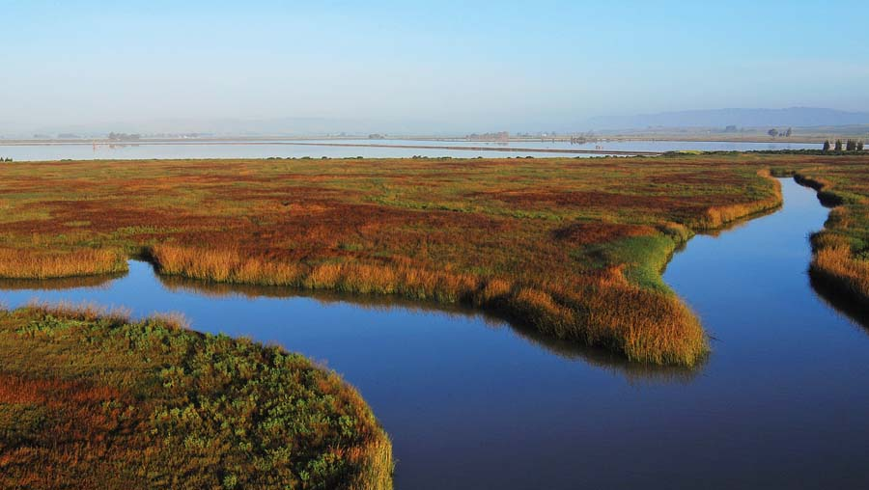
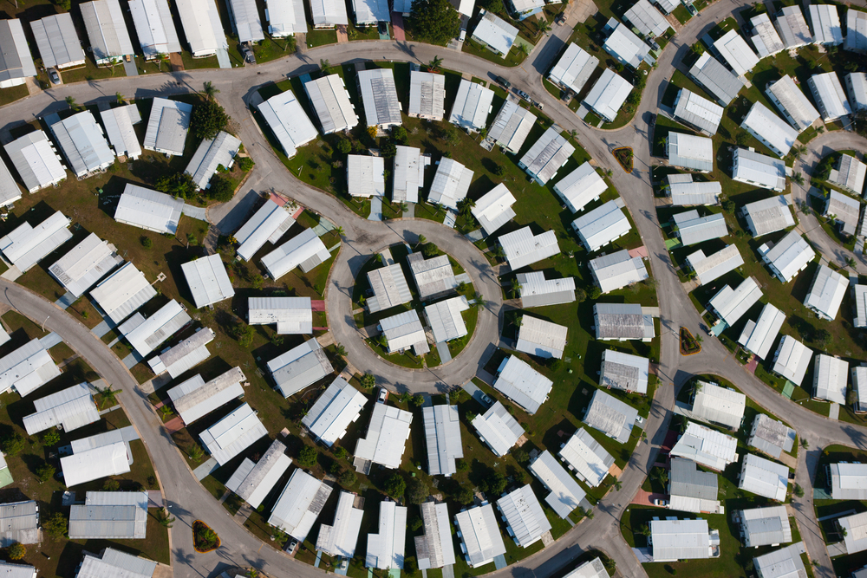
Energy and regional resiliency
ARCCA
Alliance of Regional
Collaboratives for Climate Adaptation
Bay Area passes U.S.’s first climate-adaptation tax
All nine Bay Area counties approved a $12 annual parcel tax that will raise $500 million to restore wetlands and habitats, which can help buffer against sea-level rise, high tides, and storms.
ARCCA collaboratives’ utility members include:
San Diego Gas & Electric
Sacramento Municipal Utility District
Pacific Gas & Electric
The San Diego Climate Collaborative is actively involved in climate action planning in the region, including the City of San Diego’s CAP, which commits to a 100% renewable energy goal by 2035.
Los Angeles is first to require cool roofs for new homes
In 2013, Los Angeles unanimously passed a building code to require all new and refurbished homes to have cool roofs.

Slide 4
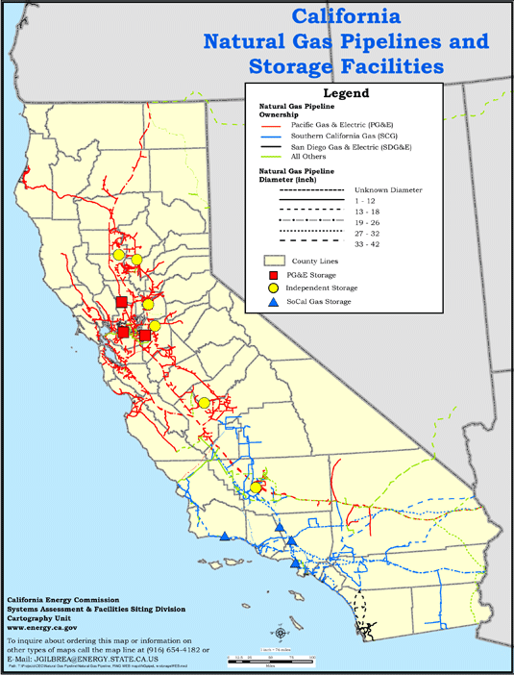
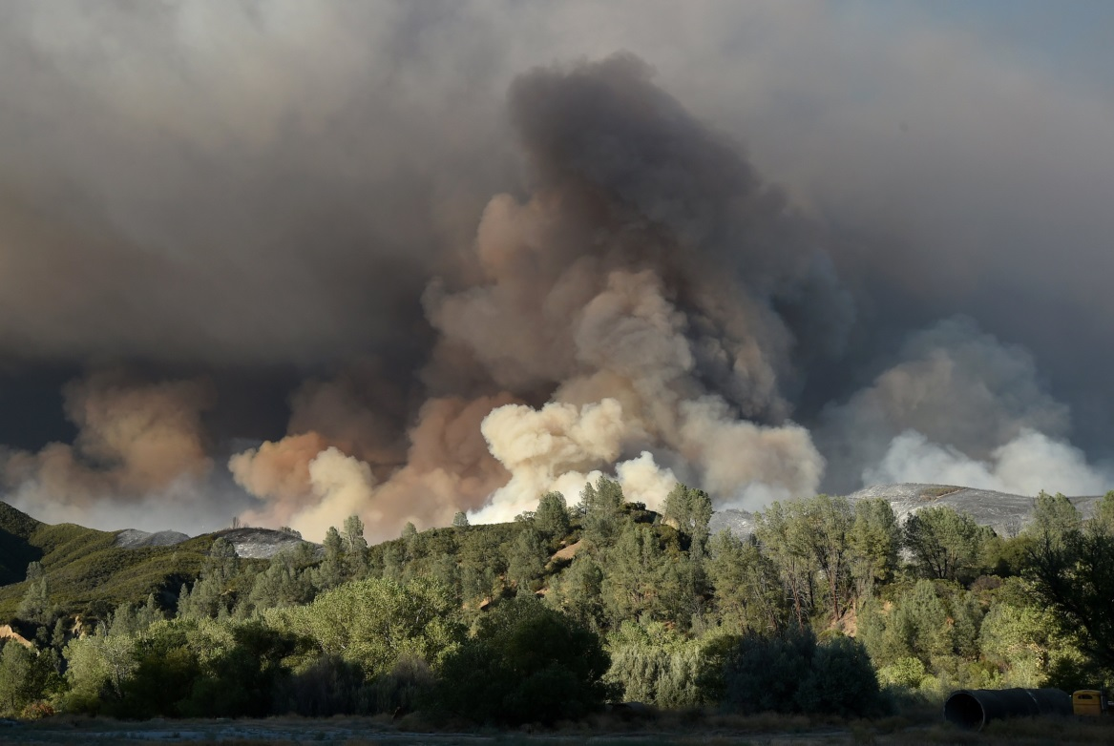
Energy and regional resiliency
ARCCA
Alliance of Regional
Collaboratives for Climate Adaptation
Reducing wildfire risk and strengthening the Urban-Rural Connection
ARCCA is working to increase policymakers’ understanding of the importance of the Sierra Nevada to our hydroelectricity, water supply, and fresh air, to ensure protection of critical forests and watersheds from forest fires, which also threaten energy infrastructure.
ARCCA will support stakeholder engagement and meetings and participate in the technical advisory committee for the CEC’s regional studies on the climate vulnerability of natural gas pipelines

