Slide 1
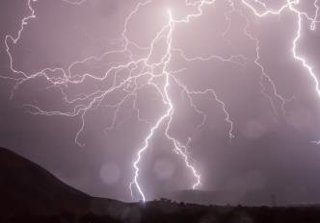
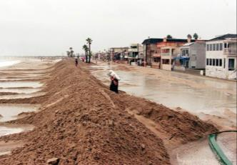
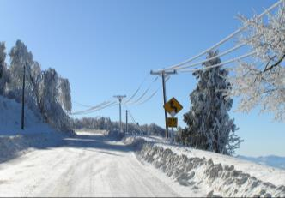
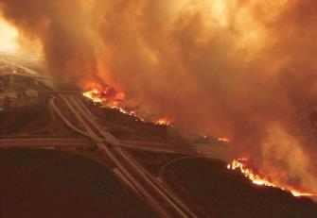
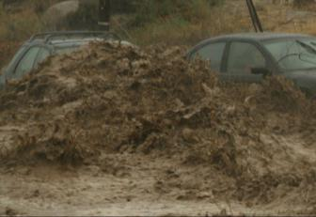


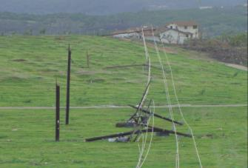


Climate Adaptation Workshop
SDG&E Wildfire Resilience & Climate Risk Strategy Overview
June 21, 2016
Brian D’Agostino
Meteorology Program Manager
Chair – American Meteorological Society’s Energy Committee

Slide 2
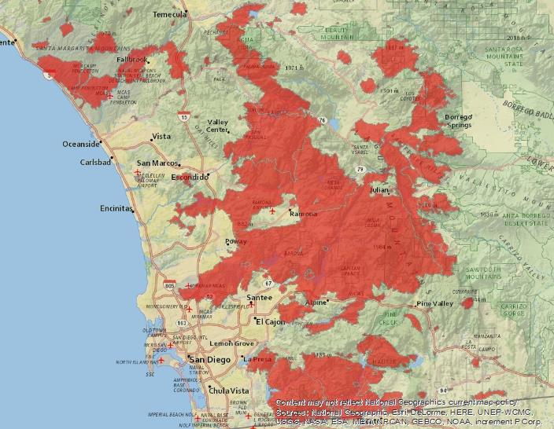
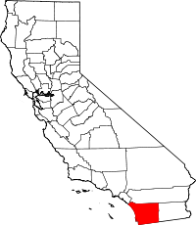
SDG&E’s Service Territory and Wildfire Overview
4,100 Square Miles
1.4 Million
Electric Meters
2,076 Miles Transmission Lines
  1,800 miles overhead
23,891 Miles Distribution Lines
  7,000 miles overhead
1,193MW Generating Capacity
Data Source: Sempra Energy
2014 Annual Report
San Diego County areas burned by wildfires (since 2000)

Slide 3
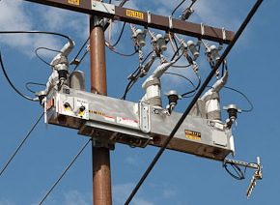
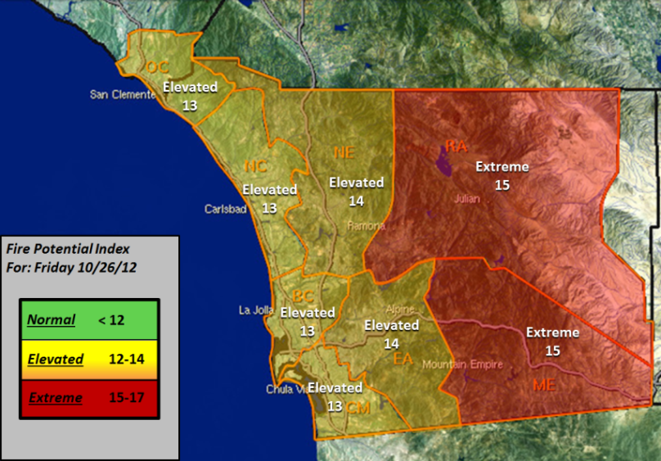
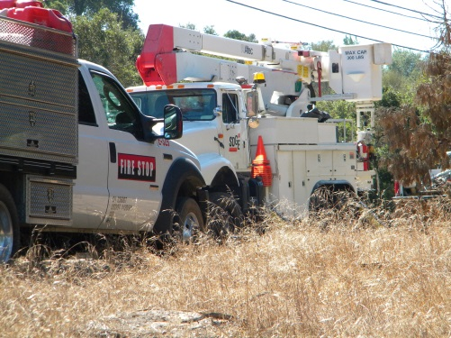
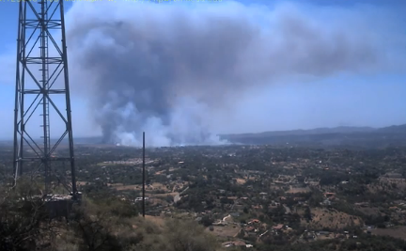

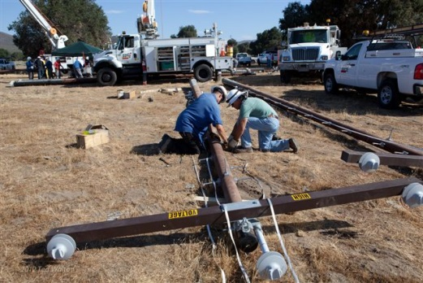
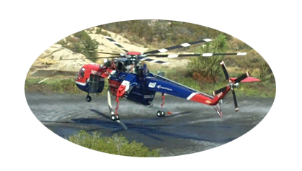
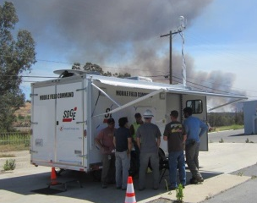
Adaptation to Wildfire Risk
Anticipate…
Prepare…
Meteorology provides weather briefings, 7 days out, day of, during
FPI informs operations
SDGE Weather Network
Activate EOC
Turn off Reclosing
Crew Staging
Community Collaboration
React & Execute…
Recover…
Patrols prior to Energizing
System Hardening
FiRM & Wood-to-Steel
Fire Coordination Staff provides intel, reporting, manages Capstone crews
Helicopters
Mobile Command Centers deployed

Slide 4
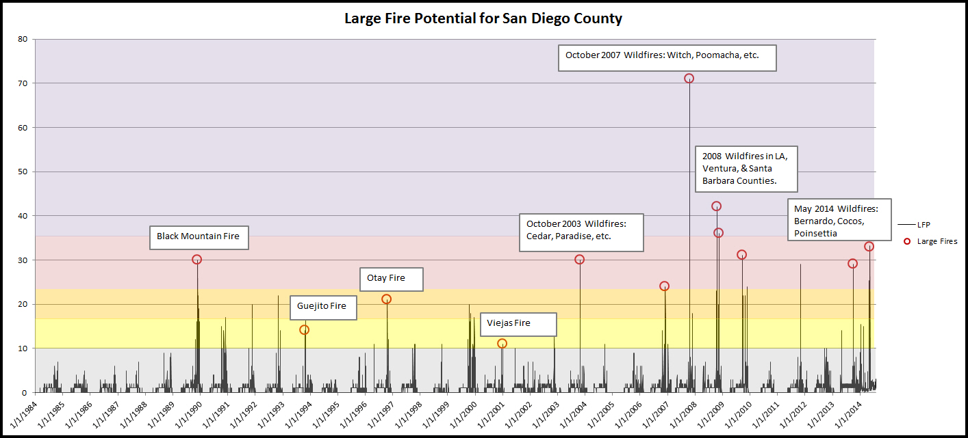
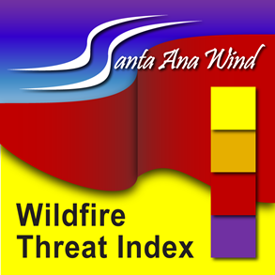
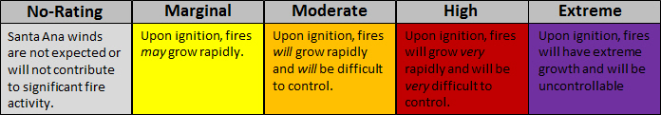
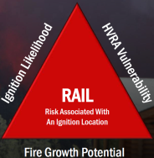
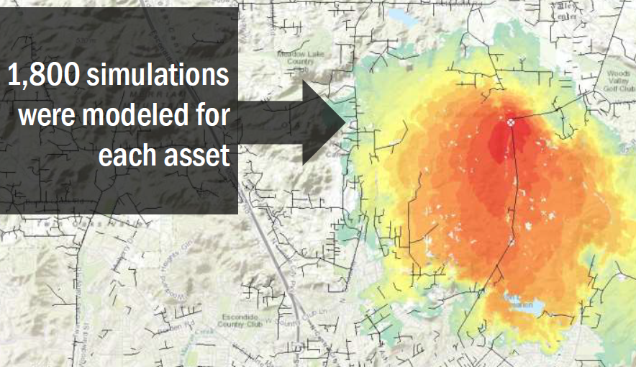
SDG&E Wildfire Risk Reduction Models
Santa Ana Wildfire
Threat Index (SAWTI)
We drove this multi-agency collaborative effort to provide a decision support tool to fire agencies and the general public, increasing public safety and overall preparedness.
Wildfire Risk Reduction Model (WRRM)
This system uses world-class fire behavior modeling techniques and high performance computing to assess the overall wildfire risk at all SDG&E assets. This model is used to prioritize system hardening efforts.

Slide 5
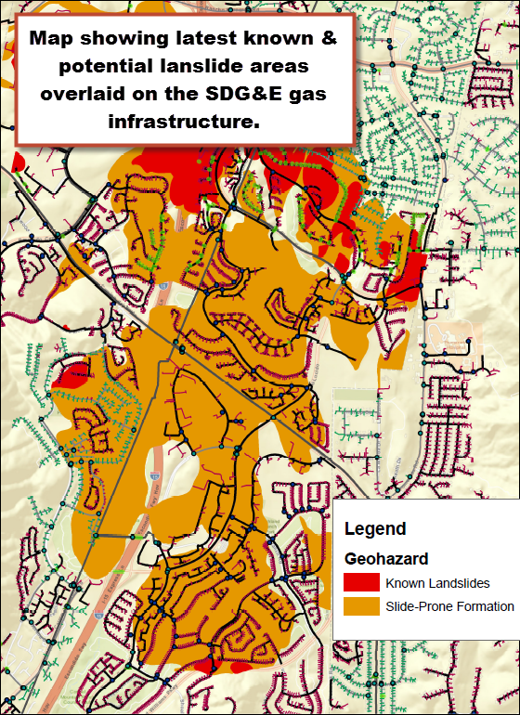
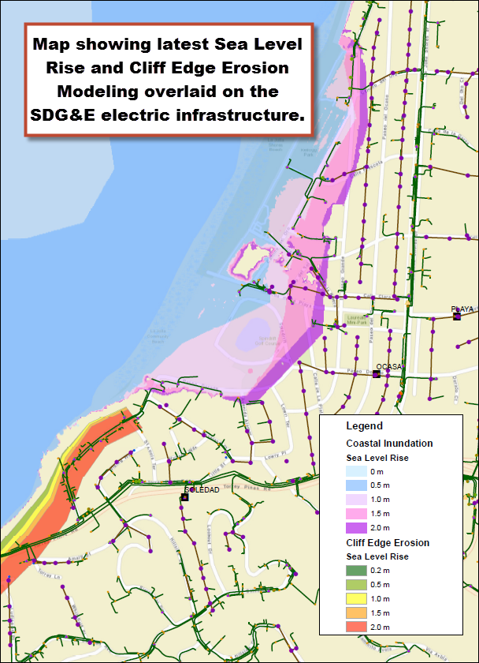
SDG&E Asset-by-Asset Climate Vulnerabilities
Map showing the latest known and potential landslide areas
overlaid on the SDG&E gas
infrastructure

Slide 6
SDG&E Climate Risk Mitigation Strategy
Climate Impacted Risks
2016 SDG&E Enterprise
Risk Registry
Wildfires*
Insufficient Natural Gas Supply
DERs*
High Electric Rates
Electric Infrastructure Integrity*
IT Infrastructure
Insurance Coverage/Rates
Climate Change*
Gas Distribution*
Emergency Spares
Unplanned Generation Plant Outages
Business Resumption Plans
*Risk Assessment Mitigation Phase
(RAMP) Risks
Climate Risk
Mitigation
SDG&E Climate Adaptation
Vulnerabilities

Slide 7

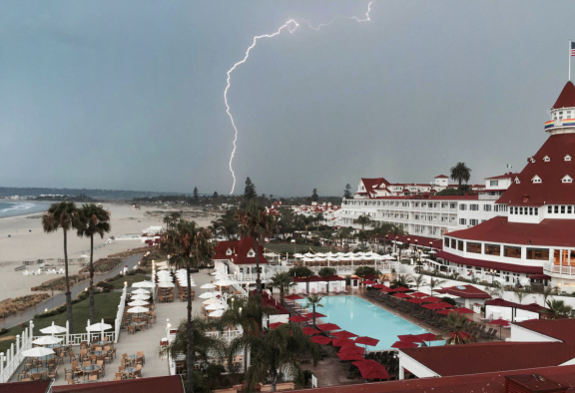
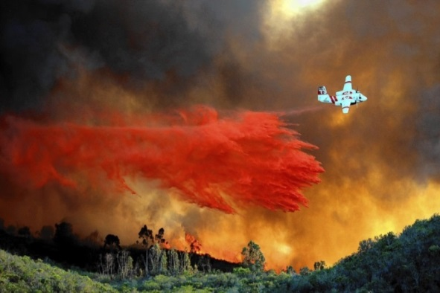
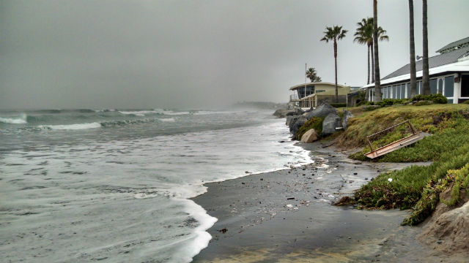
Questions?
Brian D’Agostino
Meteorology Program Manager
Chair – American Meteorological Society’s Energy Committee

